Slide 1
IPC for Marburg Virus Disease (MVD):
PPE Part 3: Reprocessing Medical Equipment and PPE
Healthcare Settings with Limited to Intermediate Resources
Updated: March 2023
Notes:
Intended Audience: This presentation focuses on what facilities management personnel should know about safely reprocessing equipment and reusable PPE in the context of Marburg virus disease.
Please note that the IPC for Marburg Virus Disease topics are presented in sequence, with the expectation that participants will progress through the series. You may, however, mix and match content to meet participant needs, and may need to adjust the sample script below accordingly.
Script:
Welcome! Today we'll be focusing what facilities management personnel need to know about safely reprocessing medical equipment and reusable PPE in the context of Marburg virus disease.

Slide 2
Learning Objectives
After this presentation, participants will be able to
  Identify items that can and can’t be reprocessed.
  Explain why proper reprocessing of medical equipment and PPE is important in the context of Marburg virus disease.
  Explain what steps to take and what PPE to wear when reprocessing PPE.
Notes:
Script:
We have 3 learning objectives for today. By the end of our time together, you should be able to identify items that can and can’t be reprocessed, explain why proper reprocessing of medical equipment and PPE is important in the context of Marburg virus disease, and explain the steps taken and PPE that needs to be worn when reprocessing PPE.

Slide 3
Which of these items could safely be re-used once they’ve been cleaned and disinfected?
Paper face mask
Syringe
Thermometer
Rubber boots
Goggles
Notes:
Activating background knowledge.
A key benefit of working with adult learners is that they likely already have some knowledge or experience related to the topic you are teaching. Activating background knowledge helps students connect new learning to what they already know and may help them understand new information better. It also helps you, the instructor, to identify gaps in knowledge where you may need to spend extra time or add emphasis while teaching. Use this slide as an opportunity to let students share what they already know.
Script:
Some medical equipment and PPE can only safely be used one time and then must be disposed of. But some equipment can be cleaned and disinfected for re-use. Which of these items could be re-used if properly cleaned and disinfected? Take a minute to think, and then I’ll give you the answer.
[Allow participants 1-2 minutes to think about their answer.]

Slide 4

Which of these items could safely be re-used once they’ve been cleaned and disinfected?
Paper face mask
Syringe
Thermometer
Rubber boots
Goggles
Notes:
Activating background knowledge.
A key benefit of working with adult learners is that they likely already have some knowledge or experience related to the topic you are teaching. Activating background knowledge helps students connect new learning to what they already know and may help them understand new information better. It also helps you, the instructor, to identify gaps in knowledge where you may need to spend extra time or add emphasis while teaching. Use this slide as an opportunity to let students share what they already know.
Script:
Here’s the answer. The first two items are single-use items meaning that after they’ve been used once, they have to be thrown away. They cannot safely be re-used. But the other items – the thermometer, rubber boots, and goggles – can all be reprocessed and safely used again.
In today’s session, we’re going to focus on what reprocessing is and how to do it properly.

Slide 5
Reprocessing Medical Equipment & PPE

Slide 6
Definition: Reprocessing
Reprocessing (sometimes called decontaminating) medical equipment and PPE is the process of making reusable medical equipment and PPE safe for reuse.
Reprocessing = cleaning + disinfecting
Notes:
Script:
First, let’s talk about what reprocessing is. Reprocessing medical equipment (called decontamination in some contexts) is the process of making reusable medical equipment safe for reuse. Reprocessing always involves cleaning followed by disinfecting.

Slide 7
Why Is Reprocessing Important?
Marburg virus can live/persist on medical equipment (thermometers, surgical instruments, etc.) and used PPE.
Inappropriate reprocessing of medical equipment and PPE can contribute to the spread of Marburg virus disease in facilities. It puts you, other staff, and patients at risk.
Proper reprocessing helps keep you, others in your healthcare facility, and your community safe.
Notes:
Script:
Reprocessing is important for medical equipment and PPE that will be re-used because Marburg virus can live on these items.
If Marburg virus gets on medical equipment or PPE, and that medical equipment or PPE is not properly cleaned and disinfected, then when the medical equipment or PPE is used again, it puts you, other staff, and patients at risk and can contribute to the spread of Marburg virus disease in your facility.
Proper reprocessing ensures that if Marburg virus is on these items, it is removed. This helps keep you and others in your healthcare facility safe. If you remain healthy, you don’t run the risk of passing Marburg virus disease on to family and friends, so you are helping to keep your community safe, too.

Slide 8
When to Reprocess
Equipment is reprocessed based on the category of medical equipment and manufacturer’s instructions for reprocessing
Single use medical equipment and PPE (needles, paper face masks) are not manufactured to be reprocessed
  Reprocessing can compromise integrity of instrument/equipment
Reusable instruments/equipment (stethoscopes, thermometers) can be reprocessed
Reusable PPE items (rubber gloves, thick aprons, rubber boots, goggles) can be reprocessed
Notes:
Script:
Whether or not equipment and PPE can be reprocessed is based on the category of medical equipment and the manufacturer’s instructions for reprocessing.
As we mentioned earlier, some instruments, equipment, and PPE are single use such as needles and paper face masks. They are not designed to be reprocessed, and attempting to reprocess them can compromise their integrity meaning that they may not work as well or as intended.
However, some instruments, equipment, and PPE are designed to be reusable such as stethoscopes, thermometers, rubber gloves, and thick aprons. This means that if properly reprocessed, they can be safely used again.

Slide 9
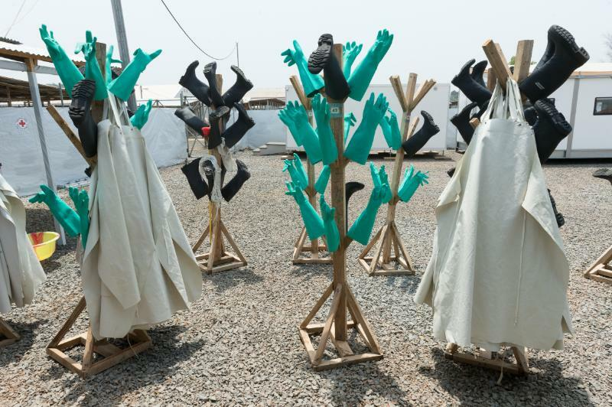
How to Reprocess Reusable PPE
Clean with soap and water, using mechanical action (e.g., scrubbing), to remove any contamination
Disinfect
  Soak in 0.05% chlorine for 30 minutes
Rinse with water (removes chlorine residue)
Hang to dry
http://cdcmuseum.org/exhibits/show/Ebola/public-health/ipc
*Any liquid waste (water for cleaning items, chlorine solution) is poured into separate latrine
Notes:
Script:
In the context of Marburg virus disease, PPE that can be reprocessed includes rubber gloves, thick aprons, rubber boots, and goggles.
Remember that reprocessing always involves cleaning followed by disinfecting. So, when reprocessing PPE in the context of Marburg virus disease, it is crucial that items are cleaned first with soap and water and scrubbed to remove any contamination.
Disinfection should follow. It involves soaking the reusable PPE in 0.05% chlorine for 30 minutes.
After soaking is complete, the reusable PPE should be rinsed with water to remove the chlorine residue and hung to dry. You can see in this picture rubber gloves, thick aprons, and rubber boots that have been cleaned and disinfected and are hanging outside to dry.
Note that any liquid waste created during this process such as water for cleaning items and the chlorine solution for soaking should be poured into a separate latrine or toilet designated for liquid waste.

Slide 10
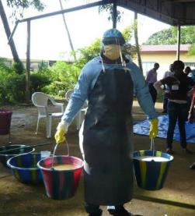
Reprocessing in the Context of Marburg Virus Disease
Single-use/disposable equipment and PPE should be used for Marburg virus disease patients whenever possible
Staff who are reprocessing equipment or PPE that has been used for the care of suspected or confirmed Marburg virus disease patients should:
  Wear full Marburg virus disease PPE to avoid contact with blood or other body fluids and any splashes to the mucus membranes of the face
  Wear thick rubber gloves to protect against the chemicals used
Healthcare workers reprocessing equipment while wearing Marburg virus disease PPE (including rubber gloves)
Notes:
Script:
In the context of Marburg virus disease, your facility should use single-use or disposable equipment for patients whenever possible. Consider having dedicated stethoscopes, dedicated thermometers, etc. for each patient.
Staff who are doing the reprocessing of equipment or PPE should wear full Marburg virus disease PPE while completing the reprocessing tasks to protect themselves from splashes and should wear thick rubber gloves to protect skin from the chemicals used.
For more information about appropriate PPE for Marburg virus disease, you can refer to the slide decks <HCW Slide Deck 6: PPE Part 1 – When, Why and What to Use for PPE for MVD> and <Slide Deck 7: PPE Part 2 – How to Put On and Remove PPE for MVD> [links]

Slide 11
Reflection
How is the reprocessing of medical equipment and PPE in the context of Marburg virus disease different from how reprocessing is currently done in your facility?
What challenges might be encountered when trying to properly reprocess items at your facility?
Notes:
Reflection: Encourages participants to apply, analyze, and/or evaluate what they’ve learned, helps them to deepen their understanding of the topic and also allows you to check their comprehension of what they learned..
Personalization: Helps participants think about how what they have learned applies to their specific situations. Connecting learning to personal experiences helps learners to better understand and remember the ideas taught.
Script:
Now let’s think specifically about how the information we’ve discussed today about reprocessing applies to your own facility(ies). Based on what you learned today, how is the reprocessing of medical items and PPE in the context of Marburg virus disease different from how reprocessing is currently done in your facility?
[Give participants 2-3 minutes to discuss in small groups or as a large group.]
What challenges might be encountered when trying to properly reprocess items at your facility?
[Give participants 2-3 minutes to discuss as a large group. Then, open discussion for several minutes for ways participants might deal with these challenges. This discussion could be longer or shorter depending on the time available.]

Slide 12
Key Takeaways
Some medical equipment, and PPE can be safely reused if they are designed for re-use and properly reprocessed.
Proper reprocessing (cleaning + disinfection) helps prevent the spread of Marburg virus disease and protects:
YOU
Your patients & co-workers
Your community
Notes:
Script:
As we wrap up today, I want to review a couple of key points.
First, some medical equipment, and PPE can be safely reused if they are manufactured to be reused and are properly reprocessed.
Proper reprocessing involves cleaning followed by disinfection, and it helps prevent the spread of Marburg virus disease to you and others in your healthcare facility. By keeping yourself safe from Marburg virus disease, you also prevent spreading it to your family, friends, and community, meaning you keep them safe, too.

Slide 13
Thank you!

