Slide 1
IPC for Marburg Virus Disease (MVD):
PPE Part 2 – Putting On and Taking Off PPE
Healthcare Settings with Limited to Intermediate Resources
Updated: March 2023
Notes:
Intended Audience: This presentation focuses on what healthcare workers and facilities management staff need to know to properly don (put on) and doff (take off) PPE for Marburg virus disease. See <HCW Slide Deck 6: PPE Part 1 – When, Why, and what to Use for PPE for Marburg Virus Disease> [link] for basic information on PPE and its importance.
Please note that the IPC for Marburg Virus Disease topics are presented in sequence, with the expectation that participants will progress through the series. You may, however, mix and match content to meet participant needs, and you may need to adjust the sample script below accordingly.
Script:
Welcome! Today we'll be focusing on how to correctly put on and take off personal protective equipment (also called PPE) when Marburg virus disease is a threat in your area. This session builds on the PPE Part 1 presentation, where we talked about the basics of personal protective equipment and its importance. If you want to review the information from that session you can find it at <HCW Slide Deck 6: PPE Part 1 – When, Why, and what to Use for PPE for Marburg Virus Disease> [link].

Slide 2
Learning Objectives
After this presentation, participants will be able to
  Explain why carefully putting on and taking off PPE is important in the context of Marburg virus disease
  Describe at least three considerations for putting on PPE correctly in the context of Marburg virus disease.
  Describe at least three considerations for taking off PPE correctly in the context of Marburg virus disease.
Notes:
Script:
We have 3 learning objectives for today. By the end of today’s session, you should be able to explain why putting on and taking off PPE carefully is important in the context of Marburg virus disease. You should also be able to describe at least three considerations for putting on PPE correctly and at least three considerations for taking it off correctly in the context of Marburg virus disease.

Slide 3
Why PPE?
Marburg virus disease can spread through direct contact (such as through broken skin or mucous membranes in the eyes, nose, or mouth) with
Blood or body fluids
Objects contaminated with blood or body fluids
PPE works as a barrier to protect your eyes, nose, mouth, skin, and clothing from contact with a patient’s body fluid keeping you and those around you safe.
Notes:
Script:
As you may remember from the last session, PPE is an important part of the standard precautions that help protect you when you run the risk of exposure to Marburg virus disease such as when you are dealing with a patient potentially ill with Marburg virus disease or when disposing of waste that may include the blood or body fluids of ill patients.
Remember that Marburg virus disease can spread through direct contact (such as through broken skin or mucous membranes in the eyes, nose, or mouth) with
blood or body fluids of a person who is sick with or has died of Marburg virus disease or with objects contaminated with blood or body fluids from a person who is sick with or has died from Marburg virus disease.
PPE works as a barrier to protect your eyes, nose, mouth, skin, and clothing from contact with a patient’s blood or body fluid, and in this way, it helps protect you from infection. If you avoid getting infected, you help keep your co-workers, patients, family, and friends safe, so proper use of PPE is important.

Slide 4
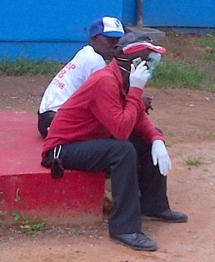
Discuss
Based on what you already know about PPE use, what recommendations would you give this man in the red shirt to help him better protect himself and others?
Notes:
Activating background knowledge:
A key benefit of working with adult learners is that they likely already have some knowledge or experience related to the topic you are teaching. Activating background knowledge helps students connect new learning to what they already know and may help them understand new information better. It also helps you, the instructor, to identify gaps in knowledge where you may need to spend extra time or add emphasis while teaching. Use this slide as an opportunity to let students share what they already know.
Script:
Before we dig deeper into today’s topic, let’s look at a picture of someone using PPE, in this case, gloves and a face mask. Based on what you already know about PPE use, what recommendations would you give the man in the red shirt to help him better protect himself and those around him?
[Give 2 minutes for participants to discuss in small groups or as a large group. You may need to adapt the following based on what participants say in discussion.]
One problem is that he’s holding a phone with gloves on. When you’re wearing PPE, you should NOT pick up personal objects including phones. Instead, you should remove your gloves and perform hand hygiene before picking up objects to avoid transferring pathogens from your gloves to your hands.
He seems also to be wearing the PPE out of context. PPE should be put on for a task – treating a patient, disposing of waste, cleaning and disinfecting – and then it should be removed when the task is completed.

Slide 5
PPE Key Point
PPE can protect you from infection but…
PPE only works if it is used correctly every time.
Notes:
Script:
The picture on the last slide reminds us that PPE helps protect you from Marburg virus disease, but it only works when used correctly every time.
In the last session, we talked about some general do’s and don’t’s for PPE use. Today, we’re going to talk specifically about how to correctly put on and take off PPE so that you can receive maximum protection from it.

Slide 6
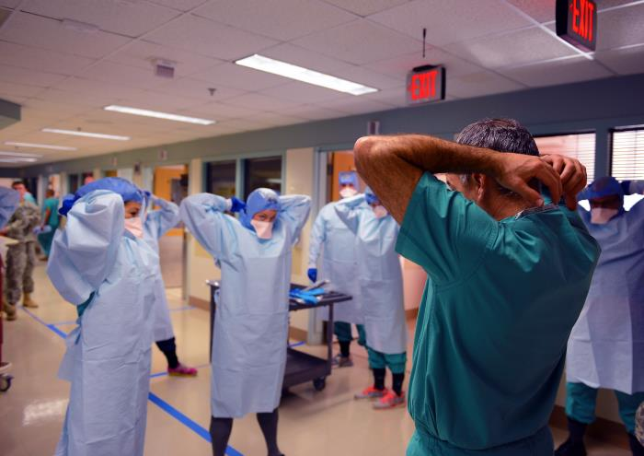
Definition: Donning & Doffing
Donning = putting on an article of clothing
Doffing = taking off an article of clothing
https://phil.cdc.gov//PHIL_Images/18351/18351_lores.jpg
Notes:
Script:
Before we go any farther, let’s talk about a couple of words that you’ll hear me using today and what they mean.
The first word is “donning.” “Donning” means to put something on such as an article of clothing.
The other word is “doffing.” “Doffing” is the opposite of “donning.” It means to take something off such as an article of clothing.
Today you’ll hear me talk about donning and doffing PPE, and that just means putting on and taking off PPE.

Slide 7
PPE
Donning & Doffing Videos
Exactly how to don and doff PPE depends on the specific PPE items available.
The link below provides videos on donning and doffing:
https://www.cdc.gov/vhf/ebola/hcp/ppe-training/index.html
Notes:
Script:
Exactly how to don and doff PPE depends on the specific PPE items available in your country and in your facility. For example, if a gown is used, the donning and doffing process might look different than if a coverall is used.
This is a link to CDC videos of donning and doffing PPE. Different examples are available to show different ways of putting on PPE based on the available items.
I’ll share this link with you so that you can watch the videos on your own time, but we won’t go through the specifics of donning and doffing right now because the process varies. Instead, we will focus on some important general considerations to keep in mind when donning and doffing PPE.

Slide 8
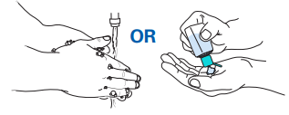
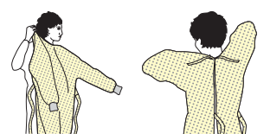
Donning PPE: Notes
Before donning PPE
  Wear dedicated clothing or garments that can be replaced or laundered (e.g., scrubs)
  Take off jewelry and accessories
  Perform hand hygiene
  Check for tears and other damage in PPE that could reduce effectiveness
Donning a gown
  Secure at neck and waist with ties
Notes:
Script:
First, let’s talk about some things to keep in mind when you’re donning PPE. In the context of Marburg virus disease, you should wear dedicated clothing or garments under your PPE that can be replaced or laundered such as scrubs. You should take off any jewelry or accessories, and then you should perform hand hygiene. As you put on PPE, you should check it for tears or other damage that could reduce its effectiveness.
When putting on a gown, if it’s tied at the back, it should be tied tightly enough that it is secure at the neck and waist. However, you should be careful that it’s not tied so tightly that it becomes a knot that you can’t get undone when it is time to remove PPE.

Slide 9
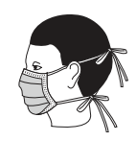
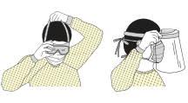
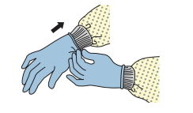
Donning PPE: Notes (continued)
Face mask
  Place mask over nose, mouth, and chin
  Fit flexible nose piece over bridge of nose
  Adjust to fit
Face shield or goggles
  Place over face and eyes
  Adjust to fit
Gloves
  Inner pair of gloves goes under cuff of gown
  Outer pair of gloves goes over cuff of gown
Notes:
Script:
Facemasks should cover your nose, mouth, and chin, and if your mask has a flexible nose piece over the bridge of the nose it should be adjusted to fit your nose. Any type of face shield or goggles should be placed over the face and eyes. It’s important that all masks, face shields, and goggles are adjusted to fit. Remember that you don’t want to have to touch PPE on your face once you are done putting on PPE, so ensure that items covering your eyes, nose, and mouth are fitted and secure and won’t move around and need adjusting.
As mentioned in our first session on PPE, you will put on two pairs of gloves: an inner pair that goes under the cuffs of the gown and an outer pair that goes over the cuffs of the gown. These will help if the outer layer of gloves needs to be changed, and they will also protect you as you remove your PPE.

Slide 10
When to Doff PPE
Change PPE if it becomes…
Heavily contaminated with blood or body fluids
Damaged (e.g., glove tears, gown rips)
Take off PPE after…
Caring for patients
  Before leaving the isolation area
  In the designated doffing location
Completing waste management or environmental cleaning tasks
Notes:
Script:
In some cases, you may need to remove PPE and put on new PPE for example if your PPE becomes heavily contaminated with blood or body fluids or if it becomes damaged while you are working such as a tear in a glove or gown.
When you are done caring for patients with suspected or confirmed Marburg virus disease, you should remove your PPE before leaving the isolation area or patient care area in the designated doffing location.
If you are wearing PPE to perform waste management or environmental cleaning activities, you should remove your PPE when your task is complete.

Slide 11
Key Points for Doffing PPE
Risk of self-contamination is very high when removing PPE
  Potential for contamination from PPE to hands and from hands to mucous membranes, clothing, and skin
  The outside of PPE should not touch your skin or any other body part
Remove PPE slowly and carefully
Remove outermost PPE first
  It is likely to be the most contaminated (e.g., outer gloves)
Notes:
Script:
The risk of self-contamination is very high when removing PPE because of the potential for contamination from PPE to hands and then from hands to mucous membranes – eyes, nose, and mouth – as well as clothing and skin. This makes hand hygiene very important during the process of doffing PPE. Besides keeping hands clean, you want to ensure that the outside of PPE does not touch your skin or any other body part, which can also lead to self-contamination.
PPE removal should be done slowly and carefully. The general principle is that the outermost PPE is taken off first because it’s likely to be most contaminated, for example the apron and the outer gloves are removed first. The last thing to be taken off is the inner pair of gloves.
When wearing full PPE for Marburg virus disease, carefully taking off all PPE items can take 10-15 minutes. However, it’s important to take off PPE properly even if you’re in a hurry and even if you’re tired. Remember that PPE is only effective when used correctly, and proper removal is crucial for keeping you safe.

Slide 12
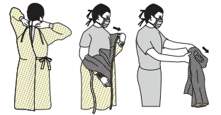
Doffing PPE: Notes
Gloves
  Pinch one glove at wrist and peel away from hand, allowing glove to turn inside out
  Hold removed glove in other hand and slide fingers of ungloved hand inside wrist area; remove by rolling down and folding inside out
Gown
  Break knot around neck and side
  Grasp external front shoulders and pull forward slowly
  Pull away from body and fold inside out as you remove
Avoid touching outside of gown to body
Notes:
Script:
When removing gloves, make sure you’re rolling inside out and not touching the surface of the glove that’s potentially contaminated.
When removing gowns, you should break the knot and roll it away from the body putting it inside out so that you don’t touch the surface that’s potentially contaminated.
Notice that both of these steps help ensure that the outside of PPE does not touch your skin or any other body part, which can lead to self-contamination.

Slide 13
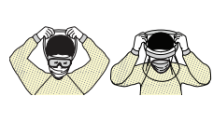
Doffing PPE: Notes (continued)
Face shield or goggles
  Remove from back by lifting head band or earpieces
  Keep eyes closed
  Discard (or, if reusable, place in appropriate bin for reprocessing)
Avoid touching front of face shield or goggles, which may be contaminated
Mask or respirator
  Grasp bottom of strap and lift over head (or untie bottom strap)
  Lift off top strap or tie
  Bring forward off face
  Discard
Avoid touching front of mask or respirator, which may be contaminated
Notes:
Script:
When removing face shields or goggles, you should remove them from the back by lifting the head band or earpieces to avoid touching the front of the face shield or goggles, which might be contaminated. You should also keep your eyes closed to avoid splashes in the eyes.
And the same goes for the mask or respirator; to remove it, you want to grasp it from the back and pull it forward off your face to avoid touching the front, which might be contaminated.
As you do all this, it’s important to keep gloved hands clean so you can remove PPE without spreading contamination.
This procedure is just an example, not for Marburg virus disease-isolation area where double gloving is recommended. [Uncertain what this last sentence is referring to.]

Slide 14
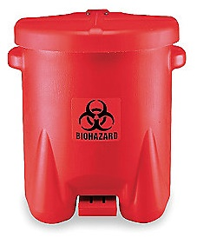
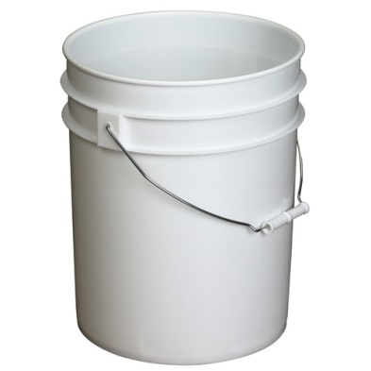
Doffing PPE: Waste Disposal
Biohazard waste bin
Bucket
Disposable PPE
(e.g. face masks, disposable gloves)
PPE to be reprocessed
(e.g. goggles, rubber boots)
Biohazard waste bin
(can be yellow or red)
Bucket for dirty, reusable PPE to be reprocessed
Notes:
Script:
As you remove PPE, you should place items into appropriate waste bins. Appropriate waste streams should be available to you in the designated area for doffing PPE. These include a biohazard waste bin for disposable PPE (sometimes yellow, sometimes red) that should be labeled clearly as infectious waste. You should also have available a bucket designated for reusable PPE that will be reprocessed. If you have any re-usable PPE, such as goggles or certain aprons, put them in the designated bucket. When removing PPE, remember that PPE is considered contaminated once you enter the patient area, even if it doesn’t look dirty.

Slide 15
Doffing PPE: Hand Hygiene
When to Perform Hand Hygiene
  After every item of PPE you take off
  After completely doffing PPE, when your hands are bare
Notes:
Script:
As you are removing PPE, remember that it’s important to keep gloved hands clean so you don’t spread contamination.
You need to perform hand hygiene after taking off each item of PPE and when you are completely finished removing PPE and have bare hands.
A hand hygiene station should be available to you in the designated area for doffing PPE to help facilitate this.

Slide 16
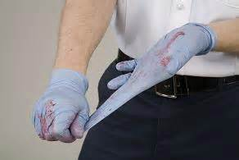
Knowledge Check: PPE
If you saw a co-worker taking off their gloves like this, what suggestion could you make to help them do this more safely?
Notes:
Script:
Based on what we’ve talked about so far, let’s check your knowledge.
If you saw a co-worker taking off their gloves like this, what suggestion could you make to them to help them do this more safely?

Slide 17
Feedback: PPE
Incorrect method to remove gloves (risk of splashing)
Grasp glove at wrist/palm and carefully roll inside out
Notes:
[You may wish to adapt the script for this slide based on how participants answered the question on the previous slide.]
Script:
The way this person is taking off their gloves is incorrect. This person runs the risk of splashing contaminated body fluid onto themselves.
To help this person do this more safely, we could suggest that they take off the gloves by grasping the glove at the wrist or palm and carefully rolling it off inside out. This would help avoid splashing and ensure that the outside of the PPE does not touch the person’s skin, which could lead to self-contamination.

Slide 18
Reflection
What challenges have you experienced with donning and doffing PPE properly in the past?
Do you expect to have similar challenges with PPE for Marburg virus disease?
How can those challenges be overcome?
Notes:
Reflection: Encourages participants to apply, analyze, and/or evaluate what they’ve learned, helps them to deepen their understanding of the topic and also helps you to check their comprehension of what they learned.
Personalization: Helps participants think about how what they have learned applies to their specific situations. Connecting learning to personal experiences helps learners to better understand and remember the ideas taught.
Script:
Now that we’ve talked about proper techniques for donning and doffing PPE, I’d like to hear about your personal experiences with PPE.
What challenges have you experienced with putting on and taking off PPE properly in the past? Do you expect to have similar challenges with PPE for Marburg virus disease? How can these challenges be overcome?
[List challenges as participants mention them. Then, ask the group to offer suggestions for ways they might overcome those challenges. Answers will vary. You may also offer suggestions as you see fit.]

Slide 19
Key Takeaways
PPE helps protect you from infection.
Protecting yourself helps protect your patients, co-workers, family, and friends.
But PPE only works if it is worn and removed correctly.
Notes:
Script:
To wrap up, I want you to remember two key things from this session. First, PPE helps protect you from infection. And if you keep yourself from becoming infected, you protect your patients, co-workers, family, and friends. But PPE only works if it is worn correctly and removed correctly. Remember that there is especially high risk for self-contamination when taking off PPE, so you want to follow the steps for taking it off exactly and remove it slowly and carefully even if you’re tired and even if you’re in a hurry.

Slide 20
Thank you!

