Slide 1
IPC for Marburg Virus Disease (MVD):
PPE Part 1:PPE Basics – What, When, and Why to Use PPE
Healthcare Settings with Limited to Intermediate Resources
Updated March 2023
Notes:
Intended Audience: This presentation is aimed at healthcare workers and facilities management staff. This slide deck focuses on PPE basics – what PPE is, why it’s needed, and when to use it in the context of a Marburg virus disease outbreak. It also features some important do’s and don’ts for safe and proper PPE use. Another presentation follows this one focusing on the details of putting on and taking off PPE.
Please note that the IPC for Marburg Virus Disease topics are presented in sequence, with the expectation that participants will progress through the series. You may, however, mix and match content to meet participant needs, and in these cases, you may need to adjust the sample script below accordingly.
Script:
Welcome! Today we'll be focusing on the basics of personal protective equipment, often called PPE, in the context of a Marburg virus disease outbreak. This is the first of two sessions on using PPE. In this session we’ll talk about what PPE is, why it’s needed, and when it should be used. The next session will go into more depth on how to put on and take off PPE correctly and safely.

Slide 2
Learning Objectives
After this presentation, participants will be able to
  Explain why PPE is important in the context of Marburg virus disease
  Choose appropriate PPE for certain activities
  Identify if PPE is being used correctly
Notes:
Script:
We have three learning objectives for today. By the end of this session, you’ll be able to explain why PPE is important in the context of Marburg virus disease, choose appropriate PPE depending on what you’re doing – screening at entry ways, caring for suspected Marburg virus disease patients, or cleaning and disinfecting, and identify if PPE is being used correctly.

Slide 3
What Is Personal Protective Equipment (PPE)?
Notes:
Script:
To get started, let’s talk about what PPE is.

Slide 4
Definition: PPE
PPE is specialized clothing or equipment worn by healthcare workers that provides barriers or layers to protect their eyes, nose, mouth, skin, and clothing from contact with a patient’s body fluids (blood, vomit, urine, stool, or sweat).
Correct use of PPE helps protect you from infection.
Notes:
Script:
Personal protective equipment, or PPE, is specialized clothing or equipment worn by healthcare workers that provides barriers or layers to protect their eyes, nose, mouth, skin, and clothing from contact with a patient’s body fluids (blood, vomit, urine, stool, or sweat).
Correct use of PPE helps protect you from infection. But it only works if it’s used correctly. We’ll start by looking at examples of PPE, and then we’ll talk about proper use.

Slide 5
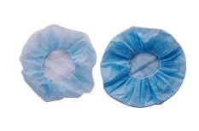
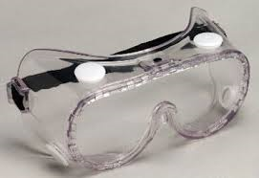
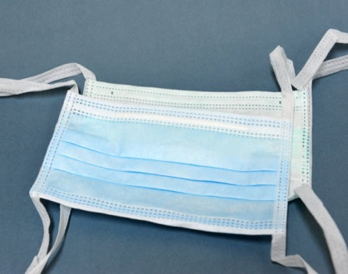
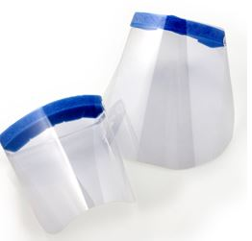
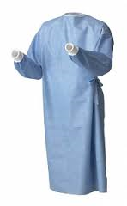
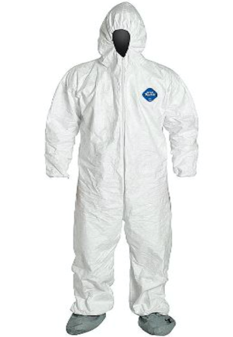
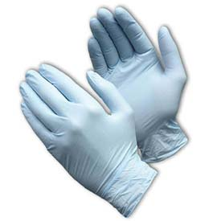
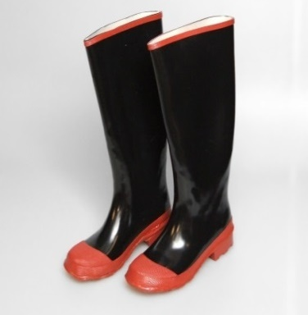
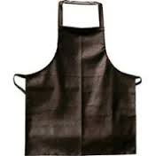
PPE Items
Head covering
Goggles
Mask
Face shield
Head + hair
Eyes
Nose + Mouth
Eyes + Nose + Mouth
Gown
Coverall
Gloves
Boots
Apron
Body
Body
Body
Hands
Feet
Notes:
Activating background knowledge.
A key benefit of working with adult learners is that they likely already have some knowledge or experience related to the topic you are teaching. After discussing the items on this slide, there is an opportunity to let students share what they already know from personal experience and education.
Script:
These pictures show personal protective equipment used to protect different parts of the body.
The head covering covers the head and hair.
Goggles protect the eyes.
Masks protect the nose and mouth, and face shields can protect the eyes, nose, and mouth.
Protection for the body includes gowns, coveralls, and aprons.
Gloves protect the hands, and waterproof boots cover the feet.
A note concerning the gowns and the coveralls – these may look different depending on the manufacturer. Usually, gowns have no type of hood or head cover. Some coveralls come with an attached hood; some do not. So, the specific PPE configuration needed will depend on the PPE items available in your country and at your facility.
Which of these have you worn before? Why did you need to wear it?
[Allow participants 2 minutes to discuss as a large group or in small groups.}

Slide 6
Why PPE?
Marburg virus disease can spread through direct contact (such as through broken skin or mucous membranes in the eyes, nose, or mouth) with
Blood or other body fluids of a person who is sick with or has died of Marburg virus disease
Objects contaminated with blood or other body fluids from a person who is sick with or has died from Marburg virus disease.
PPE works as a barrier to protect your eyes, nose, mouth, skin, and clothing from contact with a patient’s body fluid.
Notes:
Script:
Why is PPE so important during a Marburg virus disease outbreak? Because Marburg virus disease can spread through direct contact (such as through broken skin or mucous membranes in the eyes, nose, or mouth) with blood or other body fluids of a person who is sick with or has died of Marburg virus disease or with objects contaminated with blood or other body fluids from a person who is sick with or has died from Marburg virus disease.
PPE works as a barrier to protect your eyes, nose, mouth, skin, and clothing from contact with a patient’s body fluids, and in this way, it helps protect you from getting sick. If you avoid getting sick, you help protect your co-workers and patients, family and friends, and others you come in contact with in the community, so proper use of PPE is important.

Slide 7
When to Use PPE
Notes:
Script:
So, when do you need PPE in the context of Marburg virus disease?

Slide 8
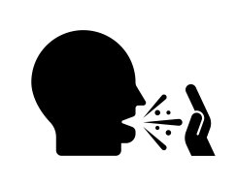

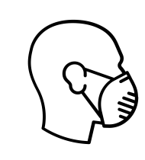



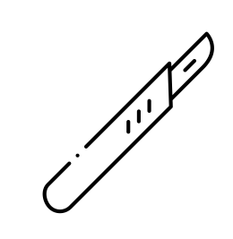

Standard Precautions
Used for all patient care
Protect healthcare workers from infection and prevent the spread of infection from patient to patient
Hand hygiene
Cover coughs / respiratory hygiene
Personal protective equipment (PPE)
based on risk of exposure
Clean and disinfect patient care equipment and instruments
Safe injection practices
Clean and disinfect healthcare environment
Sharps safety
Handle textiles and linens carefully
Notes:
Script:
Standard precautions remain the cornerstone for infection prevention in all healthcare settings. In general, standard precautions are recommended for the care of all patients, regardless of suspected or confirmed infection. Application of standard precautions depends on the nature of healthcare worker personnel-patient interaction and the anticipated exposure to blood, other body fluids, or known infectious agents.
Wearing appropriate PPE is an important part of standard precautions, but note that there are many other actions you should also take take to help protect yourself: hand hygiene, respiratory hygiene and covering your mouth when you cough, cleaning and disinfecting patient care equipment and instruments, safe injection practices, cleaning and disinfecting the healthcare environment, sharps safety, and handling textiles and linens carefully. We will talk about most of these standard precautions in more detail in other sessions.

Slide 9
Key Point on PPE
PPE alone is not enough. Safe patient care during a Marburg virus disease outbreak requires all standard precautions including:
Hand hygiene
Environmental cleaning
Screening and isolation
Notes:
Script:
When it comes to PPE, it’s important to remember that PPE helps protect you, but PPE alone is not enough. Patient care that keeps you safe during a Marburg virus disease outbreak requires all standard precautions be taken including hand hygiene, environmental cleaning, and proper screening and isolation.
So what PPE is recommended in the context of Marburg virus disease? That depends on what you’re doing in your healthcare facility.

Slide 10
PPE and Standard Precautions during Marburg Virus Disease Outbreak
It is not always possible to clearly identify patients with Marburg virus disease because early symptoms are nonspecific.
Because of this, during an Marburg virus disease outbreak, use Standard Precautions for any care or activities that might allow exposure to blood or other body fluids.
  Note: Gloves should be considered if you will be touching patient
Notes:
Script:
It is not always possible to clearly identify patients with Marburg virus disease because early symptoms are nonspecific.
Therefore, when caring for patients during a Marburg virus disease outbreak, you should use standard IPC precautions for any care or activities that might allow exposure to blood or other body fluids.
Note that if you will be touching the patient, gloves should be considered as part of the PPE needed. For example, if you will be touching a patient during patient care activities, you should think about the risk of touching infectious sweat during an examination. You would want to put on gloves and make sure to perform hand hygiene when you take them off."

Slide 11
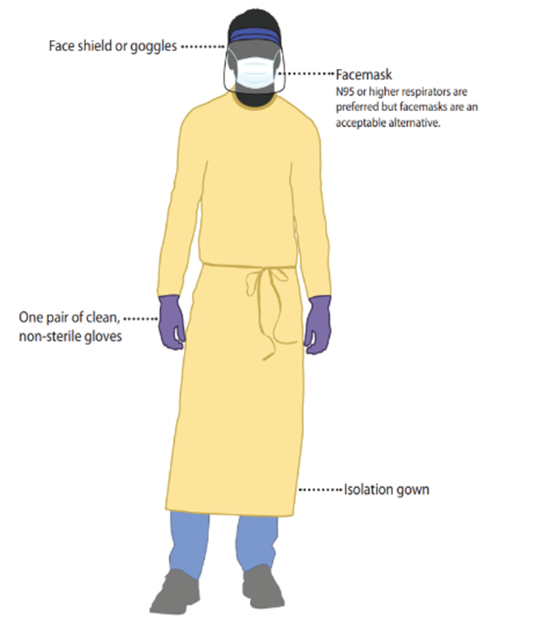
PPE for Marburg Virus Disease Screening
Screening can be a non-contact activity
  Maintain distance of at least 1 meter
  Avoid direct face-to-face interaction (physical separation such as plexiglass preferred)
If distance can be maintained → PPE not required
If distance can’t be maintained → PPE
  Mucous membrane protection (goggles + face mask OR face shield + face mask)
  Single gloves
  Gown
If PPE is worn → remove after each person you screen + perform hand hygiene
PPE for screening when distance cannot be maintained
Notes:
Script:
If you remember from the session on screening for Marburg virus disease, screening is, preferably, a non-contact activity. It involves asking questions about symptoms and contacts and a non-contact temperature check with an infrared thermometer. Ideally, when you are screening people entering the facility, you will be able to maintain at least 1 meter of distance from them, and you will be able to avoid direct face-to-face interaction with them either by angling your chairs so that you don’t face each other directly or by putting up a physical barrier such as plexiglass.
If you can maintain distance and avoid face-to-face interaction, then you don’t need to wear PPE, and if you don’t need it, you shouldn’t wear it. Wearing extra PPE in situations where it’s not needed introduces some risk, for example wearing gloves throughout an entire shift while touching phones and other objects increases risk instead of reducing it.
If you can’t maintain the needed distance during screening or you can’t avoid face-to-face interaction, you will need PPE for Marburg virus disease. This includes protection for your eyes, nose, and mouth – either goggles and a face mask or a face shield with a face mask. A single layer of examination gloves are needed to protect the hands, and either a gown or coveralls should be worn to protect the body. The person in the image here is dressed in appropriate PPE for screening.
If you use PPE during screening, you must remove it after each person you screen and perform hand hygiene.

Slide 12
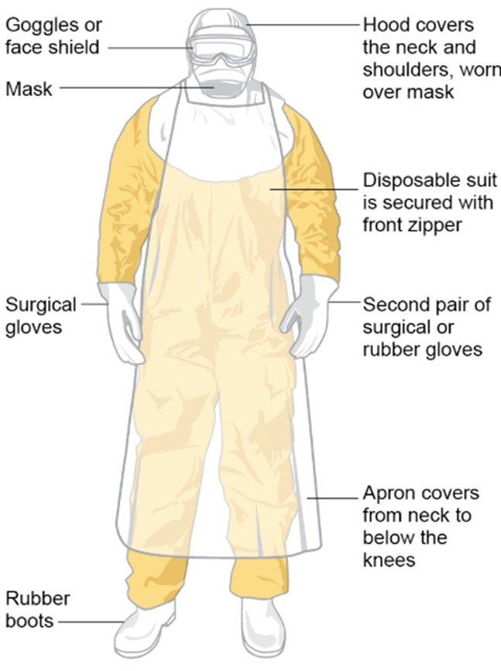
PPE for Patient Care & Environmental Cleaning
Goggles or face shield
Hood covers the neck and shoulders, worn over mask
Double gloves (inner pair and outer pair)
Gown OR coverall
Apron
Head cover
Waterproof boots
Mucous membrane protection (face mask* + face shield) OR (face mask* + goggles)
Mask
Disposable suit is secured with front zipper
Surgical gloves
Second pair of surgical or rubber gloves
Apron covers from neck to below the knees
*Respirator can be used in place of face mask (structure of respirator keeps it from collapsing when soaked with sweat; may be preferred in hot, humid climates)
Rubber boots
Notes:
Script:
When caring for patients with suspected or confirmed Marburg virus disease, you should wear PPE as part of transmission-based precautions. You should also use PPE when performing environmental cleaning and disinfection. The PPE for both of these situations is similar, and you can see that the person here is dressed in appropriate PPE for these situations.
To protect yourself, you need to have a double layer of gloves – an inner layer and an outer layer. The inner pair goes under the gown cuffs, and the outer pair goes over the cuffs. That inner pair is so that if there is contamination on the outer pair, you can remove the outer pair of gloves and replace them while still having protection. The inner pair is also useful while taking off PPE so that once that outer pair is removed and other PPE is still being taken off, there’s still the inner pair of gloves providing protection.
The outer layer of gloves will likely differ based on what your intended task is. You may wear a second pair of surgical gloves if you will be attending to patients. If you are cleaning, an outer pair of thick, rubber gloves is needed for protection from the chemicals used to clean and disinfect.
Besides gloves, you also need to wear either a gown or a coverall AND an apron to protect your body. The apron on top is an extra layer to prevent fluid exposure.
You should wear a head cover or other type of head and neck protection and waterproof boots or other kind of shoe cover that can be removed.
To protect mucous membranes (your eyes, nose, and mouth), you should wear a face mask and face shield or a face mask with goggles. If you find that your face mask collapses from getting soaked with sweat, you can wear a respirator in place of the face mask. The structure of the respirator will prevent this problem and also provide proper protection.
In the next session we’ll talk in more detail about how to put on and take off this PPE.
PPE for use in a filovirus disease outbreak (WHO 2016)

Slide 13
Using PPE Correctly
Notes:
Script:
So now that we’ve talked about what PPE is and when you need it, let’s talk about how to use it correctly.

Slide 14
Key Point on PPE (Reminder)
PPE helps protect you from infection but…
PPE only works if it is used correctly every time.
Notes:
Script:
As already mentioned, PPE helps protect you from infection but only if it’s used correctly every time.

Slide 15

Do’s and Don’ts While Wearing PPE
DO
Change PPE that is heavily contaminated with blood or other body fluids
Change PPE if it gets damaged (e.g., glove tears, gown rips)
Remove PPE correctly and carefully, even when you're tired
DON’T
Touch or adjust PPE once it’s on
Touch your face
Touch unnecessary objects, such as cell phones, pens, patient charts
Touch surfaces such as bed rails, counters unless absolutely necessary
Notes:
Script:
So, when you’re wearing PPE, you should
Change it if it becomes heavily contaminated with blood or other body fluids
And change it if it gets damaged such as a tear in your glove or a rip in your gown. If bodily fluids can get into your PPE, the PPE is not protecting you.
It’s also very important to remove PPE correctly and carefully. Even if you’re in a hurry. Even if you’re very tired. If you don’t follow the steps to remove PPE correctly, you can expose yourself to infectious agents. We’ll talk more in a future session <HCW Slide Deck 7: PPE Part 2 – How to Put On and Remove PPE> about step-by-step how to remove PPE. It is a time-consuming process but it’s crucial that you follow the process carefully for your protection.
When you are wearing PPE, you need to be careful what you touch.
You should NOT touch or adjust the PPE once it’s on. Touching it with contaminated hands can cause self-contamination of your eyes, mouth, and nose. When you’re putting PPE on, pay special attention to items on the face and head. You don’t want to have to adjust goggles, for example, once your gloves have potentially been contaminated. Make sure when you put it on that it fits well and check that it stays in place so that you don’t have to move it around once you’ve completed putting it on. Also avoid touching your face.
You should avoid touching unnecessary objects such as cell phones, pens, or patient charts with your PPE on. If you touch one of these objects with your contaminated PPE and then later touch those items while you are not wearing PPE, you can potentially come in contact with infectious pathogens.
You should also avoid touching surfaces such as bed rails and counters unless it’s absolutely necessary.

Slide 16
What if PPE is limited?
Prioritize PPE use for:
  Cleaning staff
  Any patient interaction with potential for exposure to body fluids, especially blood (e.g., maternity and trauma patients)
Remember that PPE is one aspect of Standard Precautions:
  Maintain at least 1 meter distance (e.g., neutral space for passing medication)
  Perform hand hygiene as indicated
  Identify solutions based on local context (adaptations to procedures and clothing)
Notes:
Script:
Ideally, you would have access to all the PPE you need whenever you need it. But what happens when PPE is limited or unavailable?
How you handle this will depend on the context, what type of health facility you’re in, and other factors. But generally, PPE should be prioritized for use by cleaning staff and for use in patient interactions with potential for exposure to body fluids, especially blood, for example, in labor and delivery units or with trauma patients.
And remember that PPE is just one aspect of Standard Precautions. Even if you have no access to PPE, you can still do things to help protect yourself when caring for patients such as keeping at least one meter distance between you and the patient, putting up physical barriers or screens, and performing proper hand hygiene to keep hands clean.
Solutions can also be identified based on the context. Adaptations to procedures and clothing can be made to provide some protection. For example, when giving something to patients (medications, supplies), put the item down on a table and let the patient pick it up from the table to avoid direct contact.
Because of COVID, there are now more resources available about what to do when PPE is limited. If you were working in a healthcare facility during COVID, you may already be familiar with some of these adaptations that worked in your facility.

Slide 17
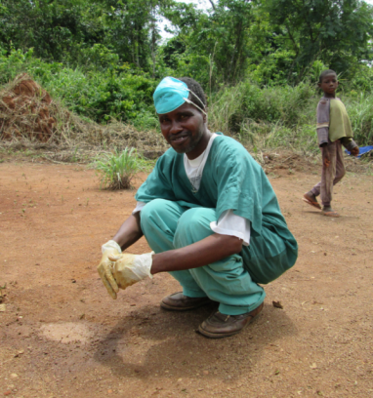
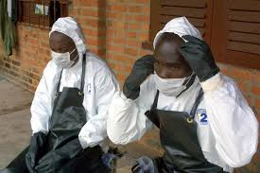
Knowledge Check: PPE
Imagine these are your co-workers. Based on what you know about proper use of PPE, what suggestions would you give them in each of these scenarios to help them better protect themselves?
1
2
Notes:
Script:
Now, I want you to imagine these are your co-workers. Based on what you know about proper use of PPE discussed in today’s presentation, what suggestions would you give them in each of these scenarios to help them better protect themselves during a Marburg virus disease outbreak?

Slide 18
Feedback: PPE
Picture 1:
PPE worn out of context
Face mask not worn correctly - ensure mask covers nose and mouth; adjust to fit
Overly soiled gloves need to be removed
Picture 2:
Touching coverall hood and sides of face mask with gloved hands
Coverall hood not fully covering hair
Mask not covering nose
No eye protection
Notes:
Script:
1. In picture 1, the top right picture, we can see several problems. The first is that the PPE is being worn out of context. PPE should be put on for the task at hand – treating a patient, disposing of waste, cleaning and disinfecting – and then it should be removed when the task is completed. If this person has completed a task where these items of PPE were needed, he should remove them. PPE should also be taken off before leaving the healthcare facility area (unless a person is assisting with burials).
If the man in this picture is in a situation where PPE is needed, the face mask is not being worn correctly because it is not covering his nose and mouth. And his gloves are overly soiled and need to be removed or changed before he performs another task.
2. In picture 2, the bottom right picture, notice that the man on the right of the photo is touching his coverall hood and the sides of his face mask with his gloved hands. If his gloves are contaminated, he risks self-contamination through his eyes and nose. He seems to be adjusting the coverall hood, which needs to fully cover his hair, and his mask is not covering his nose. Remember that it’s important to put PPE on so that it covers you properly – the hood should fully cover hair and ears and the mask should fully cover the nose and mouth. It’s also important that once you put PPE on, it’s secure so that it doesn’t move around and so that you don’t have to adjust it as you work. Once you’re wearing PPE, you should avoid touching your face for any reason.
Neither of the men in this picture is wearing eye protection. In the context of Marburg virus disease, when the hair covering, face mask, coveralls, apron, and gloves are needed, an eye covering such as goggles is also needed.

Slide 19
Reflection
Have you experienced a shortage or lack of PPE in your healthcare facility before? If so, what did you and your co-workers do to protect yourselves despite limited PPE?
In the context of Marburg virus disease, what are some adaptations you might consider in your facility if PPE is limited?
Notes:
Reflection: Encourages participants to apply, analyze, and/or evaluate what they’ve learned, helps them to deepen their understanding of the topic and also helps you to check their comprehension of what they learned.
Personalization: Helps participants think about how what they have learned applies to their specific situations. Connecting learning to personal experiences helps learners to better understand and remember the ideas taught.
Script:
Now that we’ve talked in detail about using PPE, I’d like to hear about your personal experiences with PPE. Have you experienced a shortage or lack of PPE in your healthcare facility before? If so, what did you and your co-workers do to protect yourselves despite limited PPE?
In the context of Marburg virus disease, what are some adaptations you might consider in your facility if PPE is limited?
[Allow participants several minutes to discuss in small groups or as a large group. You may respond to suggestions as you see fit.]

Slide 20
Key Takeaways
PPE helps protect you from infection.
  Protecting yourself helps protect your patients and your community.
  But PPE only works if it is used correctly.
PPE is just one aspect of Standard Precautions.
  Hand hygiene, environmental cleaning and disinfection, and other precautions are key to helping keep you, your patients, and your community safe.
Notes:
Script:
To wrap up, I want you to remember two key things from this session. First, PPE helps protect you from infection. And if you keep yourself from becoming infected, you protect your patients, your family, and your friends. But PPE only works if it is used correctly.
Also remember that PPE is just one aspect of Standard Precautions. Hand hygiene, environmental cleaning and disinfection, and other precautions are key to keeping you, your patients, and your community safe. This means that PPE alone is not enough to protect from Marburg virus disease. But it also means that when PPE access is limited, you still have ways to keep yourself and others safe.

Slide 21
Thank you!

