Slide 1
IPC for Marburg Virus Disease (MVD):
Hand Hygiene
Healthcare Settings with Limited to Intermediate Resources
Updated: March 2023
Notes:
Intended Audience: This presentation focuses on what healthcare workers should know about performing hand hygiene in the context of Marburg virus disease.
Please note that the IPC for Marburg Virus Disease topics are presented in sequence, with the expectation that participants will progress through the series. You may, however, mix and match content to meet participant needs, and you will need to adjust the sample script below.
Script:
Welcome! Today we'll be focusing on keeping clean hands, frequently called “hand hygiene,” as a standard precaution to protect you, your patients, and your community from Marburg virus disease.

Slide 2
Learning Objectives
After this presentation, participants will be able to
  Explain why hand hygiene is important in the context of Marburg virus disease
  Describe at least 5 times when hand hygiene should be performed during the workday
  Describe 3 considerations to ensure good hand hygiene
Notes:
Script:
We have three learning objectives for today. By the end of our time together today, you should be able to explain why hand hygiene is important in the context of Marburg virus disease, describe at least 5 times during the workday when hand hygiene should be performed, and describe 3 considerations to ensure good hand hygiene.

Slide 3
Warm-up
How often do you wash your hands or clean your hands with alcohol-based hand rub during a typical day at work?
Notes:
[This activity comes directly from PFL slides on hand hygiene: Hand Hygiene (Session Plan) (cdc.gov)]
Activating background knowledge.
A key benefit of working with adult learners is that they likely already have some knowledge or experience related to the topic you are teaching. Activating background knowledge helps students connect new learning to what they already know and may help them understand new information better. It also helps you, the instructor, to identify gaps in knowledge where you may need to spend extra time or add emphasis while teaching. Use this slide as an opportunity to let students share what they already know.
Script:
To get us started today, I want you to think about how often you wash your hands or clean your hands with alcohol-based hand rub during a typical workday. I’ll give you one or two minutes to reflect on a typical day at your job and estimate the total. If you need to write something down to help you add this up, please feel free.
(Pause for 1-2 minutes as participants reflect.)
Alright, let’s see who has the highest count! Who cleans their hands more than 5 times a day during work?”
(Pause for responses.)
How about 10 times per workday?”
(Pause for responses. Continue in this way until you find the individual who has the highest estimate.)
“Wow! And if we factored in cleaning our hands outside of work, too, the numbers might get even higher! But why do you clean your hands so often while at work? Why is it important?
[Allow a few participants to share their reasons.]

Slide 4
Hand Hygiene
Notes:
Script:
Now that we’ve talked about what keeping clean hands look like in your day-to-day work, let’s dig in a bit deeper to why hand hygiene is so important and how to ensure that you’re doing it properly.

Slide 5
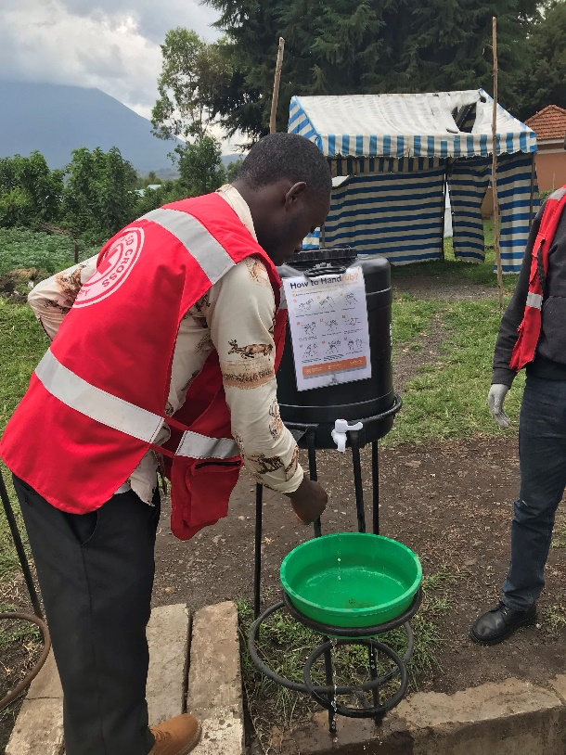
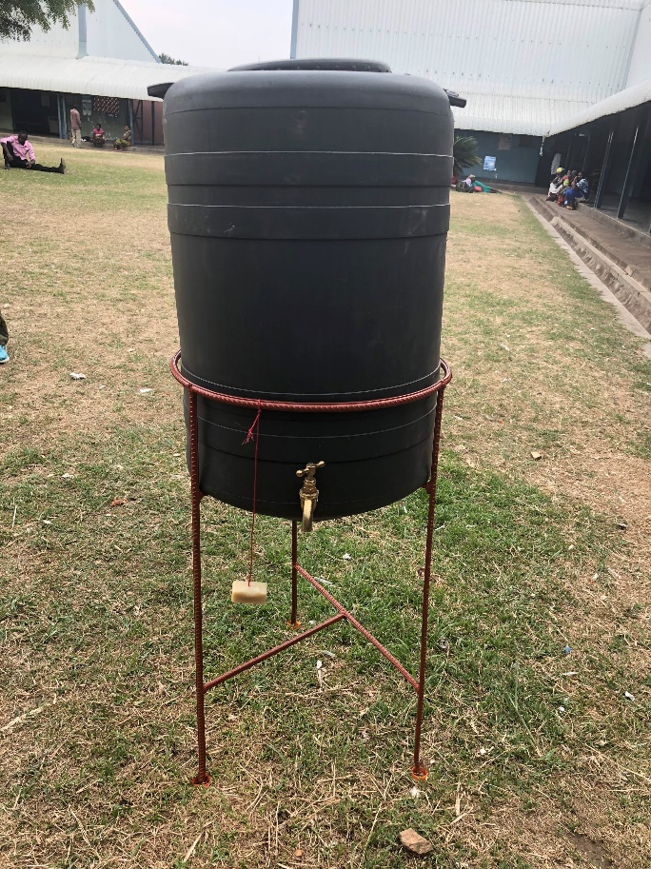
Definition: Hand Hygiene
Hand hygiene is the general term used for cleaning hands, whether using soap and water, alcohol-based hand rub, or surgical hand scrub
Handwash = soap + water
Handrub = alcohol-based hand rub
Notes:
Script:
First, a definition to keep in mind: Hand hygiene is the general term used for cleaning hands, whether using soap and water, alcohol-based hand rub, or surgical hand scrub. In technical documents, you may see references to handwashing, which involves the use of soap and water, and to hand rubbing, which involves the use of alcohol-based hand rub.
These are some examples of hand hygiene stations you might be used to seeing at your facility. Usually, these stations include a bucket sometimes with a waste basin. It’s common to see buckets of water with soap hanging by them, or it may be chlorinated water in the buckets, which we’ll talk about more shortly.

Slide 6
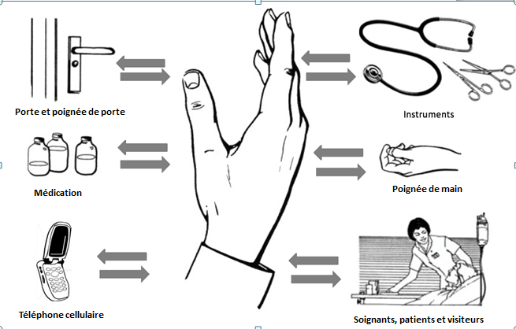
Why Hand Hygiene?
Equipment and instruments
Door handles
Medication vials
Hands
Phones
Health workers, patients, and visitors
Notes:
Script:
You touch lots of things at work each day. This image shows just some examples of the many things you may touch during a typical workday. As indicated by the arrows in this image, touching people, objects, and surfaces allows the transfer of pathogens from you to them and from them to you.
If you touch an unclean surface, such as a door handle, medical equipment, or your phone and then touch your eyes, nose, or mouth, you can transfer pathogens, including Marburg virus disease, to yourself. You can also transfer pathogens to patients if you touch an unclean surface and then touch the patient or touch a medical device.
Hand hygiene is a simple step that can make a big difference in keeping you, your patients, and your community safe from Marburg virus disease.

Slide 7
When to Perform Hand Hygiene
 | Before | After
Patient Care | Touching patient or patient environment Performing a sterile procedure | Touching patient or patient environment Touching patients’ body fluids
Using PPE | Putting on PPE | Removing PPE
Cleaning | Performing environmental services/cleaning activities | Performing environmental services/cleaning activities Handling waste
Personal Activities | Preparing food or eating | Using the toilet Blowing nose/coughing
Notes:
Script:
Notice that hand hygiene should happen before and after many activities during your workday.
When caring for patients, you should perform hand hygiene both before and after contact with the patient or with the patient’s environment. You should clean hands before performing a sterile procedure and after touching a patient’s body fluids.
When using PPE, you need to wash hands before putting on PPE and after removing it.
You need to wash hands before and after performing environmental services or cleaning activities and after handling waste.
You should also be mindful of hand hygiene before and after personal activities during your workday, for example, cleaning your hands before preparing food or eating and after using the toilet, blowing your nose, or coughing.
Hand hygiene stations should be available at facility entrances, in all patient care areas, and in areas for putting on and removing PPE to facilitate good hand hygiene.

Slide 8
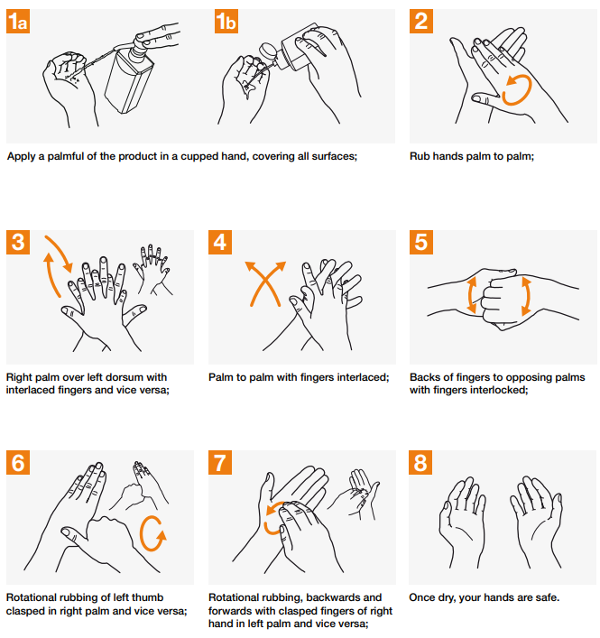
Alcohol-Based Hand Rub (ABHR)
Considerations:
Rub for at least 20-30 seconds
Use enough product to keep hands wet while rubbing (usually 3-5 mL)
If hands are visibly dirty, use soap and water
Notes:
Script:
Alcohol-based hand rub is preferred for hand hygiene by the World Health Organization given the variable access to clean water globally.
This is a diagram of the technique to make sure you cover all surfaces when using alcohol-based hand rub.
Something important to remember when using alcohol-based hand rub: You need to rub hands for at least 20 to 30 seconds, and you need enough product to keep your hands wet while rubbing that entire time. This is usually about 3-5 milliliters of product, which is a good bit.

Slide 9
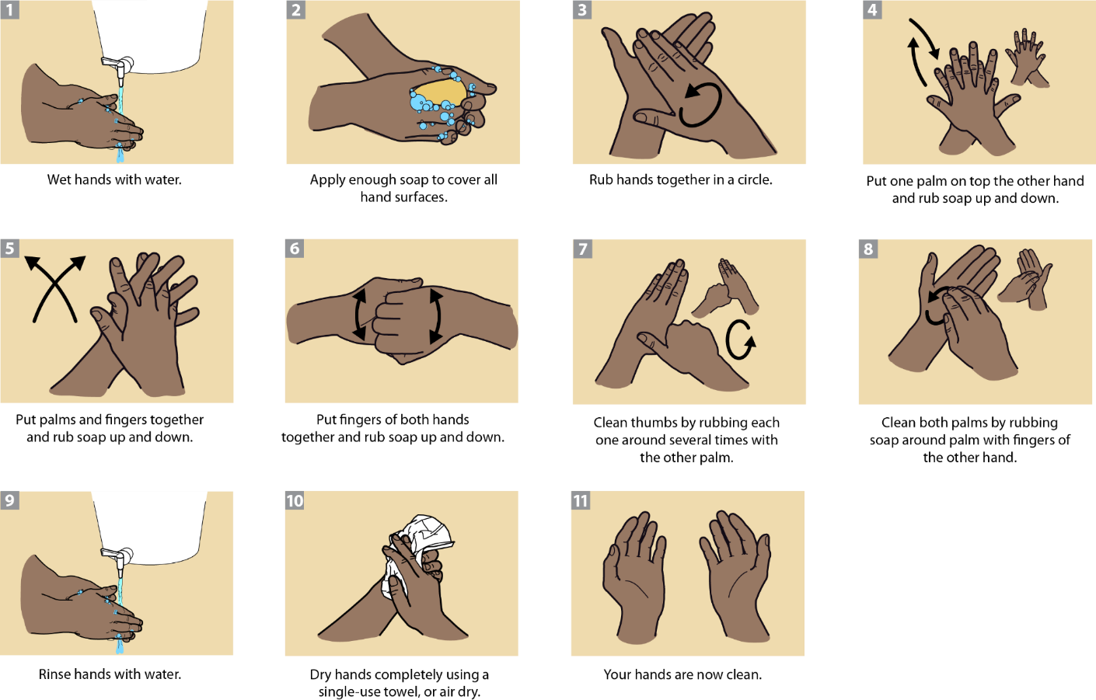
Handwashing with Soap and Water
Considerations:
Wash long enough to complete all steps in the diagram (40+ sec)
Turn tap off without contaminating hands
Use single-use towels for drying or air dry
Notes:
Script:
If your facility offers soap and water for hand hygiene, your hands need to be washed long enough to complete all the steps in the diagram, so more than 5-10 seconds and hopefully 40 seconds or more.
Consider how you can turn off the tap without contaminating your hands. For example, is there an elbow lever that could be used?
When we think about drying, single-use towels are preferred because shared towels can become contaminated. If there are no towels, air drying works as well.

Slide 10
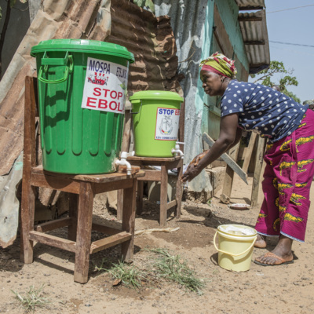
Use of Chlorine for Hand Hygiene
NOT recommended as a routine option for hand hygiene
Interim option when no other hand hygiene options are available
Chlorine solutions must be:
  Diluted correctly
  Prepared daily
http://cdcmuseum.org/exhibits/show/ebola/public-health/ipc/handwashing
Notes:
Script:
The use of chlorine for hand hygiene is not recommended by World Health Organization (WHO) guidelines, but it can work as an interim option if no other hand hygiene products are available.
Not all chlorine is the same. There are different concentrations and different formulations, and how it is diluted matters. If it’s not diluted correctly it can be too strong, which can potentially injure hands or it can be too weak, which would potentially not be useful.
Chlorine is also not ideal because it must be prepared daily since it loses strength over time, and it must be shielded from light, which is why you often see it in covered buckets.
Resource:
1WHO Guideline on hand hygiene in health care in the context of filovirus disease outbreak response : rapid advice guideline, November 2014

Slide 11
Reflection
Based on what you’ve learned about hand hygiene today…
What are 2 things you will change about how you clean your hands while at work?
What is 1 thing that could change at your facility to help make hand hygiene easier or more effective?
Notes:
Reflection: Encourages participants to apply, analyze, and/or evaluate what they’ve learned, helps them to deepen their understanding of the topic and also helps you to check their comprehension of what they learned.
Personalization: Helps participants think about how what they have learned applies to their specific situations. Connecting learning to personal experiences helps learners to better understand and remember the ideas taught.
Script:
Now that we’ve talked about hand hygiene, let’s take some time to think about what you’ve learned and how it applies to your day-to-day life at work.
First, based on what you learned today, what are 2 things you will change about how you clean your hands while at work? For example, will you wash or rub your hands longer? Will you try to turn the tap off with your elbow? Will you use more alcohol-based rub each time so that you have enough to keep your hands wet while you rub? Take a minute and write these things down. If you can think of more than 2 things, write down everything you can think of. You won’t have to share this with the group if you don’t want to. This is just for you, but I’ll ask for a couple of volunteers who are willing to share after you’ve had a minute to think.
[Because this is personal, allow participants 1-2 minutes to write this down by themselves. If some participants want to share their answers with the group after, you might give some time for that; however, don’t require anyone to answer to the whole group.]
Now, let’s think about the facilities where you work. What is one thing that could change at your facility to help make hand hygiene easier or more effective? For example, is chlorine the only available option instead of soap or alcohol-based rub? Are shared towels common? Are hand hygiene stations located at entrances and patient care areas to make hand cleaning convenient to do frequently? Take a minute to write this down. If you can think of more than one thing that could change, list everything you can think of. After you’ve had a minute to think, I’ll ask for volunteers to share their answers.
[Allow participants to share answers. Discuss as a group ways to overcome these challenges.]

Slide 12
Key Takeaways
Proper hand hygiene helps protect you and your patients from infection. By protecting yourself, you also protect your community.
Hand hygiene should be performed many times during the workday.
To clean hands properly:
  Rub/wash long enough
  Use enough product
  Use single use towels or air dry
Notes:
Script:
To wrap up, here are some key things I hope you take away from today’s session.
First, proper hand hygiene helps protect you and your patients from infection. By protecting yourself, you also protect your coworkers, your family and friends, and others in your community. Hand hygiene is a simple step that can make a big difference.
Hand hygiene should be performed many times during the workday including before and after certain actions for patient care, cleaning, using PPE, and personal activities.
Also remember when performing hand hygiene that to get your hands clean, you need to clean them for the recommended amount of time (20-30 seconds for hand rub and 40 or more seconds when using soap and water), and if you’re using alcohol-based hand rub, you need to use enough so that your hands stay wet while you rub. If using soap and water or chlorine, use a single-use towel to dry your hands, or if that’s not available, allow your hands to air dry.

Slide 13
Thank you!

