Slide 1
Train as a Disease Detective.
Become a Laboratory Leader.
Applying to become a member of
CDC’s Laboratory Leadership Service (LLS)
Notes:
LLS trains PhD laboratory scientists to be laboratory leaders through service to their host sites and as CDC disease detectives.
LLS fellow application period runs between March and June. Be sure to check the LLS website for application opening and closing dates.
Selected fellows begin their fellowship the following July.

Slide 2
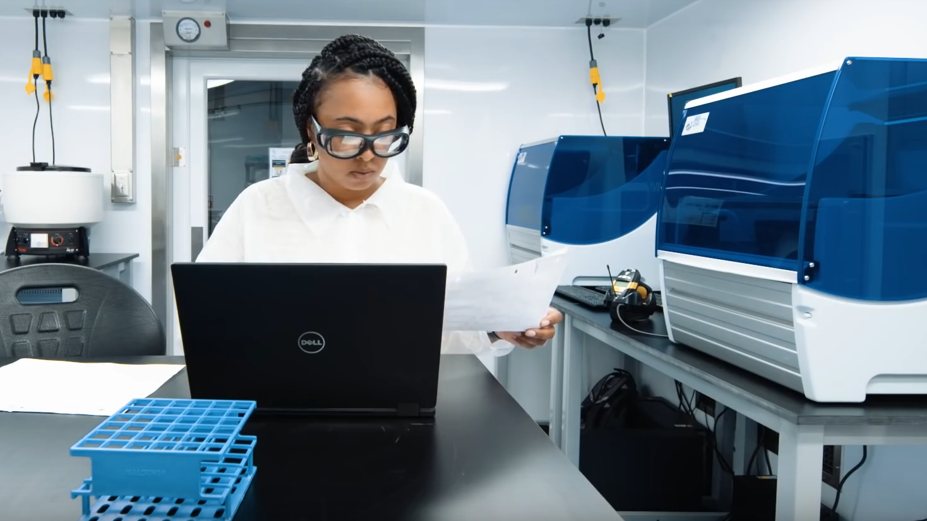
LLS fellows train to be leaders in public health.
Notes:
The mission of LLS is to develop a diverse cohort of future public health leaders who demonstrate scientific excellence through leadership, service, and high standards of laboratory quality and safety.​
Class of 2018 fellow Brandi Freeman supports a response deployment to the U.S. Virgin Islands public health laboratory. Brandi is now the Deputy Branch Chief for laboratories in the Polio and Picornavirus Branch.

Slide 3
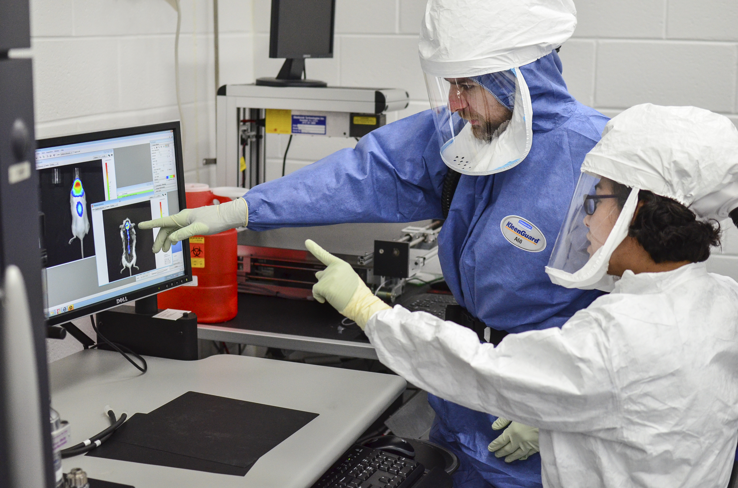
LLS is a
2-year fellowship
for PhD laboratory
scientists seeking careers
in public health.
Notes:
LLS is a two-year program for PhD scientists in a laboratory-related field.
Newly graduated (or soon to graduate) PhDs or those with postdoctoral experience are welcome to apply.
The most competitive applicants have an interest in or passion for a career in public health.
Class of 2017 fellow Dave Lowe worked with a novel rabies model as part of his LLS applied research. Dave is now a team lead with CDC’s Coronavirus and other Respiratory Viruses Division Laboratory Branch.

Slide 4
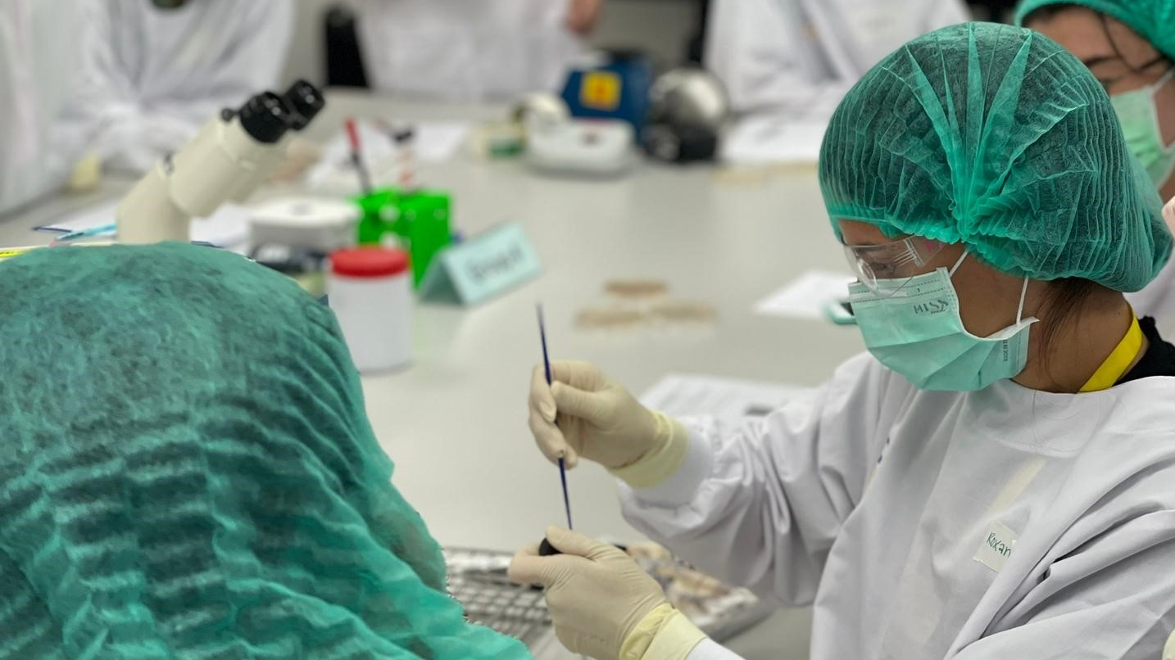
LLS is a
competency-based,
service-learning fellowship.
Notes:
LLS training and experiences are based on competencies deemed critical for success as a leader in the public health laboratory workforce, such as applied research lab safety and quality, bioinformatics, lab management, and communications.
Curriculum is designed to weave leadership experience and training throughout all the competencies.
Fellows complete Core activities of Learning, or CALs, throughout their fellowship to build proficiency and skill within these competency domains.
Find more information on LLS competencies and CALs on the LLS website under What Fellows Learn.
Class of 2022 fellow Roxana Rodriguez Stewart trains partners in Thailand on antifungal susceptibility testing on behalf of her host site laboratory.

Slide 5
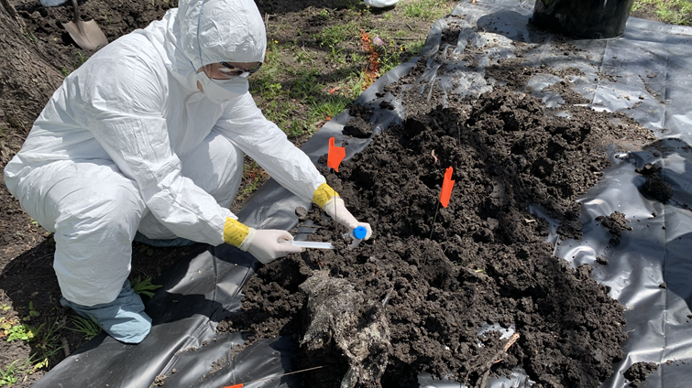

91% experiential
91% experiential
9% didactic
Notes:
LLS training is largely on-the-job and experiential, either in the host lab assignment, in the field, or supporting an agency response.
A small portion of fellows’ time is spent in didactic training, which includes a month-long orientation at the beginning of the fellowship in Atlanta, two week-long workshops during in the fellowship, and monthly professional development sessions.
Service-based learning is a cornerstone of LLS training. On a near-daily basis, fellows support the mission objectives of their host labs through service, whether through applied research contributions, conducting risk assessments, supporting laboratory operations, or other routine, yet high-performance activities.
Fellows can also serve through different types of responses that can take them out into the field.
Class of 2021 fellow Maureen Ty collects environmental on a Burkholderia investigation in Texas.

Slide 6
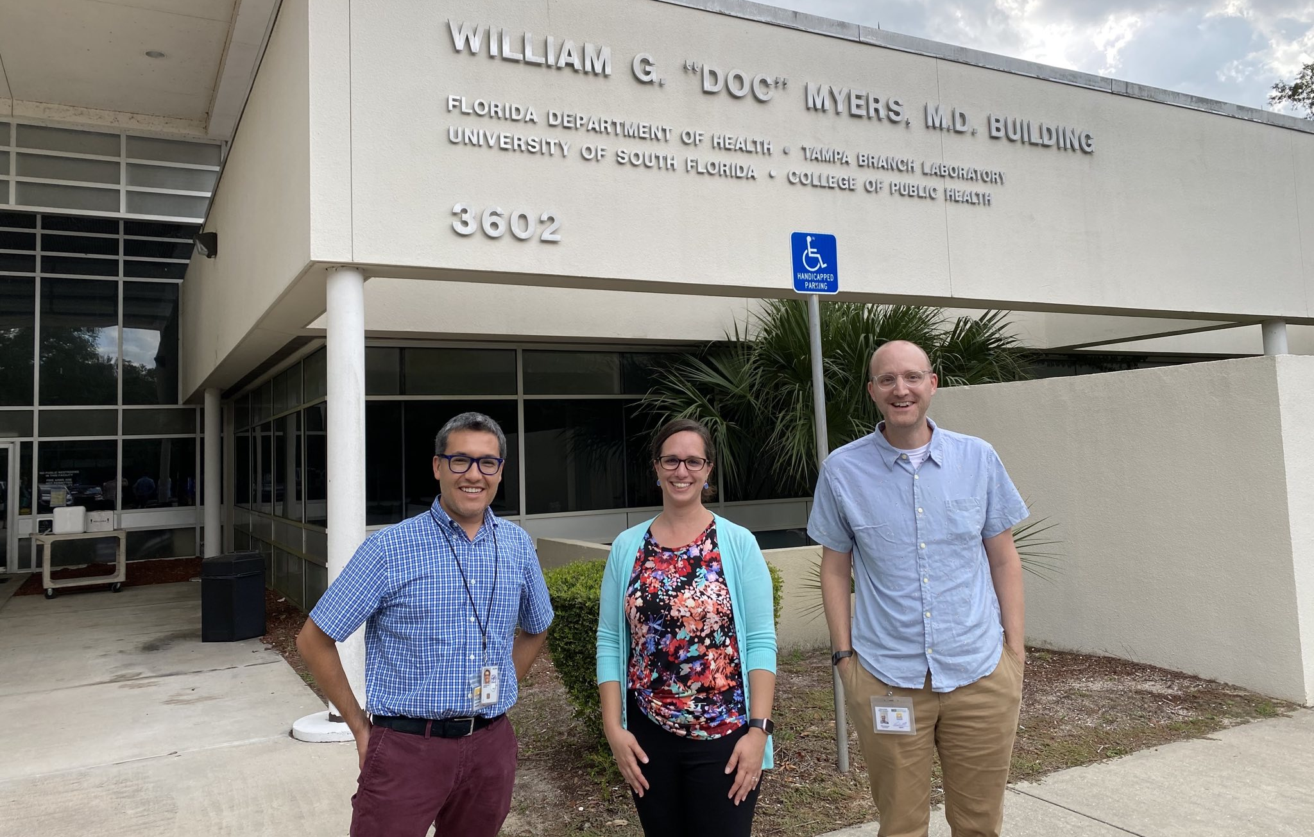
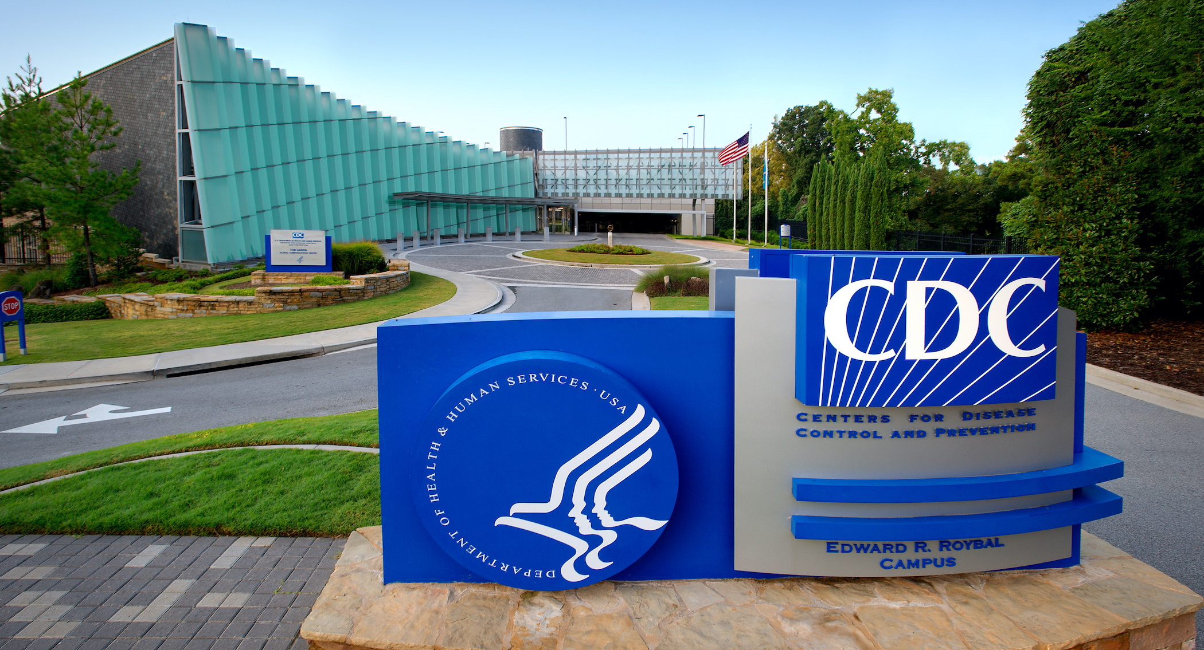
LLS fellows train at public health laboratories around the country.
Notes:
LLS fellows are CDC employees hosted in CDC or jurisdictional (e.g., state or local) public health labs. CDC labs include those at Atlanta headquarters or others throughout the country
LLS field fellows, those not assigned to a CDC headquarters lab, are not isolated. They frequently engage with headquarters-based fellows, CDC scientists, leadership, and SMEs, and the LLS program
Headquarters-based fellows train with state and local labs gain experience in jurisdictional laboratories with a two-week immersive training; field fellows get to experience laboratory operations at other state or local labs with the same training.
Applicants are encouraged to be open to both headquarters and field placements
Class of 2022 fellows Sergio Rodriguez (far left) and Peter Dumoulin (far right) at the Tampa Bureau of Laboratories in Tampa, FL with a collaborating EIS officer (center).

Slide 7
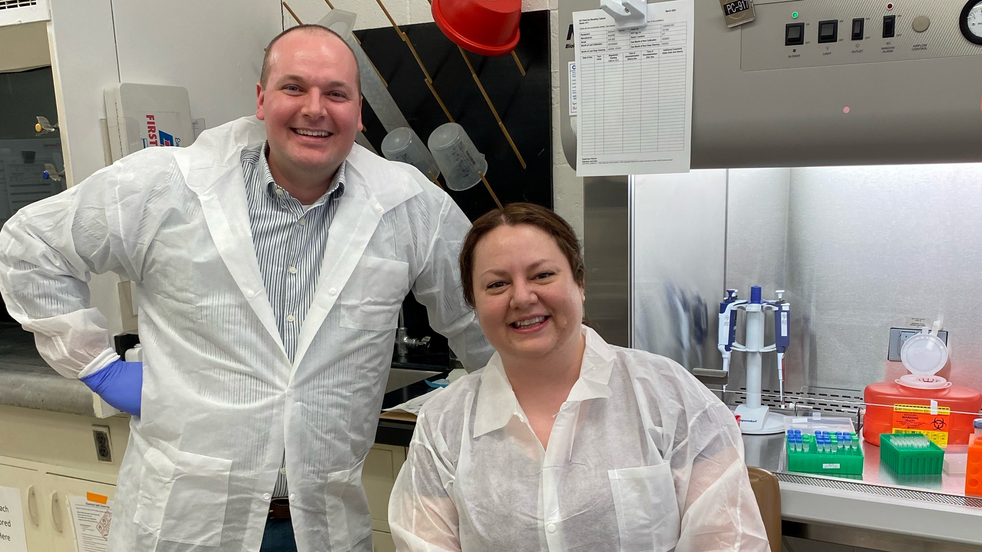
Nearly 94% of
LLS fellows remain
in public health.
Notes:
LLS seeks to train fellows through service and retain them in public health.
As 2023, 94% of LLS fellows remain in public health after LLS. 67% accept positions with CDC.
Class of 2021 fellow Erik Kopping and class of 2022 fellow Elizabeth Watts both accepted division chief positions with their LLS host site laboratory, the New York City Department of Health and Mental Hygiene Public Health Laboratory.

Slide 8
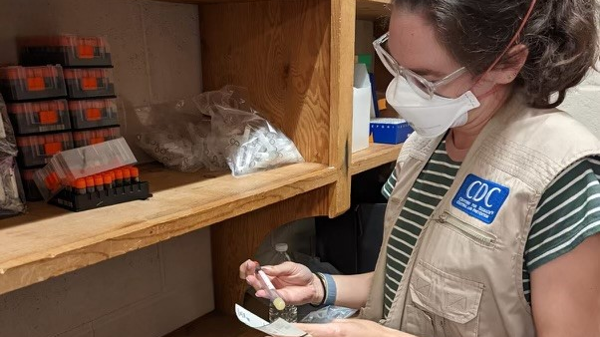
LLS Fellows are
CDC Disease Detectives.
Notes:
LLS fellows are a deployable force and may be called upon to protect the nation’s health.
In 2019, LLS pivoted full to support CDC and the nation’s COVID-19 response.
The first CDC mpox responder in 2022 was an LLS fellow.
Even though LLS fellows don’t spend all of their time on a response or in the field, they remain ready to deploy.
Class of 2022 fellow Perri Callaway prepares specimen for a an mpox vaccine study.

Slide 9
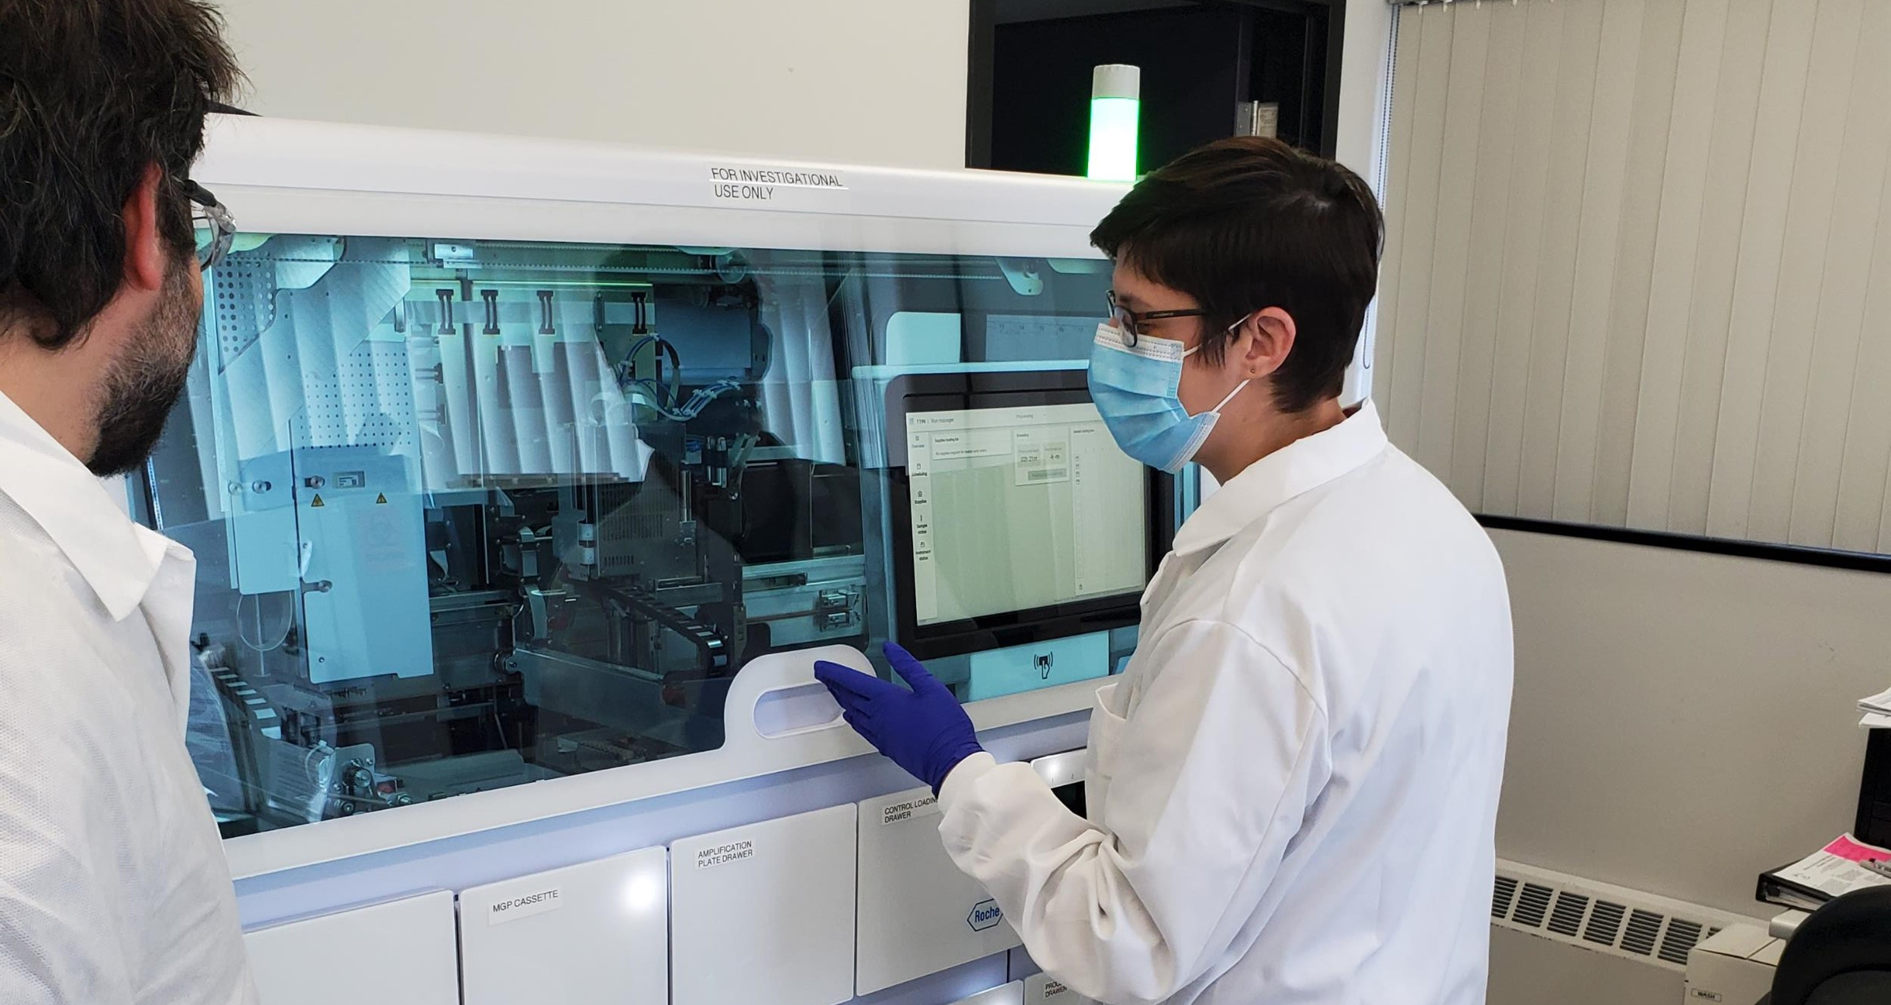
LLS emphasizes laboratory leadership
LLS
emphasizes
laboratory leadership.
Notes:
LLS fellows participate in a variety of non-deployment service-based activities that provide unique leadership training opportunities
LLS fellow service is a part of their daily assignment duties; they are challenged to not just complete an activity but take a leadership role in that activity.
Class of 2022 fellow Katie Margulieux leads a laboratory training at her host site on a new testing process she’d implemented.
Other training opportunities that have provided fellows unique leadership experience include consulting with the WHO on laboratory biosafety and biosecurity, serving as the branch liaison on interagency collaborations with the FDA or leading the design and setup of a new laboratory for rapid STD testing in New York City.

Slide 10
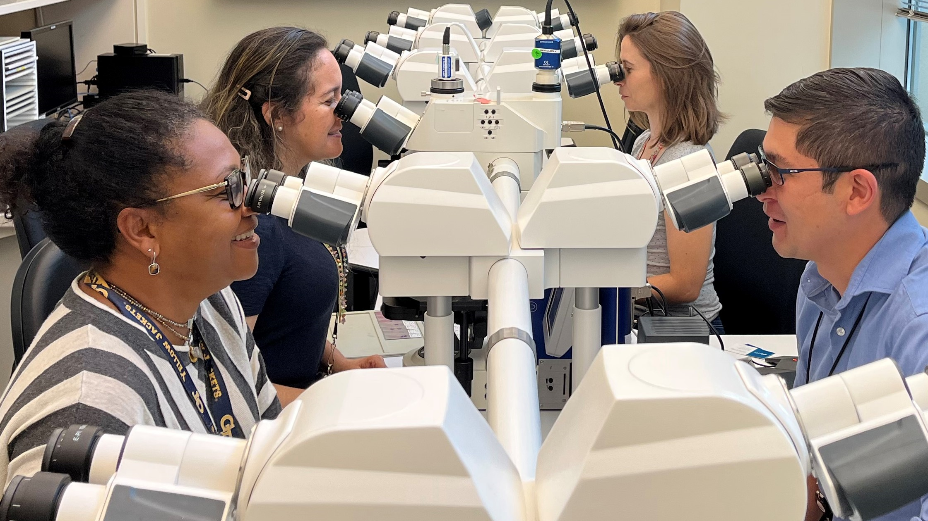
LLS is more than the field
LLS is more than the field.
Notes:
LLS can provide exciting field response and deployment opportunities, but the LLS experience doesn’t just happen in the field
The magic of LLS is in the day-to-day with the high caliber and challenging activities at a fellow’s host site, the ability to engage with public health leadership at all levels across multiple agencies and those partnerships they are building in the process.
LLS is about the mentorship fellows receive from leaders and subject matter experts dedicated to their professional development.
There’s a balance to the LLS experience. The LLS program ensures fellows gain diverse experiences throughout their fellowship.
Members of the Infectious Disease Pathology Branch (shown) at CDC with Class of 2022 fellow Andres Wong-Sam (front right).

Slide 11
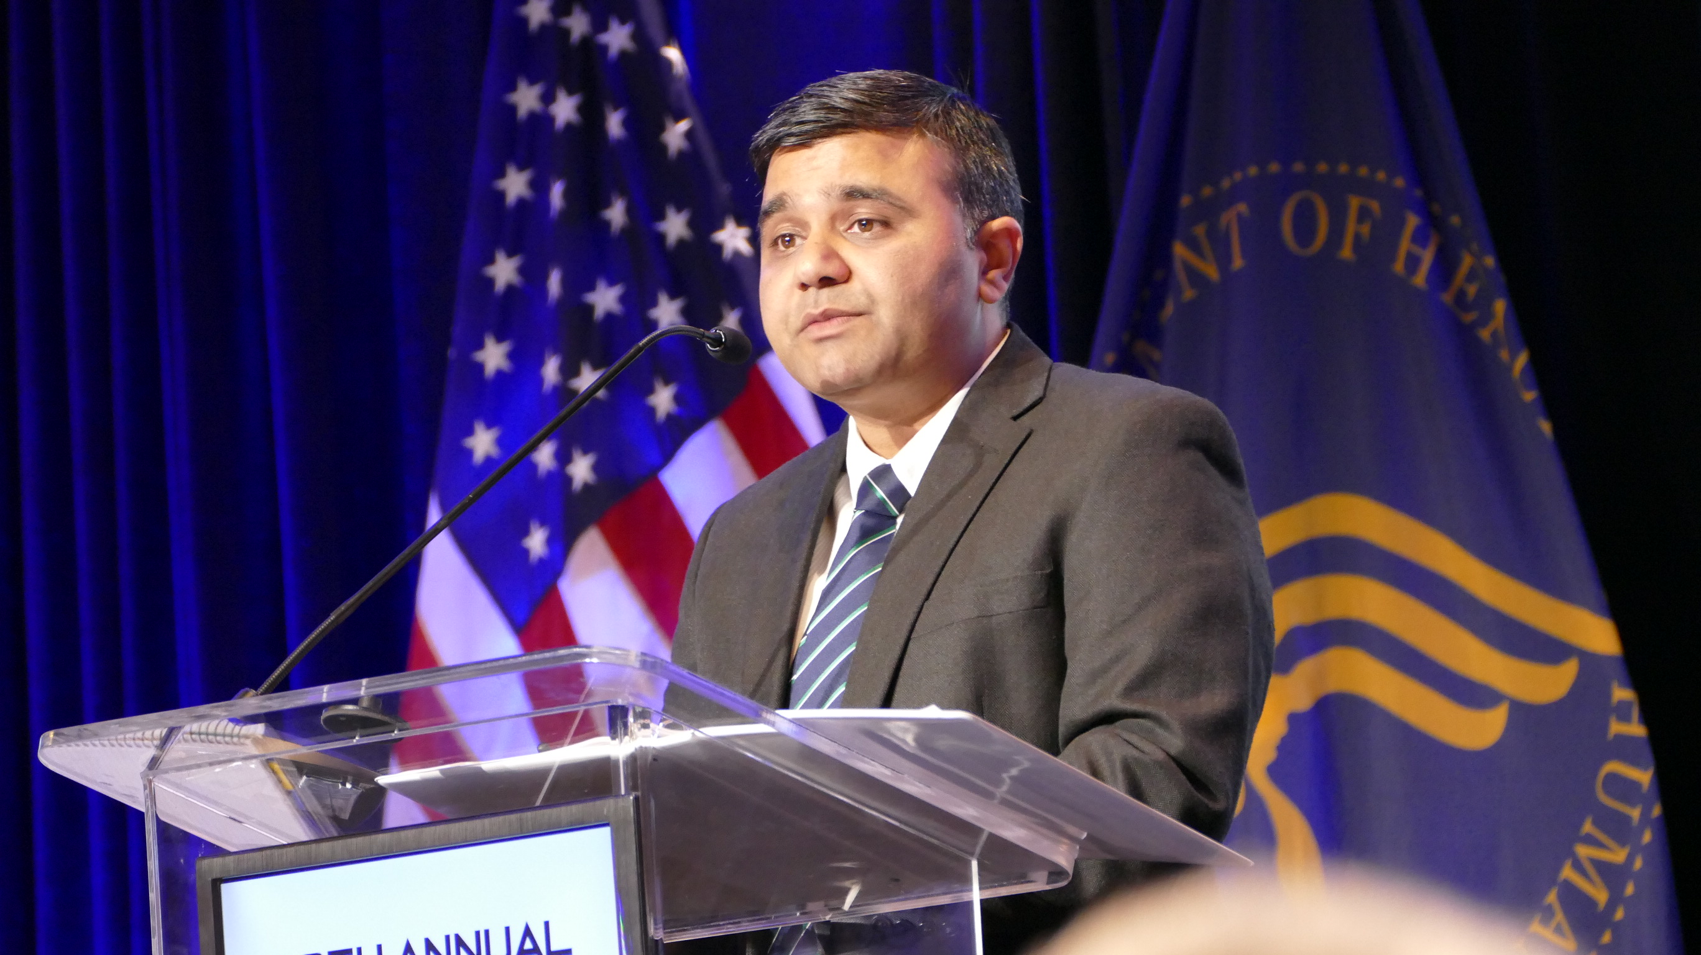
LLS provides an unparalleled training experience.
Notes:
Fellows have unique opportunities to engage with multiple different SMEs by participating in or leading cross-cutting projects in the agency or at a field host site location.
LLS fellows learn from experts, and their projects have a direct, positive impact on operations, scientific quality, or public health at-large.
LLS fellows make a difference in the lab and beyond the bench
Class of 2018 fellow Ash Wadwha presents at the 2019 EIS Conference. Ash is now an Unit Lead with CDC’s Enterics Disease Laboratory Branch.

Slide 12
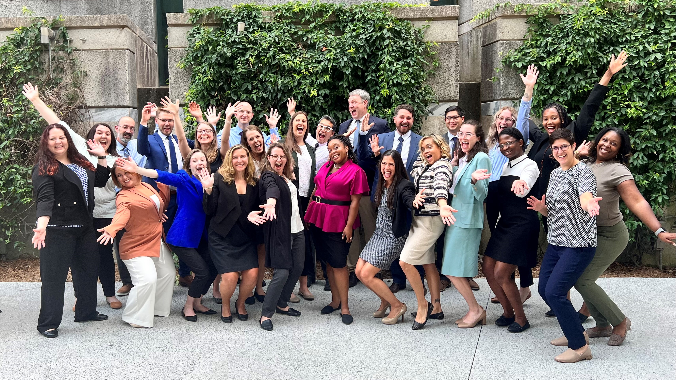
Learn more
Learn more and apply at www.cdc.gov/LLS
Contact the LLS program at lls@cdc.gov
Notes:
Learn more about the LLS program, the application process, and how to connect with current and former fellows at the LLS website (www.cdc.gov/lls)
The LLS program is happy to answer any questions or connect you with LLS questions. Reach out to them by email at lls@cdc.gov. You can get answers to your questions through email, but the program is always happy to virtually meet with candidates.
LLS class of 2022 (shown) together at their orientation and summer course training in Atlanta.

