Slide 1


U.S. Centers for Disease Control and Prevention
Notes:
This slide set presents data on HIV-related mortality through 2023.
These slides were prepared by the Division of HIV Prevention, National Center for HIV, Viral Hepatitis, STD, and TB Prevention (NCHHSTP), Centers for Disease Control and Prevention (CDC). These slides present data on persons with HIV in the United States based on cases of HIV reported to CDC’s National HIV Surveillance System (NHSS) through December 2024.
Note. This slide set is in the public domain. You may reproduce these slides without permission; however, citation as to source is appreciated.
Centers for Disease Control and Prevention. HIV Mortality 2023. Atlanta: U.S. Department of Health and Human Services; 2024.
You are also free to adapt and revise these slides; however, you must remove the CDC name and logo if changes are made.

Slide 2
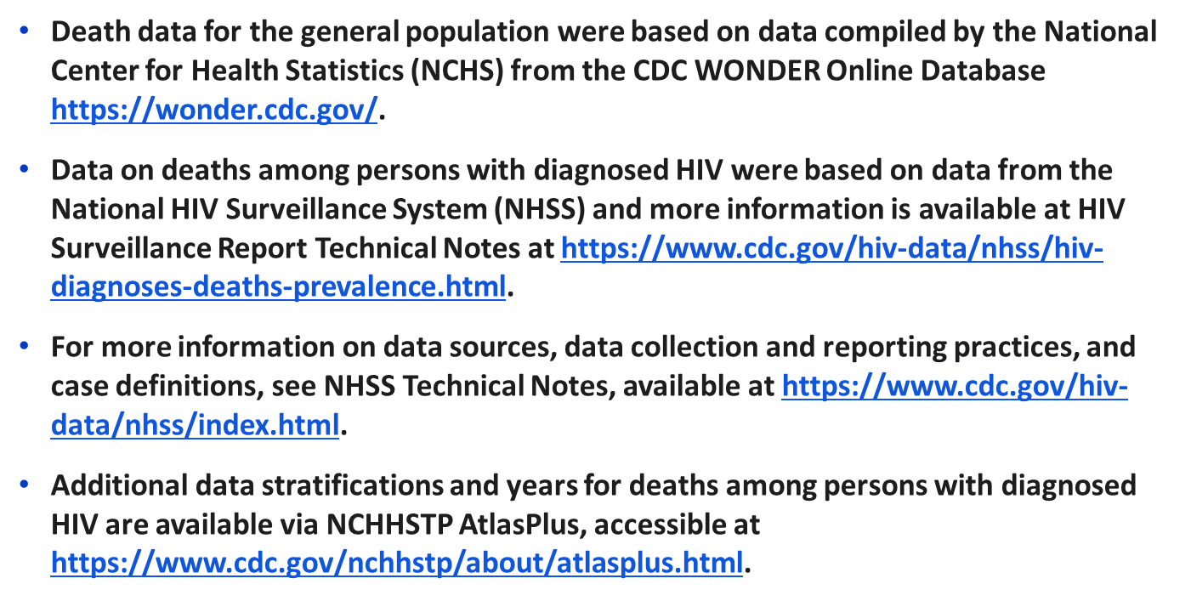

Data Sources and Technical Notes
Notes:
For all slides in this series, the following notes apply:
This slide set presents analyses of trends in rates and distributions of deaths in the United States, focusing on deaths with HIV disease as the underlying cause.
Death data for the general population were based on data compiled by the National Center for Health Statistics (NCHS) from death certificates of US residents in the 50 states and the District of Columbia for the years 1987–2023 and downloaded from the CDC WONDER Online Database https://wonder.cdc.gov/. The underlying cause of each death is selected from the conditions reported by physicians, medical examiners, and coroners in the cause-of-death section of the death certificate. When more than one condition is reported, the underlying cause is determined by using a set of standardized rules promulgated as part of the International Classification of Diseases (ICD). Additional information on the nature and sources of death-certificate data on causes of death may be found at the NCHS website. These data from NCHS are the sole source of information on all causes of death in the national population, allowing comparison of deaths due to HIV disease and deaths due to other causes. For more information, see the NCHS Web site: http://www.cdc.gov/nchs/deaths.htm.
Data on deaths among persons with diagnosed HIV (including persons with HIV ever classified as stage 3 [AIDS]) in the 50 states and the District of Columbia are from the National HIV Surveillance System (NHSS).
For more information on data sources, data collection and reporting practices, and case definitions, see the National HIV Surveillance System (NHSS) Technical Notes, available at https://www.cdc.gov/hiv-data/nhss/index.html.
For more information on deaths, see HIV Surveillance Report Technical Notes at https://www.cdc.gov/hiv-data/nhss/hiv-diagnoses-deaths-prevalence.html.
Additional data stratifications and years for deaths among persons with diagnosed HIV are available via NCHHSTP AtlasPlus, accessible at https://www.cdc.gov/nchhstp/about/atlasplus.html.

Slide 3
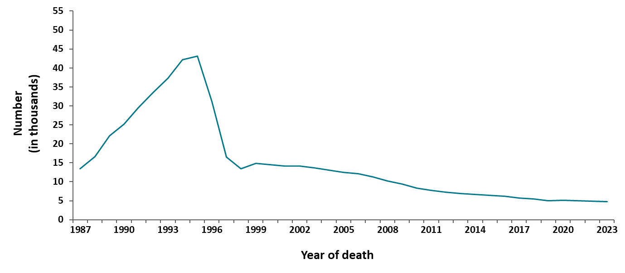
Deaths in the general population with HIV disease as the underlying cause of death, 1987−2023—United States
Note. Data from CDC WONDER Online Database based on death certificate data compiled by the National Center for Health Statistics.
Notes:
In 2023, there were 13,981 deaths (all causes) among persons with HIV ever classified as stage 3 (AIDS). The cumulative number (1987‒2023) of deaths (all causes) among persons with HIV ever classified as stage 3 (AIDS) was 771,864. In 2023, there were 4,748 deaths in the general population that were attributed to HIV. The cumulative number (1987‒2023) of deaths attributable to HIV in the United States was 549,459.
Note.
The data for this slide come from death certificate data compiled by the National Center for Health Statistics (NCHS) and downloaded from the CDC WONDER Online Database https://wonder.cdc.gov/.
For details on reporting of sex, age, and race/ethnicity, please see NCHS’s Funeral Director’s Handbook on Death Registration and Fetal Death Reporting (https://www.cdc.gov/nchs/data/nvss/handbook/2019-Funeral-Directors-Handbook-508.pdf).

Slide 4
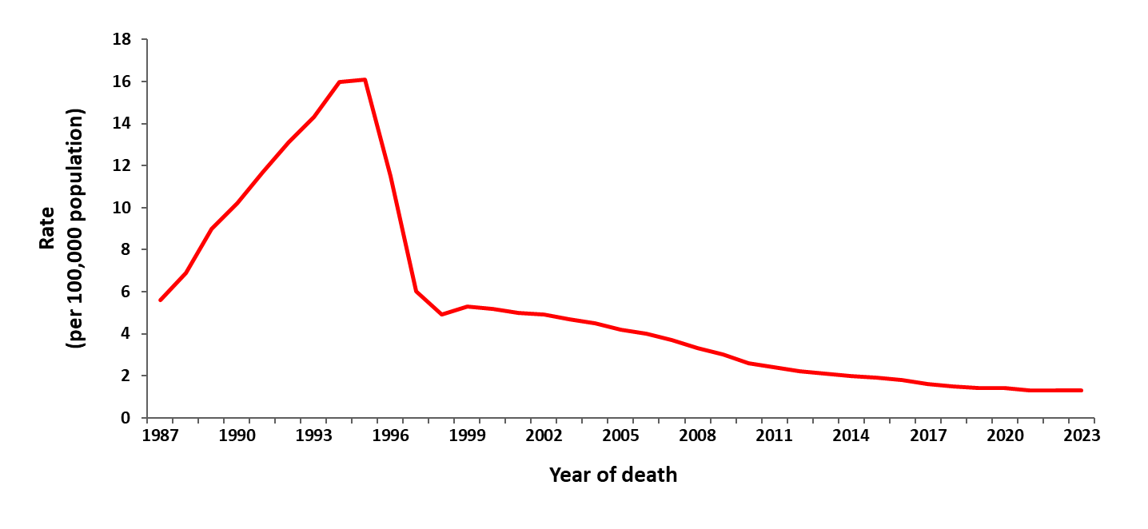
Age-adjusted rates of death in the general population with HIV disease as the underlying cause, 1987−2023—United States
Note. Data from CDC WONDER Online Database based on death certificate data compiled by the National Center for Health Statistics.
Notes:
In the United States, the age-adjusted rate of death with HIV disease as the underlying cause increased almost linearly from 6 deaths per 100,000 population in 1987 to 16 deaths per 100,000 population in 1994 and 1995, then decreased to 6 deaths per 100,000 population in 1997. Thereafter, the rate almost leveled off at about 5 deaths per 100,000 population up to 2003, after which it decreased slowly through 2023. The age-adjusted HIV death rate decreased 29% from 1995−1996, 48% from 1996−1997, and 18% from 1997−1998. After 1998, the annual percentage decrease ranged from 0%−13%.
The decrease in the rate in 1996 and 1997 was largely due to improvements in antiretroviral therapy. Prophylactic medications for opportunistic infections and the prevention of HIV may also have contributed to this decrease. The slowing of the rate of decrease after 1998 may reflect a lack of access to or effectiveness of therapy among some persons. Possible reasons for this include delay in diagnosis of HIV until symptoms have occurred, inadequate treatment after diagnosis, difficulty in adherence to medication regimens, and development of viral resistance to therapy. Other barriers to effective therapy include failure to be linked to care or continuously engaged in care after diagnosis.
Note.
The data for this slide come from death certificate data compiled by the National Center for Health Statistics (NCHS) and downloaded from the CDC WONDER Online Database https://wonder.cdc.gov/.
For details on reporting of sex, age, and race/ethnicity, please see NCHS’s Funeral Director’s Handbook on Death Registration and Fetal Death Reporting (https://www.cdc.gov/nchs/data/nvss/handbook/2019-Funeral-Directors-Handbook-508.pdf).

Slide 5
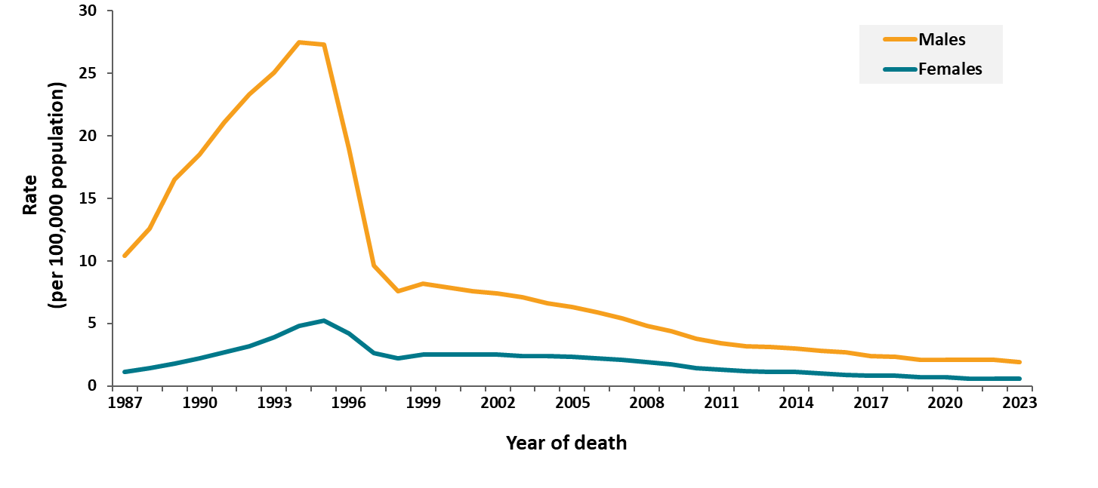
Age-adjusted rates of death in the general population with HIV disease as the underlying cause, by sex, 1987−2023—United States
Note. Data from CDC WONDER Online Database based on death certificate data compiled by the National Center for Health Statistics.
Notes:
In the United States, the rate of death with HIV disease as the underlying cause among males has always been several times the rate among females, but the ratio of these rates has decreased from approximately 10-to-1 in 1987 to 3-to-1 in 1998 and later years. For both sexes, the rates of death with HIV disease as the underlying cause were highest in 1994 and 1995. After 1997, the average death rate among females has been 1.5 deaths per 100,000 population. The rate among males continued to decrease slowly every year: from 1998−2023, the average annual percentage decrease was about 6%.
Note.
The data for this slide come from death certificate data compiled by the National Center for Health Statistics (NCHS) and downloaded from the CDC WONDER Online Database https://wonder.cdc.gov/.
For details on reporting of sex, age, and race/ethnicity, please see NCHS’s Funeral Director’s Handbook on Death Registration and Fetal Death Reporting (https://www.cdc.gov/nchs/data/nvss/handbook/2019-Funeral-Directors-Handbook-508.pdf).

Slide 6
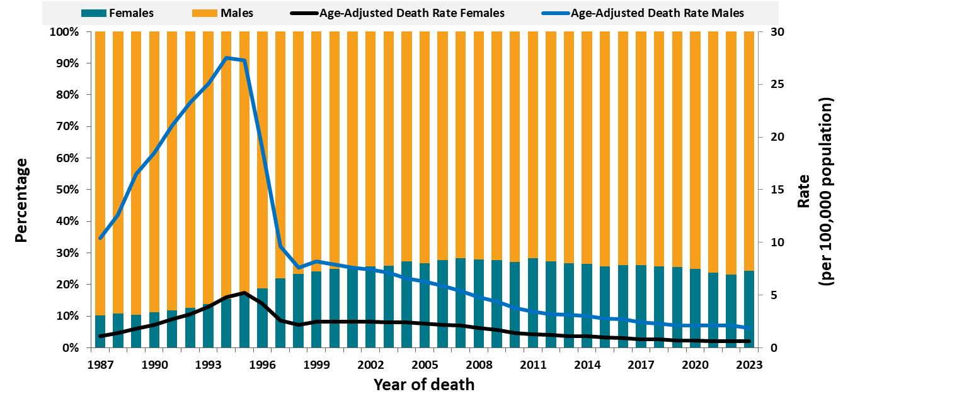
Age-adjusted rates and percentage distribution of deaths in the general population with HIV disease as the underlying cause by sex, 1987–2023—United States
Note. Data from CDC WONDER Online Database based on death certificate data compiled by the National Center for Health Statistics.
Notes:
From 1987−2023 in the United States, the percentage of females among persons who died of HIV disease increased from 10%−24%, while the percentage of males decreased from 90% to 76%.
Note.
The data for this slide comes from death certificate data compiled by the National Center for Health Statistics (NCHS) and downloaded from the CDC WONDER Online Database https://wonder.cdc.gov/.
For details on reporting of sex, age, and race/ethnicity, please see NCHS’s Funeral Director’s Handbook on Death Registration and Fetal Death Reporting (https://www.cdc.gov/nchs/data/nvss/handbook/2019-Funeral-Directors-Handbook-508.pdf).

Slide 7
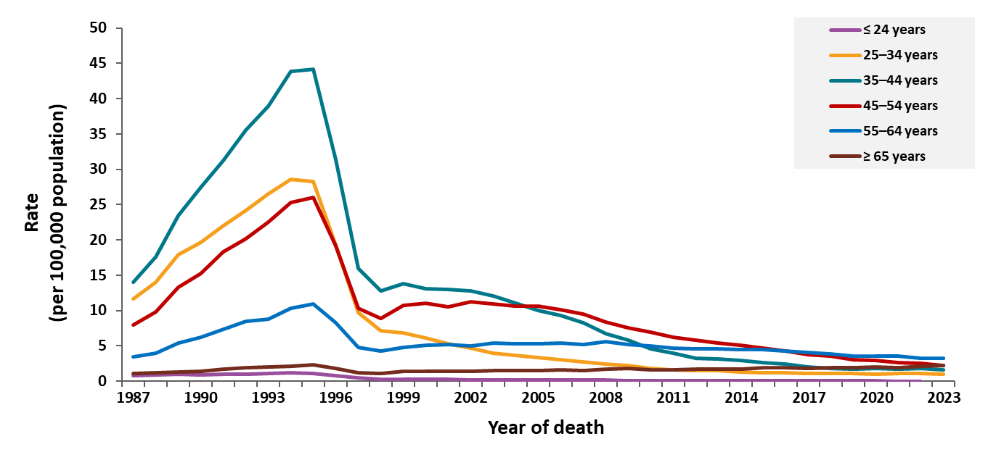
Deaths in the general population with HIV disease as the underlying cause, by age group, 1987–2023—United States
Note. Data from CDC WONDER Online Database based on death certificate data compiled by the National Center for Health Statistics.
Notes:
Trends in the rate of death with HIV disease in the United States as the underlying cause have varied by age group. From 1995−1997, the rate of death dropped most rapidly among persons aged 35–44 years. After 1997, the rate of death continued to decline in this age groups and among persons aged 25–34 and 45–54 years but was stable in other age groups.
Note.
The data for this slide come from death certificate data compiled by the National Center for Health Statistics (NCHS) and downloaded from the CDC WONDER Online Database https://wonder.cdc.gov/.
For details on reporting of sex, age, and race/ethnicity, please see NCHS’s Funeral Director’s Handbook on Death Registration and Fetal Death Reporting (https://www.cdc.gov/nchs/data/nvss/handbook/2019-Funeral-Directors-Handbook-508.pdf).

Slide 8
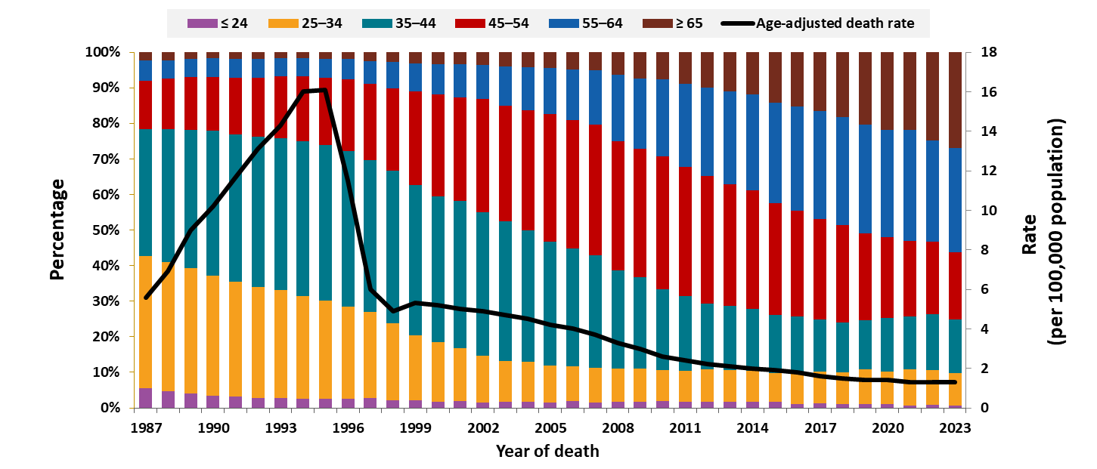
Age-adjusted rates and percentage distribution of deaths in the general population with HIV disease as the underlying cause by age group, 1987−2023—United States
Note. Data from CDC WONDER Online Database based on death certificate data compiled by the National Center for Health Statistics.
Notes:
From 1987−2023 in the United States, the percentage of deaths with HIV disease as the underlying cause among persons younger than 35 years of age (represented by the bottom two components of the bars in the graph) decreased from 44% to 10%, while the percentage of deaths among older persons, particularly persons aged 45 years or older (represented by the top three components of the bars), increased from 22% to 75%.
From 1987−1993, 73%−74% of deaths with HIV disease as the underlying cause were among persons aged 25−44 years of age (represented by the orange and teal components of the bars). After 1993, the percentage of deaths among persons aged 25−44 years began to decrease, reaching 24% by 2023. In 2023, more than 50% of the deaths attributed to HIV disease were among persons aged 55 years and older. Specifically, 29% of deaths were among persons aged 55–64 years and 27% of deaths were among persons aged 65 years and older.
Note.
The data for this slide come from death certificate data compiled by the National Center for Health Statistics (NCHS) and downloaded from the CDC WONDER Online Database https://wonder.cdc.gov/.
For details on reporting of sex, age, and race/ethnicity, please see NCHS’s Funeral Director’s Handbook on Death Registration and Fetal Death Reporting (https://www.cdc.gov/nchs/data/nvss/handbook/2019-Funeral-Directors-Handbook-508.pdf).

Slide 9
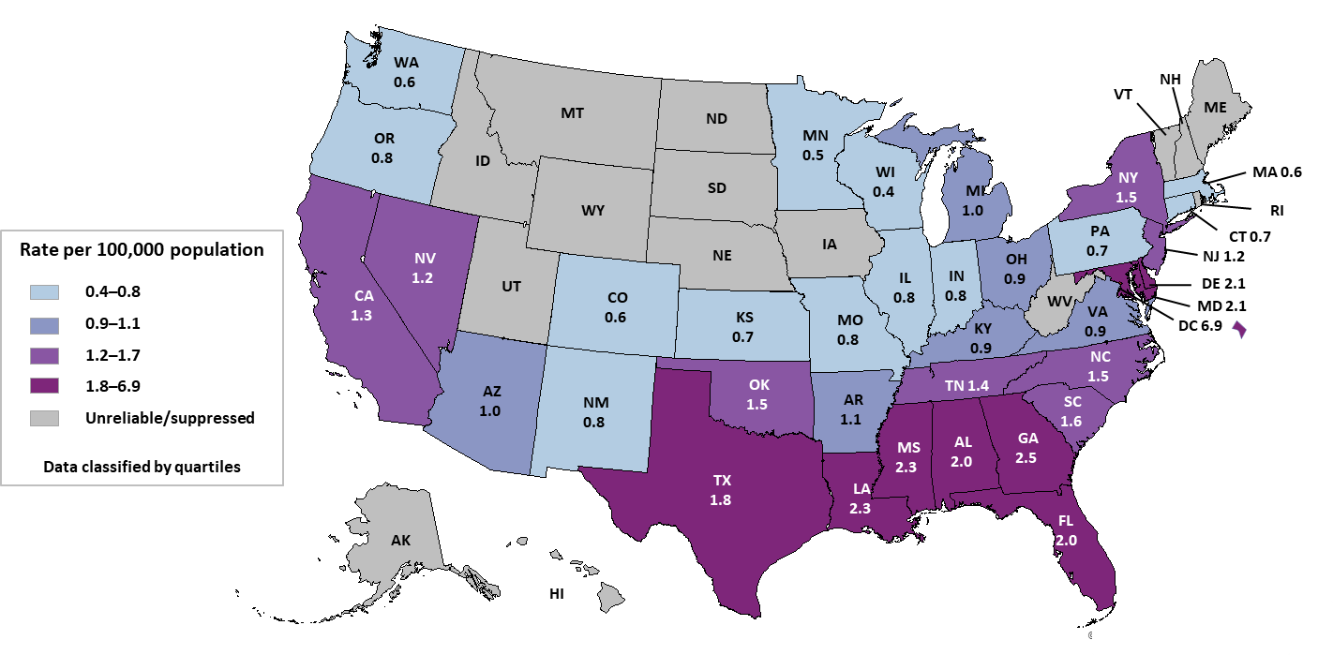
Age-adjusted rates of death in the general population with HIV disease as the underlying cause, by state, 2023—United States
Note. Data are from CDC WONDER Online Database and are based on death certificate data compiled by the National Center for Health Statistics.
Death rates are not shown when unreliable (rate is calculated with a numerator of 20 or less) or suppressed (the data meet the criteria for confidentiality constraints).
Notes:
In the United States in 2023, rates of deaths with HIV disease as the underlying cause were highest in Alabama, Delaware, the District of Columbia, Florida, Georgia, Louisiana, Maryland, Mississippi, and Texas.
Note.
Data are suppressed when the data meet the criteria for confidentiality constraints. Death rates are considered unreliable when the rate is calculated with a numerator of 20 or less.
Death data are based on residence at death. The data for this slide come from death certificate data compiled by the National Center for Health Statistics (NCHS) and downloaded from the CDC WONDER Online Database https://wonder.cdc.gov/.
For details on reporting of sex, age, and race/ethnicity, please see NCHS’s Funeral Director’s Handbook on Death Registration and Fetal Death Reporting (https://www.cdc.gov/nchs/data/nvss/handbook/2019-Funeral-Directors-Handbook-508.pdf).

Slide 10
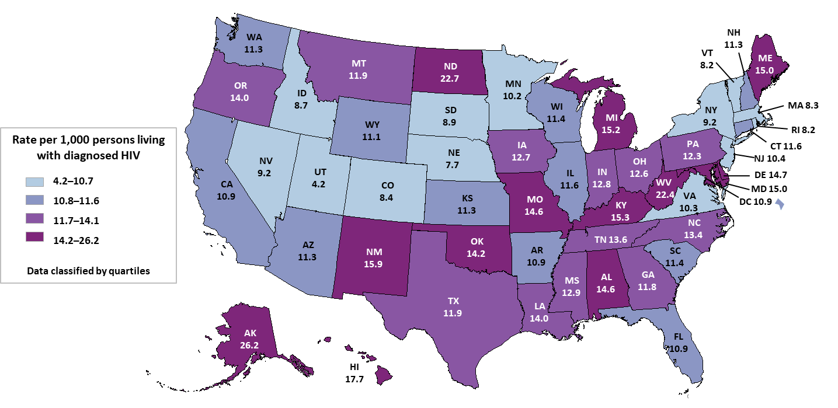
Age-adjusted* rates† of death (any cause) among persons with diagnosed HIV
by state, 2023—United States
Note. Data from the National HIV Surveillance System. *Standard: age distribution of 2000 US population. †Per 1,000 persons living with diagnosed HIV.
Notes:
This slide uses data reported to the National HIV Surveillance System through December 31, 2024, in the United States, and represents the deaths of persons with diagnosed HIV due to any underlying cause. To control for geographic differences in the prevalence of HIV, the death rates were based on denominators consisting of numbers of persons with an HIV diagnosis, rather than the general populations of the states. The rates were highest in Alabama, Alaska, Delaware, Hawaii, Kentucky, Maine, Maryland, Michigan, Missouri, New Mexico, North Dakota, Oklahoma, and West Virginia.
Note.
Death and prevalence data for Mississippi and Utah should be interpreted with caution due to incomplete reporting of deaths to CDC for the year 2023.
Death data are based on residence at death. The data for this slide comes from the National HIV Surveillance System.
For more information on data sources, data collection and reporting practices, and case definitions, see the National HIV Surveillance System (NHSS) Technical Notes, available at https://www.cdc.gov/hiv-data/nhss/index.html.
For more information on deaths and prevalence, see HIV Surveillance Report Technical Notes at https://www.cdc.gov/hiv-data/nhss/hiv-diagnoses-deaths-prevalence.html.

Slide 11
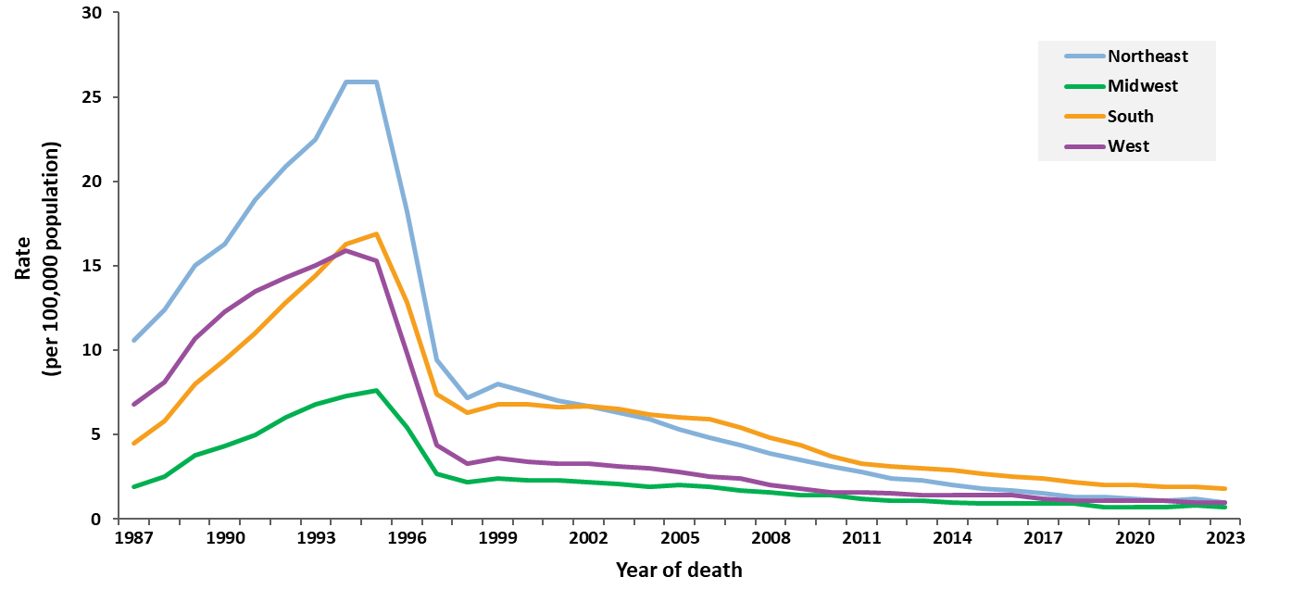
Age-adjusted rates of death in the general population with HIV disease as the underlying cause, by region, 1987–2023—United States
Note. Data from CDC WONDER Online Database based on death certificate data compiled by the National Center for Health Statistics.
Notes:
In all four U.S. Census regions of the United States, the age-adjusted rate of death due to HIV disease increased until 1994 and 1995, and then rapidly decreased in 1996 and 1997, coinciding with the increase in the use of highly active antiretroviral therapy (HAART).
Note.
Death data are based on residence at death. The data for this slide come from death certificate data compiled by the National Center for Health Statistics (NCHS) and downloaded from the CDC WONDER Online Database https://wonder.cdc.gov/.
For details on reporting of sex, age, and race/ethnicity, please see NCHS’s Funeral Director’s Handbook on Death Registration and Fetal Death Reporting (https://www.cdc.gov/nchs/data/nvss/handbook/2019-Funeral-Directors-Handbook-508.pdf).
For more information on regions, see the National HIV Surveillance System (NHSS) Technical Notes, available at https://www.cdc.gov/hiv-data/nhss/index.html.

Slide 12
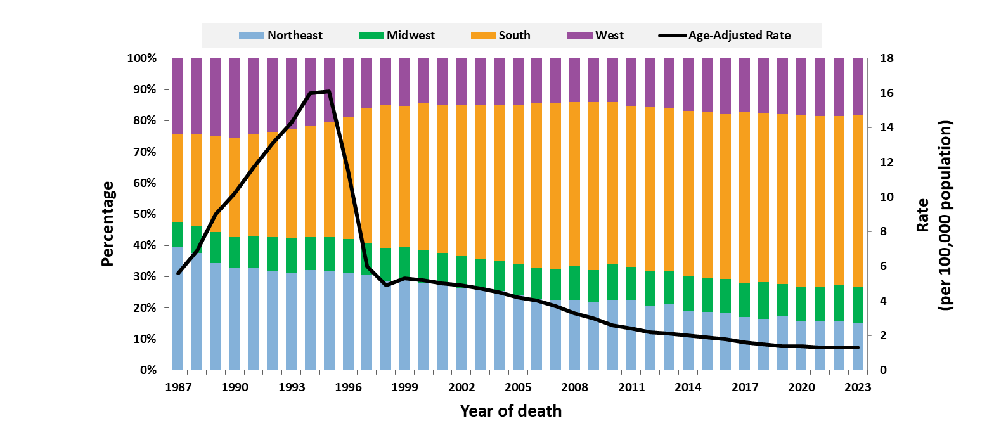
Age-adjusted rates and percentage distribution of deaths in the general population with HIV disease as the underlying cause by region, 1987−2023—United States
Note. Data from CDC WONDER Online Database based on death certificate data compiled by the National Center for Health Statistics.
Notes:
In the United States, of persons who died of HIV disease from 1987 to 2023, the percentage who resided in the South increased from 28% to 55%, while the percentage in the Northeast decreased from 39% to 15%, and the percentage in the West decreased from 24% to 18%. The percentage in the Midwest has been relatively stable, ranging from 8%−12%, and at 12% in 2023.
Note.
The data for this slide comes from death certificate data compiled by the National Center for Health Statistics (NCHS) and downloaded from the CDC WONDER Online Database https://wonder.cdc.gov/. Death data are based on residence at death.
For details on reporting of sex, age, and race/ethnicity, please see NCHS’s Funeral Director’s Handbook on Death Registration and Fetal Death Reporting (https://www.cdc.gov/nchs/data/nvss/handbook/2019-Funeral-Directors-Handbook-508.pdf).
For more information on region, see the National HIV Surveillance System (NHSS) Technical Notes, available at https://www.cdc.gov/hiv-data/nhss/index.html.

Slide 13
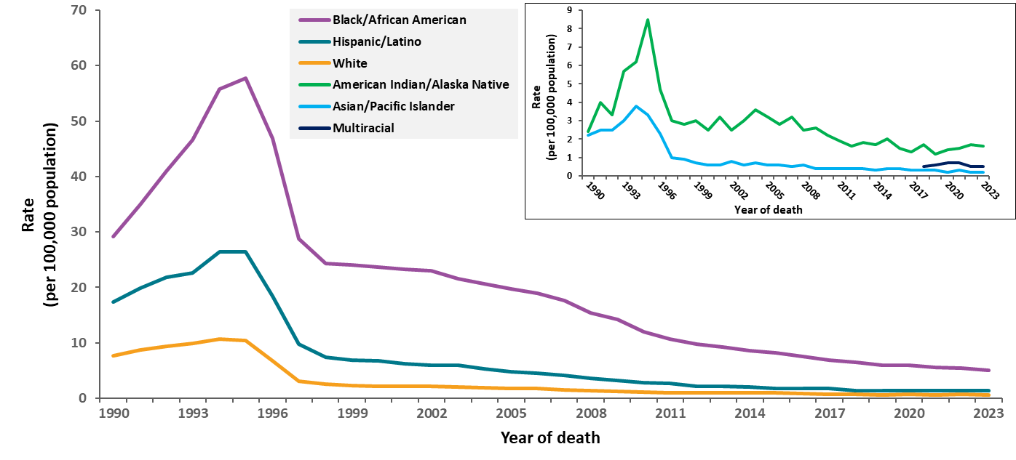
Age-adjusted rates of death in the general population with HIV disease as the underlying cause, by race/ethnicity, 1990–2023—United States
Note. Data are from CDC WONDER Online Database and are based on death certificate data compiled by the National Center for Health Statistics. Hispanic/Latino persons can be of any race.
Notes:
In the United States, the age-adjusted rate of death with HIV disease as the underlying cause has been highest among Black/African American persons and second highest among Hispanic/Latino persons. In every racial/ethnic group, the rate decreased greatly from 1995−1998.
Note.
The data for this slide come from death certificate data compiled by the National Center for Health Statistics (NCHS). Data for years 1990–1998 were requested from NCHS and analyzed by CDC’s HIV Surveillance Branch. Data for years 1999–2023 were published and downloaded from the CDC WONDER Online Database https://wonder.cdc.gov/. For the calculation of national death rates by race and ethnicity, data for a few states were excluded for the years when death certificates for those states did not collect information on Hispanic/Latino ethnicity. The states for which data were omitted were: Connecticut and Louisiana in 1990, New Hampshire through 1992, and Oklahoma through 1996. Deaths for multiracial persons were available starting in 2018.
For details on reporting of sex, age, and race/ethnicity, please see NCHS’s Funeral Director’s Handbook on Death Registration and Fetal Death Reporting (https://www.cdc.gov/nchs/data/nvss/handbook/2019-Funeral-Directors-Handbook-508.pdf).

Slide 14
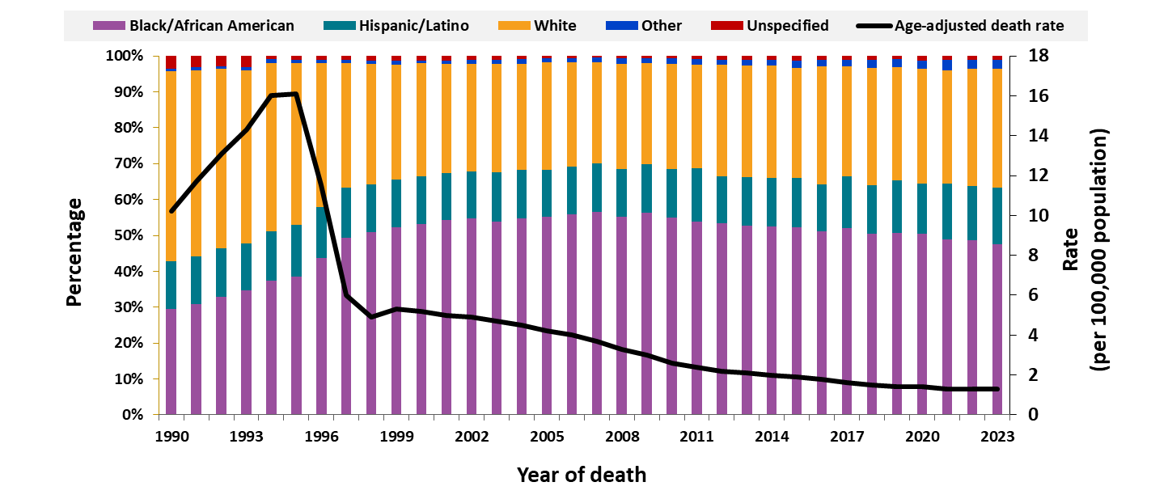
Age-adjusted rates and percentage distribution of deaths in the general population with HIV disease as the underlying cause by race/ethnicity, 1990−2023—United States
Note. Data are from CDC WONDER Online Database and are based on death certificate data compiled by the National Center for Health Statistics. Hispanic/Latino persons can be of any race.
Notes:
In the United States, from 1990 to 2023, the percentage of Black/African American persons among those who died of HIV disease as the underlying cause increased from 29% to 48%, while the percentage of White persons decreased from 53% to 33%. This shift in the racial/ethnic distribution of deaths accelerated from 1996−1998, coincident with the increasing use of highly active antiretroviral therapy. For all years, the percentage of Hispanic/Latino persons was stable, ranging from approximately 13%−16%, and the percentage of persons in other racial/ethnic groups (including Asian/Pacific Islander persons and American Indian/Alaska Native persons) was stable, ranging from 1%−3%. In addition, the percentage of persons of unspecified race/ethnicity decreased from 4% in 1990 to around 1% in 2023.
Note.
The data for this slide come from death certificate data compiled by the National Center for Health Statistics (NCHS) and downloaded from the CDC WONDER Online Database https://wonder.cdc.gov/. For the calculation of the national percentage of deaths by race and ethnicity, data for a few states were excluded for the years when death certificates for those states did not collect information on Hispanic/Latino ethnicity. The states for which data were omitted are Connecticut and Louisiana in 1990, New Hampshire through 1992, and Oklahoma through 1996.
Other race/ethnicity includes American Indian/Alaska Native, Asian, Native Hawaiian or other Pacific Islander, and multiracial persons. Unspecified race/ethnicity includes persons with an unknown race/ethnicity.
For details on reporting of sex, age, and race/ethnicity, please see NCHS’s Funeral Director’s Handbook on Death Registration and Fetal Death Reporting (https://www.cdc.gov/nchs/data/nvss/handbook/2019-Funeral-Directors-Handbook-508.pdf).

Slide 15
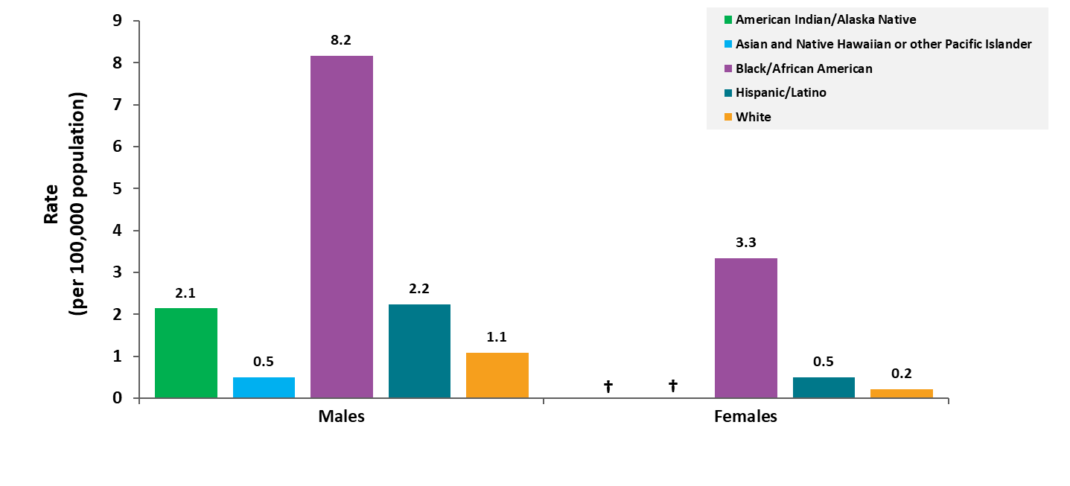
Average annual age-adjusted rates of death in the general population with HIV disease as the underlying cause, by sex and race/ethnicity, 2019−2023—United States
Note. Data are from CDC WONDER Online Database and are based on death certificate data compiled by the National Center for Health Statistics. Hispanic/Latino persons can be of any race.† Unreliable rate due to a numerator of less than 20 deaths.
Notes:
In the United States, for both males and females, in the most recent 5 years for which data were available, the average rates of death with HIV disease as the underlying cause among Black/African American persons were higher than the rates among Hispanic/Latino persons, which were higher than the rates among the remaining racial/ethnic groups. Among males, the rate among Asian/Pacific Islander persons was lower than the rates in each of the four other groups, including White persons, and the rate among American Indian/Alaska Native males was higher than the rate among White males. The rate among Black/African American females was higher than the rate among males in every racial/ethnic group, except Black/African American males.
Note.
The data for this slide comes from death certificate data compiled by the National Center for Health Statistics (NCHS) and downloaded from the CDC WONDER Online Database https://wonder.cdc.gov/. Death rates are considered unreliable when the rate is calculated with a numerator of 20 or less.
Due to unreliable annual age-adjusted rates, data are excluded for American Indian/Alaska Native, Asian, and Native Hawaiian or other Pacific Islander females and multiracial males and females.
For details on reporting of sex, age, and race/ethnicity, please see NCHS’s Funeral Director’s Handbook on Death Registration and Fetal Death Reporting (https://www.cdc.gov/nchs/data/nvss/handbook/2019-Funeral-Directors-Handbook-508.pdf).

Slide 16
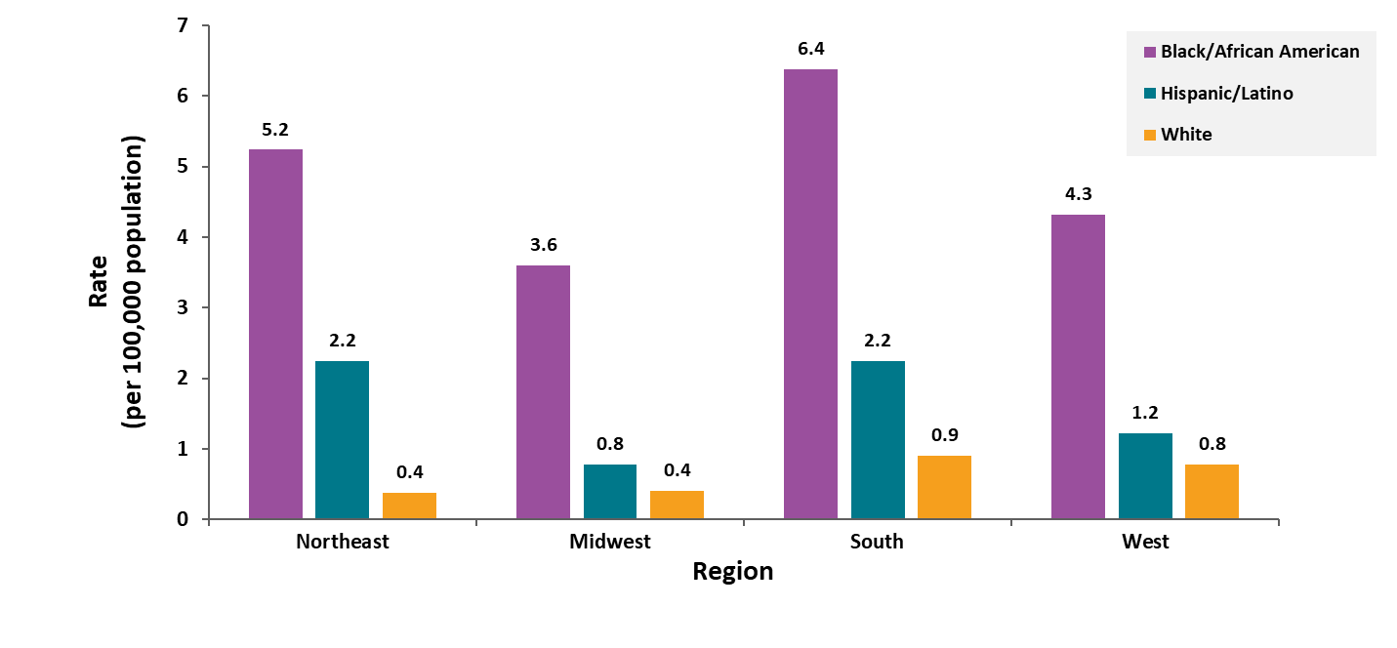
Average annual age-adjusted rates of death among Black/African American, Hispanic/Latino, and White persons in the general population with HIV disease as the underlying cause by region, 2019−2023—United States
Note. Data are from CDC WONDER Online Database and are based on death certificate data compiled by the National Center for Health Statistics. Hispanic/Latino persons can be of any race.
Notes:
In the United States, in the most recent 5 years for which data were available, Black/African American persons had the highest rate in each of the four regions. The rates among Black/African American persons were higher in the Northeast and South than in the other two regions (Northeast: 5.2 per 100,000; South: 6.4 per 100,000). The rates among Hispanic/Latino persons varied by region, with the highest rate in the Northeast and South (2.2 deaths per 100,000 population). The rates among White persons varied slightly by region, with the highest average rate of death in the South at 0.9 deaths per 100,000.
Across all regions, average rates of death among Black/African American persons were several times higher than rates among Hispanic/Latino and White persons. In the Northeast, the death rate among Black/African American persons was 13.8 times the rate of death among White persons. In the Midwest, South, and West ,the rate of deaths due to HIV disease was 9.0, 7.1, and 5.5 times higher, respectively, among Black/African American persons compared to White persons. In all regions, the rate among Hispanic/Latino persons was higher than the rate among White persons. In the Northeast, the death rate among Hispanic/Latino persons was 5.9 times the rate of death among White persons. In the Midwest, South, and West, the rate of deaths due to HIV disease was 2.0, 2.5, and 1.6 times higher, respectively, among Hispanic/Latino persons compared to White persons.
Note.
Data for American Indian/Alaska Native, Asian/Pacific Islander, and multiracial persons were either unreliable or suppressed for years 2019−2023. Data are suppressed when the data meet the criteria for confidentiality constraints.
The data for this slide comes from death certificate data compiled by the National Center for Health Statistics (NCHS) and downloaded from the CDC WONDER Online Database https://wonder.cdc.gov/.
For details on reporting of sex, age, and race/ethnicity, please see NCHS’s Funeral Director’s Handbook on Death Registration and Fetal Death Reporting (https://www.cdc.gov/nchs/data/nvss/handbook/2019-Funeral-Directors-Handbook-508.pdf).
For more information on region, see the National HIV Surveillance System (NHSS) Technical Notes, available at https://www.cdc.gov/hiv-data/nhss/index.html.

Slide 17
Trends in annual rates of death among persons aged 25–44 years

Slide 18
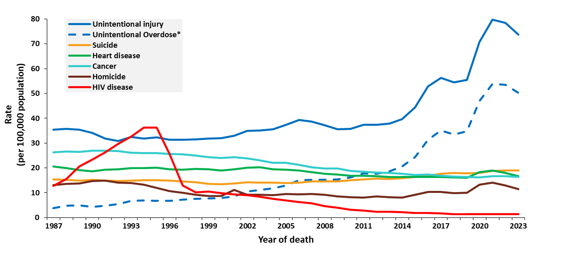
Deaths in the general population with HIV disease as the underlying cause versus the leading causes among persons aged 25–44 years, 1987–2023—United States
Note. Data are from CDC WONDER Online Database and are based on death certificate data compiled by the National Center for Health Statistics. *Deaths with an underlying cause of unintentional overdose are a subset of deaths with an underlying cause of unintentional injury.
Notes:
In the United States, HIV disease was the leading cause of death among persons 25−44 years old in 1994 and 1995. In 1995, HIV disease caused about 30,500 deaths, or 19% of all deaths in this age group. The rank of HIV disease fell to 3rd place in 1997−1998, to 5th place in 1999−2000, to 6th place in 2001, eventually falling to 12th place in 2023 causing about 1,146 deaths, or less than 1% of all deaths in this age group.
Note.
The data for this slide come from death certificate data compiled by the National Center for Health Statistics (NCHS) and downloaded from the CDC WONDER Online Database https://wonder.cdc.gov/.
For details on reporting of sex, age, and race/ethnicity, please see NCHS’s Funeral Director’s Handbook on Death Registration and Fetal Death Reporting (https://www.cdc.gov/nchs/data/nvss/handbook/2019-Funeral-Directors-Handbook-508.pdf).

Slide 19
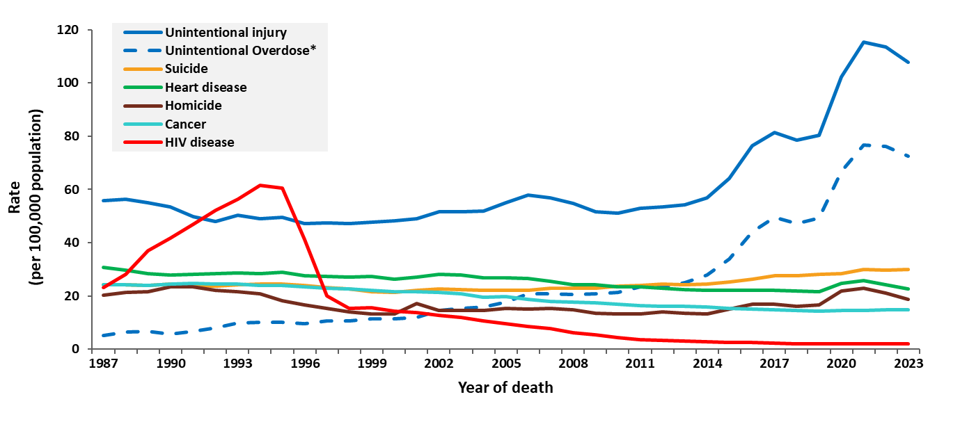
Deaths in the general population with HIV disease as the underlying cause versus the leading causes among males aged 25–44 years, 1987–2023—United States
Note. Data are from CDC WONDER Online Database and are based on death certificate data compiled by the National Center for Health Statistics. *Deaths with an underlying cause of unintentional overdose are a subset of deaths with an underlying cause of unintentional injury.
Notes:
In the United States, among males aged 25–44 years HIV disease was the leading cause of death from 1992–1996. The rank of death due to HIV disease fell to 3rd place from 1997–1998, to 5th place in 1999, then fell to 9th place in 2023 causing 878 deaths, or less than 1% of all deaths in this age group.
Note.
The data for this slide come from death certificate data compiled by the National Center for Health Statistics (NCHS) and downloaded from the CDC WONDER Online Database https://wonder.cdc.gov/.
For details on reporting of sex, age, and race/ethnicity, please see NCHS’s Funeral Director’s Handbook on Death Registration and Fetal Death Reporting (https://www.cdc.gov/nchs/data/nvss/handbook/2019-Funeral-Directors-Handbook-508.pdf).

Slide 20
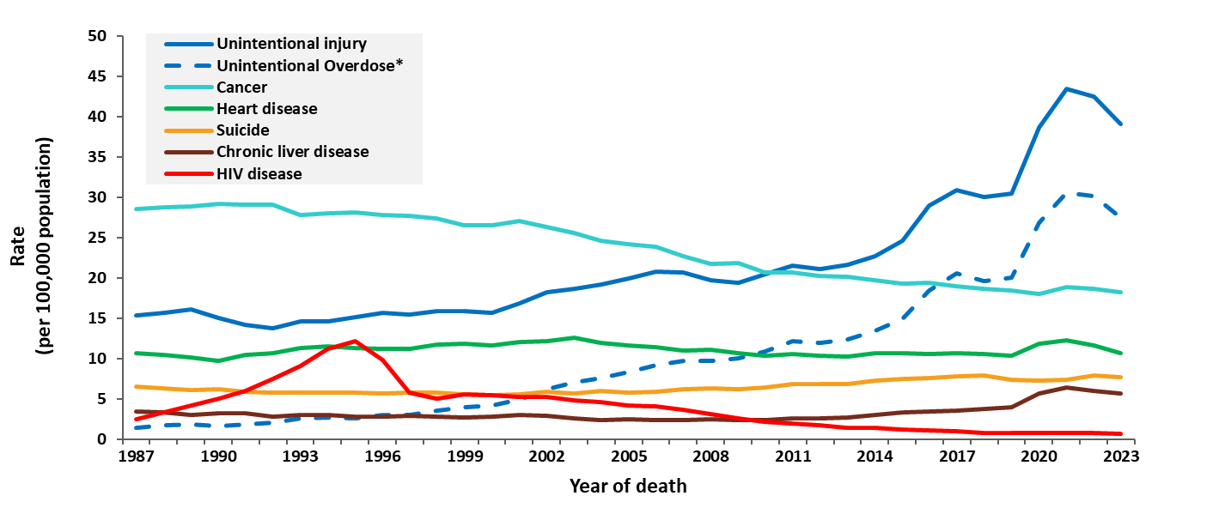
Deaths in the general population with HIV disease as the underlying cause versus the leading causes among females aged 25–44 years, 1987–2023—United States
Note. Data are from CDC WONDER Online Database and are based on death certificate data compiled by the National Center for Health Statistics. *Deaths with an underlying cause of unintentional overdose are a subset of deaths with an underlying cause of unintentional injury.
Notes:
In the United States, among females aged 25–44 years HIV disease was the leading cause of death in 1995, when HIV disease caused more than 5,000 deaths, or 11% of all deaths in this group. Thereafter, the rate of death due to HIV disease dropped to about the same as the rate due to suicide in the late 1990’s and early 2000’s and is currently lower than both the rate of suicide and chronic liver disease.
Note.
The data for this slide come from death certificate data compiled by the National Center for Health Statistics (NCHS) and downloaded from the CDC WONDER Online Database https://wonder.cdc.gov/.
For details on reporting of sex, age, and race/ethnicity, please see NCHS’s Funeral Director’s Handbook on Death Registration and Fetal Death Reporting (https://www.cdc.gov/nchs/data/nvss/handbook/2019-Funeral-Directors-Handbook-508.pdf).

Slide 21
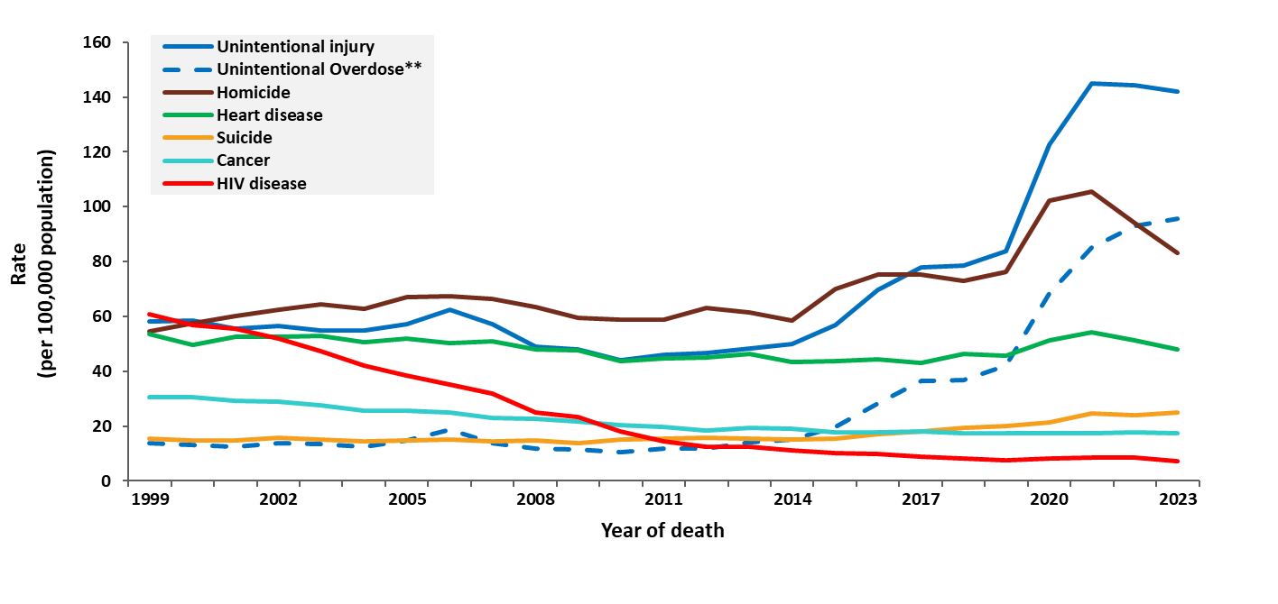
Deaths in the general population with HIV disease as the underlying cause versus the leading causes among Black/African American* males aged 25–44 years, 1999–2023—United States
Note. Data are from CDC WONDER Online Database and are based on death certificate data compiled by the National Center for Health Statistics. *Does not include persons of Hispanic/Latino ethnicity. **Deaths with an underlying cause of unintentional overdose are a subset of deaths with an underlying cause of unintentional injury.
Notes:
In the United States, among Black/African American males aged 25–44 years, HIV disease was the leading cause of death in 1999, falling to 3rd in 2000–2001. The rate of HIV disease as the underlying cause of death continued to fall and was ranked 7th among all causes of death in 2023, when HIV disease caused 437 deaths, or about 2% of all deaths in this group.
Note.
The data for this slide come from death certificate data compiled by the National Center for Health Statistics (NCHS) and downloaded from the CDC WONDER Online Database https://wonder.cdc.gov/.
For details on reporting of sex, age, and race/ethnicity, please see NCHS’s Funeral Director’s Handbook on Death Registration and Fetal Death Reporting (https://www.cdc.gov/nchs/data/nvss/handbook/2019-Funeral-Directors-Handbook-508.pdf).

Slide 22
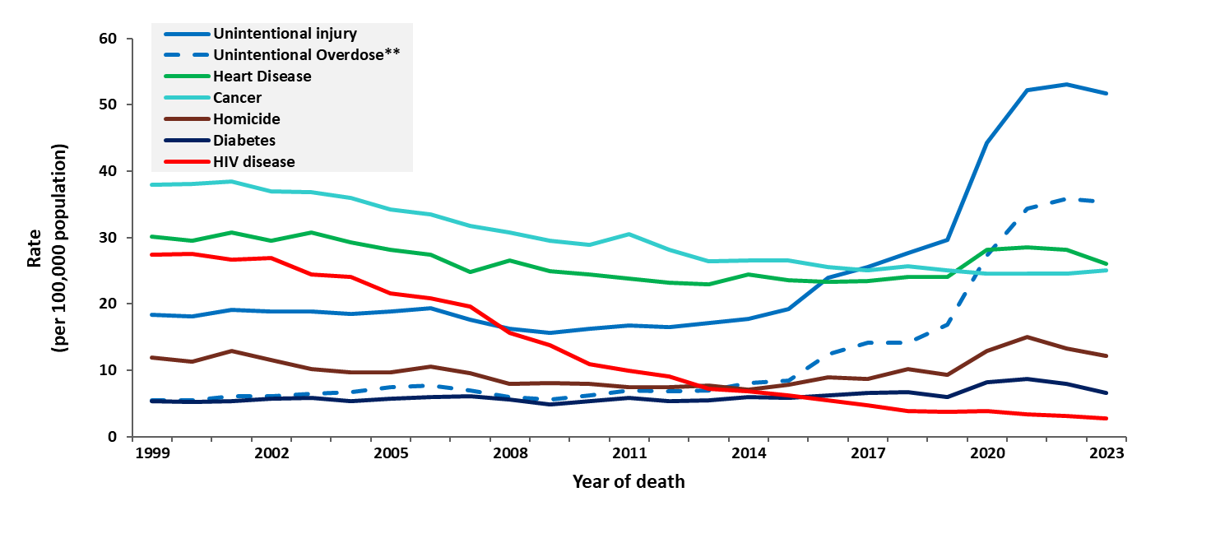
Deaths in the general population with HIV disease as the underlying cause versus the leading causes among Black/African American* females aged 25–44 years, 1999–2023—United States
Note. Data are from CDC WONDER Online Database and are based on death certificate data compiled by the National Center for Health Statistics. *Does not include persons of Hispanic/Latino ethnicity. **Deaths with an underlying cause of unintentional overdose are a subset of deaths with an underlying cause of unintentional injury.
Notes:
In the United States, among Black/African American females aged 25–44 years, HIV disease was ranked as the 3rd leading cause of death in 1999–2007. The rate of HIV disease as the underlying cause of death continued to fall and was ranked 11th among all causes of death in 2023, when it caused 168 deaths, or about 1% of all deaths in this group.
Note.
The data for this slide come from death certificate data compiled by the National Center for Health Statistics (NCHS) and downloaded from the CDC WONDER Online Database https://wonder.cdc.gov/.
For details on reporting of sex, age, and race/ethnicity, please see NCHS’s Funeral Director’s Handbook on Death Registration and Fetal Death Reporting (https://www.cdc.gov/nchs/data/nvss/handbook/2019-Funeral-Directors-Handbook-508.pdf).

Slide 23
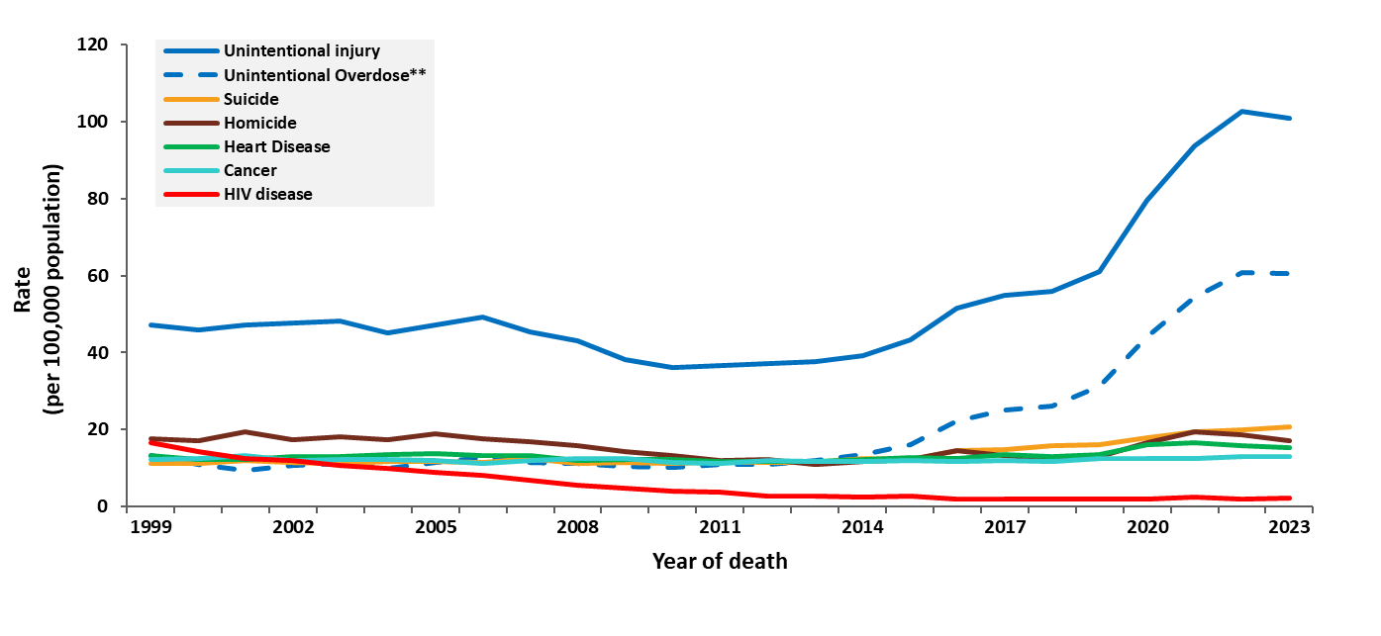
Deaths in the general population with HIV disease as the underlying cause versus the leading causes among Hispanic/Latino* males aged 25–44 years, 1999–2023—United States
Note. Data are from CDC WONDER Online Database and are based on death certificate data compiled by the National Center for Health Statistics. *Hispanic/Latino persons can be of any race. **Deaths with an underlying cause of unintentional overdose are a subset of deaths with an underlying cause of unintentional injury.
Notes:
In the United States, among Hispanic/Latino males aged 25–44 years, HIV disease was ranked as the 3rd leading cause of death in 1999–2000, falling to 4th in 2001. The rate of HIV disease as the underlying cause of death continued to fall and was ranked 9th among all causes of death in 2023, when it caused 223 deaths, or about 1% of all deaths in the group.
Note.
The data for this slide come from death certificate data compiled by the National Center for Health Statistics (NCHS) and downloaded from the CDC WONDER Online Database https://wonder.cdc.gov/.
For details on reporting of sex, age, and race/ethnicity, please see NCHS’s Funeral Director’s Handbook on Death Registration and Fetal Death Reporting (https://www.cdc.gov/nchs/data/nvss/handbook/2019-Funeral-Directors-Handbook-508.pdf).

Slide 24
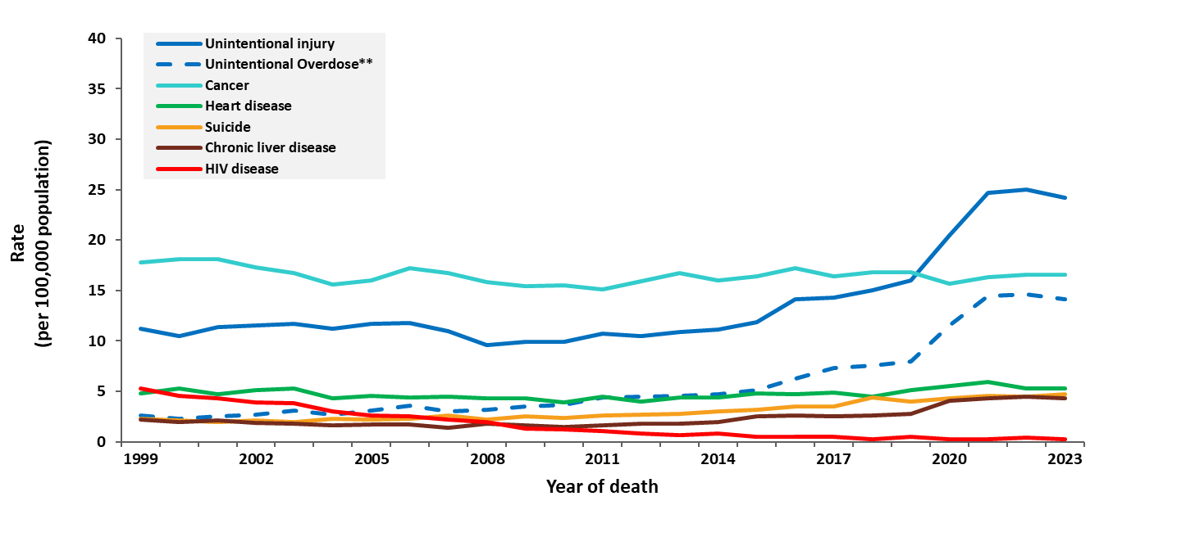
Deaths in the general population with HIV disease as the underlying cause versus the leading causes among Hispanic/Latino* females aged 25–44 years, 1999–2023—United States
Note. Data are from CDC WONDER Online Database and are based on death certificate data compiled by the National Center for Health Statistics. *Hispanic/Latino persons can be of any race. **Deaths with an underlying cause of unintentional overdose are a subset of deaths with an underlying cause of unintentional injury
Notes:
In the United States, among Hispanic/Latino females aged 25–44 years, HIV disease was ranked as the 3rd leading cause of death in 1999, falling to 4th in 2000. The rate of HIV disease as the underlying cause of death continued to fall and was ranked 18th among all causes of death in 2023, when it caused 30 deaths, or less than 1% of all deaths in the group.
Note.
The data for this slide come from death certificate data compiled by the National Center for Health Statistics (NCHS) and downloaded from the CDC WONDER Online Database https://wonder.cdc.gov/.
For details on reporting of sex, age, and race/ethnicity, please see NCHS’s Funeral Director’s Handbook on Death Registration and Fetal Death Reporting (https://www.cdc.gov/nchs/data/nvss/handbook/2019-Funeral-Directors-Handbook-508.pdf).

Slide 25
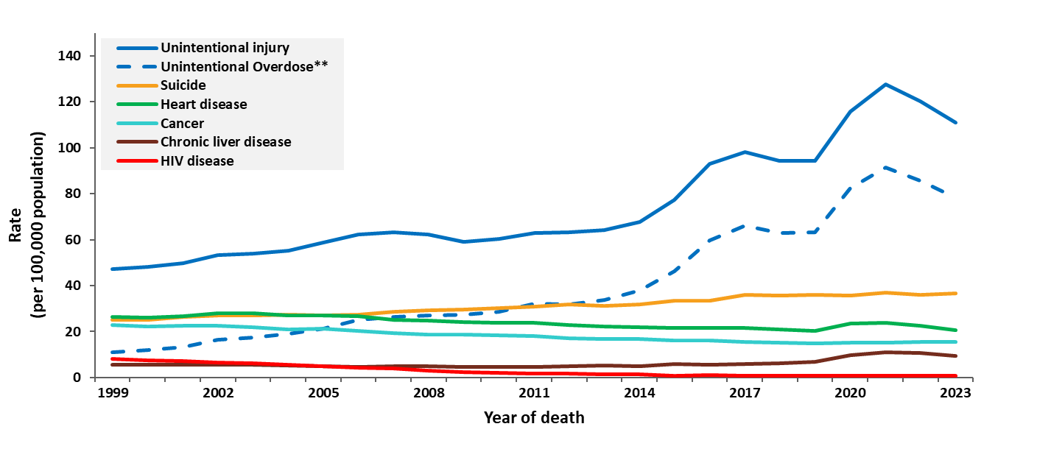
Deaths in the general population with HIV disease as the underlying cause versus the leading causes among White* males aged 25–44 years, 1999–2023—United States
Note. Data are from CDC WONDER Online Database and are based on death certificate data compiled by the National Center for Health Statistics. *Does not include persons of Hispanic/Latino ethnicity. **Deaths with an underlying cause of unintentional overdose are a subset of deaths with an underlying cause of unintentional injury.
Notes:
In the United States, among White males aged 25–44 years, HIV disease was ranked as the 5th leading cause of death in 1999–2000, falling to 9th from 2009–2012. The rate of HIV disease as the underlying cause of death continued to fall and was ranked 16th among all causes of death in 2023, when it caused 180 deaths, or less than 1% of all deaths in this group.
Note.
The data for this slide come from death certificate data compiled by the National Center for Health Statistics (NCHS) and downloaded from the CDC WONDER Online Database https://wonder.cdc.gov/.
For details on reporting of sex, age, and race/ethnicity, please see NCHS’s Funeral Director’s Handbook on Death Registration and Fetal Death Reporting (https://www.cdc.gov/nchs/data/nvss/handbook/2019-Funeral-Directors-Handbook-508.pdf).

Slide 26
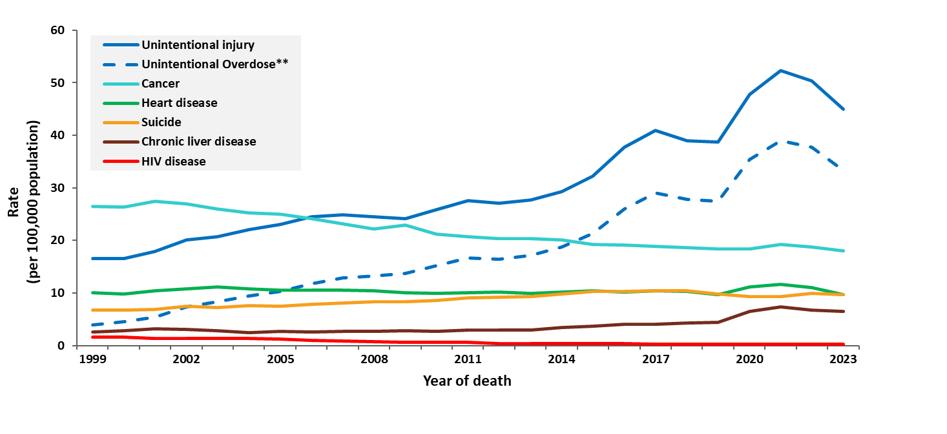
Deaths in the general population with HIV disease as the underlying cause versus the leading causes among White* females aged 25–44 years, 1999–2023—United States
Note. Data are from CDC WONDER Online Database and are based on death certificate data compiled by the National Center for Health Statistics. *Does not include persons of Hispanic/Latino ethnicity. ** Deaths with an underlying cause of unintentional overdose are a subset of deaths with an underlying cause of unintentional injury.
Notes:
In the United States, among White females aged 25–44 years, HIV disease was ranked as the 9th leading cause of death in 1999–2000, falling to 10th in 2001 then 11th in 2002. The rate of HIV disease as the underlying cause of death continued to fall and was ranked 20th among all causes of death in 2023, when it caused 58 deaths, or less than 1% of all deaths in this group.
Note.
The data for this slide come from death certificate data compiled by the National Center for Health Statistics (NCHS) and downloaded from the CDC WONDER Online Database https://wonder.cdc.gov/.
For details on reporting of sex, age, and race/ethnicity, please see NCHS’s Funeral Director’s Handbook on Death Registration and Fetal Death Reporting (https://www.cdc.gov/nchs/data/nvss/handbook/2019-Funeral-Directors-Handbook-508.pdf).

Slide 27
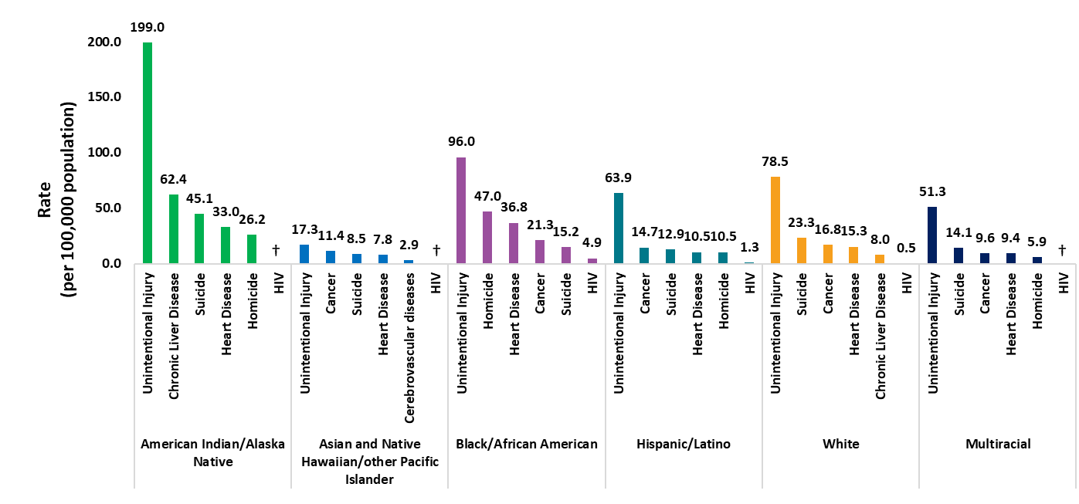
Deaths in the general population with HIV disease as the underlying cause versus the top 5 leading causes among persons aged 25–44 years, by race/ethnicity 2023—United States
Note. Data from CDC WONDER Online Database based on death certificate data compiled by the National Center for Health Statistics. Hispanic/Latino persons can be of any race †Unreliable rate due to a numerator of less than 20 deaths.
Notes:
In the United States in 2023, unintentional injury was the highest underlying cause of death among all race/ethnicity groups aged 25–44 years, accounting for 66,322 deaths, or about 38% of deaths in this age group. Deaths due to unintentional injury were highest among American Indian/Alaska Native persons aged 25–44 years, at a rate of 199 deaths per 100,000 persons. Deaths with an underlying cause of HIV disease were highest among Black/African American persons, with an overall rate of 4.9 deaths per 100,000 persons.
Note.
The data for this slide come from death certificate data compiled by the National Center for Health Statistics (NCHS) and downloaded from the CDC WONDER Online Database https://wonder.cdc.gov/. Death rates are considered unreliable when the rate is calculated with a numerator of 20 or less.
For details on reporting of sex, age, and race/ethnicity, please see NCHS’s Funeral Director’s Handbook on Death Registration and Fetal Death Reporting (https://www.cdc.gov/nchs/data/nvss/handbook/2019-Funeral-Directors-Handbook-508.pdf).

Slide 28
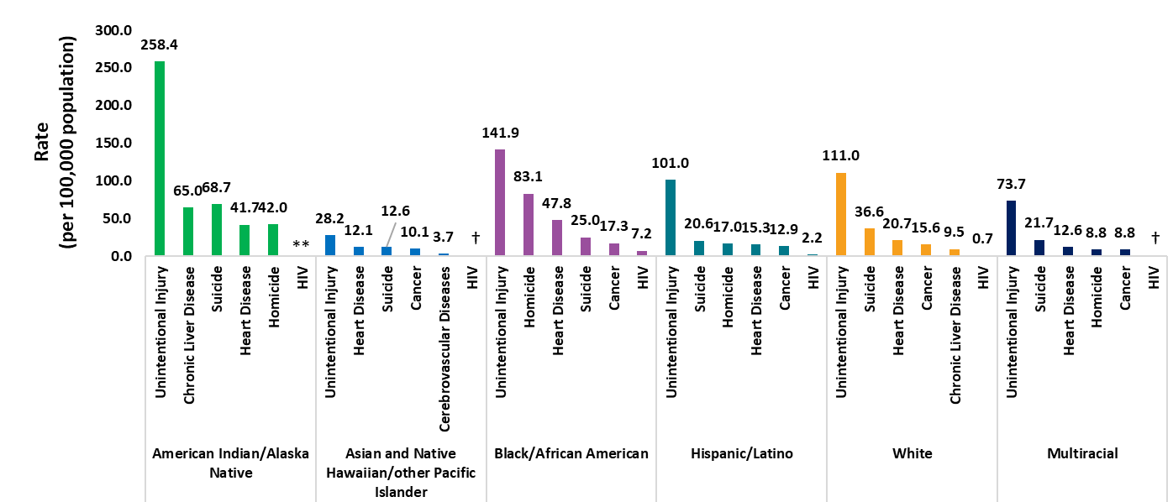
Deaths in the general population with HIV disease as the underlying cause versus the top 5 leading causes among males aged 25–44 years, by race/ethnicity, 2023—United States
Note. Data from CDC WONDER Online Database based on death certificate data compiled by the National Center for Health Statistics. Hispanic/Latino persons can be of any race. **Data meet the criteria for confidentiality constraints and are suppressed. †Unreliable rate due to a numerator of less than 20 deaths.
Notes:
In the United States in 2023, unintentional injury was the highest underlying cause of death among all males in all race/ethnicity groups aged 25−44 years, accounting for 48,907 deaths, or about 42% of the deaths in this group. Deaths due to unintentional injury were highest among American Indian/Alaska Native males aged 25−44 years, at a rate of 258.4 deaths per 100,000 persons. Deaths with an underlying cause of HIV disease were highest among Black/African American males, with an overall rate of 7.2 deaths per 100,000 persons.
Note.
The data for this slide come from death certificate data compiled by the National Center for Health Statistics (NCHS) and downloaded from the CDC WONDER Online Database https://wonder.cdc.gov/. Data are suppressed when the data meet the criteria for confidentiality constraints. Death rates are considered unreliable when the rate is calculated with a numerator of 20 or less.
For details on reporting of sex, age, and race/ethnicity, please see NCHS’s Funeral Director’s Handbook on Death Registration and Fetal Death Reporting (https://www.cdc.gov/nchs/data/nvss/handbook/2019-Funeral-Directors-Handbook-508.pdf).

Slide 29
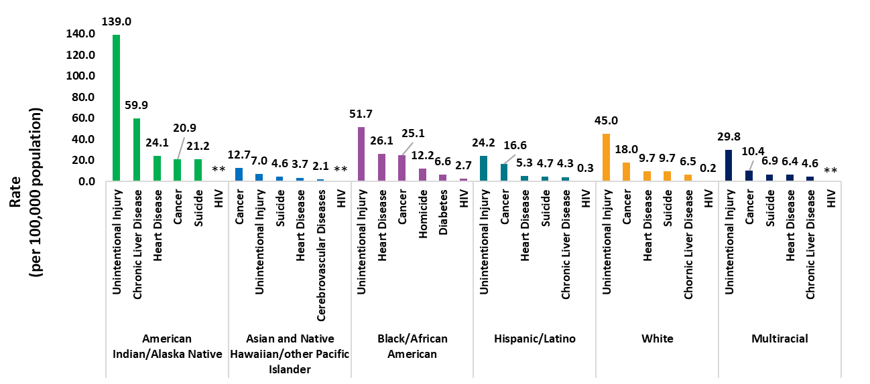
Deaths in the general population with HIV disease as the underlying cause versus the top 5 leading causes among females aged 25–44 years, by race/ethnicity, 2023—United States
Note. Data from CDC WONDER Online Database based on death certificate data compiled by the National Center for Health Statistics. Hispanic/Latino persons can be of any race. **Data meet the criteria for confidentiality constraints and are suppressed.
Notes:
In the United States in 2023, unintentional injury was the highest underlying cause of death among all females of all race/ethnicity groups aged 25−44 years, accounting for 17,415 deaths, or about 32% of deaths in this group. Deaths due to unintentional injury were highest among American Indian/Alaska Native females aged 25−44 years, at a rate of 139 deaths per 100,000 persons. Deaths with an underlying cause of HIV disease were highest among Black/African American females, with an overall rate of 2.7 deaths per 100,000 persons.
Note.
The data for this slide come from death certificate data compiled by the National Center for Health Statistics (NCHS) and downloaded from the CDC WONDER Online Database https://wonder.cdc.gov/. Data are suppressed when the data meet the criteria for confidentiality constraints.
For details on reporting of sex, age, and race/ethnicity, please see NCHS’s Funeral Director’s Handbook on Death Registration and Fetal Death Reporting (https://www.cdc.gov/nchs/data/nvss/handbook/2019-Funeral-Directors-Handbook-508.pdf).

Slide 30
Leading causes of death among persons aged 25–44 years with diagnosed HIV

Slide 31
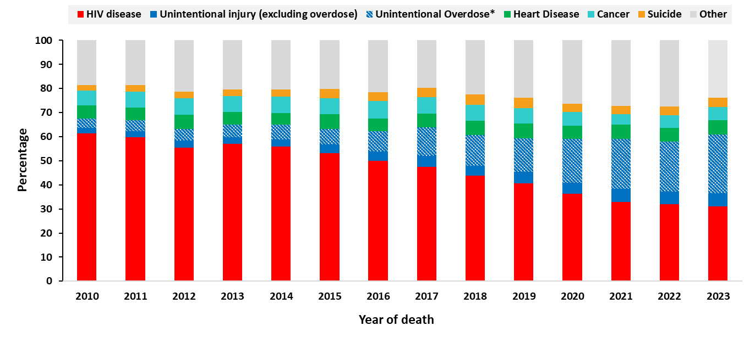
Top 5 leading causes of death among persons aged 25–44 years with diagnosed HIV, 2010–2023—United States
Note. Data on cause of death among persons with diagnosed HIV are from the National HIV Surveillance System (NHSS) and presented for persons with a known cause of death.
*Deaths with an underlying cause of unintentional overdose are a subset of deaths with an underlying cause of unintentional injury.
Notes:
In the United States, among persons aged 25−44 years with diagnosed HIV who died during 2010−2023 and have a known cause of death, an underlying cause of HIV disease accounted for the highest percentage of deaths, at 61% in 2010 falling to 31% in 2023. In 2023, 30% of deaths among this group were due to unintentional injury, including 25% of which were due to unintentional overdose.
Note.
The data presented in this slide are from the National HIV Surveillance System (NHSS). Other causes of death include all other deaths with a known cause among persons with diagnosed HIV.
For more information on data sources, data collection and reporting practices, and case definitions, see the National HIV Surveillance System (NHSS) Technical Notes, available at https://www.cdc.gov/hiv-data/nhss/index.html.
For more information on deaths, see HIV Surveillance Report Technical Notes at https://www.cdc.gov/hiv-data/nhss/hiv-diagnoses-deaths-prevalence.html.

Slide 32
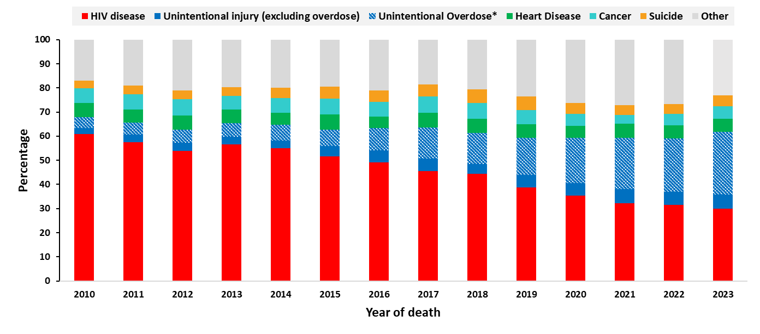
Top 5 leading causes of death among males aged 25−44 years with diagnosed HIV, 2010–2023—United States
Note. Data on cause of death among persons with diagnosed HIV are from the National HIV Surveillance System (NHSS) and presented for persons with a known cause of death.
*Deaths with an underlying cause of unintentional overdose are a subset of deaths with an underlying cause of unintentional injury.
Notes:
In the United States, among males aged 25−44 years with diagnosed HIV who died during 2010−2023 and have a known cause of death, an underlying cause of HIV disease accounted for the highest percentage of deaths, at 61% in 2010 falling to 30% in 2023. In 2023, 32% deaths in this group were due to unintentional injury, including 26% of which were due to unintentional overdose.
Note.
The data presented in this slide are from the National HIV Surveillance System (NHSS). Other causes of death include all other deaths with a known cause among persons with diagnosed HIV.
For more information on data sources, data collection and reporting practices, and case definitions, see the National HIV Surveillance System (NHSS) Technical Notes, available at https://www.cdc.gov/hiv-data/nhss/index.html.
For more information on deaths, see HIV Surveillance Report Technical Notes at https://www.cdc.gov/hiv-data/nhss/hiv-diagnoses-deaths-prevalence.html.

Slide 33
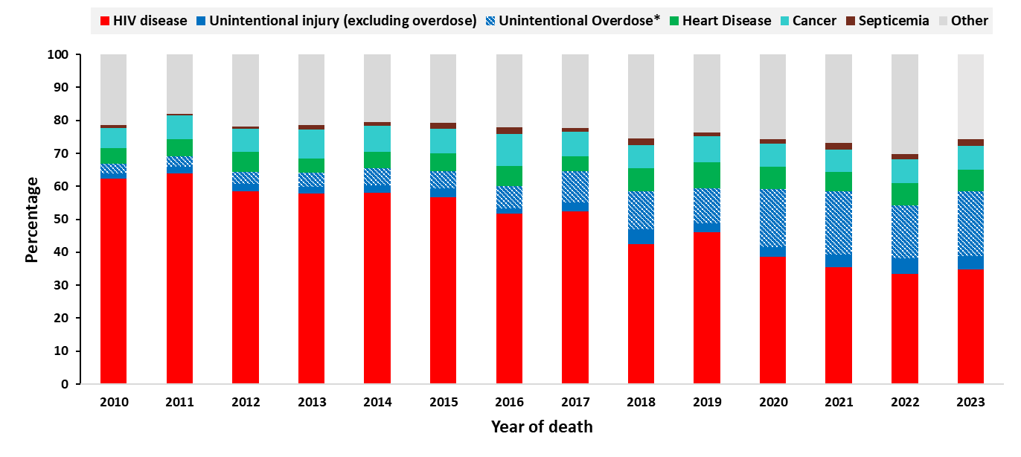
Top 5 leading causes of death among females aged 25−44 years with diagnosed HIV, 2010–2023—United States
Note. Data on cause of death among persons with diagnosed HIV are from the National HIV Surveillance System (NHSS) and presented for persons with a known cause of death.
*Deaths with an underlying cause of unintentional overdose are a subset of deaths with an underlying cause of unintentional injury.
Notes:
In the United States, among females aged 25−44 years with diagnosed HIV who died during 2010−2023 and have a known cause of death, an underlying cause of HIV disease accounted for the highest percentage of deaths, at 62% in 2010 falling to 35% in 2023. In 2023, 24% of deaths in this group were due to unintentional injury, including 20% of which were due to unintentional overdose.
Note.
The data presented in this slide are from the National HIV Surveillance System (NHSS). Other causes of death include all other deaths with a known cause among persons with diagnosed HIV.
For more information on data sources, data collection and reporting practices, and case definitions, see the National HIV Surveillance System (NHSS) Technical Notes, available at https://www.cdc.gov/hiv-data/nhss/index.html.
For more information on deaths, see HIV Surveillance Report Technical Notes at https://www.cdc.gov/hiv-data/nhss/hiv-diagnoses-deaths-prevalence.html.

Slide 34
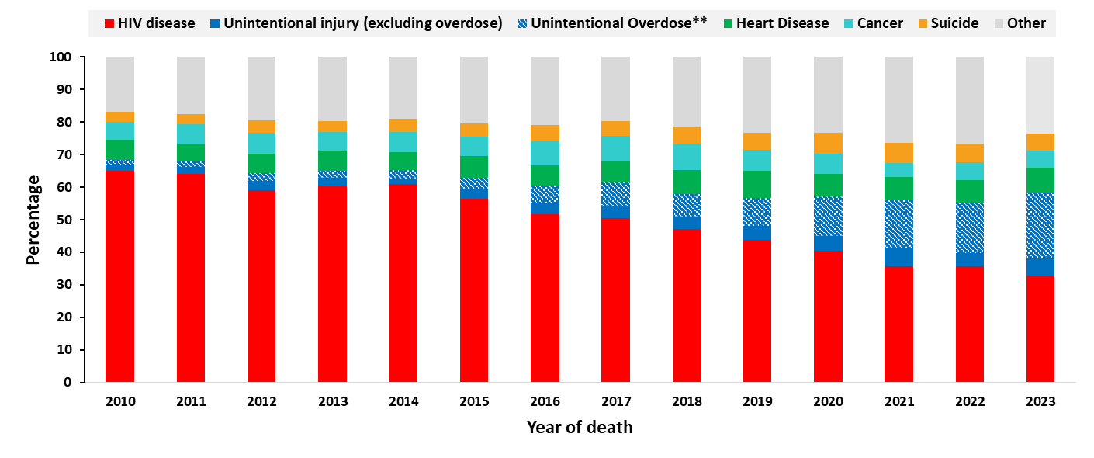
Top 5 leading causes of death among Black/African American* persons aged 25−44 years with diagnosed HIV, 2010–2023—United States
Note. Data on cause of death among persons with diagnosed HIV are from the National HIV Surveillance System (NHSS) and presented for persons with a known cause of death.
*Does not include persons of Hispanic/Latino ethnicity. **Deaths with an underlying cause of unintentional overdose are a subset of deaths with an underlying cause of unintentional injury.
Notes:
In the United States, among Black/African American persons aged 25−44 years with diagnosed HIV who died during 2010−2023 and have a known cause of death, an underlying cause of HIV disease accounted for the highest percentage of deaths, at 65% in 2010 falling to 33% in 2023. In 2023, 26% of deaths in this group were due to unintentional injury, including 20% of which were due to unintentional overdose.
Note.
The data presented in this slide are from the National HIV Surveillance System (NHSS). Other causes of death include all other deaths with a known cause among persons with diagnosed HIV.
For more information on data sources, data collection and reporting practices, and case definitions, see the National HIV Surveillance System (NHSS) Technical Notes, available at https://www.cdc.gov/hiv-data/nhss/index.html.
For more information on deaths, see HIV Surveillance Report Technical Notes at https://www.cdc.gov/hiv-data/nhss/hiv-diagnoses-deaths-prevalence.html.

Slide 35
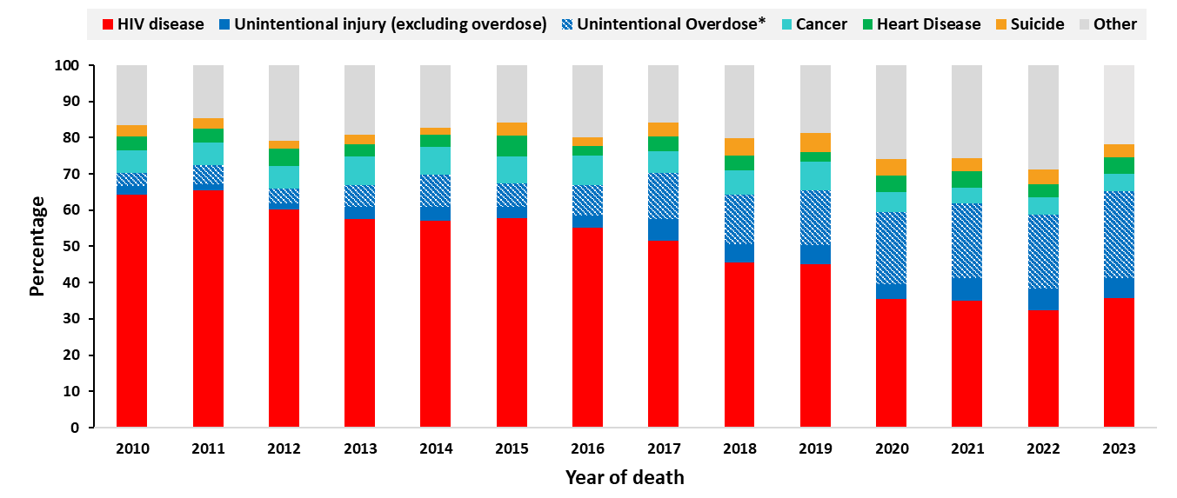
Top 5 leading causes of death among Hispanic/Latino persons aged 25−44 years with diagnosed HIV, 2010–2023—United States
Note. Data on cause of death among persons with diagnosed HIV are from the National HIV Surveillance System (NHSS) and presented for persons with a known cause of death.
Hispanic/Latino persons can be of any race. *Deaths with an underlying cause of unintentional overdose are a subset of deaths with an underlying cause of unintentional injury.
Notes:
In the United States, among Hispanic/Latino persons aged 25−44 years with diagnosed HIV who died during 2010−2023 and have a known cause of death, an underlying cause of HIV disease accounted for the highest percentage of deaths, at 64% in 2010 falling to 36% in 2023. In 2023, 29% of deaths in this group were due to unintentional injury, including 24% of which were due to unintentional overdose.
Note.
The data presented in this slide are from the National HIV Surveillance System (NHSS). Other causes of death include all other deaths with a known cause among persons with diagnosed HIV.
For more information on data sources, data collection and reporting practices, and case definitions, see the National HIV Surveillance System (NHSS) Technical Notes, available at https://www.cdc.gov/hiv-data/nhss/index.html.
For more information on deaths, see HIV Surveillance Report Technical Notes at https://www.cdc.gov/hiv-data/nhss/hiv-diagnoses-deaths-prevalence.html.

Slide 36
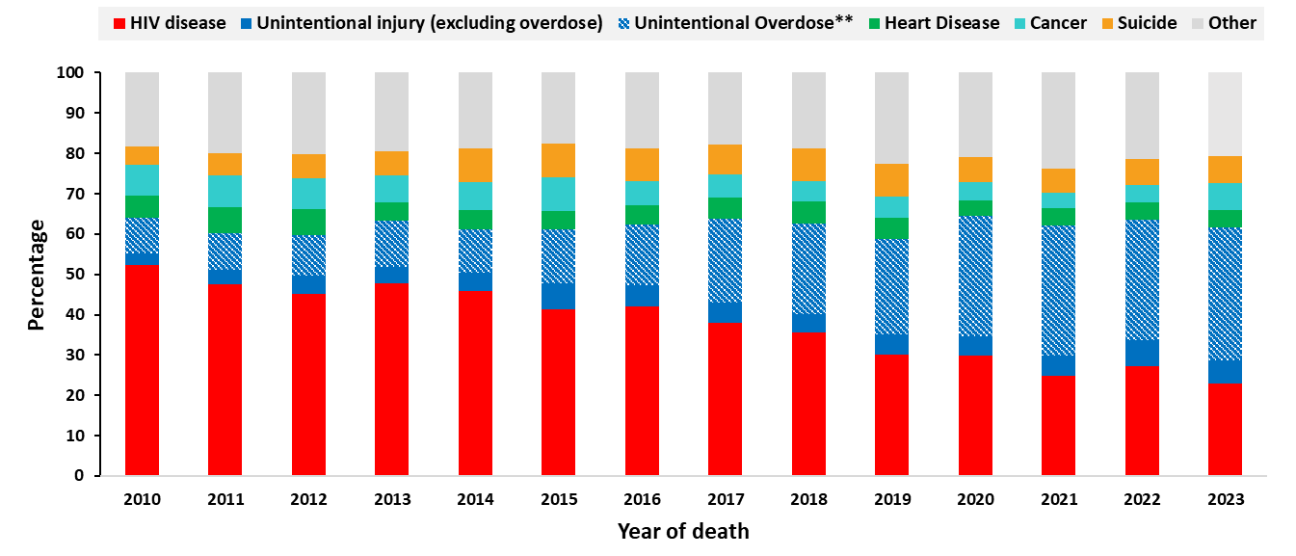
Top 5 leading causes of death among White* Persons aged 25−44 years with diagnosed HIV, 2010–2023—United States
Note. Data on cause of death among persons with diagnosed HIV are from the National HIV Surveillance System (NHSS) and presented for persons with a known cause of death.
*Does not include persons of Hispanic/Latino ethnicity. **Deaths with an underlying cause of unintentional overdose are a subset of deaths with an underlying cause of unintentional injury.
Notes:
In the United States, among White persons aged 25−44 years with diagnosed HIV who died during 2010−2023 and have a known cause of death, an underlying cause of HIV disease accounted for the highest percentage of deaths, at 52% in 2010 falling to 23% in 2023. In 2023, 39% of deaths in this group were due to unintentional injury, including 33% of which were due to unintentional overdose.
Note.
The data presented in this slide are from the National HIV Surveillance System (NHSS). Other causes of death include all other deaths with a known cause among persons with diagnosed HIV.
For more information on data sources, data collection and reporting practices, and case definitions, see the National HIV Surveillance System (NHSS) Technical Notes, available at https://www.cdc.gov/hiv-data/nhss/index.html.
For more information on deaths, see HIV Surveillance Report Technical Notes at https://www.cdc.gov/hiv-data/nhss/hiv-diagnoses-deaths-prevalence.html.

Slide 37
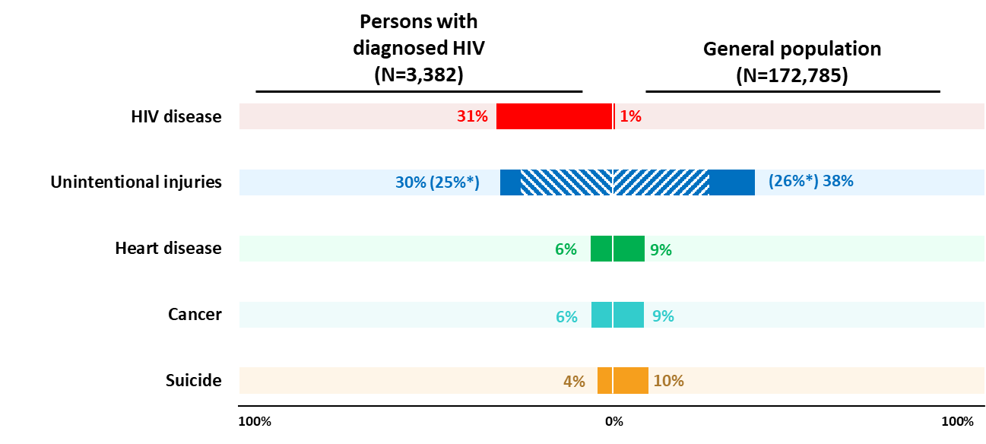
Top 5 leading causes of death among persons aged 25–44 years with diagnosed HIV compared to the general population, 2023—United States
Note. Data on cause of death among persons with diagnosed HIV are from the National HIV Surveillance System (NHSS) and presented for persons with a known cause of death. Data on cause of death among the general population are from CDC WONDER.*Deaths with an underlying cause of unintentional overdose, denoted with blue stripes, are a subset of deaths with an underlying cause of unintentional injury, denoted with solid and striped blue.
Notes:
In the United States in 2023, among persons aged 25−44 years,
1% of deaths had an underlying cause of HIV disease in the general population, compared to 31% of deaths among persons with diagnosed HIV who died in 2023 and have a known cause of death.
Unintentional injury accounted for 30% of deaths among persons with diagnosed HIV with a known cause of death, compared to 38% of deaths among the general population.
Deaths with an underlying cause of heart disease, cancer, and suicide also ranked among the top 5 causes of death among persons with diagnosed HIV, accounting for 6%, 6%, and 4% of deaths, respectively, compared to deaths in the general population for these causes, accounting for 9%, 9%, and 10%, respectively.
Note.
The data presented in this slide are from the National HIV Surveillance System (NHSS) and from death certificate data compiled by the National Center for Health Statistics (NCHS).
For more information on NHSS data sources, data collection and reporting practices, and case definitions, see the National HIV Surveillance System (NHSS) Technical Notes, available at https://www.cdc.gov/hiv-data/nhss/index.html.
The death certificate data compiled by the National Center for Health Statistics (NCHS) are downloaded from the CDC WONDER Online Database https://wonder.cdc.gov/.
For details on reporting of sex, age, and race/ethnicity for NCHS data, please see NCHS’s Funeral Director’s Handbook on Death Registration and Fetal Death Reporting (https://www.cdc.gov/nchs/data/nvss/handbook/2019-Funeral-Directors-Handbook-508.pdf).

Slide 38
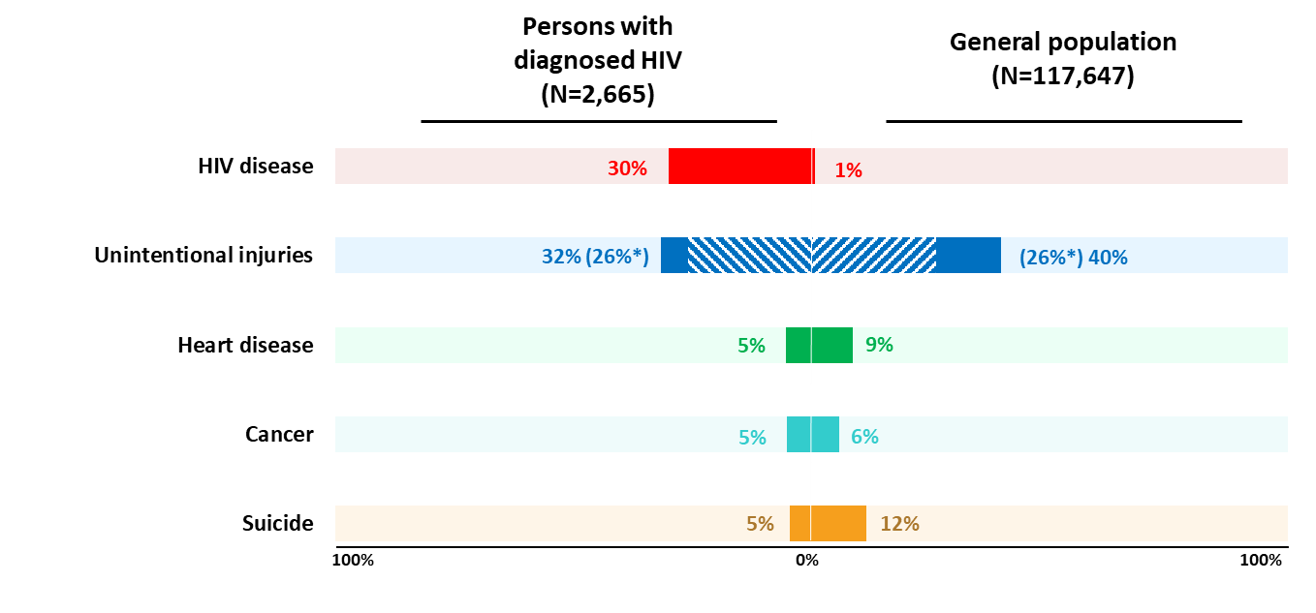
Top 5 leading causes of death among males aged 25–44 years with diagnosed HIV compared to the general population, 2023—United States
Note. Data on cause of death among persons with diagnosed HIV are from the National HIV Surveillance System (NHSS) and presented for persons with a known cause of death. Data on cause of death among the general population are from CDC WONDER. *Deaths with an underlying cause of unintentional overdose, denoted with blue stripes, are a subset of deaths with an underlying cause of unintentional injury, denoted with solid and striped blue.
Notes:
In the United States in 2023, among males aged 25−44 years:
1% of deaths had an underlying cause of HIV disease in the general population, compared to 32% of deaths among males with diagnosed HIV who died in 2023 and have a known cause of death.
Unintentional injury accounted for 32% of deaths among males with diagnosed HIV with a known cause of death, compared to 40% of deaths among the general population.
Deaths with an underlying cause of heart disease, cancer, and suicide also ranked among the top 5 causes of death among males with diagnosed HIV, accounting for 5%, 5%, and 5% of deaths, respectively, compared to deaths among males in the general population for these causes, accounting for 9%, 6%, and 12%, respectively.
Note.
The data presented in this slide are from the National HIV Surveillance System (NHSS) and from death certificate data compiled by the National Center for Health Statistics (NCHS).
For more information on NHSS data sources, data collection and reporting practices, and case definitions, see the National HIV Surveillance System (NHSS) Technical Notes, available at https://www.cdc.gov/hiv-data/nhss/index.html.
The death certificate data compiled by the National Center for Health Statistics (NCHS) are downloaded from the CDC WONDER Online Database https://wonder.cdc.gov/.
For details on reporting of sex, age, and race/ethnicity for NCHS data, please see NCHS’s Funeral Director’s Handbook on Death Registration and Fetal Death Reporting (https://www.cdc.gov/nchs/data/nvss/handbook/2019-Funeral-Directors-Handbook-508.pdf).

Slide 39
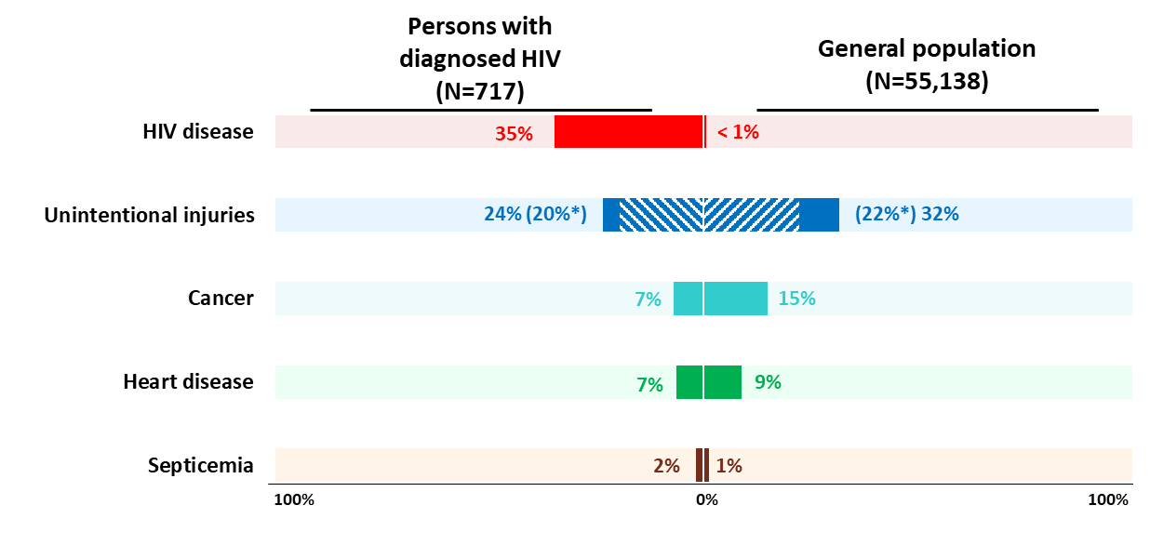
Top 5 leading causes of death among females aged 25–44 years with diagnosed HIV compared to the general population, 2023—United States
Note. Data on cause of death among persons with diagnosed HIV are from the National HIV Surveillance System (NHSS) and presented for persons with a known cause of death. Data on cause of death among the general population are from CDC WONDER. *Deaths with an underlying cause of unintentional overdose, denoted with blue stripes, are a subset of deaths with an underlying cause of unintentional injury, denoted with solid and striped blue.
Notes:
In the United States in 2023, among females aged 25 to 44 years:
Less than 1% of deaths had an underlying cause of HIV disease in the general population, compared to 35% of deaths among females with diagnosed HIV who died during 2010 to 2023 and have a known cause of death.
Unintentional injury accounted for 24% of deaths among females with diagnosed HIV with a known cause of death, compared to 32% of deaths among the general population.
Deaths with an underlying cause of cancer, heart disease, and Septicemia also ranked among the top 5 causes of death among females with diagnosed HIV, accounting for 7%, 7%, and 2% of deaths, respectively, compared to deaths among females in the general population for these causes, accounting for 15%, 9%, and 1%, respectively.
Note.
The data presented in this slide are from the National HIV Surveillance System (NHSS) and from death certificate data compiled by the National Center for Health Statistics (NCHS).
For more information on NHSS data sources, data collection and reporting practices, and case definitions, see the National HIV Surveillance System (NHSS) Technical Notes, available at https://www.cdc.gov/hiv-data/nhss/index.html.
The death certificate data compiled by the National Center for Health Statistics (NCHS) are downloaded from the CDC WONDER Online Database https://wonder.cdc.gov/.
For details on reporting of sex, age, and race/ethnicity for NCHS data, please see NCHS’s Funeral Director’s Handbook on Death Registration and Fetal Death Reporting (https://www.cdc.gov/nchs/data/nvss/handbook/2019-Funeral-Directors-Handbook-508.pdf).

Slide 40
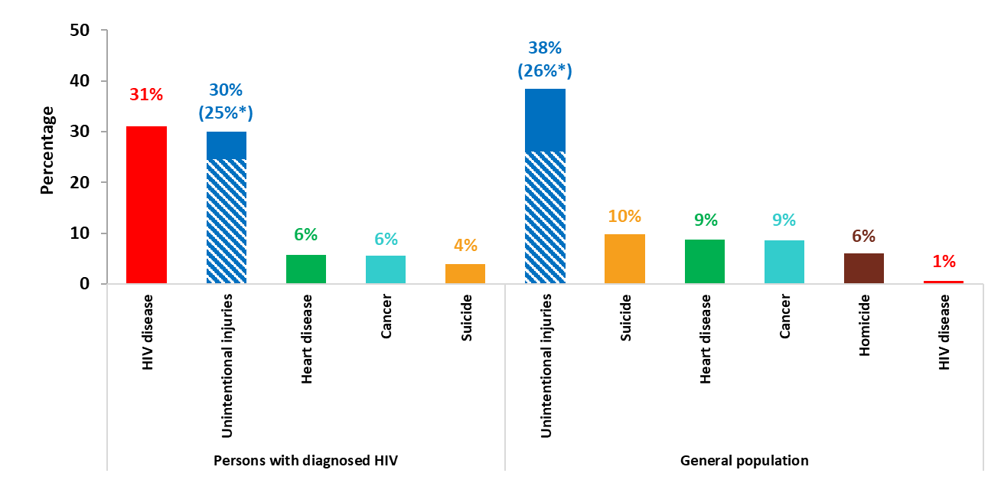
Top 5 leading causes of death among persons aged 25–44 years with diagnosed HIV compared to the leading causes of death among persons aged 25–44 years in the general population, 2023—United States
Note. Data on cause of death among persons with diagnosed HIV are from the National HIV Surveillance System (NHSS) and presented for persons with a known cause of death. Data on cause of death among the general population are from CDC WONDER. *Deaths with an underlying cause of unintentional overdose, denoted with blue stripes, are a subset of deaths with an underlying cause of unintentional injury, denoted with solid and striped blue.
Notes:
This slide displays the top 5 causes of death in the United States in 2023, by percentage of deaths, among persons aged 25–44 years with diagnosed HIV with a known cause of death and the top 5 causes of death and deaths with an underlying cause of HIV, by percentage, of persons aged 25–44 years in the general population.
Note.
The data presented in this slide are from the National HIV Surveillance System (NHSS) and from death certificate data compiled by the National Center for Health Statistics (NCHS).
For more information on NHSS data sources, data collection and reporting practices, and case definitions, see the National HIV Surveillance System (NHSS) Technical Notes, available at https://www.cdc.gov/hiv-data/nhss/index.html.
The death certificate data compiled by the National Center for Health Statistics (NCHS) are downloaded from the CDC WONDER Online Database https://wonder.cdc.gov/.
For details on reporting of sex, age, and race/ethnicity for NCHS data, please see NCHS’s Funeral Director’s Handbook on Death Registration and Fetal Death Reporting (https://www.cdc.gov/nchs/data/nvss/handbook/2019-Funeral-Directors-Handbook-508.pdf).

Slide 41
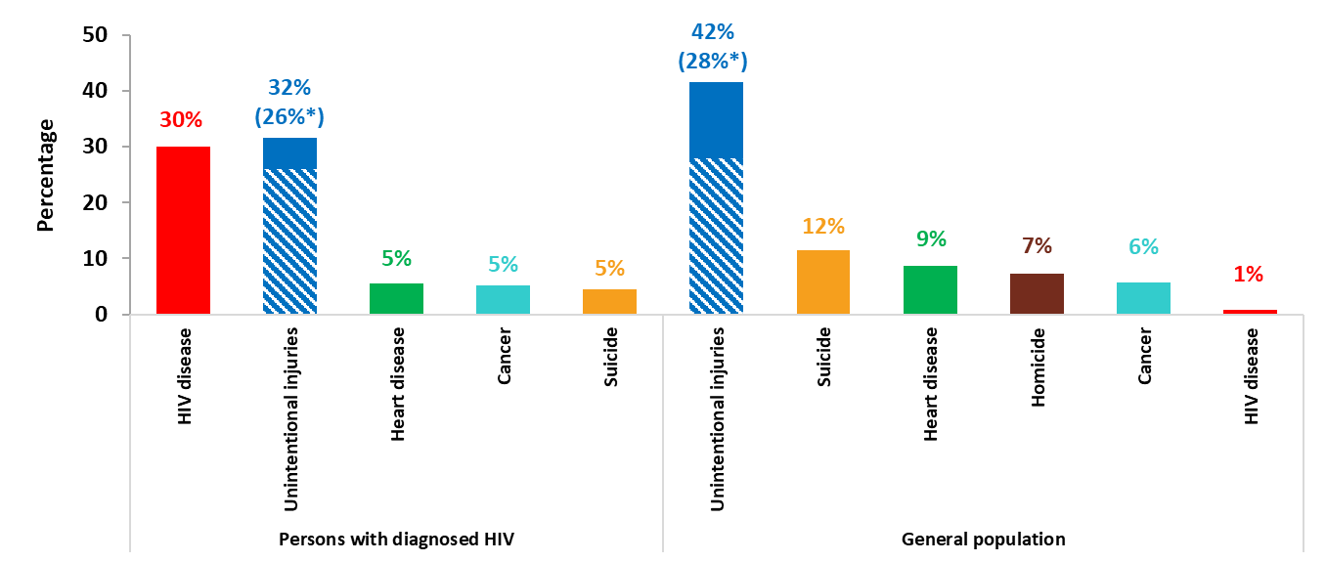
Top 5 leading causes of death among males aged 25–44 years with diagnosed HIV compared to the leading causes of death among males aged 25–44 years in the general population, 2023—United States
Note. Data on cause of death among persons with diagnosed HIV are from the National HIV Surveillance System (NHSS) and presented for persons with a known cause of death. Data on cause of death among the general population are from CDC WONDER. *Deaths with an underlying cause of unintentional overdose, denoted with blue stripes, are a subset of deaths with an underlying cause of unintentional injury, denoted with solid and striped blue.
Notes:
This slide displays the top 5 causes of death in the United States in 2023, by percentage of deaths, among males aged 25–44 years with diagnosed HIV who died in 2023 and have a known cause of death and the top 5 causes of death and deaths with an underlying cause of HIV, by percentage, of males aged 25–44 years in the general population.
Note.
The data presented in this slide are from the National HIV Surveillance System (NHSS) and from death certificate data compiled by the National Center for Health Statistics (NCHS).
For more information on NHSS data sources, data collection and reporting practices, and case definitions, see the National HIV Surveillance System (NHSS) Technical Notes, available at https://www.cdc.gov/hiv-data/nhss/index.html.
The death certificate data compiled by the National Center for Health Statistics (NCHS) are downloaded from the CDC WONDER Online Database https://wonder.cdc.gov/.
For details on reporting of sex, age, and race/ethnicity for NCHS data, please see NCHS’s Funeral Director’s Handbook on Death Registration and Fetal Death Reporting (https://www.cdc.gov/nchs/data/nvss/handbook/2019-Funeral-Directors-Handbook-508.pdf).

Slide 42
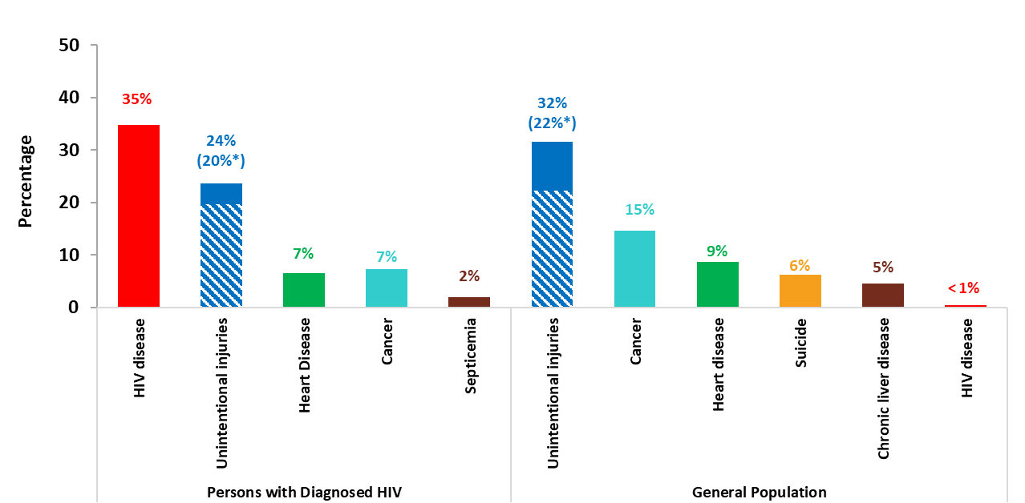
Top 5 leading causes of death among females aged 25–44 years with diagnosed HIV compared to the leading causes of death among females aged 25–44 years in the general population, 2023—United States
Note. Data on cause of death among persons with diagnosed HIV are from the National HIV Surveillance System (NHSS) and presented for persons with a known cause of death. Data on cause of death among the general population are from CDC WONDER. *Deaths with an underlying cause of unintentional overdose, denoted with blue stripes, are a subset of deaths with an underlying cause of unintentional injury, denoted with solid and striped blue.
Notes:
This slide displays the top 5 causes of death in the United States in 2023, by percentage of deaths, among females aged 25–44 years with diagnosed HIV who died in 2023 and have a known cause of death and the top 5 causes of death and deaths with an underlying cause of HIV, by percentage, of females aged 25–44 years in the general population.
Note.
The data presented in this slide are from the National HIV Surveillance System (NHSS) and from death certificate data compiled by the National Center for Health Statistics (NCHS).
For more information on NHSS data sources, data collection and reporting practices, and case definitions, see the National HIV Surveillance System (NHSS) Technical Notes, available at https://www.cdc.gov/hiv-data/nhss/index.html.
The death certificate data compiled by the National Center for Health Statistics (NCHS) are downloaded from the CDC WONDER Online Database https://wonder.cdc.gov/.
For details on reporting of sex, age, and race/ethnicity for NCHS data, please see NCHS’s Funeral Director’s Handbook on Death Registration and Fetal Death Reporting (https://www.cdc.gov/nchs/data/nvss/handbook/2019-Funeral-Directors-Handbook-508.pdf).

Slide 43
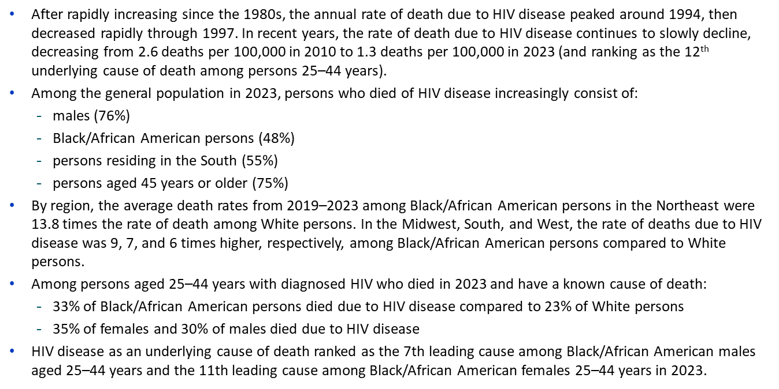
Summary

