Slide 1

Notes:
HIV Disease, Stage 3 (AIDS).
These slides were prepared by the Division of HIV Prevention, National Center for HIV, Viral Hepatitis, STD, and TB Prevention (NCHHSTP), Centers for Disease Control and Prevention (CDC). These slides present data on persons with HIV in the United States based on cases of HIV reported to CDC’s National HIV Surveillance System (NHSS) through December 2024.
Note. This slide set is in the public domain. You may reproduce these slides without permission; however, citation as to source is appreciated.
Centers for Disease Control and Prevention. HIV Disease, Stage 3 (AIDS) 2023. Atlanta: U.S. Department of Health and Human Services; 2025.
You are also free to adapt and revise these slides; however, you must remove the CDC name and logo if changes are made.

Slide 2
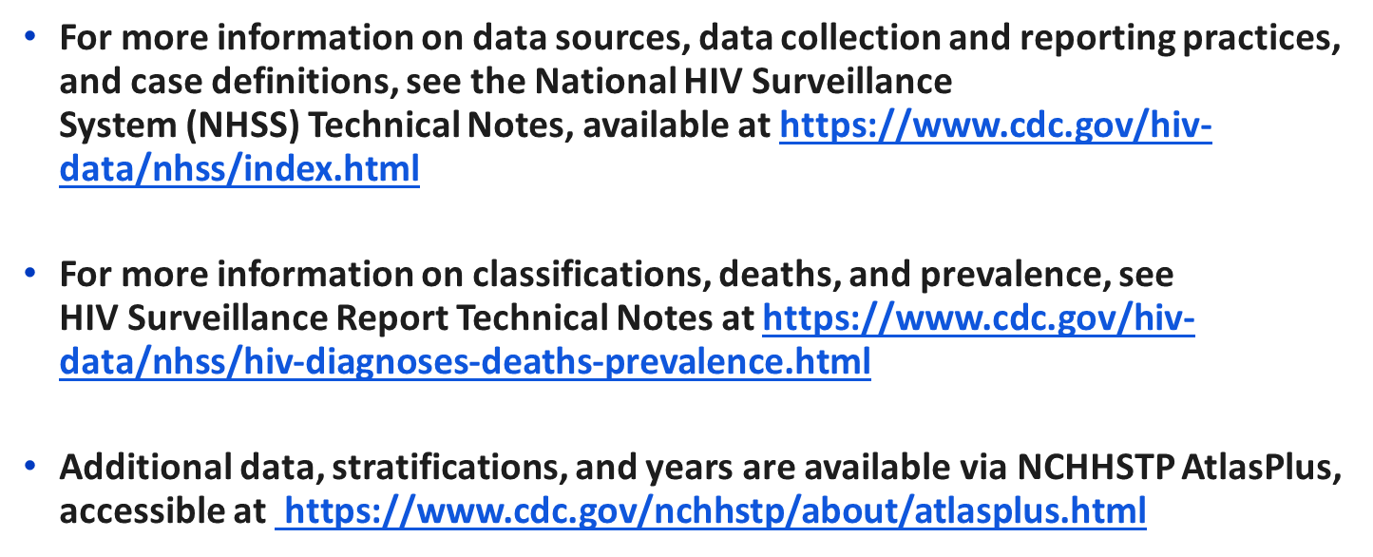

Data Sources and Technical Notes​
Notes:
For all slides in this series, the following notes apply:
All data presented in this slide set were reported to CDC through December 31, 2024, and are considered provisional and subject to change as additional reports are submitted for HIV cases and as HIV surveillance data quality improves with further evaluation of the surveillance system and data repository. Because reporting delays can impact the reliability of data presented in this report, caution should be applied when interpreting the results.
Numbers, percentages, and rates of diagnosed HIV classified as stage 3 (AIDS) are based on data from 50 states, the District of Columbia, and 6 U.S. territories and freely associated states.
Rates for transmission category are not provided because of the absence of denominator data from the U.S. Census Bureau.
Rates are not calculated by race/ethnicity for the 6 U.S. territories and freely associated states because the U.S. Census Bureau does not collect information from all U.S. territories and freely associated states.
For more information on data sources, data collection and reporting practices, and case definitions, see the National HIV Surveillance System (NHSS) Technical Notes, available at https://www.cdc.gov/hiv-data/nhss/index.html.
For more information on classification, deaths, and prevalence; see HIV Surveillance Report Technical Notes at https://www.cdc.gov/hiv-data/nhss/hiv-diagnoses-deaths-prevalence.html.
Additional data, stratifications, and years are available via NCHHSTP AtlasPlus, accessible at https://www.cdc.gov/nchhstp/about/atlasplus.html.
Data for 2020, which coincided with the onset of the COVID-19 pandemic, should be interpreted with caution. The pandemic had a significant impact on access to HIV testing, care, and related services, and case surveillance activities in state and local jurisdictions. As the COVID-19 pandemic lasted beyond 2020, readers should also consider the potential influence of these pandemic effects on U.S. public health systems when interpreting HIV data for 2021–2022. Death data for years 2020 and 2021 should be interpreted with caution due to excess deaths in the United States population attributed to the COVID-19 pandemic. For additional information, see https://www.cdc.gov/nchs/nvss/vsrr/covid19/excess_deaths.htm.
.

Slide 3
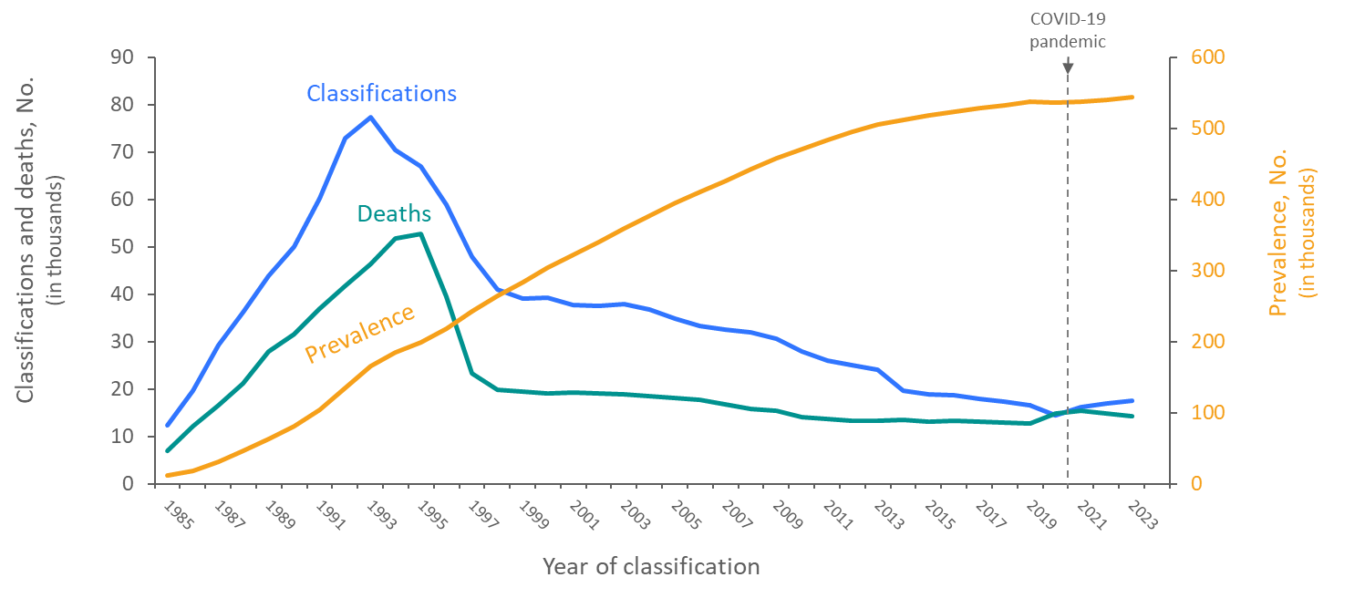
Stage 3 (AIDS) classifications, deaths (any cause), and persons living with diagnosed HIV ever classified as stage 3 (AIDS), 1985–2023— United States and 6 territories and freely associated states
Note. Data are presented for persons of all ages.
Notes:
In the United States and 6 territories and freely associated states, stage 3 (AIDS) classifications and deaths of persons with stage 3 (AIDS) increased sharply from 1985 through the mid-1990s. The overall declines in stage 3 (AIDS) classifications and deaths of persons with stage 3 (AIDS) since the mid-1990s are due to breakthroughs in early detection of HIV, improved screening technologies, advances in antiretroviral and combination drug therapies, prophylactic medications against opportunistic infections, and HIV prevention awareness campaigns. The prevalence of stage 3 (AIDS) has steadily increased throughout 1985–2023.
Note.
Deaths of persons with HIV disease ever classified as stage 3 (AIDS) may be due to any cause.
Prevalence data for 2023 should be interpreted with caution due to the use of preliminary death data for that year reported to CDC as of December 2024.​
The data for 2020, which coincided with the onset of the COVID-19 pandemic, should be interpreted with caution. The pandemic had a significant impact on access to HIV testing, care, and related services, and case surveillance activities in state and local jurisdictions. As the COVID-19 pandemic lasted beyond 2020, readers should also consider the potential influence of these pandemic effects on U.S. public health systems when interpreting HIV data for 2021–2022. For additional information, see https://www.cdc.gov/nchs/nvss/vsrr/covid19/excess_deaths.htm.
For more information on data sources, data collection and reporting practices, and case definitions, see the National HIV Surveillance System (NHSS) Technical Notes, available at https://www.cdc.gov/hiv-data/nhss/index.html.

Slide 4
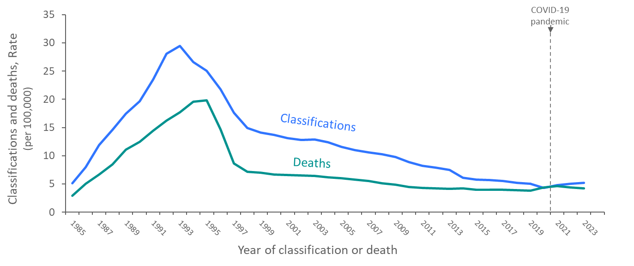
Rates of Stage 3 (AIDS) classifications and deaths (any cause) of persons with diagnosed HIV ever classified as stage 3 (AIDS), 1985–2023—United States and 5 territories and freely associated states
Note. Data are presented for persons of all ages.
Notes:
In the United States and 6 territories and freely associated states, rates of stage 3 (AIDS) classifications and rates of deaths of persons with stage 3 (AIDS) increased from 1985 through the mid-1990s. The overall declines in rates of stage 3 (AIDS) classifications and rates of deaths of persons with stage 3 (AIDS) since the mid-1990s are due to breakthroughs in early detection of HIV, improved screening technologies, advances in antiretroviral and combination drug therapies, prophylactic medications against opportunistic infections, and HIV prevention awareness campaigns.
Note.
Deaths of persons with HIV disease ever classified as stage 3 (AIDS) may be due to any cause.
Rates displayed here are based on data from the 50 U.S. states, the District of Columbia, American Samoa, Guam, the Northern Mariana Islands, Puerto Rico, and the U.S. Virgin Islands. Data for the Republic of Palau is not included due to lack of population estimates from 1985-1989.
Prevalence data for 2023 should be interpreted with caution due to the use of preliminary death data for that year reported to CDC as of December 2024.​
The data for 2020, which coincided with the onset of the COVID-19 pandemic, should be interpreted with caution. The pandemic had a significant impact on access to HIV testing, care, and related services, and case surveillance activities in state and local jurisdictions. As the COVID-19 pandemic lasted beyond 2020, readers should also consider the potential influence of these pandemic effects on U.S. public health systems when interpreting HIV data for 2021–2022. For additional information, see https://www.cdc.gov/nchs/nvss/vsrr/covid19/excess_deaths.htm.
For more information on data sources, data collection and reporting practices, and case definitions, see the National HIV Surveillance System (NHSS) Technical Notes, available at https://www.cdc.gov/hiv-data/nhss/index.html.

Slide 5
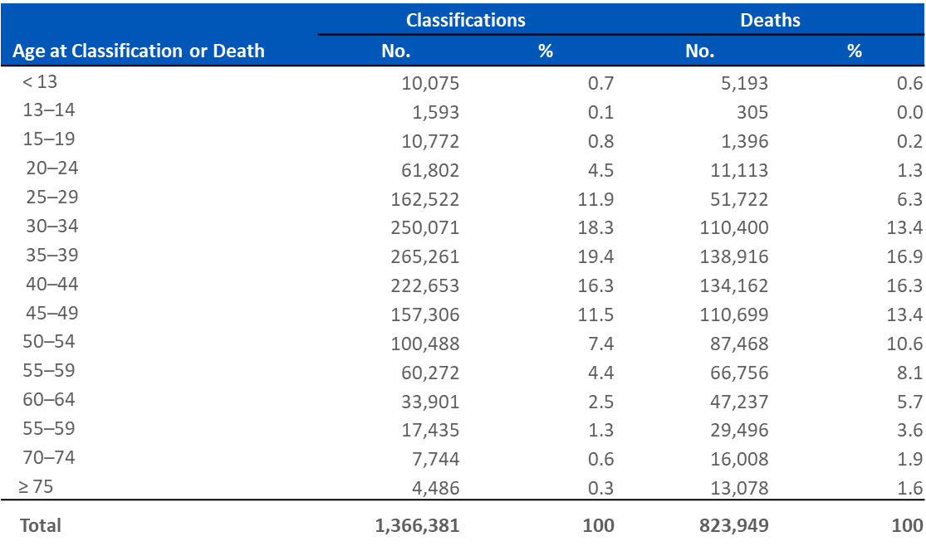
Stage 3 (AIDS) classifications and deaths of persons with stage 3 (AIDS), by age at classification or death (any cause), cumulative as of year-end 2023—United States and 6 territories and freely associated states
Notes:
By year-2023 in the United States and 6 territories and freely associated states, there were 1,366,381 stage 3 (AIDS) classifications and 823,949 deaths among persons with Stage 3 (AIDS).
As of year-end 2023, cumulative stage 3 (AIDS) classifications were as follows:
Persons aged 30–34 years accounted for 18.3%
Persons aged 35–39 years accounted for 19.4%
Persons aged 40–44 years accounted for 16.3%
Cumulative stage 3 (AIDS) deaths were as follows:
Persons aged 35–39 years accounted for 16.9%
Persons aged 40–44 years accounted for 16.3%
Persons aged 30–34 years and 45-49 years both accounted for 13.4%
Note.
Deaths of persons with HIV disease, stage 3 (AIDS) may be due to any cause.
Cumulative data are from the beginning of the epidemic through 2023.
For more information on data sources, data collection and reporting practices, and case definitions, see the National HIV Surveillance System (NHSS) Technical Notes, available at https://www.cdc.gov/hiv-data/nhss/index.html.

Slide 6
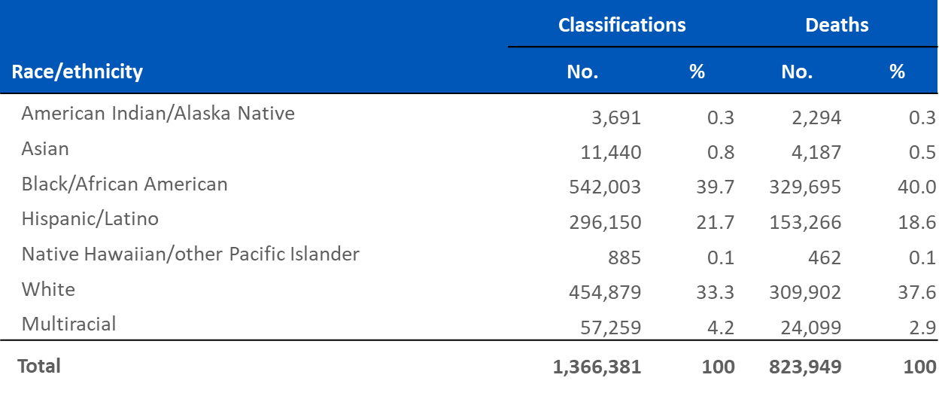
Stage 3 (AIDS) classifications and deaths (any cause) of persons with stage 3 (AIDS), by race/ethnicity, cumulative as of year-end 2023—United States and 6 territories and freely associated states
Note. Data are presented for persons of all ages. Hispanic/Latino persons can be of any race.
Notes:
By year-2023 in the United States and 6 territories and freely associated states, there were 1,366,381 stage 3 (AIDS) classifications and 823,949 deaths among persons with Stage 3 (AIDS).
As of year-end 2023, cumulative stage 3 (AIDS) classifications were as follows:
Black/African American persons accounted for 39.7%
White persons accounted for 33.3%
As of year-end 2023, cumulative stage 3 (AIDS) deaths were as follows:
Black/African American persons accounted for 40.0%
White persons accounted for 37.6%
Note.
Deaths of persons with HIV disease, stage 3 (AIDS) may be due to any cause.
Cumulative data are from the beginning of the epidemic through 2023.
Data presented for Asian persons includes Asian/Pacific Islander legacy cases.
Total includes persons whose race/ethnicity is unknown.
For more information on data sources, data collection and reporting practices, and case definitions, see the National HIV Surveillance System (NHSS) Technical Notes, available at https://www.cdc.gov/hiv-data/nhss/index.html.

Slide 7
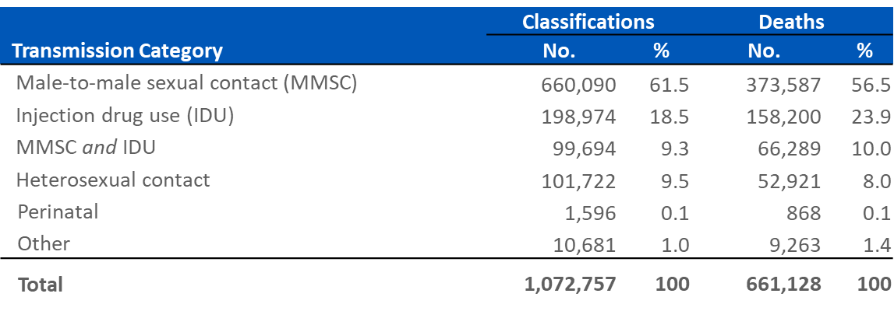
Stage 3 (AIDS) classifications and deaths (any cause) of persons with stage 3 (AIDS) among males, by transmission category, cumulative as of year-end 2023—United States and 6 territories and freely associated states
Note. Data are presented for persons aged ≥ 13 years. Data are based on sex
Notes:
By year-2023 in the United States and 6 territories and freely associated states, among males aged ≥13 years, there were 1,072,757 stage 3 (AIDS) classifications and 661,128 deaths among persons with Stage 3 (AIDS).
As of year-end 2023, cumulative stage 3 (AIDS) classifications were as follows:
Males with HIV attributed to male-to-male sexual contact (MMSC) accounted for 61.5%
Males with HIV attributed to injection drug use (IDU) accounted for 18.5%
As of year-end 2023, cumulative stage 3 (AIDS) deaths were as follows:
Males with HIV attributed to male-to-male sexual contact (MMSC) accounted for 56.5%
Males with HIV attributed to injection drug use (IDU) accounted for 23.9%
Note.
Deaths of persons with HIV disease, stage 3 (AIDS) may be due to any cause.
Cumulative data are from the beginning of the epidemic through 2023.
Transmission category is classified based on a hierarchy of the risk factors most likely responsible for HIV transmission; classification is determined based on the person’s sex. Data have been statistically adjusted to account for missing transmission category, and column totals for numbers were calculated independently of the values for the subpopulations; therefore, values may not sum to column total.
Total includes other risk factors including hemophilia, blood transfusion, and risk factor not reported or not identified.
For more information on data sources, data collection and reporting practices, and case definitions, see the National HIV Surveillance System (NHSS) Technical Notes, available at https://www.cdc.gov/hiv-data/nhss/index.html.

Slide 8
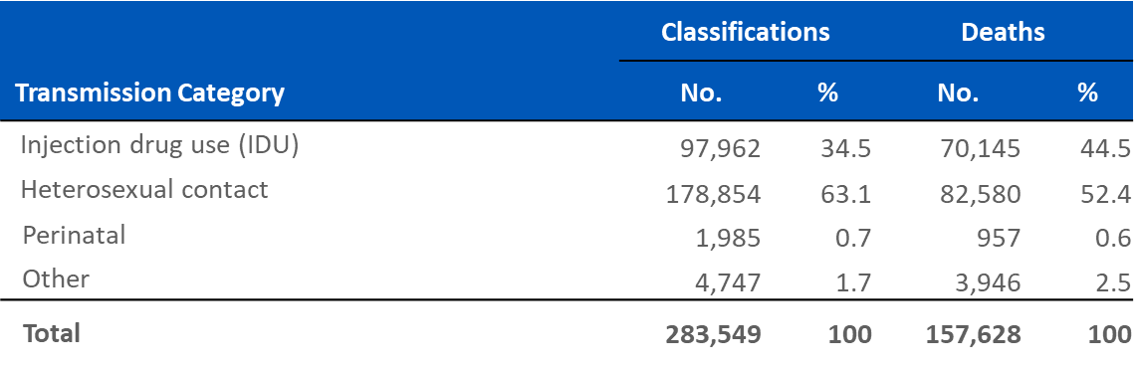
Stage 3 (AIDS) classifications and deaths (any cause) of persons with stage 3 (AIDS) females, by transmission category, cumulative as of year-end 2023—United States and 6 territories and freely associated states
Note. Data are presented for persons aged ≥ 13 years. Data are based on sex.
Notes:
By year-2023 in the United States and 6 territories and freely associated states, among females aged ≥13 years, there were 283,549 stage 3 (AIDS) classifications and 157,628 deaths among persons with Stage 3 (AIDS).
As of year-end 2023, cumulative stage 3 (AIDS) classifications were as follows:
Females with HIV attributed to heterosexual contact accounted for 63.1%
Females with HIV attributed to injection drug use (IDU) accounted for 34.5%
As of year-end 2023, cumulative stage 3 (AIDS) deaths were as follows:
Females with HIV attributed to heterosexual contact accounted for 52.4%
Females with HIV attributed to injection drug use (IDU) accounted for 44.5%
Note.
Deaths of persons with HIV disease, stage 3 (AIDS) may be due to any cause.
Cumulative data are from beginning of the epidemic through 2023.
Transmission category is classified based on a hierarchy of the risk factors most likely responsible for HIV transmission; classification is determined based on the person’s sex. Data have been statistically adjusted to account for missing transmission category, and column totals for numbers were calculated independently of the values for the subpopulations; therefore, values may not sum to column total.
Total includes other risk factors including hemophilia, blood transfusion, and risk factor not reported or not identified.
For more information on data sources, data collection and reporting practices, and case definitions, see the National HIV Surveillance System (NHSS) Technical Notes, available at https://www.cdc.gov/hiv-data/nhss/index.html.

Slide 9
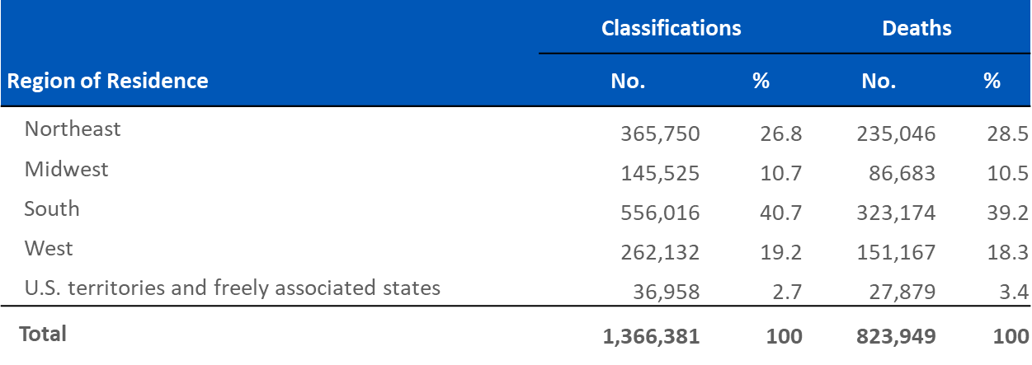
Stage 3 (AIDS) classifications and deaths (any cause) of persons with stage 3 (AIDS), by region of residence, cumulative as of year-end 2023—United States and 6 territories and freely associated states
Note. Data are presented for persons of all ages. Data are based on residence at time of stage 3 (AIDS) classification or death.
Notes:
By year-2023 in the United States and 6 territories and freely associated states, there were 1,366,381 stage 3 (AIDS) classifications and 823,949 deaths among persons with stage 3 (AIDS).
As of year-end 2023, cumulative stage 3 (AIDS) classifications were as follows:
Persons residing in the South accounted for 40.7%
Persons residing in the Northeast accounted for 26.8%
As of year-end 2023, cumulative stage 3 (AIDS) deaths were as follows:
Persons residing in the South accounted for 39.2%
Persons residing in the Northeast accounted for 28.5%
Note.
Deaths of persons with HIV disease, stage 3 (AIDS) may be due to any cause.
Cumulative data are from the beginning of the epidemic through 2023.
Region of residence used in report are defined by the U.S. Census. For more information, see https://www.census.gov/programs-surveys/economic-census/guidance-geographies/levels.html.
For more information on data sources, data collection and reporting practices, and case definitions, see the National HIV Surveillance System (NHSS) Technical Notes, available at https://www.cdc.gov/hiv-data/nhss/index.html.

Slide 10
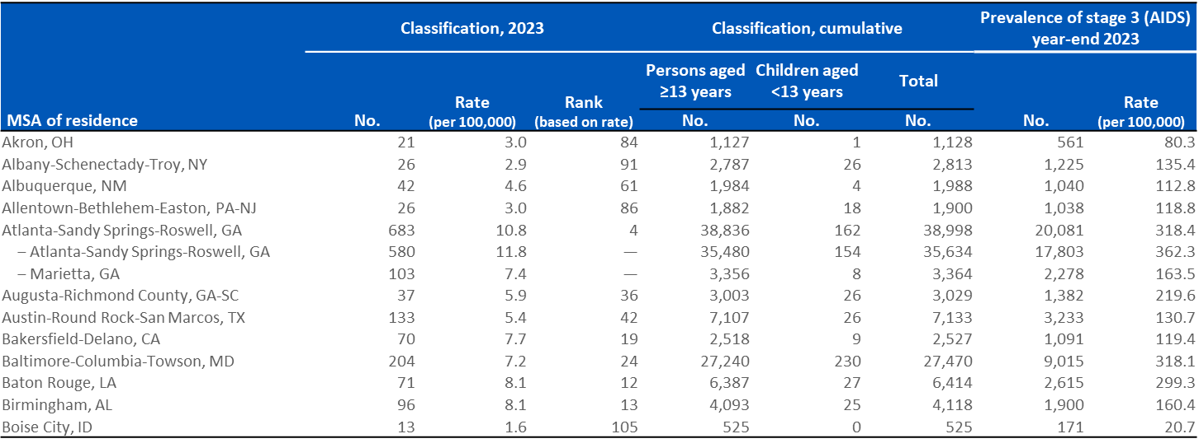
Stage 3 (AIDS), 2023 and cumulative, and persons living with diagnosed HIV ever classified as stage 3 (AIDS) (prevalence), year-end 2023 by metropolitan statistical area of residence—United States and Puerto Rico (Slide 1 of 10)
Note. Data are presented for persons of all ages.
Notes:
Note.
Metropolitan statistical area (MSA) definitions for this report can be found at http://www.census.gov/programs-surveys/metro-micro.html.
The MSA rankings are based on rates derived from 12 or more cases, as smaller numbers should be interpreted with caution.
The indented data presented on the slide include metropolitan divisions (subunits within a larger MSA) with populations greater than 500,000. Metropolitan divisions may not sum to the MSA total. The Boston-Cambridge-Newton, MA-NH and San Francisco-Oakland-Berkeley, CA MSAs include 1 division with a population less than 500,000. Therefore, data presented for divisions in these 2 MSAs do not sum to the MSA totals.
Stage 3 (AIDS) classification data are based on residence at time of classification.
Cumulative data are from the beginning of the epidemic through 2023.
Prevalence data are based on address of residence at the end of the specified year (i.e., most recent known address).
For more information on data sources, data collection and reporting practices, and case definitions, see the National HIV Surveillance System (NHSS) Technical Notes, available at https://www.cdc.gov/hiv-data/nhss/index.html.

Slide 11
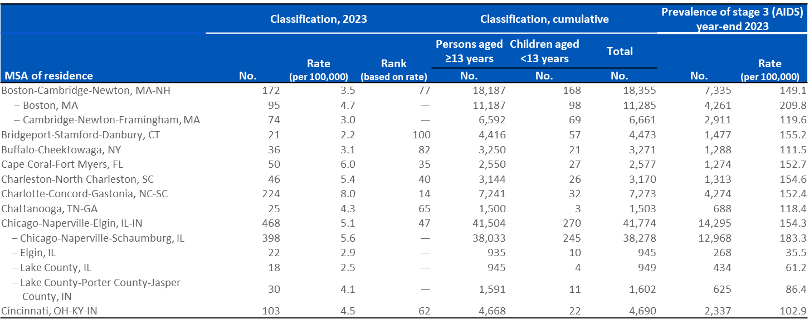
Stage 3 (AIDS), 2023 and cumulative, and persons living with diagnosed HIV ever classified as stage 3 (AIDS) (prevalence), year-end 2023 by metropolitan statistical area of residence—United States and Puerto Rico (Slide 2 of 10)
Note. Data are presented for persons of all ages.
Notes:
Note.
Metropolitan statistical area (MSA) definitions for this report can be found at http://www.census.gov/programs-surveys/metro-micro.html.
The MSA rankings are based on rates derived from 12 or more cases, as smaller numbers should be interpreted with caution.
The indented data presented on the slide include metropolitan divisions (subunits within a larger MSA) with populations greater than 500,000. Metropolitan divisions may not sum to the MSA total. The Boston-Cambridge-Newton, MA-NH and San Francisco-Oakland-Berkeley, CA MSAs include 1 division with a population less than 500,000. Therefore, data presented for divisions in these 2 MSAs do not sum to the MSA totals.
Stage 3 (AIDS) classification data are based on residence at time of classification.
Cumulative data are from the beginning of the epidemic through 2023.
Prevalence data are based on address of residence at the end of the specified year (i.e., most recent known address).
For more information on data sources, data collection and reporting practices, and case definitions, see the National HIV Surveillance System (NHSS) Technical Notes, available at https://www.cdc.gov/hiv-data/nhss/index.html.

Slide 12
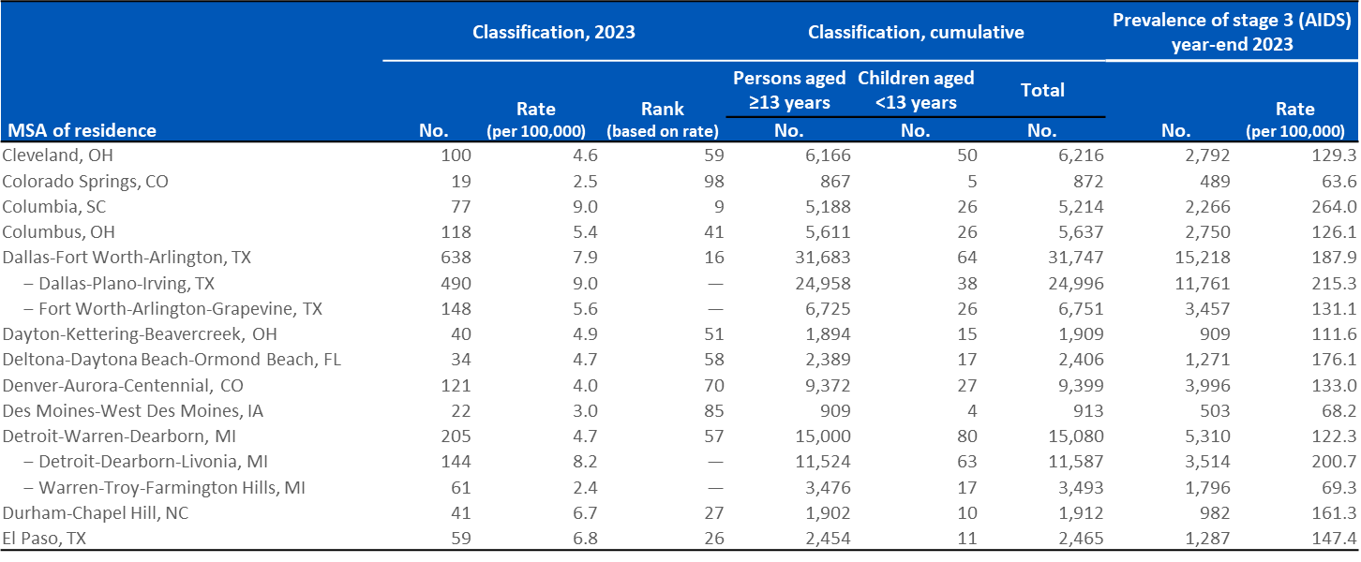
Stage 3 (AIDS), 2023 and cumulative, and persons living with diagnosed HIV ever classified as stage 3 (AIDS) (prevalence), year-end 2023 by metropolitan statistical area of residence—United States and Puerto Rico (Slide 3 of 10)
Note. Data are presented for persons of all ages.
Notes:
Note.
Metropolitan statistical area (MSA) definitions for this report can be found at http://www.census.gov/programs-surveys/metro-micro.html.
The MSA rankings are based on rates derived from 12 or more cases, as smaller numbers should be interpreted with caution.
The indented data presented on the slide include metropolitan divisions (subunits within a larger MSA) with populations greater than 500,000. Metropolitan divisions may not sum to the MSA total. The Boston-Cambridge-Newton, MA-NH and San Francisco-Oakland-Berkeley, CA MSAs include 1 division with a population less than 500,000. Therefore, data presented for divisions in these 2 MSAs do not sum to the MSA totals.
Stage 3 (AIDS) classification data are based on residence at time of classification.
Cumulative data are from the beginning of the epidemic through 2023.
Prevalence data are based on address of residence at the end of the specified year (i.e., most recent known address).
For more information on data sources, data collection and reporting practices, and case definitions, see the National HIV Surveillance System (NHSS) Technical Notes, available at https://www.cdc.gov/hiv-data/nhss/index.html.

Slide 13
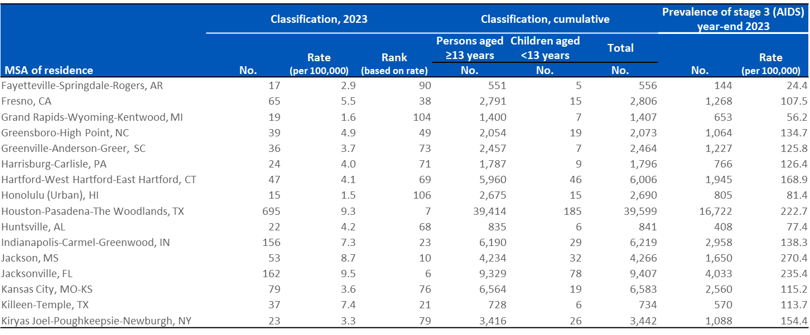
Stage 3 (AIDS), 2023 and cumulative, and persons living with diagnosed HIV ever classified as stage 3 (AIDS) (prevalence), year-end 2023 by metropolitan statistical area of residence—United States and Puerto Rico (Slide 4 of 10)
Note. Data are presented for persons of all ages.
Notes:
Note.
Metropolitan statistical area (MSA) definitions for this report can be found at http://www.census.gov/programs-surveys/metro-micro.html.
The MSA rankings are based on rates derived from 12 or more cases, as smaller numbers should be interpreted with caution.
The indented data presented on the slide include metropolitan divisions (subunits within a larger MSA) with populations greater than 500,000. Metropolitan divisions may not sum to the MSA total. The Boston-Cambridge-Newton, MA-NH and San Francisco-Oakland-Berkeley, CA MSAs include 1 division with a population less than 500,000. Therefore, data presented for divisions in these 2 MSAs do not sum to the MSA totals.
Stage 3 (AIDS) classification data are based on residence at time of classification.
Cumulative data are from the beginning of the epidemic through 2023.
Prevalence data are based on address of residence at the end of the specified year (i.e., most recent known address).
For more information on data sources, data collection and reporting practices, and case definitions, see the National HIV Surveillance System (NHSS) Technical Notes, available at https://www.cdc.gov/hiv-data/nhss/index.html.

Slide 14
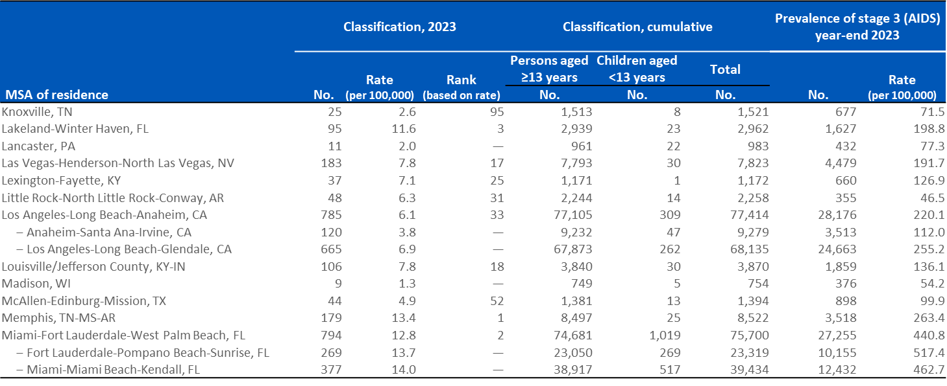
Stage 3 (AIDS), 2023 and cumulative, and persons living with diagnosed HIV ever classified as stage 3 (AIDS) (prevalence), year-end 2023 by metropolitan statistical area of residence—United States and Puerto Rico (Slide 5 of 10)
Note. Data are presented for persons of all ages.
Notes:
Note.
Metropolitan statistical area (MSA) definitions for this report can be found at http://www.census.gov/programs-surveys/metro-micro.html.
The MSA rankings are based on rates derived from 12 or more cases, as smaller numbers should be interpreted with caution.
The indented data presented on the slide include metropolitan divisions (subunits within a larger MSA) with populations greater than 500,000. Metropolitan divisions may not sum to the MSA total. The Boston-Cambridge-Newton, MA-NH and San Francisco-Oakland-Berkeley, CA MSAs include 1 division with a population less than 500,000. Therefore, data presented for divisions in these 2 MSAs do not sum to the MSA totals.
Stage 3 (AIDS) classification data are based on residence at time of classification.
Cumulative data are from the beginning of the epidemic through 2023.
Prevalence data are based on address of residence at the end of the specified year (i.e., most recent known address).
For more information on data sources, data collection and reporting practices, and case definitions, see the National HIV Surveillance System (NHSS) Technical Notes, available at https://www.cdc.gov/hiv-data/nhss/index.html.

Slide 15
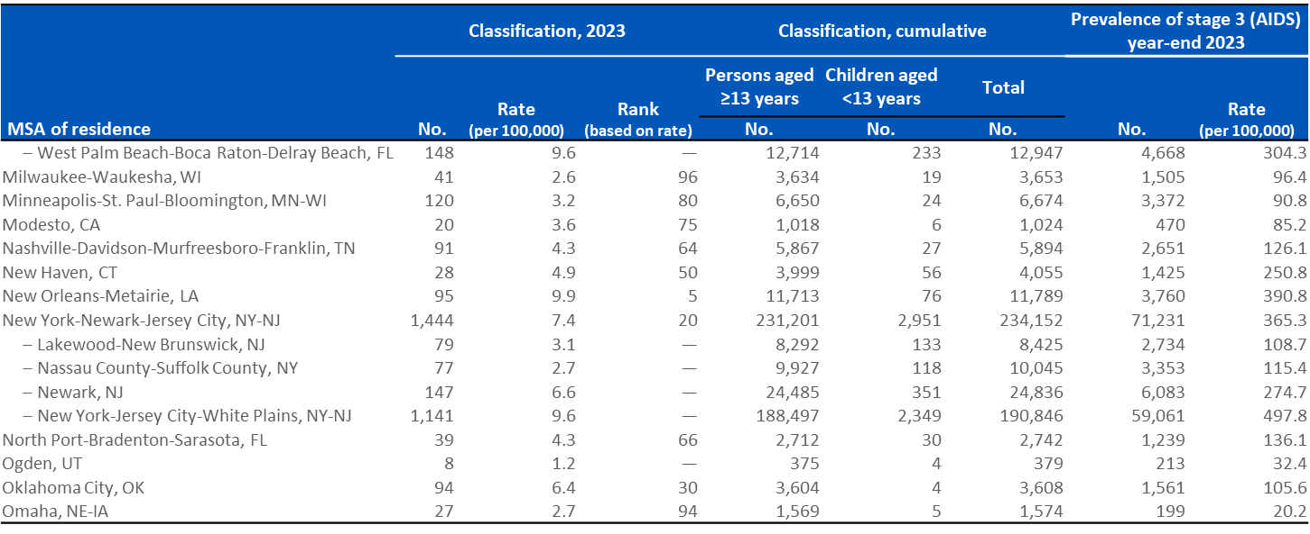
Stage 3 (AIDS), 2023 and cumulative, and persons living with diagnosed HIV ever classified as stage 3 (AIDS) (prevalence), year-end 2023 by metropolitan statistical area of residence—United States and Puerto Rico (Slide 6 of 10)
Note. Data are presented for persons of all ages.
Notes:
Note.
Metropolitan statistical area (MSA) definitions for this report can be found at http://www.census.gov/programs-surveys/metro-micro.html.
The MSA rankings are based on rates derived from 12 or more cases, as smaller numbers should be interpreted with caution.
The indented data presented on the slide include metropolitan divisions (subunits within a larger MSA) with populations greater than 500,000. Metropolitan divisions may not sum to the MSA total. The Boston-Cambridge-Newton, MA-NH and San Francisco-Oakland-Berkeley, CA MSAs include 1 division with a population less than 500,000. Therefore, data presented for divisions in these 2 MSAs do not sum to the MSA totals.
Stage 3 (AIDS) classification data are based on residence at time of classification.
Cumulative data are from the beginning of the epidemic through 2023.
Prevalence data are based on address of residence at the end of the specified year (i.e., most recent known address).
For more information on data sources, data collection and reporting practices, and case definitions, see the National HIV Surveillance System (NHSS) Technical Notes, available at https://www.cdc.gov/hiv-data/nhss/index.html.

Slide 16
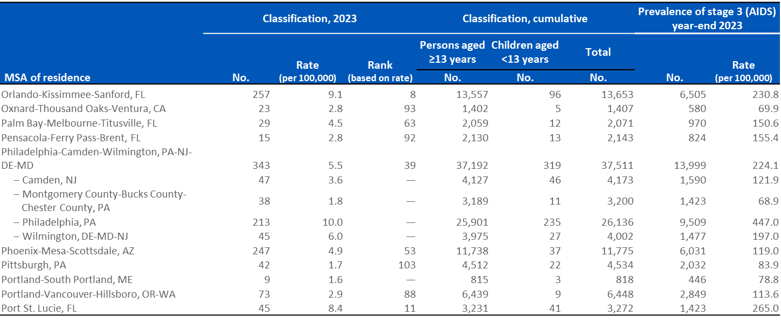
Stage 3 (AIDS), 2023 and cumulative, and persons living with diagnosed HIV ever classified as stage 3 (AIDS) (prevalence), year-end 2023 by metropolitan statistical area of residence—United States and Puerto Rico (Slide 7 of 10)
Note. Data are presented for persons of all ages.
Notes:
Note.
Metropolitan statistical area (MSA) definitions for this report can be found at http://www.census.gov/programs-surveys/metro-micro.html.
The MSA rankings are based on rates derived from 12 or more cases, as smaller numbers should be interpreted with caution.
The indented data presented on the slide include metropolitan divisions (subunits within a larger MSA) with populations greater than 500,000. Metropolitan divisions may not sum to the MSA total. The Boston-Cambridge-Newton, MA-NH and San Francisco-Oakland-Berkeley, CA MSAs include 1 division with a population less than 500,000. Therefore, data presented for divisions in these 2 MSAs do not sum to the MSA totals.
Stage 3 (AIDS) classification data are based on residence at time of classification.
Cumulative data are from the beginning of the epidemic through 2023.
Prevalence data are based on address of residence at the end of the specified year (i.e., most recent known address).
For more information on data sources, data collection and reporting practices, and case definitions, see the National HIV Surveillance System (NHSS) Technical Notes, available at https://www.cdc.gov/hiv-data/nhss/index.html.

Slide 17
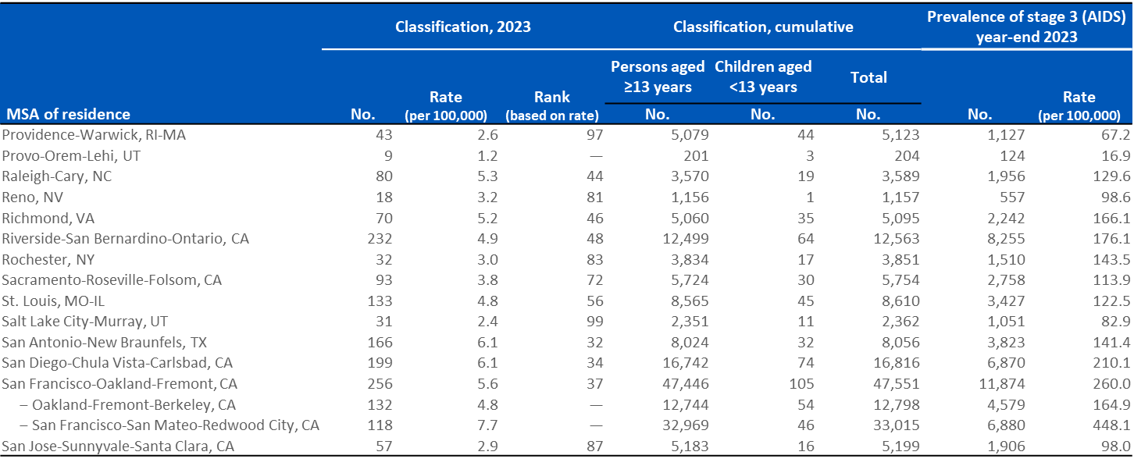
Stage 3 (AIDS), 2023 and cumulative, and persons living with diagnosed HIV ever classified as stage 3 (AIDS) (prevalence), year-end 2023 by metropolitan statistical area of residence—United States and Puerto Rico (Slide 8 of 10)
Note. Data are presented for persons of all ages.
Notes:
Note.
Metropolitan statistical area (MSA) definitions for this report can be found at http://www.census.gov/programs-surveys/metro-micro.html.
The MSA rankings are based on rates derived from 12 or more cases, as smaller numbers should be interpreted with caution.
The indented data presented on the slide include metropolitan divisions (subunits within a larger MSA) with populations greater than 500,000. Metropolitan divisions may not sum to the MSA total. The Boston-Cambridge-Newton, MA-NH and San Francisco-Oakland-Berkeley, CA MSAs include 1 division with a population less than 500,000. Therefore, data presented for divisions in these 2 MSAs do not sum to the MSA totals.
Stage 3 (AIDS) classification data are based on residence at time of classification.
Cumulative data are from the beginning of the epidemic through 2023.
Prevalence data are based on address of residence at the end of the specified year (i.e., most recent known address).
For more information on data sources, data collection and reporting practices, and case definitions, see the National HIV Surveillance System (NHSS) Technical Notes, available at https://www.cdc.gov/hiv-data/nhss/index.html.

Slide 18
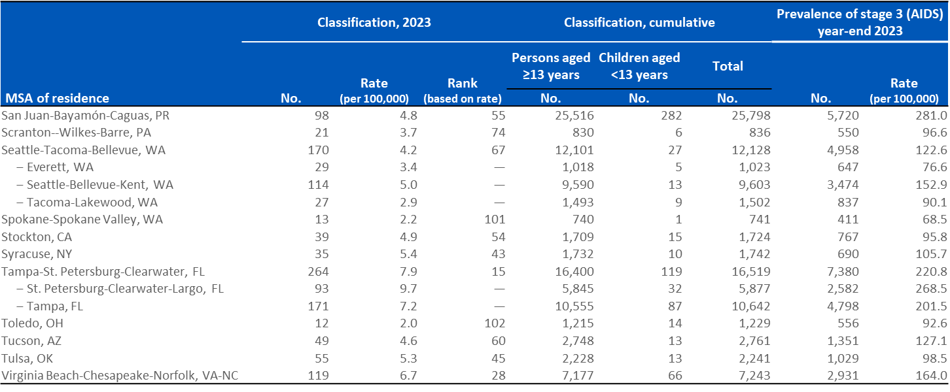
Stage 3 (AIDS), 2023 and cumulative, and persons living with diagnosed HIV ever classified as stage 3 (AIDS) (prevalence), year-end 2023 by metropolitan statistical area of residence—United States and Puerto Rico (Slide 9 of 10)
Note. Data are presented for persons of all ages.
Notes:
Note.
Metropolitan statistical area (MSA) definitions for this report can be found at http://www.census.gov/programs-surveys/metro-micro.html.
The MSA rankings are based on rates derived from 12 or more cases, as smaller numbers should be interpreted with caution.
The indented data presented on the slide include metropolitan divisions (subunits within a larger MSA) with populations greater than 500,000. Metropolitan divisions may not sum to the MSA total. The Boston-Cambridge-Newton, MA-NH and San Francisco-Oakland-Berkeley, CA MSAs include 1 division with a population less than 500,000. Therefore, data presented for divisions in these 2 MSAs do not sum to the MSA totals.
Stage 3 (AIDS) classification data are based on residence at time of classification.
Cumulative data are from the beginning of the epidemic through 2023.
Prevalence data are based on address of residence at the end of the specified year (i.e., most recent known address).
For more information on data sources, data collection and reporting practices, and case definitions, see the National HIV Surveillance System (NHSS) Technical Notes, available at https://www.cdc.gov/hiv-data/nhss/index.html.

Slide 19
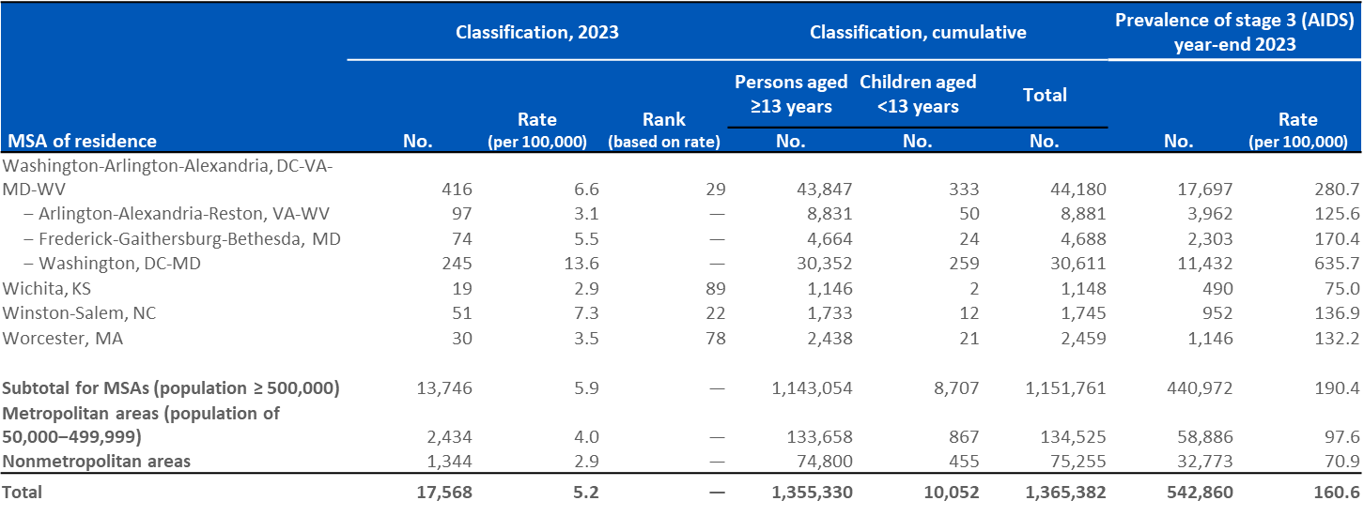
Stage 3 (AIDS), 2023 and cumulative, and persons living with diagnosed HIV ever classified as stage 3 (AIDS) (prevalence), year-end 2023 by metropolitan statistical area of residence—United States and Puerto Rico (Slide 10 of 10)
Note. Data are presented for persons of all ages.
Notes:
Note.
Metropolitan statistical area (MSA) definitions for this report can be found at http://www.census.gov/programs-surveys/metro-micro.html.
The MSA rankings are based on rates derived from 12 or more cases, as smaller numbers should be interpreted with caution.
The indented data presented on the slide include metropolitan divisions (subunits within a larger MSA) with populations greater than 500,000. Metropolitan divisions may not sum to the MSA total. The Boston-Cambridge-Newton, MA-NH and San Francisco-Oakland-Berkeley, CA MSAs include 1 division with a population less than 500,000. Therefore, data presented for divisions in these 2 MSAs do not sum to the MSA totals.
Stage 3 (AIDS) classification data are based on residence at time of classification.
Cumulative data are from the beginning of the epidemic through 2023.
Prevalence data are based on address of residence at the end of the specified year (i.e., most recent known address).
Total includes persons whose county of residence is unknown
For more information on data sources, data collection and reporting practices, and case definitions, see the National HIV Surveillance System (NHSS) Technical Notes, available at https://www.cdc.gov/hiv-data/nhss/index.html.

