Slide 1

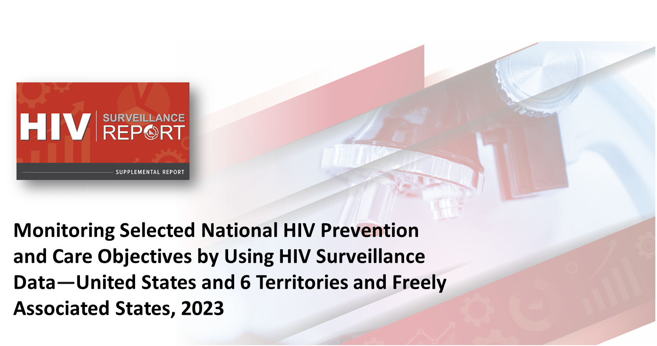
Notes:
These slides were prepared by the Division of HIV Prevention, National Center for HIV, Viral Hepatitis, STD, and TB Prevention (NCHHSTP), Centers for Disease Control and Prevention (CDC). These slides present data on persons with HIV in the United States based on cases of HIV reported to CDC’s National HIV Surveillance System through December 2024.
Note. This slide set is in the public domain. You may reproduce these slides without permission; however, citation as to source is appreciated.
Centers for Disease Control and Prevention. Monitoring Selected National HIV Prevention and Care Objectives by Using HIV Surveillance Data United States and 6 Territories and Freely Associated States, 2023. Atlanta: U.S. Department of Health and Human Services; 2025.
You are also free to adapt and revise these slides; however, you must remove the CDC name and logo if changes are made.

Slide 2
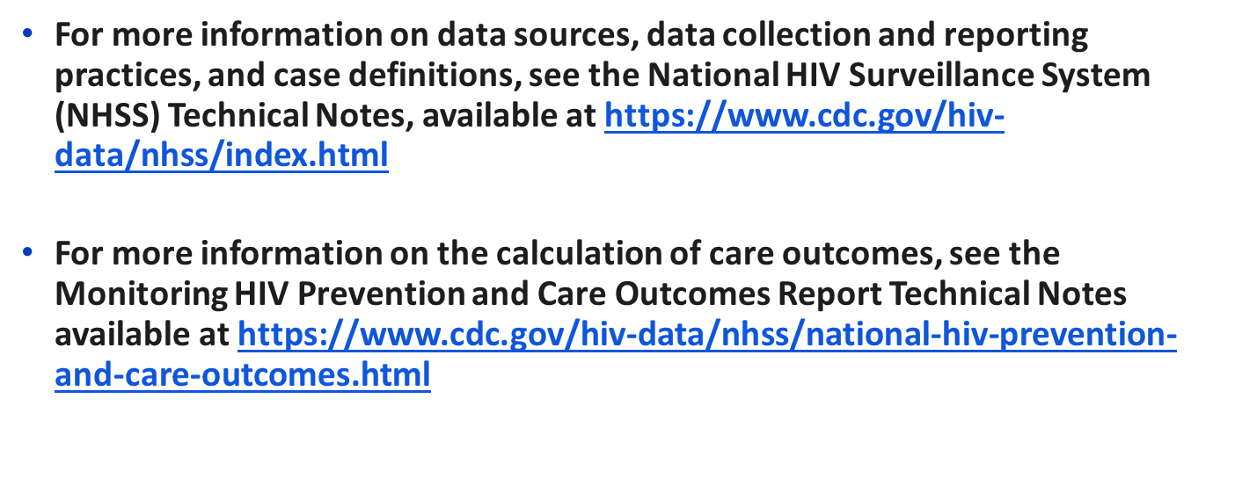

Data Sources and Technical Notes
Notes:
For more information on data sources, data collection and reporting practices, and case definitions, see the National HIV Surveillance System (NHSS) Technical Notes, available at https://www.cdc.gov/hiv-data/nhss/index.html.
For more information on the calculation of care outcomes, see the Monitoring HIV Prevention and Care Outcomes Report Technical Notes available at https://www.cdc.gov/hiv-data/nhss/national-hiv-prevention-and-care-outcomes.html.

Slide 3
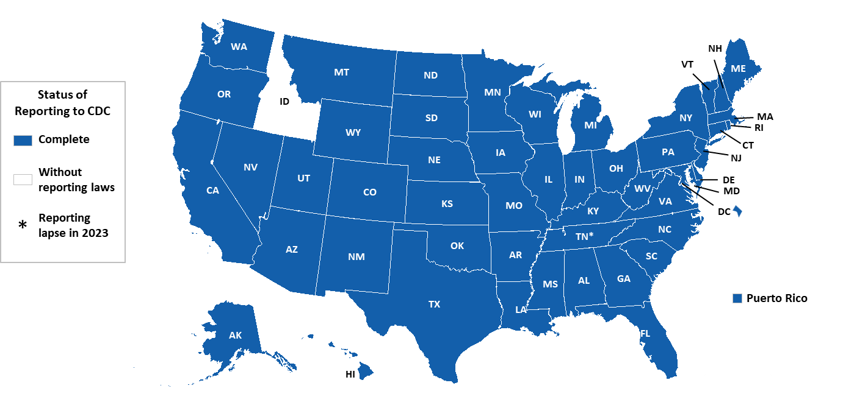
Status of CD4 and viral load reporting by HIV surveillance reporting area, as of December 2024 – United States and Puerto Rico
Notes:
As of December 2024, all areas of the United States (except Idaho) and Puerto Rico had complete laboratory reporting for specimens collected from at least January 2022 through September 2024. Data from these jurisdictions represent 99% of all persons aged ≥ 13 years living with diagnosed HIV at year-end 2023 in the United States.
Tennessee had a lapse in reporting in 2023; interpret data with caution. Idaho lacks reporting laws.
Use caution when interpreting data for the West, as it includes Idaho, which does not have laws and regulations requiring the reporting of all CD4 and viral load results.
Note.
For more information on data sources, data collection and reporting practices, and case definitions, see the National HIV Surveillance System (NHSS) Technical Notes, available at https://www.cdc.gov/hiv-data/nhss/index.html.
For more information on complete lab reporting, see the Technical Notes, available at https://www.cdc.gov/hiv-data/nhss/national-hiv-prevention-and-care-outcomes.html.
A list of jurisdictions with complete lab reporting by year is available on the NCHHSTP AtlasPlus (Table 1.7) technical notes located at https://www.cdc.gov/nchhstp/about/atlasplus.html.

Slide 4
Stage of disease at HIV diagnosis

Slide 5
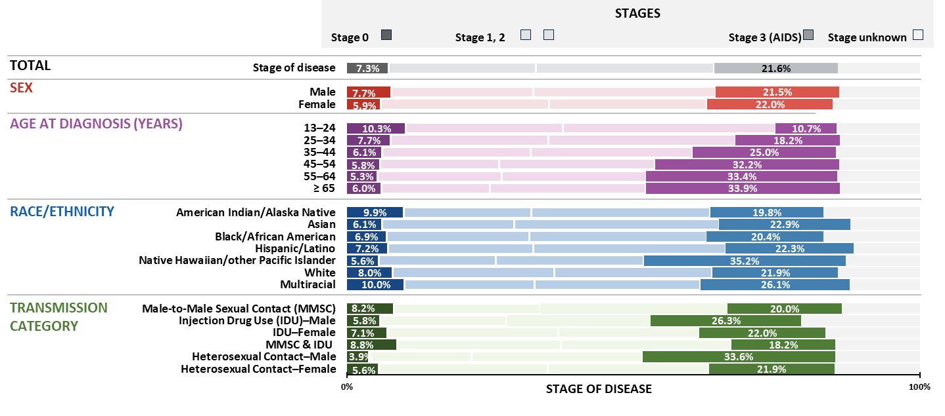
Stage of disease at diagnosis among persons with HIV, by selected characteristics, 2023—United States
Note. Data are presented for persons aged ≥ 13 years at diagnosis. Hispanic/Latino persons can be of any race.
Notes:
In 2023 in the United States, among 38,793 persons aged ≥ 13 years diagnosed with HIV, the stage of disease at time of diagnosis was classified as follows: stage 0 (7.3%), stage 1 (25.7%), stage 2 (31.1%), stage 3 (AIDS) (21.6%), and stage unknown (14.3%).
Overall, a higher percentage (21.6%) received a late stage (stage 3 [AIDS]) classification than an early (stage 0) diagnosis (7.3%).
Higher percentages of persons who received a stage 0 HIV diagnosis—males (7.7%), persons aged 13–24 years (10.3%), American Indian/Alaska Native (9.9%) and multiracial (10.0%) persons, and males with HIV attributed to male-to-male sexual contact and injection drug use (8.8%) and male-to-male sexual contact (8.2%).
Higher percentages of persons who received a late-stage (stage 3 [AIDS]) classification—females (22.0%), persons aged ≥ 65 years (33.9%), Native Hawaiian/other Pacific Islander (35.2%) persons, and males with HIV attributed to heterosexual contact (33.6%).
Note.
For additional data, see Table 1a in the report HIV Surveillance Supplemental Report: Monitoring Selected National HIV Prevention and Care Objectives by Using HIV Surveillance Data United States and 6 Territories and Freely Associated States, 2023 at https://www.cdc.gov/hiv-data/nhss/national-hiv-prevention-and-care-outcomes.html.
Data have been statistically adjusted to account for missing transmission category.
Use caution when interpreting data for American Indian/Alaska Native and Native Hawaiian/other Pacific Islander persons due to small numbers.
For more information on data sources, data collection and reporting practices, and case definitions, see the National HIV Surveillance System (NHSS) Technical Notes, available at https://www.cdc.gov/hiv-data/nhss/index.html.
For more information on stage of disease at HIV diagnosis, see the Technical Notes, available at https://www.cdc.gov/hiv-data/nhss/national-hiv-prevention-and-care-outcomes.html.
Data for all figures are available at https://www.cdc.gov/hiv-data/nhss/national-hiv-prevention-and-care-outcomes.html.

Slide 6
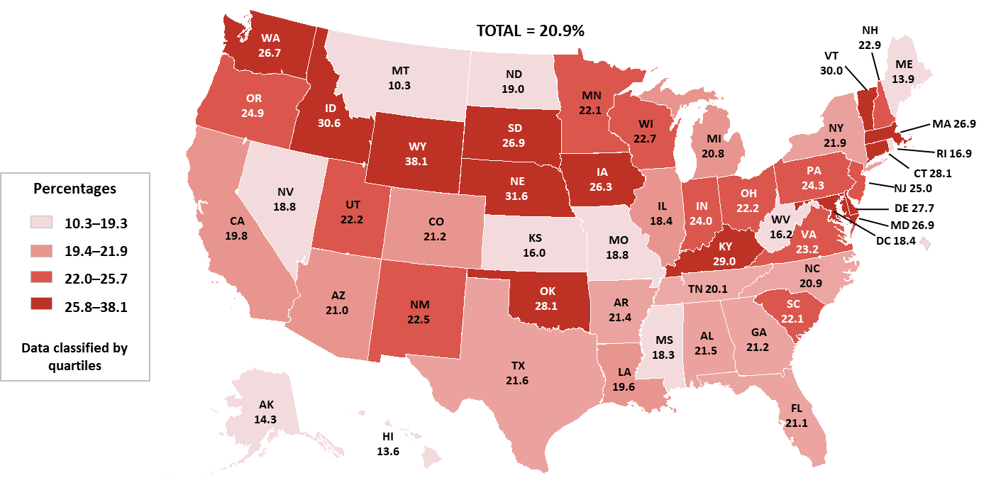
Stage 3 (AIDS) at time of HIV diagnosis during 2023—United States
Note. Data are presented for persons aged ≥ 13 years at diagnosis.
Notes:
Among the 38,793 persons aged ≥ 13 years who received an HIV diagnosis during 2023 in the United States, more than 1 in 5 persons (21.6%) received a late-stage diagnosis (stage 3 [AIDS]).
The darkest areas (CT, DE, ID, IA, KY, MD, MA, NE, OK, SD, VT, WA, WY) had ≥ 25.8% of persons who received a late-stage classification.
Note.
For additional data, see Table 5c in the report HIV Surveillance Supplemental Report: Monitoring Selected National HIV Prevention and Care Objectives by Using HIV Surveillance Data United States and 6 Territories and Freely Associated States, 2023 at https://www.cdc.gov/hiv-data/nhss/national-hiv-prevention-and-care-outcomes.html.
For more information on data sources, data collection and reporting practices, and case definitions, see the National HIV Surveillance System (NHSS) Technical Notes, available at https://www.cdc.gov/hiv-data/nhss/index.html.
For more information on stage of disease at HIV diagnosis, see the Technical Notes, available at https://www.cdc.gov/hiv-data/nhss/national-hiv-prevention-and-care-outcomes.html.
Data for all figures are available at https://www.cdc.gov/hiv-data/nhss/national-hiv-prevention-and-care-outcomes.html.

Slide 7
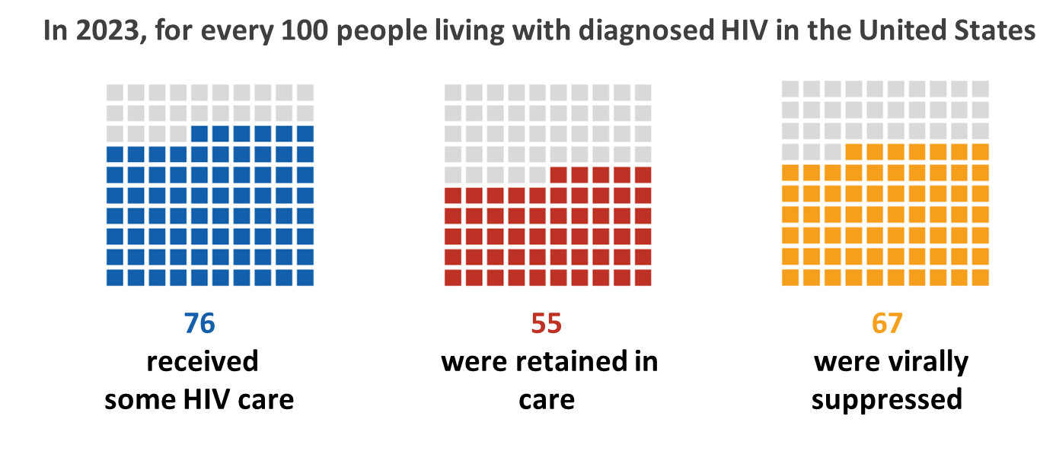
HIV care continuum for persons living with diagnosed HIV at year-end 2023—United States
Note. Data are presented for persons aged ≥ 13 years at diagnosis.
Notes:
In 2023, of the nearly 1.1 million persons aged ≥ 13 years living with diagnosed HIV in the United States:
76% received HIV medical care
55% were retained in HIV medical care
67% had viral suppression
Note.
For additional data, see Table 3a in the report HIV Surveillance Supplemental Report: Monitoring Selected National HIV Prevention and Care Objectives by Using HIV Surveillance Data United States and 6 Territories and Freely Associated States, 2023 at https://www.cdc.gov/hiv-data/nhss/national-hiv-prevention-and-care-outcomes.html.
For more information on data sources, data collection and reporting practices, and case definitions, see the National HIV Surveillance System (NHSS) Technical Notes, available at https://www.cdc.gov/hiv-data/nhss/index.html.
For more information on the U.S. region and the diagnosis-based care continuum, see the Technical Notes, available at https://www.cdc.gov/hiv-data/nhss/national-hiv-prevention-and-care-outcomes.html.
Data for all figures are available at https://www.cdc.gov/hiv-data/nhss/national-hiv-prevention-and-care-outcomes.html.

Slide 8
Linkage to HIV medical care

Slide 9
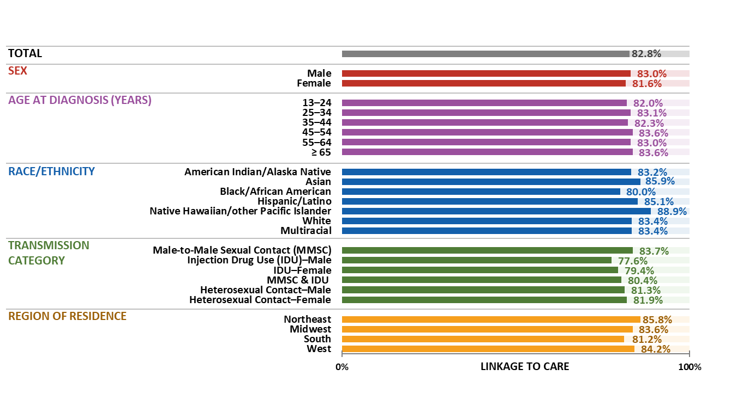
Linkage to HIV medical care within 1 month of HIV diagnosis, by selected characteristics, 2023—United States
Note. Data are presented for persons aged ≥ 13 years at diagnosis. Hispanic/Latino persons can be of any race.
Notes:
In the United States, among 38,793 persons aged ≥ 13 years with HIV diagnosed during 2023, 82.8% were linked to care within one month.
Highest percentages—males, Native Hawaiian/other Pacific Islander persons, persons with HIV attributed to male-to-male sexual contact, and persons residing in the Northeast at the time of diagnosis.
Lowest percentages—females, Black/African American persons, persons with HIV attributed to injection drug use, and persons residing in the South at the time of diagnosis.
Note.
For additional data, see Tables 2a and 2b in the report HIV Surveillance Supplemental Report: Monitoring Selected National HIV Prevention and Care Objectives by Using HIV Surveillance Data United States and 6 Territories and Freely Associated States, 2023 at https://www.cdc.gov/hiv-data/nhss/national-hiv-prevention-and-care-outcomes.html.
Data have been statistically adjusted to account for missing transmission category.
Use caution when interpreting data for American Indian/Alaska Native and Native Hawaiian/other Pacific Islander persons due to small numbers.
For more information on data sources, data collection and reporting practices, and case definitions, see the National HIV Surveillance System (NHSS) Technical Notes, available at https://www.cdc.gov/hiv-data/nhss/index.html.
For more information on linkage to HIV medical care, see the Technical Notes, available at https://www.cdc.gov/hiv-data/nhss/national-hiv-prevention-and-care-outcomes.html.
Data for all figures are available at https://www.cdc.gov/hiv-data/nhss/national-hiv-prevention-and-care-outcomes.html.

Slide 10
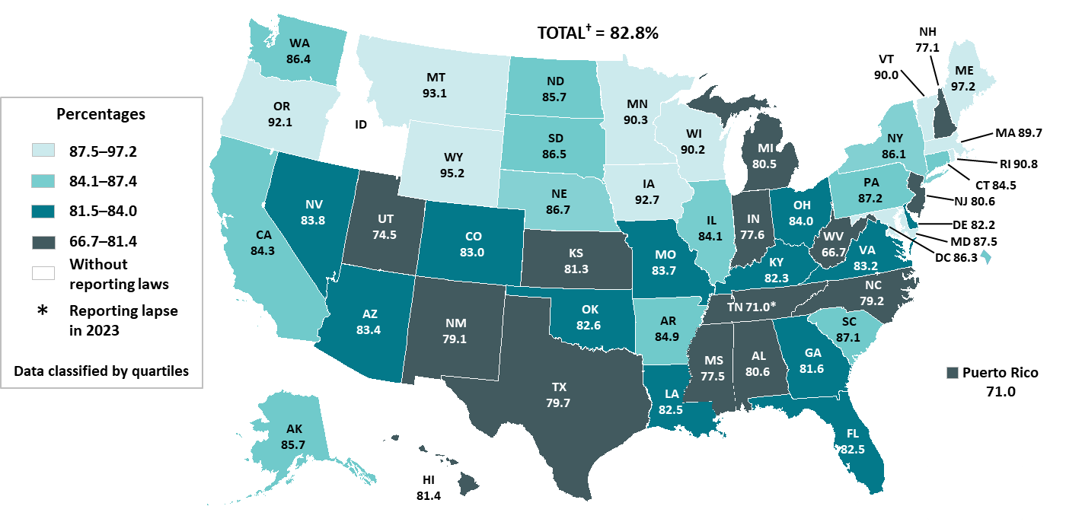
Linkage to HIV medical care within 1 month of HIV diagnosis during 2023—United States and Puerto Rico
Note. Data are presented for persons aged ≥ 13 years at diagnosis. †Total does not include Puerto Rico.
Notes:
In the United States, among 38,793 persons aged ≥ 13 years with HIV diagnosed during 2023, 82.8% were linked to care within one month of diagnosis.
The darkest areas (AL, HI, IN, KS, MI, MS, NC, NH, NJ, NM, TN, TX, UT, WV, PR) had ≤ 81.4% of persons linked to HIV medical care.
Note.
For additional data, see Table 2b in the report HIV Surveillance Supplemental Report: Monitoring Selected National HIV Prevention and Care Objectives by Using HIV Surveillance Data United States and 6 Territories and Freely Associated States, 2023 at https://www.cdc.gov/hiv-data/nhss/national-hiv-prevention-and-care-outcomes.html.
For more information on data sources, data collection and reporting practices, and case definitions, see the National HIV Surveillance System (NHSS) Technical Notes, available at https://www.cdc.gov/hiv-data/nhss/index.html.
For more information on linkage to HIV medical care, see the Technical Notes, available at https://www.cdc.gov/hiv-data/nhss/national-hiv-prevention-and-care-outcomes.html.
Data for all figures are available at https://www.cdc.gov/hiv-data/nhss/national-hiv-prevention-and-care-outcomes.html.

Slide 11
Viral suppression within 6 months of HIV ﻿﻿diagnosis

Slide 12
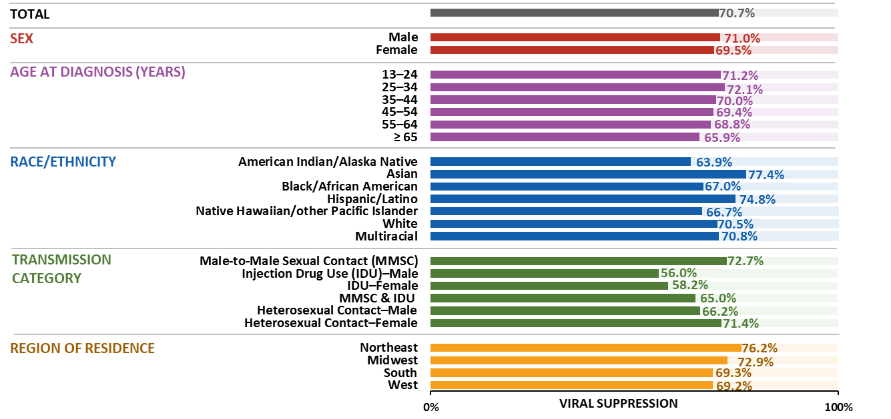
Viral suppression within 6 months of HIV diagnosis, by selected characteristics, 2023—United States
Note. Data are presented for persons aged ≥ 13 years at diagnosis. Hispanic/Latino persons can be of any race.
Notes:
Among 38,793 persons aged ≥ 13 years with HIV diagnosed during 2023 in the United States, viral load was suppressed within 6 months of HIV diagnosis in 70.7% of persons.
Highest percentages—males, persons aged ≤ 34 years, Asian persons, persons with HIV attributed to male-to-male sexual contact, and persons residing in the Northeast at the time of diagnosis
Lowest percentages —females, persons aged ≥ 45 years, American Indian/Alaska Native persons, persons with HIV attributed to injection drug use, and persons residing in the South and West at the time of diagnosis
Note.
For additional data, see Tables 2a and 2b in the report HIV Surveillance Supplemental Report: Monitoring Selected National HIV Prevention and Care Objectives by Using HIV Surveillance Data United States and 6 Territories and Freely Associated States, 2023 at https://www.cdc.gov/hiv-data/nhss/national-hiv-prevention-and-care-outcomes.html.
Data have been statistically adjusted to account for missing transmission category.
Use caution when interpreting data for American Indian/Alaska Native and Native Hawaiian/other Pacific Islander persons due to small numbers.
For more information on data sources, data collection and reporting practices, and case definitions, see the National HIV Surveillance System (NHSS) Technical Notes, available at https://www.cdc.gov/hiv-data/nhss/index.html.
For more information on linkage to HIV medical care, see the Technical Notes, available at https://www.cdc.gov/hiv-data/nhss/national-hiv-prevention-and-care-outcomes.html.
Data for all figures are available at https://www.cdc.gov/hiv-data/nhss/national-hiv-prevention-and-care-outcomes.html.

Slide 13
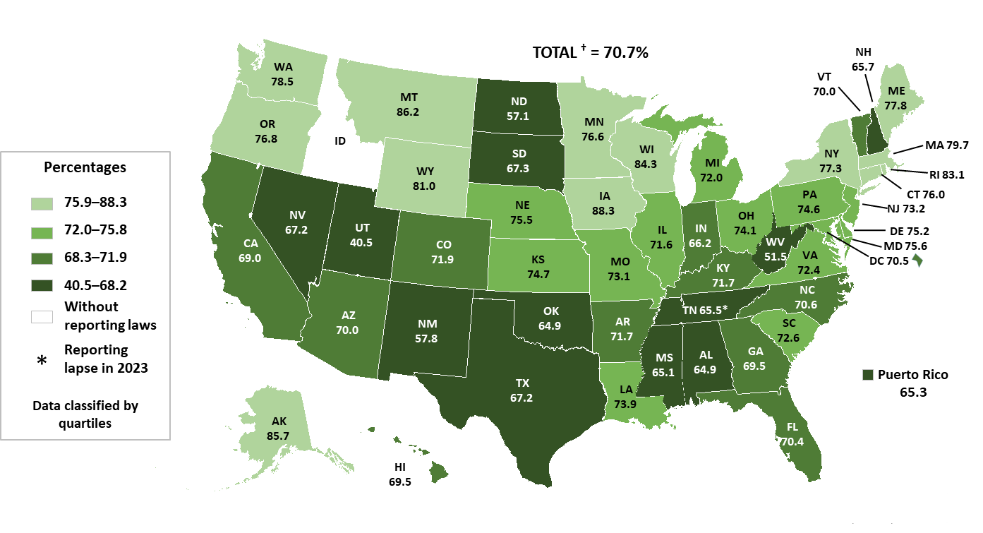
Viral suppression within 6 months of HIV diagnosis during 2023—United States and Puerto Rico
Note. Data are presented for persons aged ≥ 13 years at diagnosis. †Total does not include Puerto Rico.
Notes:
Among 38,793 persons aged ≥ 13 years with HIV diagnosed during 2023 in the United States, viral load was suppressed within 6 months of HIV diagnosis in 70.7% of persons.
The darkest areas (AL, IN, MS, NV, NH, NM, ND, OK, SD, TN, TX, UT, WV, PR) had ≤ 68.2% of persons who had viral suppression within 6 months of diagnosis.
Note.
For additional data, see Table 2b in the report HIV Surveillance Supplemental Report: Monitoring Selected National HIV Prevention and Care Objectives by Using HIV Surveillance Data United States and 6 Territories and Freely Associated States, 2023 at https://www.cdc.gov/hiv-data/nhss/national-hiv-prevention-and-care-outcomes.html.
For more information on data sources, data collection and reporting practices, and case definitions, see the National HIV Surveillance System (NHSS) Technical Notes, available at https://www.cdc.gov/hiv-data/nhss/index.html.
For more information on linkage to HIV medical care, see the Technical Notes, available at https://www.cdc.gov/hiv-data/nhss/national-hiv-prevention-and-care-outcomes.html.
Data for all figures are available at https://www.cdc.gov/hiv-data/nhss/national-hiv-prevention-and-care-outcomes.html.

Slide 14
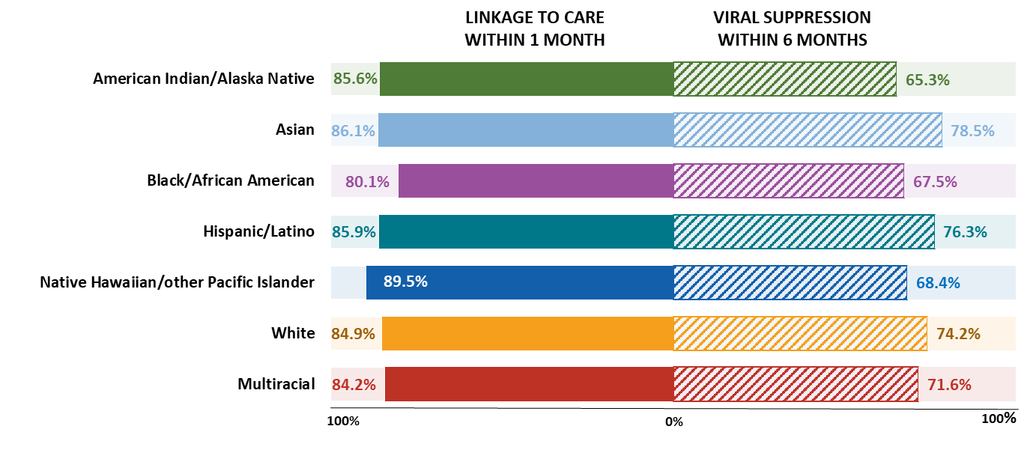
Linkage to HIV medical care within 1 month and viral suppression within 6 months of HIV diagnosis during 2023 among males with HIV attributed to male-to-male sexual contact, by race/ethnicity—United States
Note. Data are presented for persons aged ≥ 13 years at diagnosis. Hispanic/Latino persons can be of any race.
Notes:
In the United States in 2023, of 25,654 males aged ≥ 13 years with HIV attributed to male-to-male sexual contact, 83.7% were linked to care within 1 month of diagnosis and 72.7% were virally suppressed within 6 months of diagnosis.
By race/ethnicity, among males with HIV attributed to male-to-male sexual contact, lowest percentages:
Linkage to HIV medical care within 1 month of diagnosis—Black/African American persons (80.1%)
Viral suppression within 6 months of diagnosis—Black/African American persons (67.5%)
Note.
For additional data, see Table 2d in the report HIV Surveillance Supplemental Report: Monitoring Selected National HIV Prevention and Care Objectives by Using HIV Surveillance Data United States and 6 Territories and Freely Associated States, 2023 at https://www.cdc.gov/hiv-data/nhss/national-hiv-prevention-and-care-outcomes.html.
Data have been statistically adjusted to account for missing transmission category.
Use caution when interpreting data for American Indian/Alaska Native and Native Hawaiian/other Pacific Islander persons due to small numbers.
For more information on data sources, data collection and reporting practices, and case definitions, see the National HIV Surveillance System (NHSS) Technical Notes, available at https://www.cdc.gov/hiv-data/nhss/index.html.
For more information on linkage to HIV medical care within one month and viral suppression within 6 months of HIV diagnosis, see the Technical Notes, available at https://www.cdc.gov/hiv-data/nhss/national-hiv-prevention-and-care-outcomes.html.
Data for all figures are available at https://www.cdc.gov/hiv-data/nhss/national-hiv-prevention-and-care-outcomes.html.

Slide 15
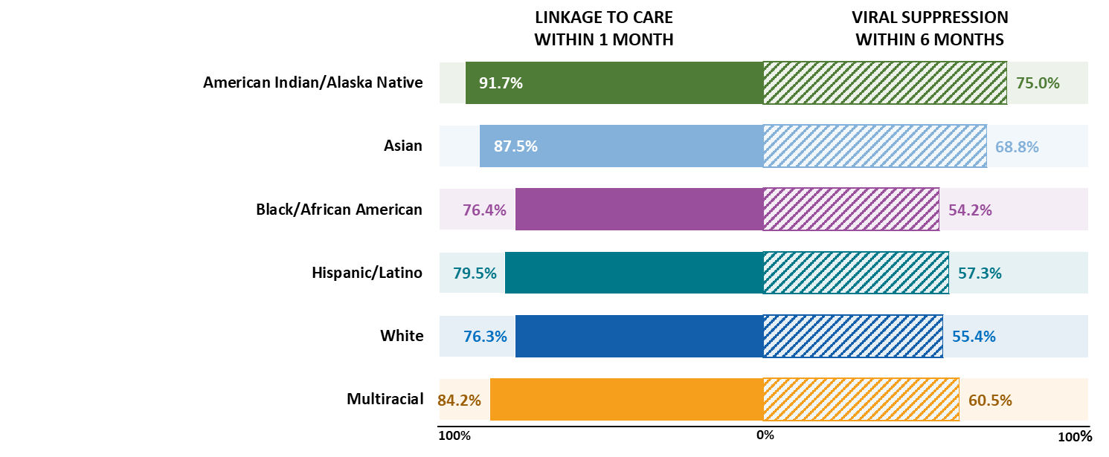
Linkage to HIV medical care within 1 month and viral suppression within 6 months of HIV diagnosis during 2023 among males with HIV attributed to injection drug use, by race/ethnicity—United States
Note. Data are presented for persons aged ≥ 13 years at diagnosis. Hispanic/Latino persons can be of any race. Data for Native Hawaiian/other Pacific Islander persons not shown
due to small numbers.
Notes:
In the United States in 2023 among 1,384 males aged ≥ 13 years with HIV attributed to injection drug use, 77.6% were linked to care within 1 month of diagnosis and 56.0% were virally suppressed within 6 months of diagnosis.
By race/ethnicity, among males with HIV attributed to injection drug use, lowest percentages:
Linkage to HIV medical care within 1 month of diagnosis—Black/African American (76.4%) and White persons (76.3%)
Viral suppression within 6 months of diagnosis—Black/African American (54.2%) and White persons (55.4%)
Note.
For additional data, see Table 2c in the report HIV Surveillance Supplemental Report: Monitoring Selected National HIV Prevention and Care Objectives by Using HIV Surveillance Data United States and 6 Territories and Freely Associated States, 2023 at https://www.cdc.gov/hiv-data/nhss/national-hiv-prevention-and-care-outcomes.html.
Data have been statistically adjusted to account for missing transmission category.
Use caution when interpreting data for American Indian/Alaska Native and Native Hawaiian/other Pacific Islander persons due to small numbers.
For more information on data sources, data collection and reporting practices, and case definitions, see the National HIV Surveillance System (NHSS) Technical Notes, available at https://www.cdc.gov/hiv-data/nhss/index.html.
For more information on linkage to HIV medical care within one month and viral suppression within 6 months of HIV diagnosis, see the Technical Notes, available at https://www.cdc.gov/hiv-data/nhss/national-hiv-prevention-and-care-outcomes.html.
Data for all figures are available at https://www.cdc.gov/hiv-data/nhss/national-hiv-prevention-and-care-outcomes.html.

Slide 16
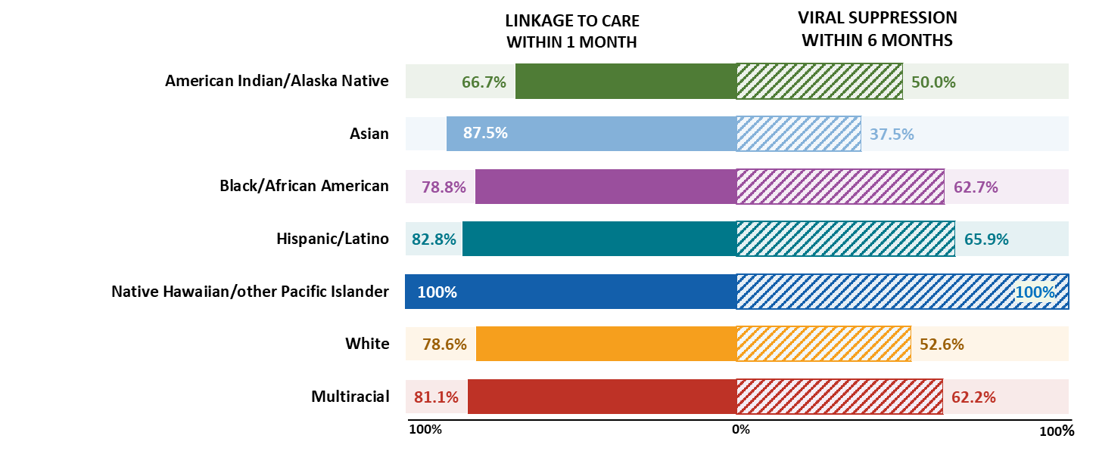
Linkage to HIV medical care within 1 month and viral suppression within 6 months of HIV diagnosis during 2023 among females with HIV attributed to injection drug use, by race/ethnicity—United States
Note. Data are presented for persons aged ≥ 13 years at diagnosis. Hispanic/Latino persons can be of any race.
Notes:
In the United States in 2023, among 1,092 females aged ≥ 13 years with HIV attributed to injection drug use, 79.4% were linked to care within 1 month of diagnosis and 58.2% were virally suppressed within 6 months of diagnosis.
By race/ethnicity, among females with HIV attributed to injection drug use, lowest percentages:
Linkage to HIV medical care within 1 month of diagnosis—American Indian/Alaska Native persons (66.7%)
Viral suppression within 6 months of diagnosis—Asian persons (37.5%)
Note.
For additional data, see Table 2c in the report HIV Surveillance Supplemental Report: Monitoring Selected National HIV Prevention and Care Objectives by Using HIV Surveillance Data United States and 6 Territories and Freely Associated States, 2023 at https://www.cdc.gov/hiv-data/nhss/national-hiv-prevention-and-care-outcomes.html.
Data have been statistically adjusted to account for missing transmission category. Use caution when interpreting data for American Indian/Alaska Native and Native Hawaiian/other Pacific Islander persons due to small numbers.
For more information on data sources, data collection and reporting practices, and case definitions, see the National HIV Surveillance System (NHSS) Technical Notes, available at https://www.cdc.gov/hiv-data/nhss/index.html.
For more information on linkage to HIV medical care within one month and viral suppression within 6 months of HIV diagnosis, see the Technical Notes, available at https://www.cdc.gov/hiv-data/nhss/national-hiv-prevention-and-care-outcomes.html.
Data for all figures are available at https://www.cdc.gov/hiv-data/nhss/national-hiv-prevention-and-care-outcomes.html.

Slide 17
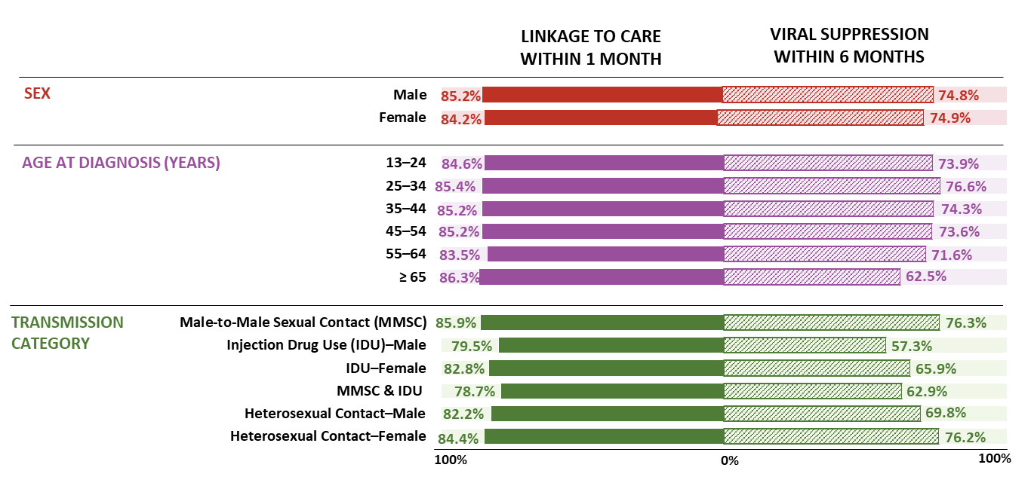
Linkage to HIV medical care within 1 month and viral suppression within 6 months of HIV diagnosis during 2023 among Hispanic/Latino persons, by selected characteristics—United States
Note. Data are presented for persons aged ≥ 13 years at diagnosis. Hispanic/Latino persons can be of any race.
Notes:
In the United States in 2023, among 13,025 Hispanic/Latino persons aged ≥ 13 years diagnosed with HIV, 85.1% were linked to HIV medical care within 1 month of diagnosis of HIV and 74.8% had viral suppression within 6 months of HIV diagnosis.
The lowest percentages among Hispanic/Latino persons were as follows:
By sex:
Linkage to HIV medical care within 1 month of diagnosis—similar between Hispanic/Latino males (85.2%) and females (84.2%)
Viral suppression within 6 months of diagnosis—similar between Hispanic/Latino males (74.8%) and females (74.9%)
By age at diagnosis:
Linkage to HIV medical care within 1 month of diagnosis—persons aged 55–64 years (83.5%)
Viral suppression within 6 months of diagnosis—persons aged ≥ 65 years (62.5%)
By transmission category:
Linkage to HIV medical care within 1 month of diagnosis—males with HIV attributed male-to-male sexual contact and injection drug use (79.5%) and males with HIV attributed to injection drug use (79.5%)
Viral suppression within 6 months of diagnosis—males with HIV attributed to injection drug use (57.3%)
Note.
For additional data, see Table 2c in the report HIV Surveillance Supplemental Report: Monitoring Selected National HIV Prevention and Care Objectives by Using HIV Surveillance Data United States and 6 Territories and Freely Associated States, 2023 at https://www.cdc.gov/hiv-data/nhss/national-hiv-prevention-and-care-outcomes.html.
Data have been statistically adjusted to account for missing transmission category.
For more information on data sources, data collection and reporting practices, and case definitions, see the National HIV Surveillance System (NHSS) Technical Notes, available at https://www.cdc.gov/hiv-data/nhss/index.html.
For more information on linkage to HIV medical care within one month and viral suppression within 6 months of HIV diagnosis, see the Technical Notes, available at https://www.cdc.gov/hiv-data/nhss/national-hiv-prevention-and-care-outcomes.html.
Data for all figures are available at https://www.cdc.gov/hiv-data/nhss/national-hiv-prevention-and-care-outcomes.html.

Slide 18
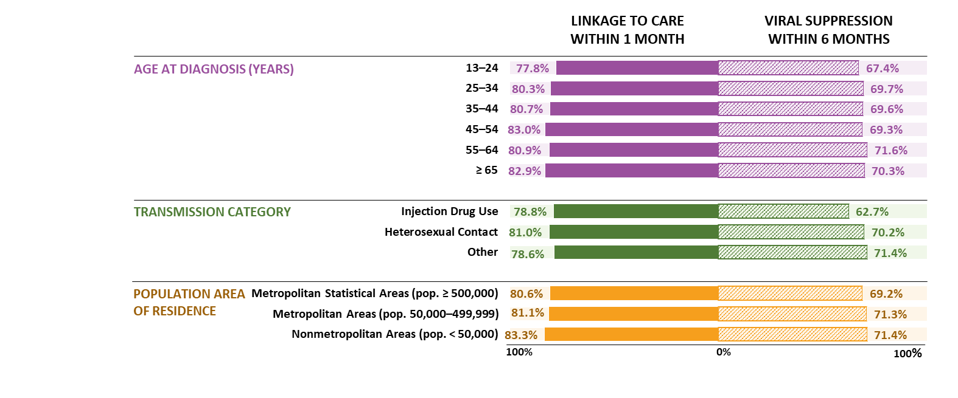
Linkage to HIV medical care within 1 month and viral suppression within 6 months of HIV diagnosis among Black/African American females, 2023—United States
Note. Data are presented for persons aged ≥ 13 years at diagnosis.
Notes:
In the United States in 2023, among 3,635 Black/African American females aged ≥ 13 years with diagnosed HIV, 80.8% were linked to HIV medical care within 1 month of diagnosis of HIV and 69.6% had viral suppression within 6 months of HIV diagnosis.
The lowest percentages among Black/African American females were as follows:
By age at diagnosis: Linkage to HIV medical care within 1 month of diagnosis—persons aged 13–24 years (77.8%)
Viral suppression within 6 months of diagnosis—persons aged 13–24 years (67.4%)
By transmission category:
Linkage to HIV medical care within 1 month of diagnosis—persons with HIV attributed to injection drug use (78.8%)
Viral suppression within 6 months of diagnosis—persons with HIV attributed to injection drug use (62.7%)
By population area of residence:
Linkage to HIV medical care within 1 month of diagnosis—persons who resided in metropolitan areas of population ≥ 500,000 (80.6%)
Viral suppression within 6 months of diagnosis—persons who resided in metropolitan areas of population ≥ 500,000 (69.2%)
Note.
For additional data, see Table 2c in the report HIV Surveillance Supplemental Report: Monitoring Selected National HIV Prevention and Care Objectives by Using HIV Surveillance Data United States and 6 Territories and Freely Associated States, 2023 at https://www.cdc.gov/hiv-data/nhss/national-hiv-prevention-and-care-outcomes.html.
Data have been statistically adjusted to account for missing transmission category.
For more information on data sources, data collection and reporting practices, and case definitions, see the National HIV Surveillance System (NHSS) Technical Notes, available at https://www.cdc.gov/hiv-data/nhss/index.html.
For more information on linkage to HIV medical care within one month and viral suppression within 6 months of HIV diagnosis, see the Technical Notes, available at https://www.cdc.gov/hiv-data/nhss/national-hiv-prevention-and-care-outcomes.html.
Data for all figures are available at https://www.cdc.gov/hiv-data/nhss/national-hiv-prevention-and-care-outcomes.html.

Slide 19
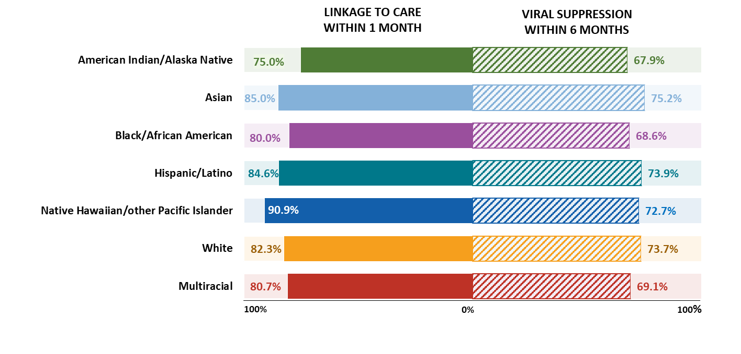
Linkage to HIV medical care within 1 month and viral suppression within 6 months of HIV diagnosis among persons aged 13–24 years, by race/ethnicity, 2023—United States
Note. Hispanic/Latino persons can be of any race. Data are presented for persons aged ≥ 13 years at diagnosis.
Notes:
Of 7,117 persons aged 13–24 years with HIV diagnosed in 2023 in the United States, 82.0% were linked to HIV medical care within 1 month of diagnosis of HIV and 71.2% had viral suppression within 6 months of HIV diagnosis.
Lowest percentages among persons aged 13–24 years by race/ethnicity were as follows:
• Linkage to HIV medical care within 1 month of diagnosis—American Indian/Alaska Native persons (75.0%)
• Viral suppression within 6 months of diagnosis—American Indian/Alaska Native (67.9%), Black/African American (68.6%), and multiracial persons (69.1%)
Note.
For additional data, see Table 2c in the report HIV Surveillance Supplemental Report: Monitoring Selected National HIV Prevention and Care Objectives by Using HIV Surveillance Data United States and 6 Territories and Freely Associated States, 2023 at https://www.cdc.gov/hiv-data/nhss/national-hiv-prevention-and-care-outcomes.html.
Use caution when interpreting data for American Indian/Alaska Native and Native Hawaiian/other Pacific Islander persons due to small numbers.
For more information on data sources, data collection and reporting practices, and case definitions, see the National HIV Surveillance System (NHSS) Technical Notes, available at https://www.cdc.gov/hiv-data/nhss/index.html.
For more information on linkage to HIV medical care within one month and viral suppression within 6 months of HIV diagnosis, see the Technical Notes, available at https://www.cdc.gov/hiv-data/nhss/national-hiv-prevention-and-care-outcomes.html.
Data for all figures are available at https://www.cdc.gov/hiv-data/nhss/national-hiv-prevention-and-care-outcomes.html.

Slide 20
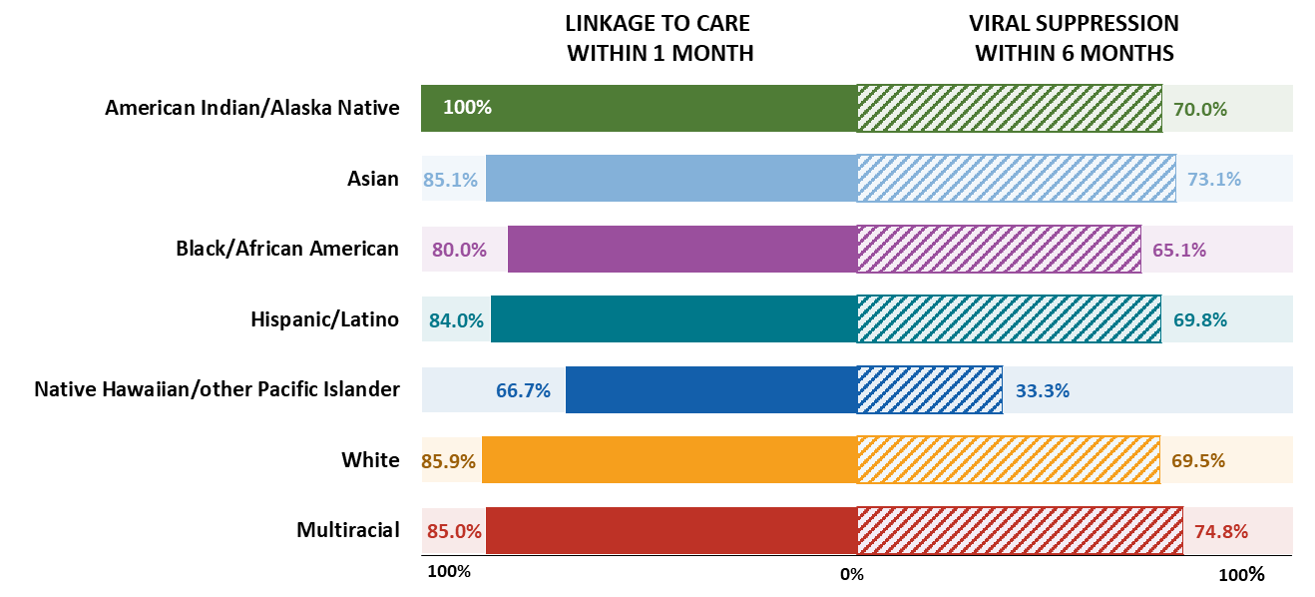
Linkage to HIV medical care within 1 month and viral suppression within 6 months of HIV diagnosis during 2023 among persons aged ≥ 55 years, by race/ethnicity—United States
Note. Hispanic/Latino persons can be of any race.
Notes:
Of 3,838 persons aged ≥ 55 years with HIV diagnosed during 2023 in the United States, 83.2% were linked to HIV medical care within 1 month of diagnosis of HIV and 68.1% had viral suppression within 6 months of HIV diagnosis.
Lowest percentages among persons aged ≥ 55 years by race/ethnicity were as follows:
• Linkage to HIV medical care within 1 month of diagnosis—Native Hawaiian/other Pacific Islander (66.7%)
• Viral suppression within 6 months of diagnosis—Native Hawaiian/other Pacific Islander (33.3%)
Note.
For additional data, see Table 2c in the report HIV Surveillance Supplemental Report: Monitoring Selected National HIV Prevention and Care Objectives by Using HIV Surveillance Data United States and 6 Territories and Freely Associated States, 2023 at https://www.cdc.gov/hiv-data/nhss/national-hiv-prevention-and-care-outcomes.html.
Use caution when interpreting data for American Indian/Alaska Native and Native Hawaiian/other Pacific Islander persons due to small numbers.
For more information on data sources, data collection and reporting practices, and case definitions, see the National HIV Surveillance System (NHSS) Technical Notes, available at https://www.cdc.gov/hiv-data/nhss/index.html.
For more information on linkage to HIV medical care within one month and viral suppression within 6 months of HIV diagnosis, see the Technical Notes, available at https://www.cdc.gov/hiv-data/nhss/national-hiv-prevention-and-care-outcomes.html.
Data for all figures are available at https://www.cdc.gov/hiv-data/nhss/national-hiv-prevention-and-care-outcomes.html.

Slide 21
Receipt of HIV medical care

Slide 22
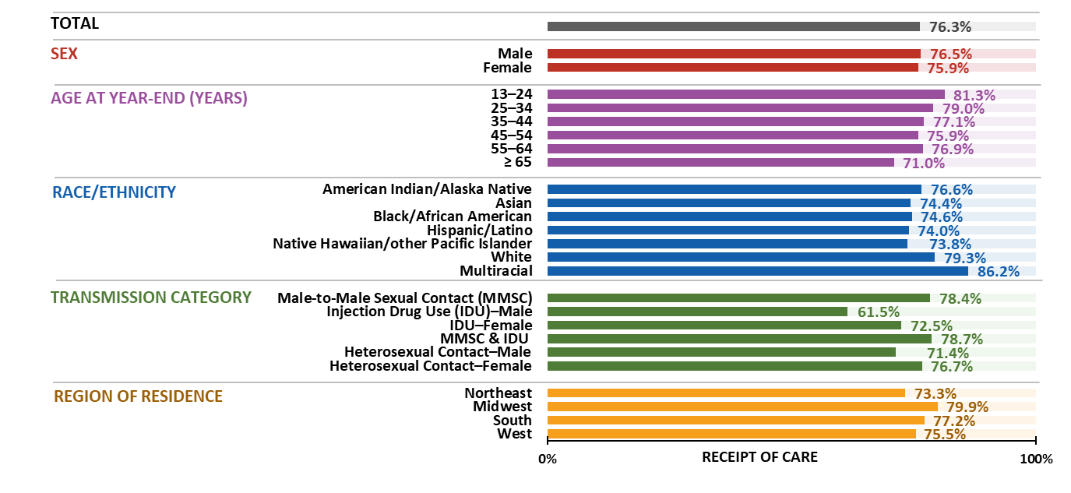
Receipt of HIV medical care during 2023 among persons living with diagnosed HIV, by selected characteristics—United States
Note. Data are presented for persons aged ≥ 13 years by year-end 2023. Hispanic/Latino persons can be of any race.
Notes:
During 2023 in the United States, 76.3% of 1,076,732 persons aged ≥ 13 years alive at year-end 2023 received any HIV medical care (at least 1 CD4 or viral load test).
Highest percentages of receipt of HIV medical care—males, persons aged 13–24 years, multiracial persons, persons with HIV attributed to male-to-male sexual contact and injection drug use, and persons currently residing in the Midwest
Lowest percentages of receipt of HIV medical care—females, persons aged ≥ 65 years; Asian, Hispanic/Latino, and Native Hawaiian/other Pacific Islander persons; males with HIV attributed to injection drug use; and persons currently residing in the Northeast
Note.
For additional data, see Tables 3a and 3b in the report HIV Surveillance Supplemental Report: Monitoring Selected National HIV Prevention and Care Objectives by Using HIV Surveillance Data United States and 6 Territories and Freely Associated States, 2023 at https://www.cdc.gov/hiv-data/nhss/national-hiv-prevention-and-care-outcomes.html.
Data have been statistically adjusted to account for missing transmission category.
Use caution when interpreting data for American Indian/Alaska Native and Native Hawaiian/other Pacific Islander persons due to small numbers.
For more information on data sources, data collection and reporting practices, and case definitions, see the National HIV Surveillance System (NHSS) Technical Notes, available at https://www.cdc.gov/hiv-data/nhss/index.html.
For more information on receipt of HIV medical care, see the Technical Notes, available at https://www.cdc.gov/hiv-data/nhss/national-hiv-prevention-and-care-outcomes.html.
Data for all figures are available at https://www.cdc.gov/hiv-data/nhss/national-hiv-prevention-and-care-outcomes.html.

Slide 23
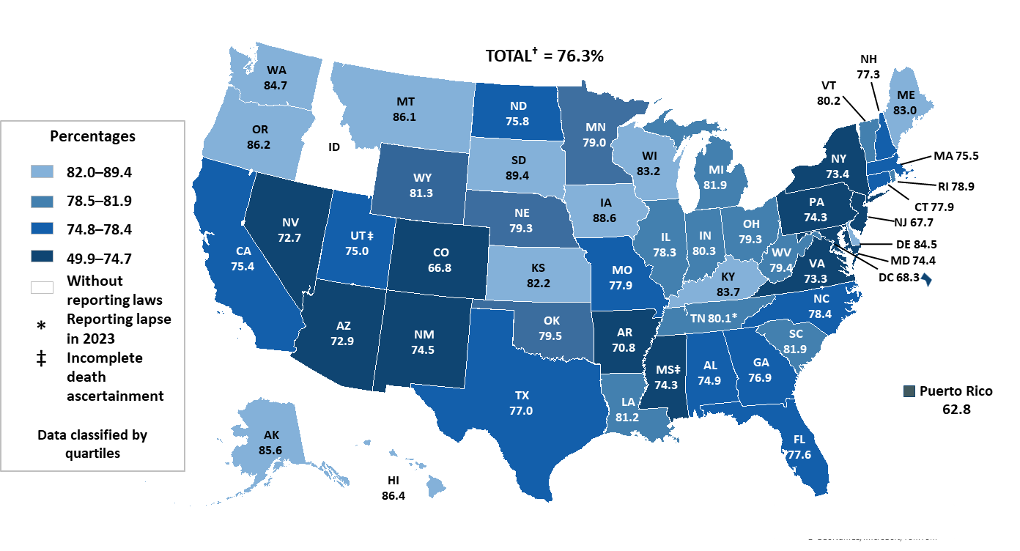
Receipt of HIV medical care during 2023 among persons living with diagnosed HIV—United States and Puerto Rico
Note. Data are presented for persons aged ≥ 13 years by year-end 2023. †Total does not include Puerto Rico.
Notes:
During 2023 in the United States, 76.3% of 1,076,732 persons aged ≥ 13 years alive at year-end 2023 received any HIV medical care (at least 1 CD4 or viral load test).
The darkest areas (AZ, AR, CO, DC, MD, NV, NM, NY, PA, VA, PR) had ≤74.7% of persons who received any HIV medical care.
Note.
For additional data, see Table 3b in the report HIV Surveillance Supplemental Report: Monitoring Selected National HIV Prevention and Care Objectives by Using HIV Surveillance Data United States and 6 Territories and Freely Associated States, 2023 at https://www.cdc.gov/hiv-data/nhss/national-hiv-prevention-and-care-outcomes.html.
For more information on data sources, data collection and reporting practices, and case definitions, see the National HIV Surveillance System (NHSS) Technical Notes, available at https://www.cdc.gov/hiv-data/nhss/index.html.
For more information on receipt of HIV medical care, see the Technical Notes, available at https://www.cdc.gov/hiv-data/nhss/national-hiv-prevention-and-care-outcomes.html.
Data for all figures are available at https://www.cdc.gov/hiv-data/nhss/national-hiv-prevention-and-care-outcomes.html.

Slide 24
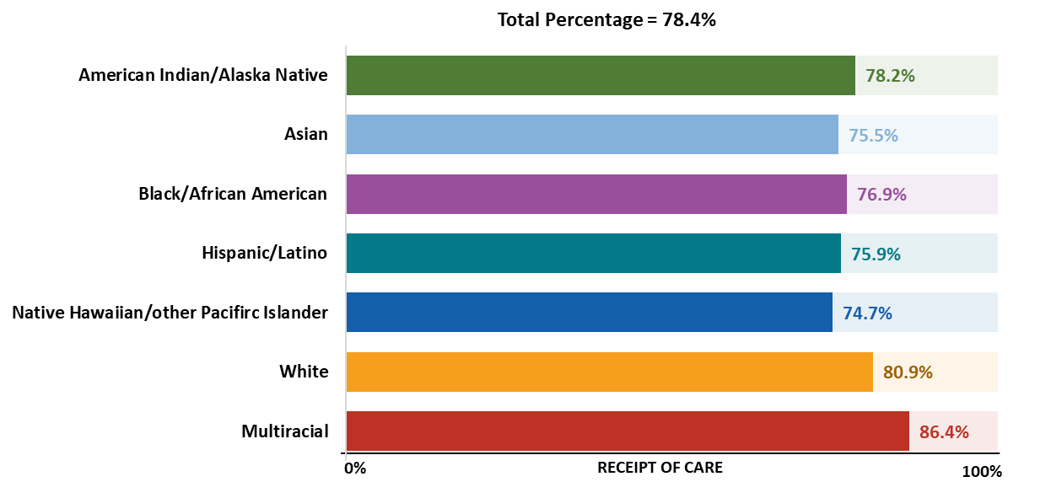
Receipt of HIV medical care during 2023 among males with HIV attributed to male-to-male sexual contact, by race/ethnicity—United States
Note. Data are presented for persons aged ≥ 13 years by year-end 2023. Hispanic/Latino persons can be of any race.
Notes:
Of 627,096 males aged ≥ 13 years living with diagnosed HIV attributed to male-to-male sexual contact at year-end 2023 in the United States, 78.4% received HIV medical care.
By race/ethnicity, among males with HIV attributed to male-to-male sexual contact, the lowest percentages were among Native Hawaiian/other Pacific Islander (74.7%), Asian (75.5%), Hispanic/Latino (75.9%), and Black/African American persons (76.9%)
Note.
For additional data, see Table 3d in the report HIV Surveillance Supplemental Report: Monitoring Selected National HIV Prevention and Care Objectives by Using HIV Surveillance Data United States and 6 Territories and Freely Associated States, 2023 at https://www.cdc.gov/hiv-data/nhss/national-hiv-prevention-and-care-outcomes.html.
Data have been statistically adjusted to account for missing transmission category.
Use caution when interpreting data for American Indian/Alaska Native and Native Hawaiian/other Pacific Islander persons due to small numbers.
For more information on data sources, data collection and reporting practices, and case definitions, see the National HIV Surveillance System (NHSS) Technical Notes, available at https://www.cdc.gov/hiv-data/nhss/index.html.
For more information on receipt of HIV medical care, see the Technical Notes, available at https://www.cdc.gov/hiv-data/nhss/national-hiv-prevention-and-care-outcomes.html.
Data for all figures are available at https://www.cdc.gov/hiv-data/nhss/national-hiv-prevention-and-care-outcomes.html.

Slide 25
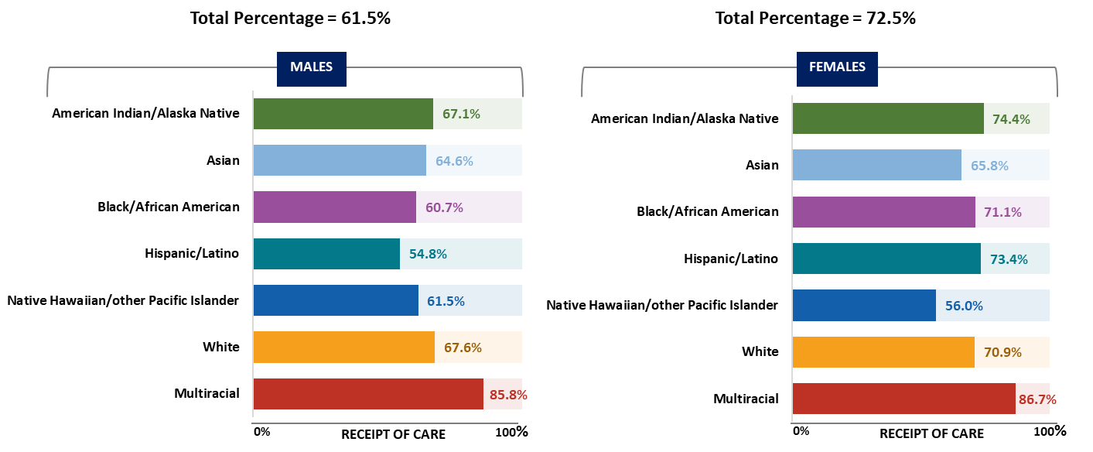
Receipt of HIV medical care during 2023 among persons with HIV attributed to injection drug use, by sex and race/ethnicity—United States
Note. Data are presented for persons aged ≥ 13 years by year-end 2023. Hispanic/Latino persons can be of any race.
Notes:
Of 60,839 males aged ≥ 13 years living with diagnosed HIV attributed to injection drug use at year-end 2023 in the United States, 61.5% received HIV medical care in 2023. Of 46,113 females aged ≥ 13 years living with diagnosed HIV attributed to injection drug use at year-end 2023 in the United States, 72.5% received HIV medical care.
Lowest percentages of receipt of care among persons with HIV attributed to injection drug use by sex and race/ethnicity were as follows:
• Male—Hispanic/Latino persons (54.8%)
• Female—Native Hawaiian/other Pacific Islander persons (56.0%)
Note.
For additional data, see Table 3c in the report HIV Surveillance Supplemental Report: Monitoring Selected National HIV Prevention and Care Objectives by Using HIV Surveillance Data United States and 6 Territories and Freely Associated States, 2023 at https://www.cdc.gov/hiv-data/nhss/national-hiv-prevention-and-care-outcomes.html.
Data have been statistically adjusted to account for missing transmission category.
Use caution when interpreting data for American Indian/Alaska Native and Native Hawaiian/other Pacific Islander persons due to small numbers.
For more information on data sources, data collection and reporting practices, and case definitions, see the National HIV Surveillance System (NHSS) Technical Notes, available at https://www.cdc.gov/hiv-data/nhss/index.html.
For more information on receipt of HIV medical care, see the Technical Notes, available at https://www.cdc.gov/hiv-data/nhss/national-hiv-prevention-and-care-outcomes.html.
Data for all figures are available at https://www.cdc.gov/hiv-data/nhss/national-hiv-prevention-and-care-outcomes.html.

Slide 26
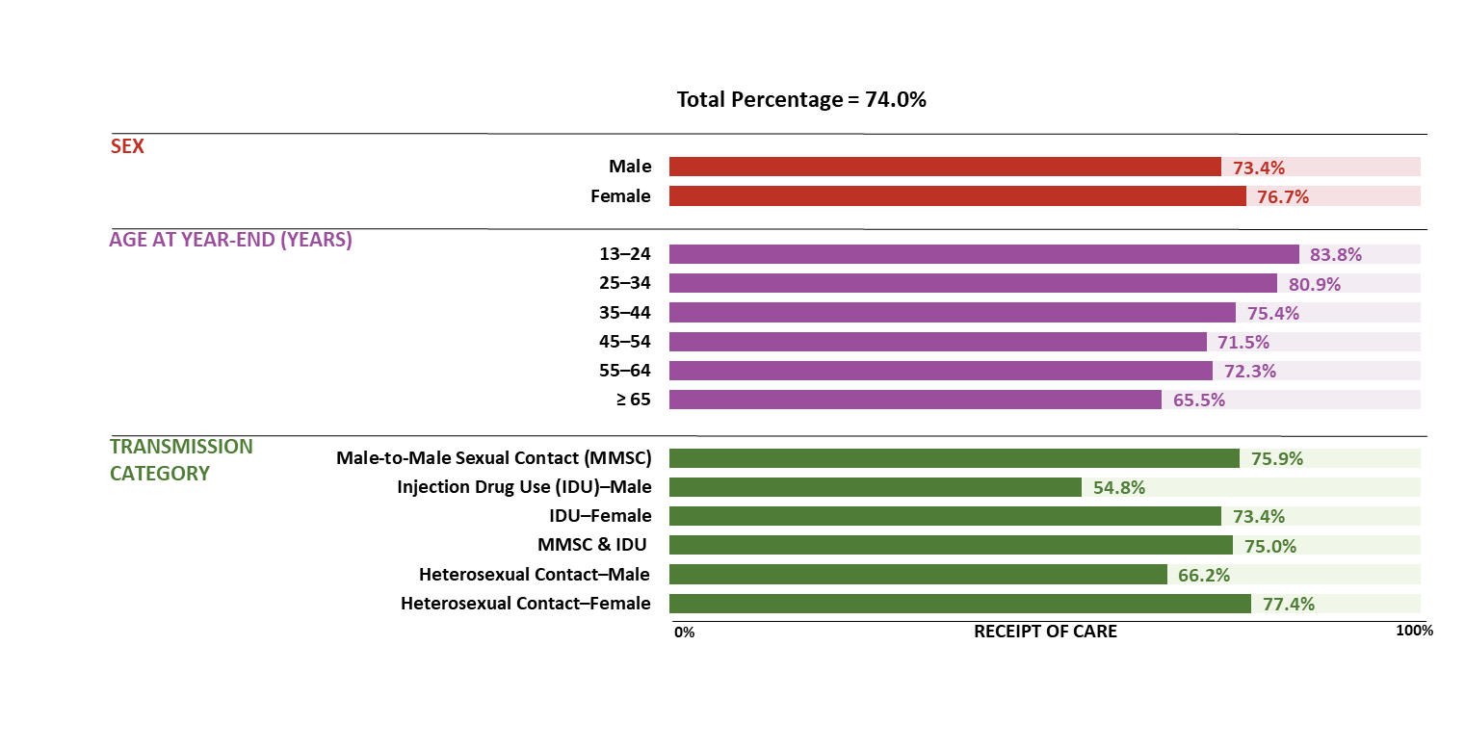
Receipt of HIV medical care during 2023 among Hispanic/Latino persons, by selected characteristics—United States
Note. Data are presented for persons aged ≥ 13 years by year-end 2023. Hispanic/Latino persons can be of any race.
Notes:
In the United States in 2023, among 273,036 Hispanic/Latino persons aged ≥ 13 years living with diagnosed HIV at year-end 2023, 74.0% received HIV medical care.
For receipt of HIV medical care, lowest percentages among Hispanic/Latino persons:
By sex—males (73.4%)
By age at year-end—persons aged ≥ 65 years (65.5%)
By transmission category—males with HIV attributed to injection drug use (54.8%)
Note.
For additional data, see Table 3c in the report HIV Surveillance Supplemental Report: Monitoring Selected National HIV Prevention and Care Objectives by Using HIV Surveillance Data United States and 6 Territories and Freely Associated States, 2023 at https://www.cdc.gov/hiv-data/nhss/national-hiv-prevention-and-care-outcomes.html.
Data have been statistically adjusted to account for missing transmission category.
For more information on data sources, data collection and reporting practices, and case definitions, see the National HIV Surveillance System (NHSS) Technical Notes, available at https://www.cdc.gov/hiv-data/nhss/index.html.
For more information on receipt of HIV medical care, see the Technical Notes, available at https://www.cdc.gov/hiv-data/nhss/national-hiv-prevention-and-care-outcomes.html.
Data for all figures are available at https://www.cdc.gov/hiv-data/nhss/national-hiv-prevention-and-care-outcomes.html.

Slide 27
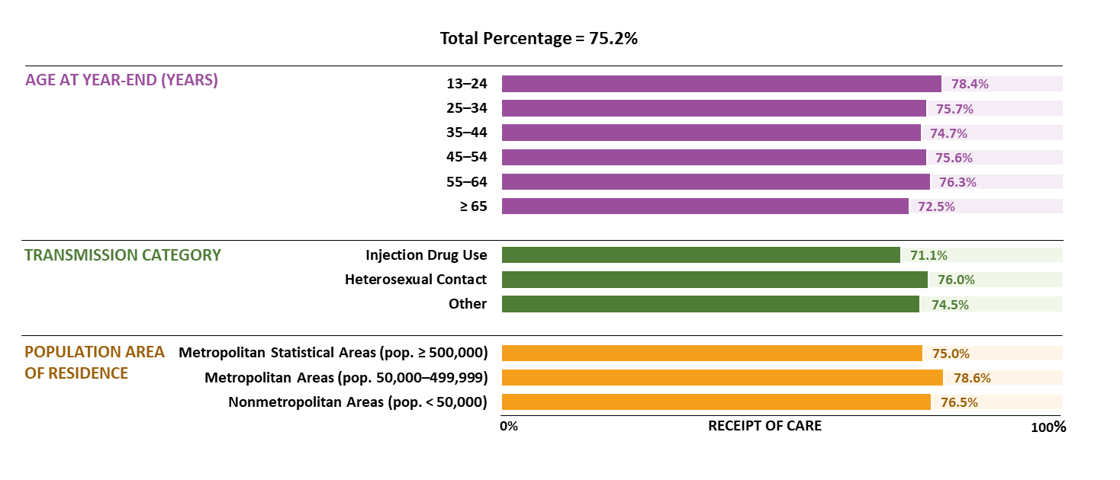
Receipt of HIV medical care during 2023 among Black/African American females—United States
Note. Data are presented for persons aged ≥ 13 years by year-end 2023.
Notes:
In the United States in 2023, among 139,363 Black/African American females aged ≥ 13 years living with diagnosed HIV at year-end 2023, 75.2% received HIV medical care.
For receipt of HIV medical care, lowest percentages among Black/African American females :
By age at year-end—persons aged ≥ 65 years (72.5%)
By transmission category—persons with HIV attributed to injection drug use (71.1%)
By population area of residence—persons who resided in metropolitan areas of population ≥ 500,000 (75.0%)
Note.
For additional data, see Table 3c in the report HIV Surveillance Supplemental Report: Monitoring Selected National HIV Prevention and Care Objectives by Using HIV Surveillance Data United States and 6 Territories and Freely Associated States, 2023 at https://www.cdc.gov/hiv-data/nhss/national-hiv-prevention-and-care-outcomes.html.
Data have been statistically adjusted to account for missing transmission category.
For more information on data sources, data collection and reporting practices, and case definitions, see the National HIV Surveillance System (NHSS) Technical Notes, available at https://www.cdc.gov/hiv-data/nhss/index.html.
For more information on receipt of HIV medical care, see the Technical Notes, available at https://www.cdc.gov/hiv-data/nhss/national-hiv-prevention-and-care-outcomes.html.
Data for all figures are available at https://www.cdc.gov/hiv-data/nhss/national-hiv-prevention-and-care-outcomes.html.

Slide 28
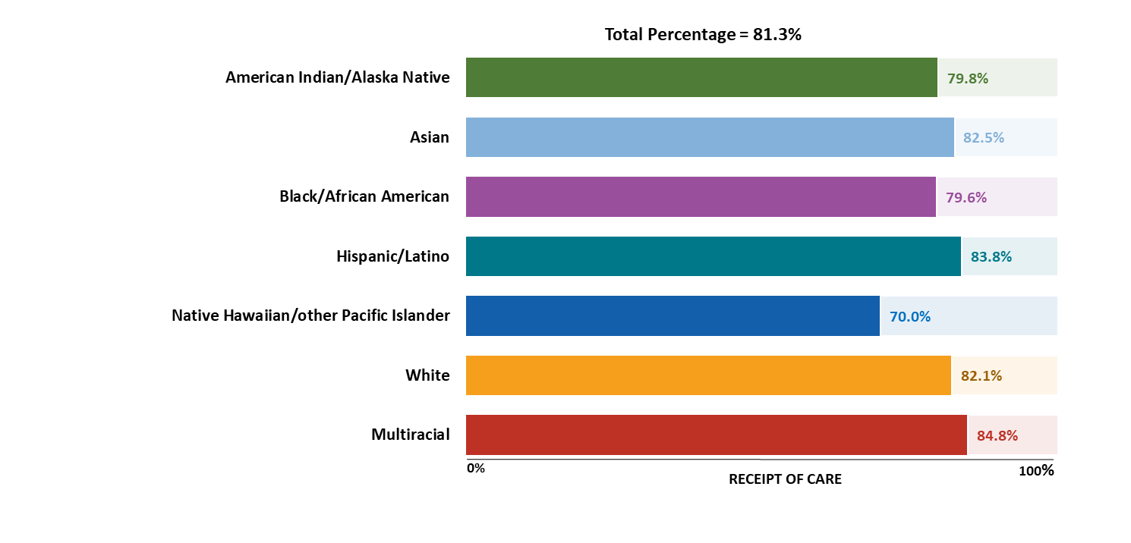
Receipt of HIV medical care during 2023 among persons aged 13–24 years, by race/ethnicity—United States
Note. Hispanic/Latino persons can be of any race. Data are presented for persons aged ≥ 13 years by year-end 2023.
Notes:
Of 28,493 persons aged 13–24 years living with diagnosed HIV at year-end 2023 in the United States, 81.3% received HIV medical care in 2023.
For receipt of HIV medical care, lowest percentages among persons aged 13–24 years by race/ethnicity—Native Hawaiian/other Pacific Islander persons (70.0%)
Note.
For additional data, see Table 3c in the report HIV Surveillance Supplemental Report: Monitoring Selected National HIV Prevention and Care Objectives by Using HIV Surveillance Data United States and 6 Territories and Freely Associated States, 2023 at https://www.cdc.gov/hiv-data/nhss/national-hiv-prevention-and-care-outcomes.html.
For more information on data sources, data collection and reporting practices, and case definitions, see the National HIV Surveillance System (NHSS) Technical Notes, available at https://www.cdc.gov/hiv-data/nhss/index.html.
Use caution when interpreting data for American Indian/Alaska Native and Native Hawaiian/other Pacific Islander persons due to small numbers.
For more information on receipt of HIV medical care, see the Technical Notes, available at https://www.cdc.gov/hiv-data/nhss/national-hiv-prevention-and-care-outcomes.html.
Data for all figures are available at https://www.cdc.gov/hiv-data/nhss/national-hiv-prevention-and-care-outcomes.html.

Slide 29
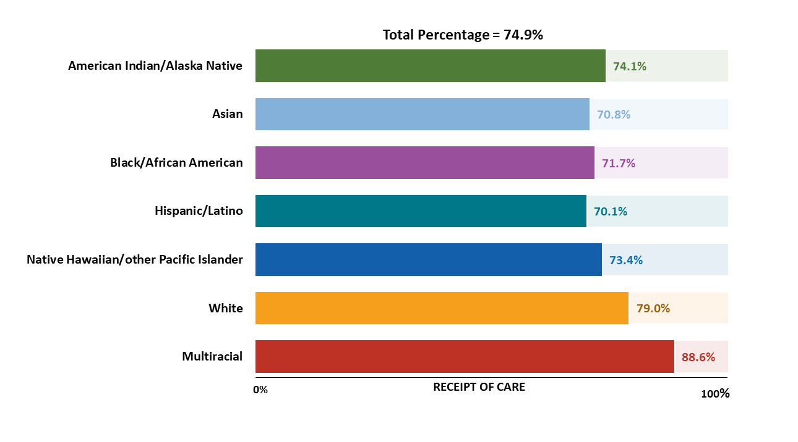
Receipt of HIV medical care during 2023 among persons aged ≥ 55 years, by race/ethnicity—United States
Note. Hispanic/Latino persons can be of any race.
Notes:
Of 439,742 persons aged ≥ 55 years living with diagnosed HIV at year-end 2023 in the United States, 74.9% received HIV medical care in 2023.
For receipt of HIV medical care, lowest percentages among persons aged ≥ 55 years by race/ethnicity were among Hispanic/Latino (70.1%), Asian (70.8%), and Black/African American persons (71.7%)
Note.
For additional data, see Table 3c in the report HIV Surveillance Supplemental Report: Monitoring Selected National HIV Prevention and Care Objectives by Using HIV Surveillance Data United States and 6 Territories and Freely Associated States, 2023 at https://www.cdc.gov/hiv-data/nhss/national-hiv-prevention-and-care-outcomes.html.
For more information on data sources, data collection and reporting practices, and case definitions, see the National HIV Surveillance System (NHSS) Technical Notes, available at https://www.cdc.gov/hiv-data/nhss/index.html.
Use caution when interpreting data for American Indian/Alaska Native and Native Hawaiian/other Pacific Islander persons due to small numbers.
For more information on receipt of HIV medical care, see the Technical Notes, available at https://www.cdc.gov/hiv-data/nhss/national-hiv-prevention-and-care-outcomes.html.
Data for all figures are available at https://www.cdc.gov/hiv-data/nhss/national-hiv-prevention-and-care-outcomes.html.

Slide 30
Viral suppression among persons living with diagnosed HIV

Slide 31
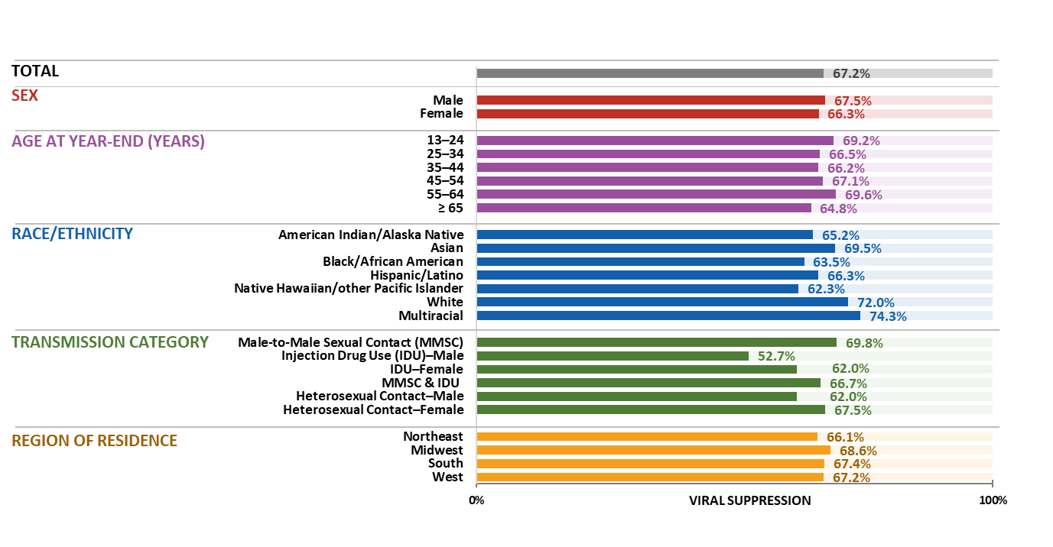
Viral suppression during 2023 among persons living with diagnosed HIV, by selected characteristics—United States
Note. Data are presented for persons aged ≥ 13 years by year-end 2023. Hispanic/Latino persons can be of any race.
Notes:
In the United States, 67.2%. of 1,076,732 persons aged ≥ 13 years living with diagnosed HIV at year-end 2023 had viral suppression at their most recent test.
Highest percentages—males, persons aged 55–64 years, multiracial persons, persons with HIV attributed to male-to-male sexual contact, and persons currently residing in the Midwest
Lowest percentages —females, persons aged 35–44 years, Native Hawaiian/other Pacific Islander persons, and males with HIV attributed to injection drug use, and persons currently residing in the Northeast
Note.
For additional data, see Tables 4a and 4b in the report HIV Surveillance Supplemental Report: Monitoring Selected National HIV Prevention and Care Objectives by Using HIV Surveillance Data United States and 6 Territories and Freely Associated States, 2023 at https://www.cdc.gov/hiv-data/nhss/national-hiv-prevention-and-care-outcomes.html.
Data have been statistically adjusted to account for missing transmission category.
Use caution when interpreting data for American Indian/Alaska Native and Native Hawaiian/other Pacific Islander persons due to small numbers.
For more information on data sources, data collection and reporting practices, and case definitions, see the National HIV Surveillance System (NHSS) Technical Notes, available at https://www.cdc.gov/hiv-data/nhss/index.html.
For more information on viral suppression, see the Technical Notes, available at https://www.cdc.gov/hiv-data/nhss/national-hiv-prevention-and-care-outcomes.html.
Data for all figures are available at https://www.cdc.gov/hiv-data/nhss/national-hiv-prevention-and-care-outcomes.html.

Slide 32
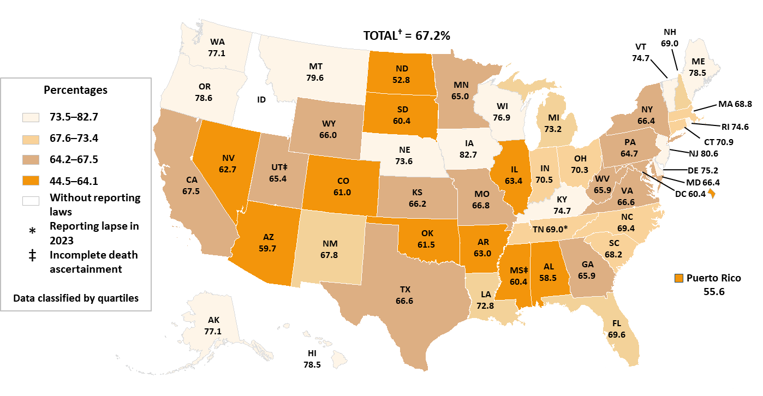
Viral suppression during 2023 among persons living with diagnosed HIV—United﻿﻿﻿﻿ States and Puerto Rico
Note. Data are presented for persons aged ≥ 13 years by year-end 2023. †Total does not include Puerto Rico.
Notes:
In the United States, 67.2%. of 1,076,732 persons aged ≥ 13 years living with diagnosed HIV at year-end 2023 had viral suppression at their most recent test.
The darkest areas (AL, AZ, AR, CO, DC, IL, MS, NV, NJ, ND, OK, SD, PR) had ≤64.1% of persons who had viral suppression.
Note.
For additional data, see Table 4b in the report HIV Surveillance Supplemental Report: Monitoring Selected National HIV Prevention and Care Objectives by Using HIV Surveillance Data United States and 6 Territories and Freely Associated States, 2023 at https://www.cdc.gov/hiv-data/nhss/national-hiv-prevention-and-care-outcomes.html.
For more information on data sources, data collection and reporting practices, and case definitions, see the National HIV Surveillance System (NHSS) Technical Notes, available at https://www.cdc.gov/hiv-data/nhss/index.html.
For more information on viral suppression, see the Technical Notes, available at https://www.cdc.gov/hiv-data/nhss/national-hiv-prevention-and-care-outcomes.html.
Data for all figures are available at https://www.cdc.gov/hiv-data/nhss/national-hiv-prevention-and-care-outcomes.html.

Slide 33
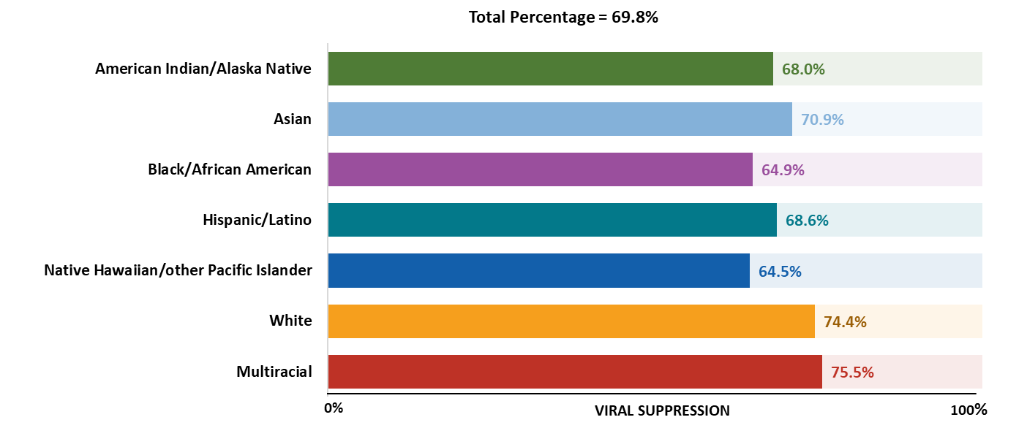
Viral suppression during 2023 among males with HIV attributed to male-to-male sexual contact, by race/ethnicity—United States
Note. Data are presented for persons aged ≥ 13 years by year-end 2023. Hispanic/Latino persons can be of any race.
Notes:
Of 627,096 males aged ≥ 13 years living with diagnosed HIV attributed to male-to-male sexual contact at year-end 2023 in the United States, 69.8% had viral suppression at their most recent test in 2023.
By race/ethnicity, among males with HIV attributed to male-to-male sexual contact the lowest percentages were among Black/African American (64.9%) and Native Hawaiian/other Pacific Islander persons (64.5%)
Note.
For additional data, see Table 3d in the report HIV Surveillance Supplemental Report: Monitoring Selected National HIV Prevention and Care Objectives by Using HIV Surveillance Data United States and 6 Territories and Freely Associated States, 2023 at https://www.cdc.gov/hiv-data/nhss/national-hiv-prevention-and-care-outcomes.html.
Data have been statistically adjusted to account for missing transmission category.
Use caution when interpreting data for American Indian/Alaska Native and Native Hawaiian/other Pacific Islander persons due to small numbers.
For more information on data sources, data collection and reporting practices, and case definitions, see the National HIV Surveillance System (NHSS) Technical Notes, available at https://www.cdc.gov/hiv-data/nhss/index.html.
For more information on viral suppression, see the Technical Notes, available at https://www.cdc.gov/hiv-data/nhss/national-hiv-prevention-and-care-outcomes.html.
Data for all figures are available at https://www.cdc.gov/hiv-data/nhss/national-hiv-prevention-and-care-outcomes.html.

Slide 34
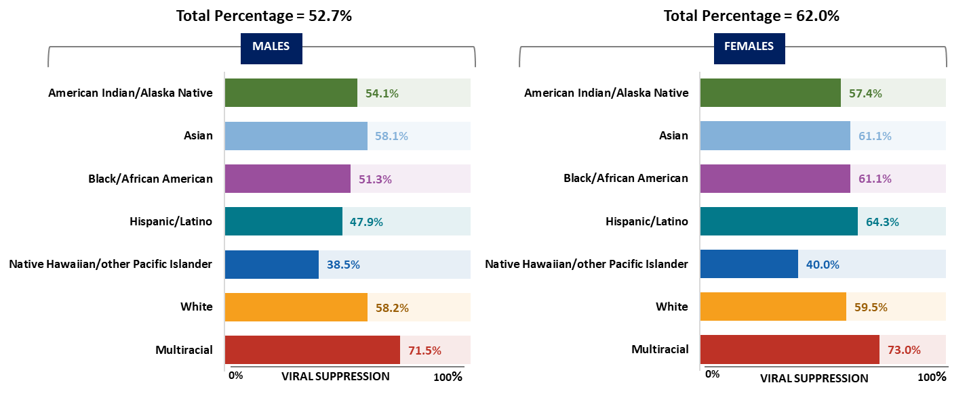
Viral suppression during 2023 among persons with HIV attributed to injection drug use, by sex and race/ethnicity—United States
Note. Data are presented for persons aged ≥ 13 years by year-end 2023. Hispanic/Latino persons can be of any race.
Notes:
Of 60,839 males aged ≥ 13 years living with diagnosed HIV attributed to injection drug use at year-end 2023 in the United States, 52.7% had viral suppression at their most recent test in 2023. Of 46,113 females aged ≥ 13 years living with diagnosed HIV attributed to injection drug use at year-end 2023 in the United States, 62.0% had viral suppression at their most recent test in 2023.
Lowest percentages of viral suppression among persons with HIV attributed to injection drug use by sex and race/ethnicity were as follows:
• Male—Native Hawaiian/other Pacific Islander persons (38.5%)
• Female—Native Hawaiian/other Pacific Islander persons (40.0%)
Note.
For additional data, see Table 3c in the report HIV Surveillance Supplemental Report: Monitoring Selected National HIV Prevention and Care Objectives by Using HIV Surveillance Data United States and 6 Territories and Freely Associated States, 2023 at https://www.cdc.gov/hiv-data/nhss/national-hiv-prevention-and-care-outcomes.html.
Data have been statistically adjusted to account for missing transmission category.
Use caution when interpreting data for American Indian/Alaska Native and Native Hawaiian/other Pacific Islander persons due to small numbers.
For more information on data sources, data collection and reporting practices, and case definitions, see the National HIV Surveillance System (NHSS) Technical Notes, available at https://www.cdc.gov/hiv-data/nhss/index.html.
For more information on viral suppression, see the Technical Notes, available at https://www.cdc.gov/hiv-data/nhss/national-hiv-prevention-and-care-outcomes.html.
Data for all figures are available at https://www.cdc.gov/hiv-data/nhss/national-hiv-prevention-and-care-outcomes.html.

Slide 35
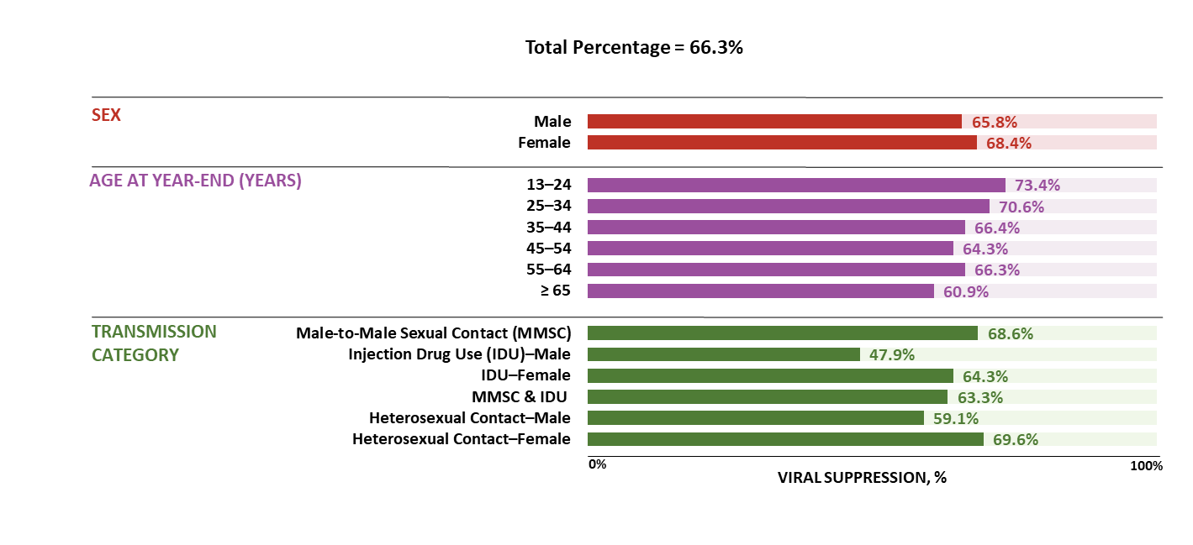
Viral suppression during 2023 among Hispanic/Latino persons, by selected characteristics—United States
Note. Data are presented for persons aged ≥ 13 years by year-end 2023. Hispanic/Latino persons can be of any race.
Notes:
Among 273,036 Hispanic/Latino persons aged ≥ 13 years living with diagnosed HIV at year-end 2023, 66.3% had viral suppression at their most recent test in 2023.
For viral suppression, lowest percentages among Hispanic/Latino persons:
By sex—males (65.8%)
By age at year-end—persons aged ≥ 65 years (60.9%)
By transmission category—males with HIV attributed to injection drug use (47.9%)
Note.
For additional data, see Table 3c in the report HIV Surveillance Supplemental Report: Monitoring Selected National HIV Prevention and Care Objectives by Using HIV Surveillance Data United States and 6 Territories and Freely Associated States, 2023 at https://www.cdc.gov/hiv-data/nhss/national-hiv-prevention-and-care-outcomes.html.
Data have been statistically adjusted to account for missing transmission category.
For more information on data sources, data collection and reporting practices, and case definitions, see the National HIV Surveillance System (NHSS) Technical Notes, available at https://www.cdc.gov/hiv-data/nhss/index.html.
For more information on viral suppression, see the Technical Notes, available at https://www.cdc.gov/hiv-data/nhss/national-hiv-prevention-and-care-outcomes.html.
Data for all figures are available at https://www.cdc.gov/hiv-data/nhss/national-hiv-prevention-and-care-outcomes.html.

Slide 36
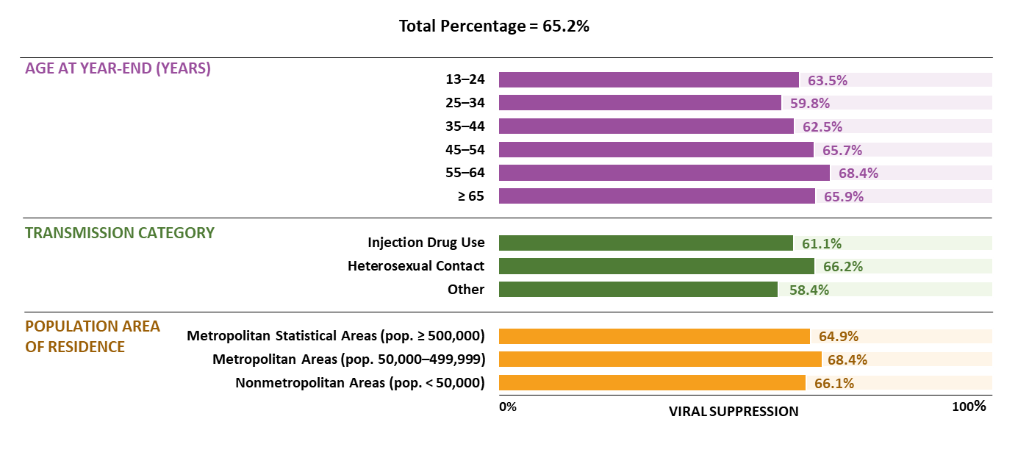
Viral suppression during 2023 among Black/African American females—United States
Note. Data are presented for persons aged ≥ 13 years by year-end 2023.
Notes:
In the United States, among 139,363 Black/African American females aged ≥ 13 years living with diagnosed HIV at year-end 2023, 65.2% had viral suppression at their most recent test in 2023.
For receipt of HIV medical care, lowest percentages among Black/African American females :
By age at year-end—persons aged 25–34 years (59.8%)
By transmission category—persons with HIV attributed to other transmission category (58.4%)
By population area of residence—persons who resided in metropolitan areas of population ≥ 500,000 (64.9%)
Note.
For additional data, see Table 3c in the report HIV Surveillance Supplemental Report: Monitoring Selected National HIV Prevention and Care Objectives by Using HIV Surveillance Data United States and 6 Territories and Freely Associated States, 2023 at https://www.cdc.gov/hiv-data/nhss/national-hiv-prevention-and-care-outcomes.html.
Data have been statistically adjusted to account for missing transmission category.
For more information on data sources, data collection and reporting practices, and case definitions, see the National HIV Surveillance System (NHSS) Technical Notes, available at https://www.cdc.gov/hiv-data/nhss/index.html.
For more information on viral suppression, see the Technical Notes, available at https://www.cdc.gov/hiv-data/nhss/national-hiv-prevention-and-care-outcomes.html.
Data for all figures are available at https://www.cdc.gov/hiv-data/nhss/national-hiv-prevention-and-care-outcomes.html.

Slide 37
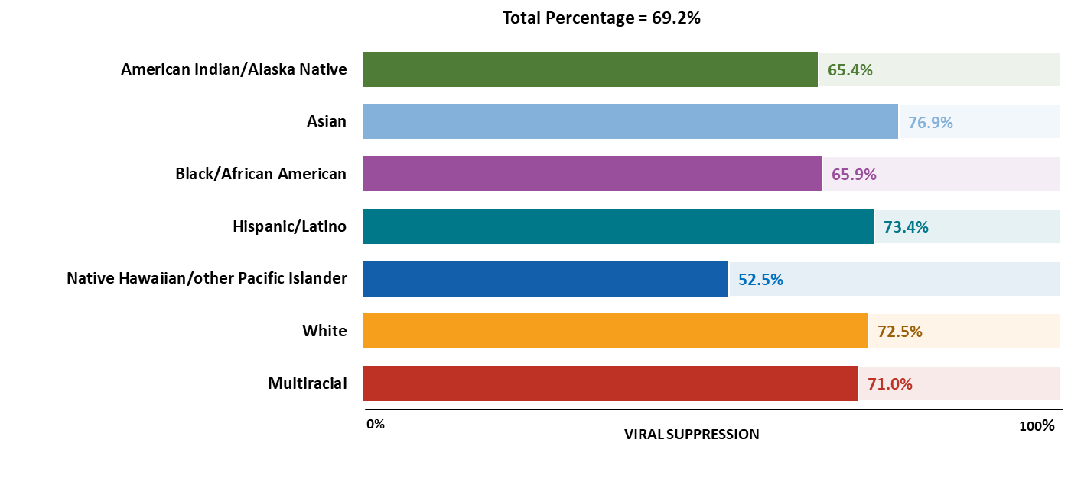
Viral suppression during 2023 among persons aged 13–24 years, by race/ethnicity—United States
Note. Hispanic/Latino persons can be of any race. Data are presented for persons aged ≥ 13 years by year-end 2023.
Notes:
Of 28,493 persons aged 13–24 years living with diagnosed HIV at year-end 2023 in the United States, 69.2% had viral suppression at their most recent test in 2023. The lowest percentage among persons aged 13–24 years by race/ethnicity was among Native Hawaiian/ other Pacific Islander persons (52.5%).
Note.
For additional data, see Table 3c in the report HIV Surveillance Supplemental Report: Monitoring Selected National HIV Prevention and Care Objectives by Using HIV Surveillance Data United States and 6 Territories and Freely Associated States, 2023 at https://www.cdc.gov/hiv-data/nhss/national-hiv-prevention-and-care-outcomes.html.
Use caution when interpreting data for American Indian/Alaska Native and Native Hawaiian/other Pacific Islander persons due to small numbers.
For more information on data sources, data collection and reporting practices, and case definitions, see the National HIV Surveillance System (NHSS) Technical Notes, available at https://www.cdc.gov/hiv-data/nhss/index.html.
For more information on viral suppression, see the Technical Notes, available at https://www.cdc.gov/hiv-data/nhss/national-hiv-prevention-and-care-outcomes.html.
Data for all figures are available at https://www.cdc.gov/hiv-data/nhss/national-hiv-prevention-and-care-outcomes.html.

Slide 38
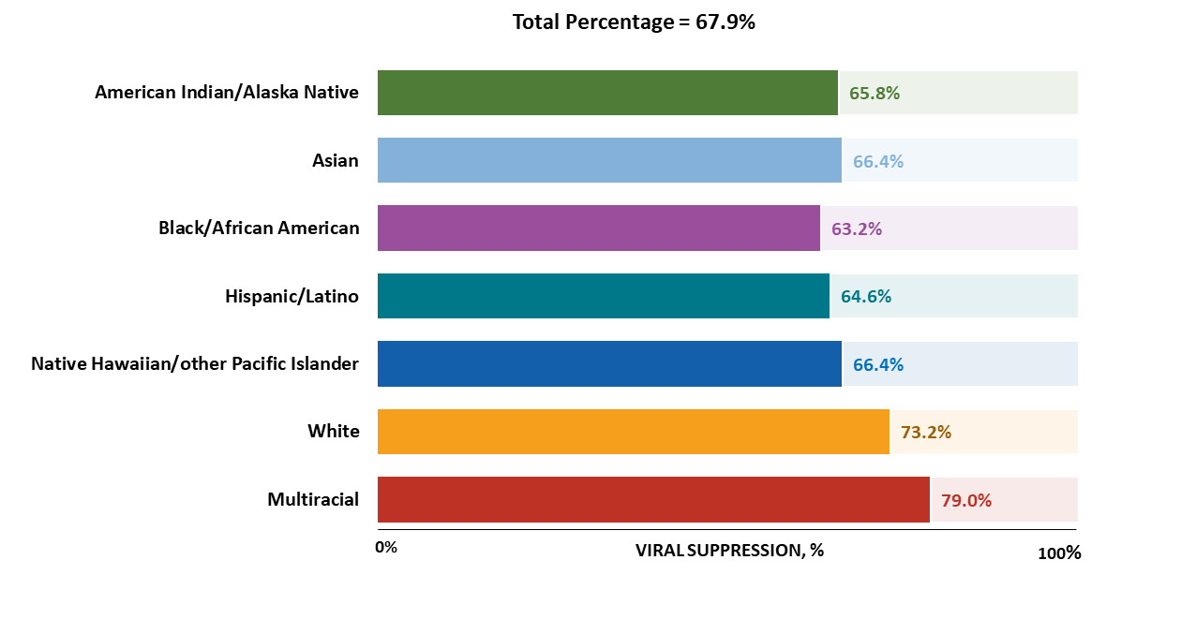
Viral suppression during 2023 among persons aged ≥ 55 years, by race/ethnicity—United States
Note. Hispanic/Latino persons can be of any race.
Notes:
Of 439,742 persons aged ≥ 55 years living with diagnosed HIV at year-end 2023 in the United States, 67.9% had viral suppression at their most recent test in 2023. The lowest percentage among persons aged ≥ 55 years by race/ethnicity was among Black/African American persons (63.2%).
Note.
For additional data, see Table 3c in the report HIV Surveillance Supplemental Report: Monitoring Selected National HIV Prevention and Care Objectives by Using HIV Surveillance Data United States and 6 Territories and Freely Associated States, 2023 at https://www.cdc.gov/hiv-data/nhss/national-hiv-prevention-and-care-outcomes.html.
Use caution when interpreting data for American Indian/Alaska Native and Native Hawaiian/other Pacific Islander persons due to small numbers.
For more information on data sources, data collection and reporting practices, and case definitions, see the National HIV Surveillance System (NHSS) Technical Notes, available at https://www.cdc.gov/hiv-data/nhss/index.html.
For more information on viral suppression, see the Technical Notes, available at https://www.cdc.gov/hiv-data/nhss/national-hiv-prevention-and-care-outcomes.html.
Data for all figures are available at https://www.cdc.gov/hiv-data/nhss/national-hiv-prevention-and-care-outcomes.html.

Slide 39
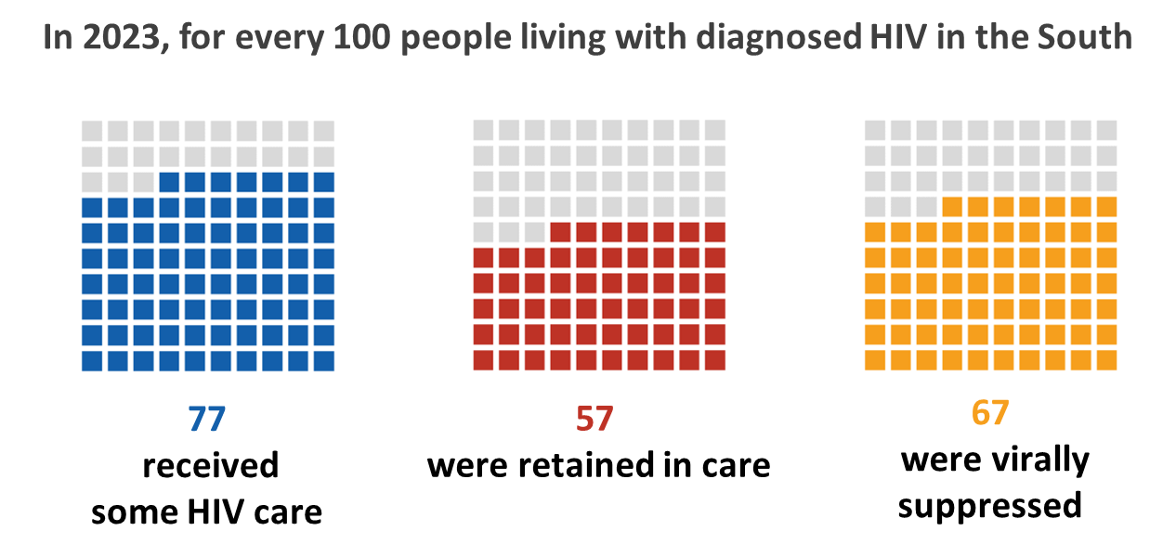
HIV care continuum for persons living with diagnosed HIV at year-end 2023—U.S. Southern Region
Note. Data are presented for persons aged ≥ 13 years at diagnosis.
Notes:
In 2023, of the 499,152 (46%) persons aged ≥ 13 years living with diagnosed HIV in the U.S. Southern Region:
77% received HIV medical care
57% were retained in HIV medical care
67% had viral suppression
Note.
For additional data, see Table 3a in the report HIV Surveillance Supplemental Report: Monitoring Selected National HIV Prevention and Care Objectives by Using HIV Surveillance Data United States and 6 Territories and Freely Associated States, 2023 at https://www.cdc.gov/hiv-data/nhss/national-hiv-prevention-and-care-outcomes.html.
For more information on data sources, data collection and reporting practices, and case definitions, see the National HIV Surveillance System (NHSS) Technical Notes, available at https://www.cdc.gov/hiv-data/nhss/index.html.
For more information on the U.S. region and the diagnosis-based care continuum, see the Technical Notes, available at https://www.cdc.gov/hiv-data/nhss/national-hiv-prevention-and-care-outcomes.html.
Data for all figures are available at https://www.cdc.gov/hiv-data/nhss/national-hiv-prevention-and-care-outcomes.html.

Slide 40
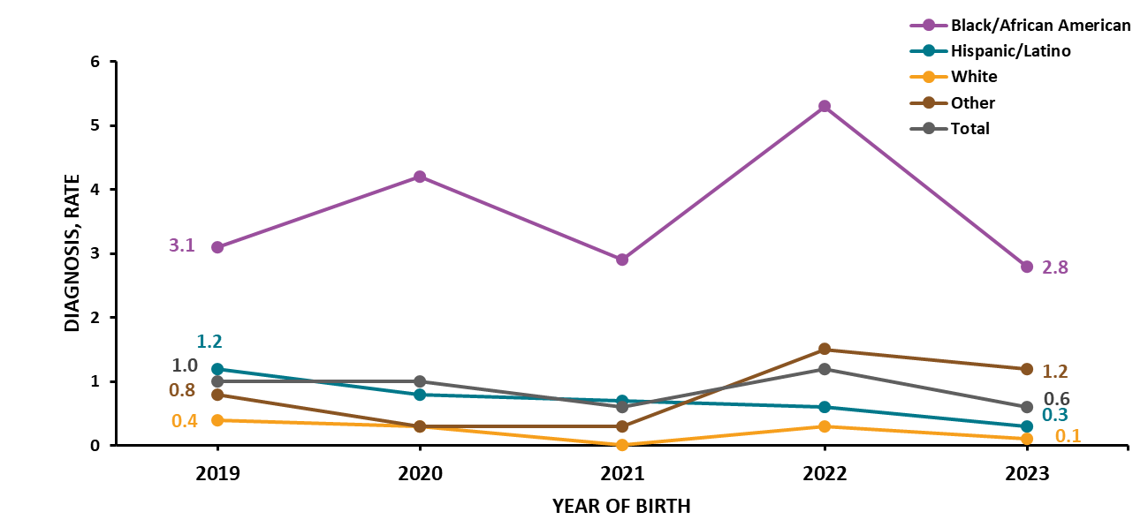
Perinatally acquired HIV among persons born in the United States, by year of birth and biological mother's race/ethnicity, 2019–2023—United States
Note. Hispanic/Latino persons can be of any race. Rates are per 100,000 live births.
Notes:
In 2023, the overall annual rate of perinatally acquired HIV in the United States was 0.6 per 100,000 live births (regardless of place of birth). The rate among births for Black/African American persons (2.8) was 4.7 times the annual rate of 0.6.
Note.
For additional data, see Table 8b in the report HIV Surveillance Supplemental Report: Monitoring Selected National HIV Prevention and Care Objectives by Using HIV Surveillance Data United States and 6 Territories and Freely Associated States, 2023 at https://www.cdc.gov/hiv-data/nhss/national-hiv-prevention-and-care-outcomes.html.
Live-birth data reflect race/ethnicity of the infant’s biological mother.
Race/ethnicity category for Other includes American Indian/Alaska Native, Asian, Native Hawaiian/other Pacific Islander, and multiracial persons. Because of delays in the reporting of births and diagnoses of HIV attributed to perinatal exposure, these numbers may be subject to change.
The data for 2020, which coincided with the onset of the COVID-19 pandemic, should be interpreted with caution. The pandemic had a significant impact on access to HIV testing, care, and related services, and case surveillance activities in state and local jurisdictions. As the COVID-19 pandemic lasted beyond 2020, please also consider the potential influence of these pandemic effects on U.S. public health systems when interpreting HIV data for 2021–2023.
For more information on perinatally acquired HIV, see the Technical Notes, available at https://www.cdc.gov/hiv-data/nhss/national-hiv-prevention-and-care-outcomes.html.
Data for all figures are available at https://www.cdc.gov/hiv-data/nhss/national-hiv-prevention-and-care-outcomes.html.

Slide 41
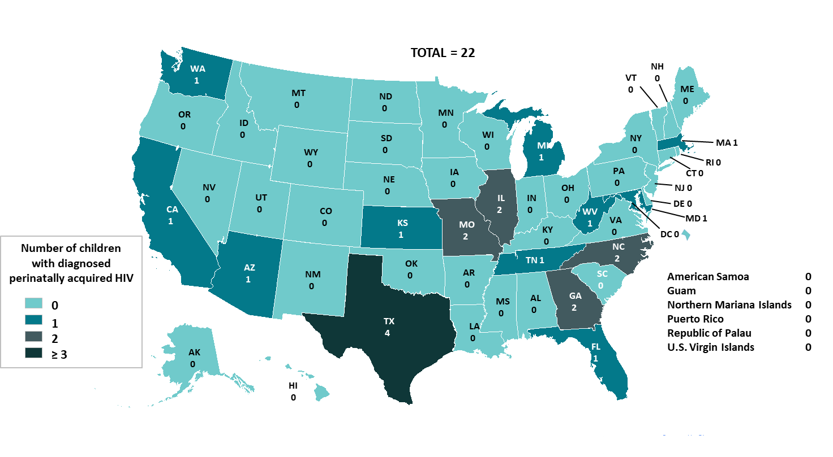
Diagnoses of perinatally acquired HIV among children born during 2023—United States and 6 territories and freely associated states
Notes:
In the United States and 6 territories and freely associated states, a total of 22 children aged <13 years and born during 2023 received an HIV diagnosis attributed to perinatal transmission.
Note.
Because of delays in the reporting of births and diagnoses of HIV attributed to perinatal exposure, numbers may be subject to change.
For more information on perinatally acquired HIV, see the Technical Notes, available https://www.cdc.gov/hiv-data/nhss/national-hiv-prevention-and-care-outcomes.html.

Slide 42
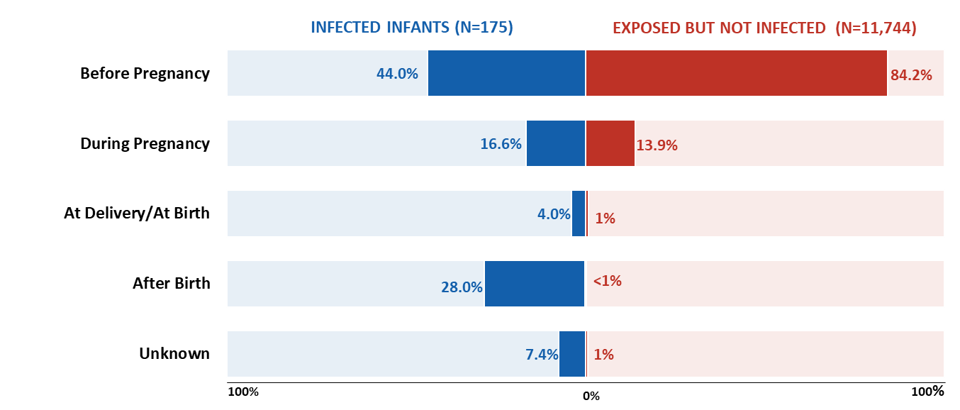
Time of biological mother's HIV testing among children with diagnosed, perinatally acquired HIV and children exposed to HIV, birth years 2019–2022—United States and Puerto Rico
Notes:
From 2019–2022 in the United States and Puerto Rico, among the 175 children aged < 13 years born with diagnosed, perinatally acquired HIV, time of biological mother’s HIV testing was as follows:
Highest percentage—persons who were tested before pregnancy (44.0%)
Lowest percentage—persons tested at the time of birth (4.0%)
From 2019–2022 in the United States and Puerto Rico, among the 11,744 children aged < 13 years born who were exposed but not perinatally infected with HIV, time of biological mother’s HIV testing was as follows:
Highest percentage—persons who were tested before pregnancy (84.2%)
Lowest percentage—persons tested after birth (< 1%)
Note.
There were no perinatally acquired HIV diagnoses for American Samoa, Guam, Northern Mariana Islands, Republic of Palau, or the U.S. Virgin Islands from 2019–2022.
For more information on perinatally acquired HIV, see the Technical Notes, available at https://www.cdc.gov/hiv-data/nhss/national-hiv-prevention-and-care-outcomes.html.
The data for 2020, which coincided with the onset of the COVID-19 pandemic, should be interpreted with caution. The pandemic had a significant impact on access to HIV testing, care, and related services, and case surveillance activities in state and local jurisdictions. As the COVID-19 pandemic lasted beyond 2020, readers should also consider the potential influence of these pandemic effects on U.S. public health systems when interpreting HIV data for 2021–2022.

