Slide 1
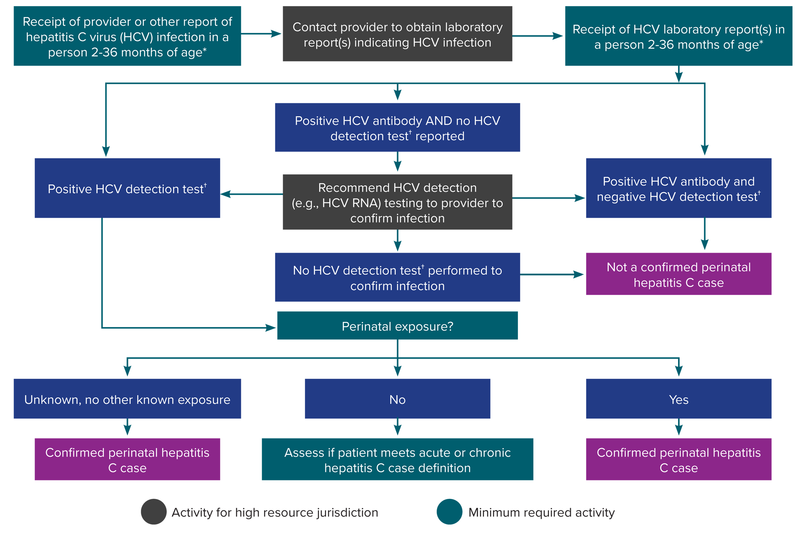
Figure 4-3. Process for perinatal hepatitis C case ascertainment and classification
*Test results among infants <2 months of age should not be used for classification. Cases among children <36 months of age who are known to have been exposed to HCV through health care or otherwise, and not perinatally, should be reported under the 2020 acute and chronic hepatitis C case definitions.
†HCV detection testing includes nucleic acid testing (NAT) for HCV RNA (including qualitative, quantitative, and genotype testing) or testing indicating the presence of HCV antigen. At present, no HCV antigen tests are approved by the US Food and Drug Administration (FDA). These tests will be acceptable laboratory criteria, equivalent to HCV RNA testing, when an FDA-approved test becomes available.
Notes:
Figure 4-3 illustrates an approach for perinatal hepatitis C case ascertainment and classification. The flow chart begins with receipt of a provider report, laboratory report, or other report indicating hepatitis C virus infection in an infant or child 36 months of age or younger and walks through follow-up and case classification decisions based on available information. Recommended follow-up activities are color-coded based on if they are minimumly required or are high resource.

