Slide 1
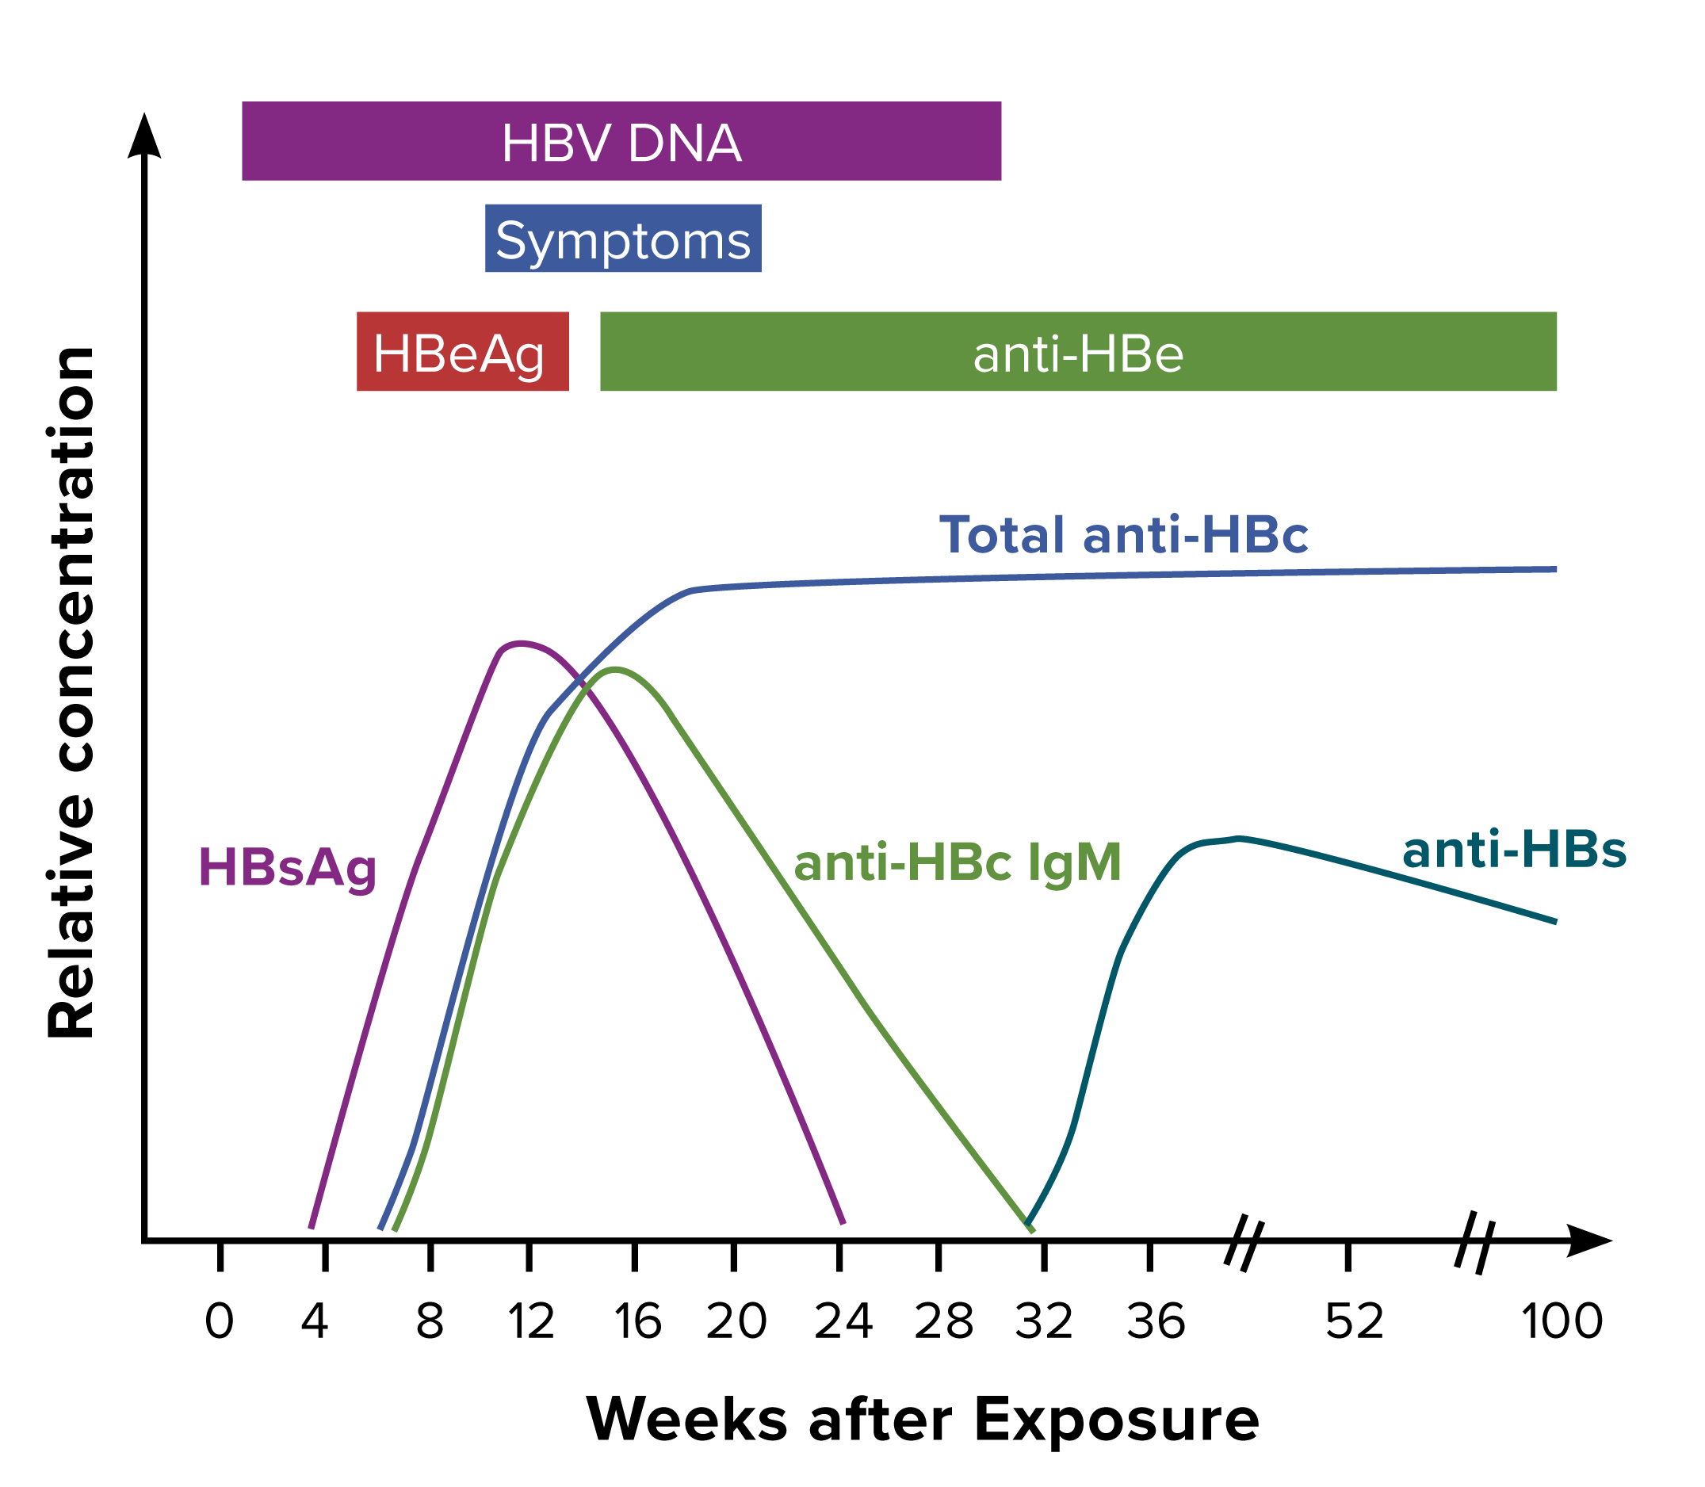
Figure 3-1. Typical serologic course of acute hepatitis B to recovery
Figure obtained from https://www.cdc.gov/mmwr/preview/mmwrhtml/rr5708a1.htm.
Notes:
Figure 3-1 illustrates the typical biomarker changes of acute hepatitis B to recovery.

