Slide 1
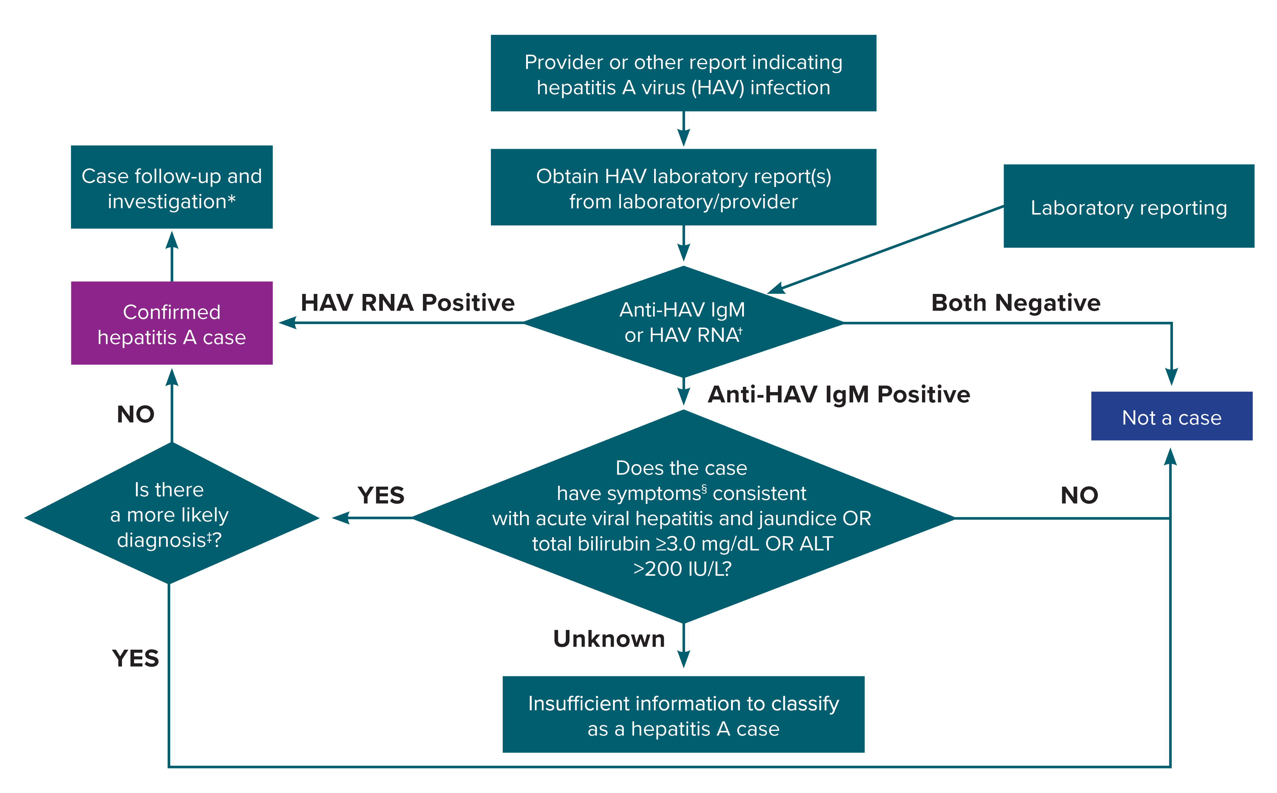
Figure 2-2. Process for hepatitis A case ascertainment and classification
*A person who had contact with a laboratory-confirmed hepatitis A case 15–50 days prior to onset of symptoms AND meets the clinical criteria should be classified as a confirmed hepatitis A case.
†Surveillance programs should provide prevention programs with information on people who have positive test outcomes for post-test counseling, as appropriate.
‡May include evidence of acute liver injury from infectious, autoimmune, metabolic, drug or toxin exposure, neoplastic, circulatory or thromboembolic, or idiopathic causes.
§Clinical symptoms include fever, headache, malaise, anorexia, nausea, vomiting, diarrhea, abdominal pain, or dark urine.
Notes:
Figure 2-2 illustrates a process for hepatitis A case ascertainment and classification in accordance with the 2019 CDC/CSTE case definition for hepatitis A.

