Slide 1
GYT for High Schools
Student Planning Group Orientation
Notes:
Note to school campaign leader: We recommend that you and other campaign partners review the Planning Guide in the GYT for High Schools Toolkit before sharing this presentation with the student planning group.

Slide 2
Agenda
What is Get Yourself Tested (GYT) for High Schools?
Planning your GYT for High Schools campaign
Ideas for GYT for High Schools events and activities
Questions

Slide 3
What is GYT for High Schools?

Slide 4
What is GYT?
GYT stands for Get Yourself Tested
GYT was started in 2009 by MTV Networks, the Kaiser Family Foundation, CDC, and other partners
GYT is a national campaign
  Local campaigns take place in colleges and clinics across the US
  Now GYT is coming to your high school!
Notes:
Note to school campaign leader: This slide corresponds to the GYT for High Schools Toolkit section “Introduction to GYT”.

Slide 5
GYT is a Social Movement
GYT aims to change social norms about HIV and STD testing
  Social norms are the “rules of behavior” within a group of people
    Social norms can be good for you or sometimes not so good for you
    Examples of social norms are:
      Dressing a certain way (or not wearing certain styles)
      Going certain places on the weekend (or not going certain places)
      Getting a flu shot (or not getting a flu shot)
Notes:
Note for school campaign leader: Students may need a few examples of social norms about getting tested for HIV and STDs to get the discussion going: “Only get tested if you hear that your partner is not faithful to you” or “Wait to get tested until you think you might have an STD”.

Slide 6
GYT is a Social Movement- cont’d
The GYT for High Schools campaign can make getting tested a social norm
  Let’s make a list of social norms about getting tested for HIV and STDs

Slide 7
GYT for High Schools can:
Get young people talking about HIV and STD testing
Link young people to local HIV and STD testing locations
Raise awareness of HIV and STDs among young people

Slide 8
What are the goals of GYT for High Schools?
Knowledge/Awareness
STD/HIV Testing
Communication
Be more aware of how STDs and HIV affect young people in your community
Be less afraid of STD and HIV testing
Feel more comfortable talking about sexual health, STDs, and HIV with partners, friends, and health care providers
Know more about STDs and HIV: how you get them, symptoms, treatment
Make getting tested for HIV and STDs something to feel proud of
Have more conversations with partners, friends, and health care providers about STDs and HIV
Recognize that you can get STDs or HIV no matter who you or your partner are
Know where you can get tested for STDs and HIV
Reduce negative beliefs and attitudes about condom use
Plan to get tested for STDs and HIV if you are sexually active
Know that STD and HIV testing can be free and confidential
Notes:
Note to school campaign leader: This slide corresponds to the “GYT for High School Logic Model” in Appendix 1 of the GYT for High Schools toolkit.

Slide 9
Key Ideas for Your GYT for High Schools Campaign
Your GYT campaign should:
  Encourage students at your school to make healthy decisions about protecting themselves from HIV and STDs
  Get students talking to friends, partners, and health care providers about getting tested
  Reach ALL students, regardless of gender identity, physical ability, race/ethnicity, and sexual orientation
  Be visible to the whole school

Slide 10
Important GYT Messages
"STDs are common; anyone who’s sexually active can get HIV or an STD"
"You can’t tell by looking who has HIV or an STD. The only way to know is to get tested"
"Getting tested is easy, painless, and part of a healthy lifestyle for anyone who is sexually active"
"If you have HIV or an STD, you can do something about it. All STDs, including HIV, are treatable and many are curable"

Slide 11
Important GYT Messages- cont’d
"You have to ASK to be tested. Don’t assume that a doctor would automatically test you for HIV or STDs—or that you have been tested as part of your annual physical"
"Be open and honest in your relationships, including talking about HIV and STDs, testing, and protection"
"To know yourself is to know your status"

Slide 12
Key Parts of GYT for High Schools
Campaign Events and Activities: The school campaign leader will guide the student planning group in creating the campaign
Access to Testing: Students will learn how to access HIV and STD testing that is free, confidential, and welcoming to youth

Slide 13
Key Parts of GYT for High Schools
Messages: Use the GYT name and brand in ways that students at your high school will see them
  Messages can be shared through Snapchat, YouTube, Facebook, Twitter, Instagram, and school announcements
  Messages can be placed on materials such as posters, wallet cards, and key chains
Events and Activities: Take place on your high school campus before, during, and after school
Notes:
Note to school campaign leader: This slide corresponds to the GYT for High Schools Toolkit “Planning Guide”. The specific material is “Getting the Word Out with Local GYT Messages and Materials”.

Slide 14
Planning your
GYT for High Schools Campaign

Slide 15
When Will Our Campaign Happen?
From now until [month], [school campaign leader, partners, other adult leaders] will work with the student planning group to plan the campaign
The student planning group will plan the following activities:
  Campaign launch
  [Number of] campaign pushes
All of the activities should promote at least one GYT goal and be fun and engaging!
Notes:
Note to school campaign leader: This slide corresponds to the GYT for High Schools Toolkit Planning Guide. The specific section is “Building Your GYT for High Schools Campaign”. Be sure to fill in the month that the campaign will end in the first bullet, as well as the partners that will support the student planning group (school campaign leader, partners and other adults leaders).

Slide 16
Types of Campaign Activities
Creating buzz gets people excited before the campaign starts
  You can create buzz by putting up posters or wearing GYT t-shirts to get people to ask, “Hey, what’s GYT?”
The campaign launch is the first big event that kicks off the campaign and lets people know about GYT
Campaign pushes are smaller, simple activities that remind people about GYT and keep them thinking about getting tested throughout the school year
Notes:
Note to school campaign leader: This slide corresponds to the GYT for High Schools Toolkit Planning Guide. The specific material is

Slide 17
What kind of help will we have for planning our campaign?
The GYT for High Schools Youth Workbook has tools and ideas for planning a GYT for High Schools campaign
You will have people to guide you in planning the campaign
  These people are:
    [Insert list of staff people from the school and partner organizations who will be working with the students to support them in planning the campaign]

Slide 18
GYT for High Schools Activity Guidelines
All GYT for High Schools activities, messages, and materials must follow district and school policies
  To allow time for the approval process, it’s important to plan as far in advance as possible.
All events and activities should address at least one GYT campaign goal
  Think about:
    Knowledge/awareness of HIV and STDs
    Talking about the benefits of getting tested
    Knowing how and where to get tested

Slide 19
For each event or activity, think about:
Date, time, and place
What will happen during this event or activity?
Which GYT goal will this event or activity meet?
How will you use GYT messages in this event or activity?
Who will lead the event and activity and who will help?
How much will the event or activity cost?
How will people find out about the event or activity?
Time to prepare and practice!

Slide 20
Ideas for GYT for High Schools Events and Activities

Slide 21
Sample Events and Activities
Poster or slam poetry contests
Games that test knowledge of HIV and STDs
Newsletters that answer questions about HIV and STDs
Free stuff (key chains, wrist bands, stickers) that promotes GYT
Making the GYT message part of sports events or spirit week
Notes:
Note to school campaign leader: This slide and the next two slides correspond to the GYT for High Schools Toolkit Planning Guide. The corresponding materials is “GYT Activity Ideas”.

Slide 22
More Sample Events and Activities
“Selfie” Photo Contest
Scavenger Hunt
Viral Video Contest (see example on the next slide!)
Valentine’s Day CandyGram
Art Contest

Slide 23
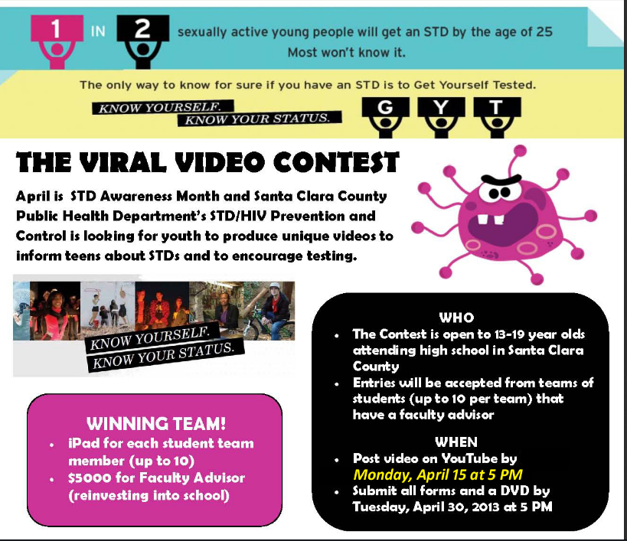

Slide 24
Questions?

Slide 25
Thank you for your attention!
What do you think we should do next?

