Slide 1

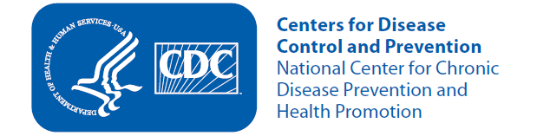
The Road to Health
Type 2 Diabetes Prevention

Slide 2
Lesson 1
Type 2 Diabetes is Preventable, and Losing Some Weight Can Help.

Slide 3


Topic 1: Preventing Type 2 Diabetes—Meeting Angela and Ray
Lesson 1: Type 2 Diabetes is Preventable, and Losing Some Weight Can Help
“ I see our future… a future without type 2 diabetes”
“ With better choices, we can prevent or delay type 2 diabetes”
Angela, 28
Elementary School Teacher
Ray, 32
Realtor
Type 2 diabetes does not have to be your destiny.
Notes:
Angela and Ray Williams are sister and brother. They are from a family affected by type 2 diabetes. Their mother and brother have diabetes, as do other members of their extended family. Because of this family history, Angela and Ray are at risk for type 2 diabetes. Over the last 2 years, Angela and Ray have made small changes in the way they eat and to their physical activity level to help prevent type 2 diabetes from becoming their destiny. Telling a story about Angela and Ray can help participants learn the key points.
Tip
Tell the story YOUR way. The Participant Guide shows Angela and Ray’s key messages, but it is up to you to add the details to make the story real to your participants. Don’t be afraid to add information about how diabetes has touched your life and your community.
Key Points
Introduce Angela and Ray Williams as a sister and brother. Describe their family history of diabetes.
Tell participants that this is only part of the story and that they will learn more about Angela and Ray as they move through the Participant Guide.
Ask and Discuss
Does anyone in your family have diabetes?
How has type 2 diabetes affected you?
Do you think you are at risk? (Participants will learn more about the risks for type 2 diabetes later.)

Slide 4
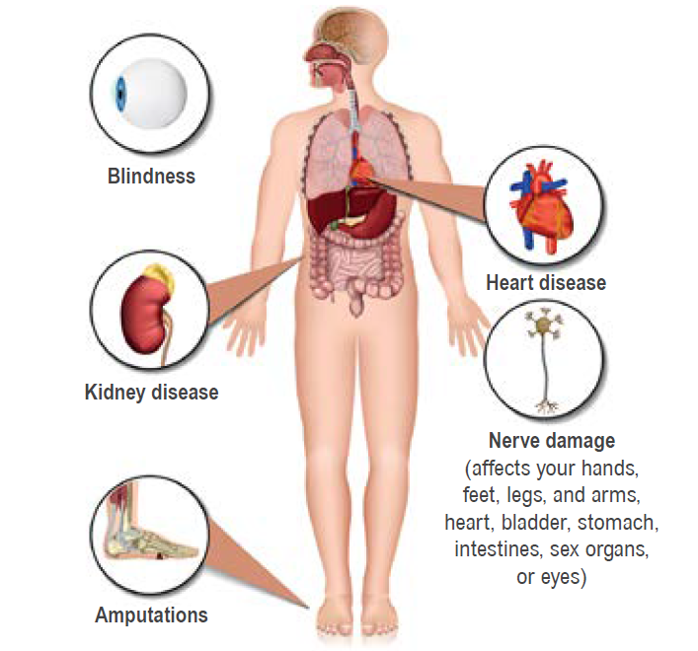
Topic 2: Diabetes Affects Various Body Organs
Lesson 1: Type 2 Diabetes is Preventable, and Losing Some Weight Can Help
Diabetes Complications
“So, what is diabetes? It affects your whole body – sometimes you don’t even know you are sick.”
Notes:
Diabetes means that your blood sugar, or glucose, is too high. Glucose comes from the food that you eat and is also made in your liver and muscles. Your blood always has some glucose in it because your body needs glucose for energy. But too much glucose in the blood isn’t good for your health. An organ called the pancreas controls the amount of glucose in your blood. The pancreas makes insulin, which helps glucose get from food into your cells. Cells take the glucose and make it into energy your body needs for life. In a person with type 2 diabetes, either the pancreas does not make enough insulin, or the cells don’t use insulin very well. So, glucose builds up in the blood and can’t get into your cells. Your blood glucose gets too high and then damages your body.
Key Points
How does diabetes affect your health? Think about a glass of lemonade that sits out overnight. As the water evaporates, it leaves a coating of sugar on the inside of the glass. Imagine that coating building up on the insides of your blood vessels or coating your nerves. This is not literally what happens to blood vessels and nerves in people with diabetes, but it is an image that helps you understand the damage diabetes can cause. Diabetes can damage any part of your body if your blood sugar level is high most of the time.
Diabetes is a serious disease. It increases your chance of blindness, heart disease, stroke, kidney failure, and amputations. But you can prevent or delay type 2 diabetes through lifestyle changes by doing the following:
Lose at least 5% of your starting weight, lose at least 4% of your starting weight and log an average of 150 minutes of activity each week, or lower your HbA1C by 0.2%.
Lose weight and maintain a healthy weight by making small changes in food choices to establish a healthier eating pattern.
Get at least 150 minutes of moderate-intensity physical activity a week. That’s only 30 minutes 5 days a week. Moderate activities may include brisk walking, yard work, actively playing with children, biking, dancing, or playing soccer.
Taking small steps is a manageable way to make great strides toward achieving your goals. For example, walking for 15 minutes on your lunch break twice this week might be a good place to start. Maybe next week you walk for 15 minutes three times a week during your lunch break, plus do 10 arm curls with exercise bands, weights, or cans of food. Don’t get too stuck on the idea that these small steps aren’t enough. Each time you achieve a small goal, you’re making positive changes toward reaching your bigger long-term goals. Small changes in our routines are manageable. When you’ve stayed with a change long enough and feel you can do a bit more, take another step forward.
Ask and Discuss
If your family talks about diabetes, what do they talk about most?
Do people you know consider diabetes a serious disease? For example, do they know diabetes can be life-threatening?
How is diabetes managed in your family?
Did you know that type 2 diabetes can be prevented or delayed?
What do you think of when you hear that small changes can prevent and delay type 2 diabetes?

Slide 5
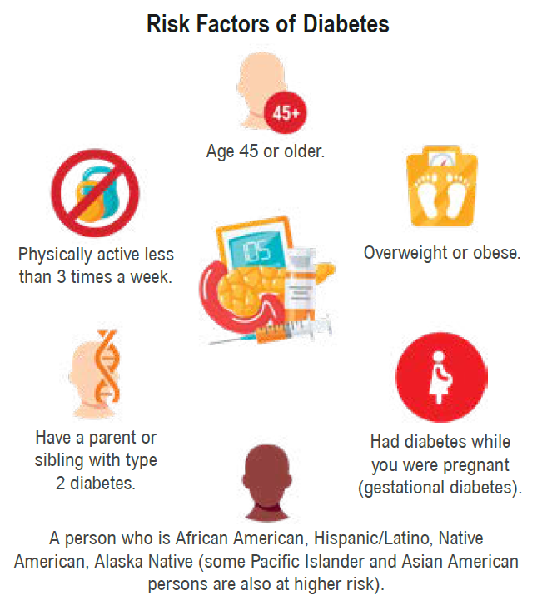
Topic 3: Type 2 Diabetes Risk Factors and How the Disease Can Be Prevented
Lesson 1: Type 2 Diabetes is Preventable, and Losing Some Weight Can Help
Risk Factors for Diabetes
“Diabetes runs in our family, but I don’t claim it. I’m making small changes to what I eat and do. I’m losing a few pounds and I’m in control.”
Even those of us at high risk can prevent or delay type 2 diabetes.
Notes:
People with certain conditions in their or their family’s health history are more likely to develop type 2 diabetes. These are called risk factors. Having one or more of the following risk factors means you are more likely to get type 2 diabetes:
Are overweight or have obesity.
Are physically active less than 3 times a week.
Are a person who is African American, Hispanic/Latino, Native American, Alaska Native (some Pacific Islander and Asian American persons are also at higher risk).
Have a parent or sibling with type 2 diabetes.
Are age 45 or older.
Had diabetes while you were pregnant (gestational diabetes).
Diabetes can develop at ANY AGE.
Key Points
Discuss the risk factors for diabetes and why it is important for people to know they may be at risk. (Because they can take steps to prevent it.)
Let your participants know that even if they are at high risk, they can do something about it.
Tell your participants that:
Consistently making healthy eating choices and remaining active can help change the course that would lead to type 2 diabetes and related health complications.
The key is small steps, taken one at a time. Small changes add up to big results.
Risk factors are not a 100% guarantee that you will get diabetes. You can make your own road to health.
Ask and Discuss
What are your risk factors?
What do you think of when you hear that you may be at higher risk for type 2 diabetes? How do you feel about it?

Slide 6
Lesson 2
Making Healthy Food Choices

Slide 7
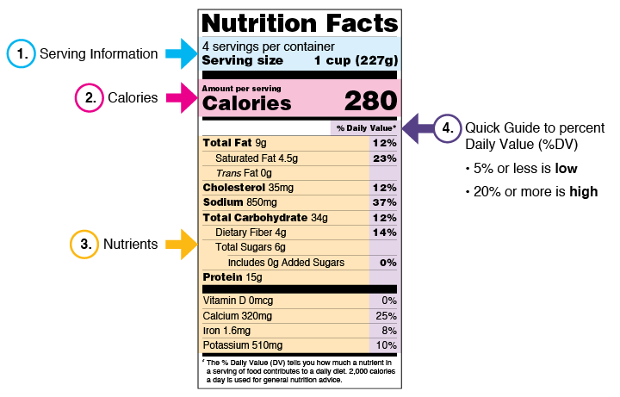

Topic 1: Reading Food Labels
Lesson 2: Making Healthy Food Choices
“We have to eat healthier and make better choices. First, I learned to read food labels.”
Small steps in eating and moving can lead to big rewards.
Notes:
Two ways to prevent or delay type 2 diabetes are to eat healthier and to be physically active. You’ll discuss these topics in the upcoming lessons. Start by teaching participants to read and understand food labels. Ray took the first step to learn what he eats and how to make better choices. Use the sample food label for frozen lasagna below to make a connection between serving size, the general quality of the food, and the balance of nutrients the food contains. You can also refer participants to the FDA nutrition label infographic for more explanation on using food labels: www.fda.gov/media/89314/download. In addition, refer to FDA’s The New Nutrition Facts Label and CDC’s Food Labels for more information on food labels.
Key Points
Serving size. That’s the size of one serving. All the other facts on the label are based on this amount. Also look at the number of servings in the package. If a package contains 4 servings and you eat the whole package, you’ll need to multiply all the other facts on the label by 4.
Calories. Knowing the number of calories can help you reach or stay at a healthy weight. Calories are the amount of energy you get from a serving of this food.
Nutrients. Eating too much fat, especially saturated fat or trans fat, cholesterol, added sugars, or sodium (salt) can raise your risk of certain health problems. These include heart disease, some cancers, and high blood pressure. Try to get less than 30% of your daily calories from fat.
% Daily Value. Most Americans don’t get enough fiber, vitamin A, vitamin C, calcium, or iron. Consuming enough of these nutrients can improve your health and lower your risk of certain health problems.
To learn more about healthy and unhealthy fats, please see Lesson 2, Topic 2 –– Limit Unhealthy Fats on page 21.
Tip
Bring food labels for foods that are high and low in fat, calories, and sugar. Teach participants to compare food labels.
Ask and Discuss
Why are food labels useful?
Do you read food labels? What do you look for?
Besides reading labels, how could you find out nutrition facts about your food?

Slide 8
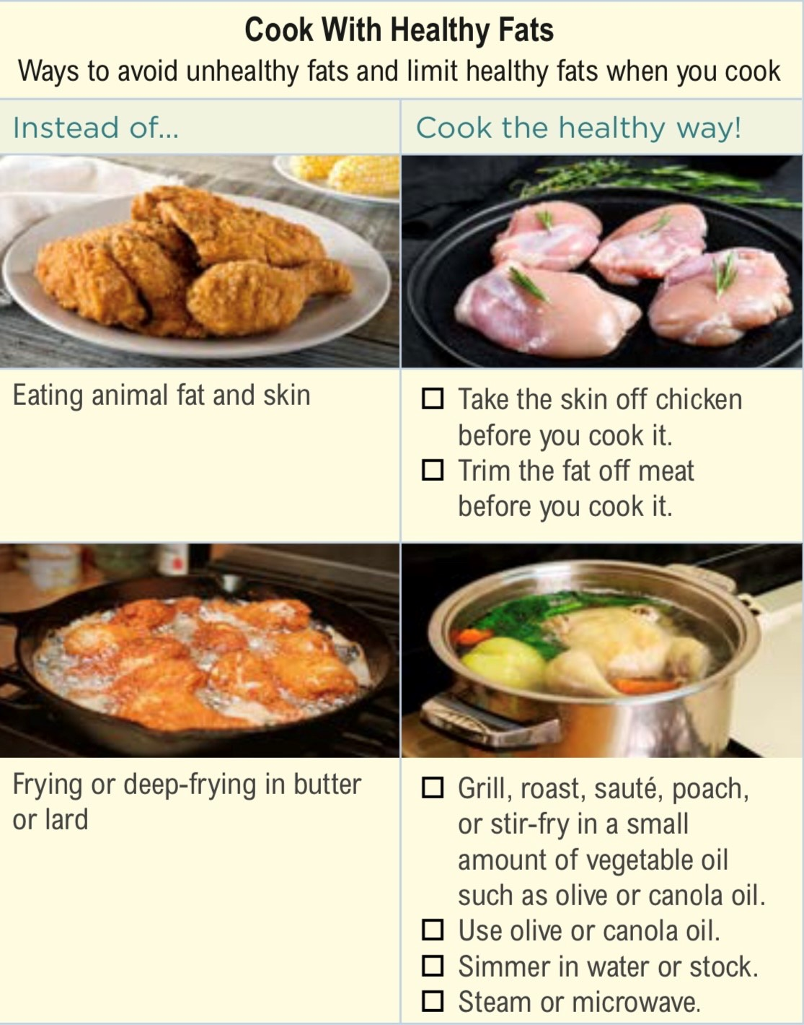
Topic 2: Limit Unhealthy Fats
Lesson 2: Making Healthy Food Choices
“I found a lot of unhealthy fats in my foods. I’ve made changes to eat healthier fats.”
Notes:
Angela talks about replacing unhealthy fats with healthier ones. We all need some fat in the foods we eat. Healthy fats give us energy and help us grow, absorb vitamins, and stay healthy. They help us to feel full sooner and longer, so we don’t eat too much. The fats to limit are called saturated fats—they are unhealthy fats. Saturated fats are found in foods such as butter, beef fat, higher-fat meats, cakes, cookies, pizza, casseroles, burgers, and traditional ground beef tacos. Eating too much unhealthy fat can raise your blood cholesterol levels and increase your risk of heart disease.
Key Points
Foods with unhealthy fats to avoid or limit:
Chicken or Turkey Skin
Sauces Made with Butter or Cream
Palm Oil, Palm Kernel Oil
Fatback, Salt Pork
High-Fat Dairy Products Like Whole or 2% Milk, Cream, Ice Cream, Full-Fat Cheese
High-Fat Meats Like Ground Beef, Bologna, Hot Dogs, Sausage, Bacon, Spareribs
Lard
Explain that foods with unhealthy fats are widely available, tempting to many of us, and are present in some traditional family or cultural dishes.

Slide 9
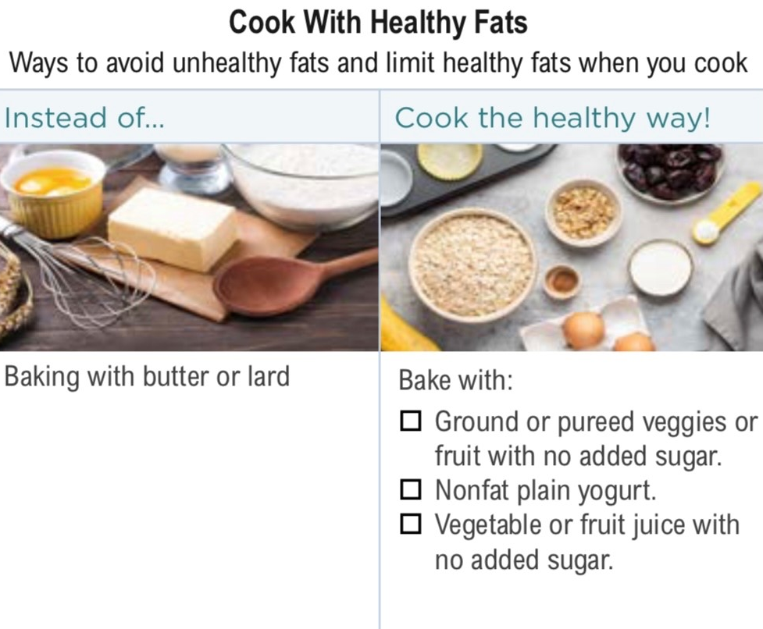
Topic 2: Limit Unhealthy Fats
Lesson 2: Making Healthy Food Choices
“I found a lot of unhealthy fats in my foods. I’ve made changes to eat healthier fats.”
Notes:
Foods high in healthy fats include:
Avocado
Canola Oil
Nuts Like Almonds, Cashews, Pecans, Walnuts, and Peanuts
Albacore Tuna, Herring, Rainbow Trout, Salmon, Sardines
Peanut Butter and Peanut Oil
Olive Oil
Corn Oil
Soft (tub) Margarine
Safflower Oil
Sunflower Oil
Soybean Oil
Sesame Seeds
Oil-based Salad Dressings
Pumpkin and Sunflower Seeds
Flaxseed and Flaxseed Oil

Slide 10
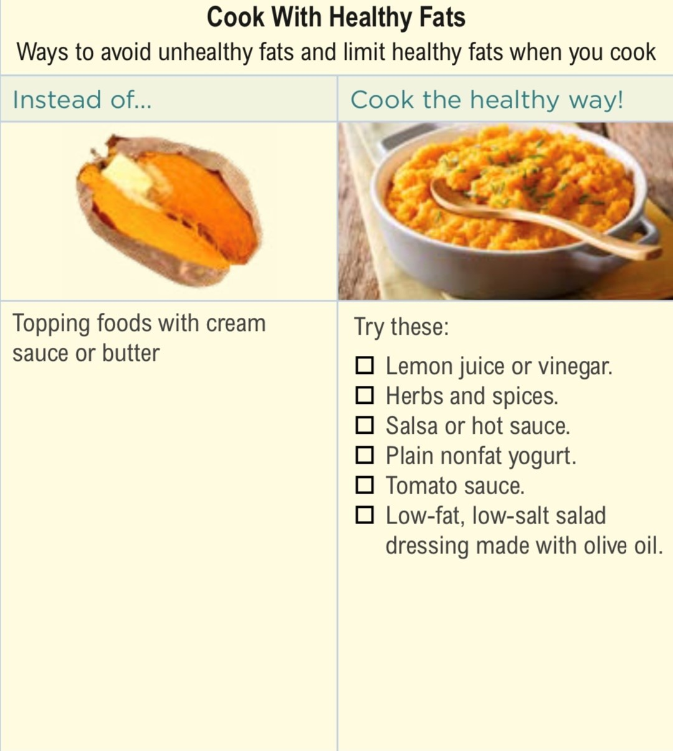
Topic 2: Limit Unhealthy Fats
Lesson 2: Making Healthy Food Choices
“I found a lot of unhealthy fats in my foods. I’ve made changes to eat healthier fats.”
Consider Ways to Replace Unhealthy Fats in Your Diet.
Notes:
You can avoid eating too much unhealthy fat by removing the skin from chicken and turkey, choosing meats with less fat, such as cuts with “loin” in the name, cooking with oils like olive oil instead of lard or butter, and using low-fat or fat-free dairy products. When a recipe calls for an ingredient that is high in unhealthy fat, see if you can replace it with vegetables or whole grains, or a lower-fat dairy product, a leaner type of meat, or a healthy fat.
Ask and Discuss
What kinds of food do you eat that contain unhealthy fats?
What are some healthy fats that you can eat in place of unhealthy fats?
What are some ways you can avoid or limit unhealthy fat in what you eat?

Slide 11
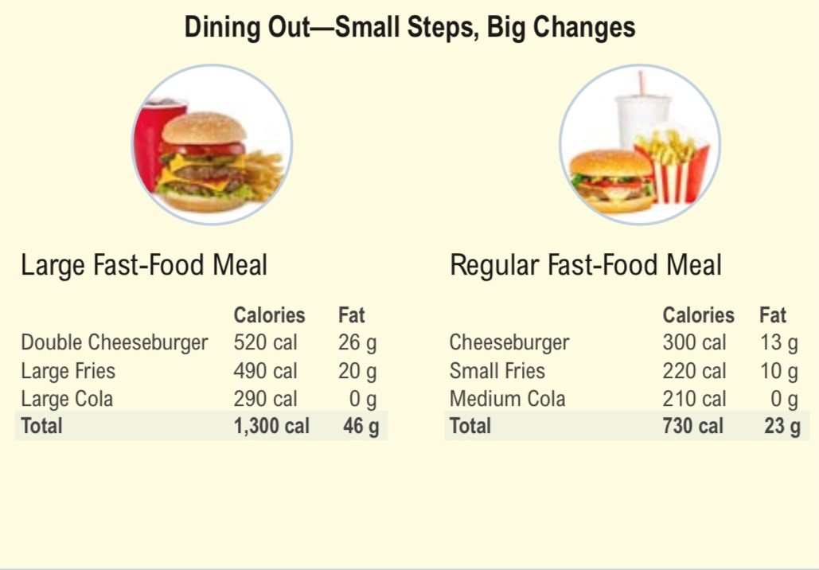
Topic 3: New Routines for Eating Well Away From Home
Lesson 2: Making Healthy Food Choices
“Value meals may have been a bargain to my wallet, but they weren’t a bargain for my health.”
The real cost of “value meals” is high calories, fat, and salt.
Notes:
Ray talks about “value meals.” After he found out more about the nutrition in them, he understood why they aren’t a good “value” for his body. As a result, Ray decided to make some small changes so he could still enjoy eating at his favorite fast-food restaurant. For example, Ray cuts down how many times a week he eats fast food, orders a smaller value meal to cut down on his portion size, and makes healthy swaps to his value meal. You can get nutrition information by asking for it at the counter of the fast-food restaurant or on the restaurant’s website.
Key Points
If participants eat fast food, ask them how they can make fast-food meals healthier. For example:
Swap out fries for a side salad with low-fat Italian dressing or olive oil.
Swap out a regular soda for calorie-free drinks such as water, tea, seltzer, or diet soda.
“Downsize,” not “super-size,” foods.
Share fries with a friend or get the children’s hamburger with no cheese.
Choose low-fat choices, such as grilled chicken or salad.
Discuss other new routines for making healthy choices anywhere you eat out.
Review the whole menu in advance to avoid surprises.
Compare calories of menu items to help guide your decisions.
Have a lighter or small main meal when you plan to order dessert.
Plan for more physical activity before and/or after a special dinner out.
Look for words on the menu that may help you make a better choice, like baked, steamed, or healthy/lighter choice.
Say, “I’d like this side item as my main course,” “My friend and I will share this item, and we’d like an extra plate,” or “Bring me a to-go box when you bring my meal, please.”
Think about portion sizes by looking around at the meals other people have ordered.
Ask and Discuss
What is one swap you can make the next time you order a meal?
Does it surprise you how many calories are saved by downsizing a fast-food meal? (Refer to the visual in the Participant Guide.)
How many calories do you eat each day? How do you know?
What are better choices at a fast-food place? (For example, grilled chicken sandwich or salad with a low-calorie or small amount of dressing.)

Slide 12
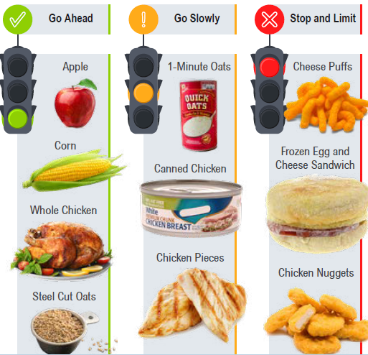
Topic 4: Using the “Traffic Light” Method to Label Foods
Lesson 2: Making Healthy Food Choices
“The least processed form of foods gives me the most control over my ingredients and portions.”
Less processed foods are better choices.
Notes:
There are many ways to divide food into categories for health. Angela used this “traffic light” method to help her make healthy food choices:
Red means stop and limit. This category consists of processed foods. A processed food is one that’s been altered from its original form and often stripped of its nutrients (that is, its vitamins, minerals, and fiber). These foods, such as hotdogs, soda, pie, and fried foods, are the highest in sugar, fat, and salt. Limit these foods and eat them only once in a while and in small portions. These foods are lowest in healthy nutrients.
Yellow means go slowly. Foods in this category contain nutrients but can still be high in sugar, fat, and salt. Eat these foods in moderation and be careful about portion size. Foods in this category may include applesauce, canned beef, 1-minute oats, cheese-flavored crackers, or canned fruit in syrup.
Green means go ahead. This category consists of unprocessed or minimally processed foods. Foods that have undergone minimal processing are the best-quality food since they contain the most nutrients, including fiber, vitamins, and minerals. These foods include vegetables, fruits, and whole grains, and leaner cuts of meat and chicken. Eat more of these foods.
For more information on the core elements that make up a healthy dietary pattern and limiting foods and beverages higher in added sugars, saturated fat, and sodium, refer to the 2020-2025 Dietary Guidelines for Americans.
Key Points
If you are in a participant’s home, bring color stickers to label foods and teach why each food
is “red,” “yellow,” or “green.” Processed foods get the red light. Foods that are less processed, but still contain high amounts of sugar, fat and salt, get the yellow light. For example, a can of pears in syrup, though a fruit, would get a yellow sticker because it’s high in sugar. Fresh fruit and fresh, canned (in water), and frozen vegetables get the green light.
If you are in a community setting (e.g., family reunion, church, school, health fair), bring samples of commonly eaten foods and have participants label them using the “traffic light” method.
Emphasize that highly processed foods should be limited and eaten in small amounts and
on special occasions. Small swaps from red to yellow and green foods can make a big difference.
Tell participants, ideally, to base meals and snacks around whole, or unprocessed, foods. However, we know this is probably not realistic for most of us. We buy processed foods because they can save time and are convenient. So, set realistic goals, and focus on some small steps you can make in the bigger picture.
Talk about how participants can easily add more foods from the “green” group.
Ask and Discuss
Think of what you ate today. Try to classify the food using the “traffic light” method. Classify what you ate last night.
What are some small changes you can make to adjust the amount of processed foods that you eat?
How can you satisfy a sweet tooth without eating too much sugar?

Slide 13
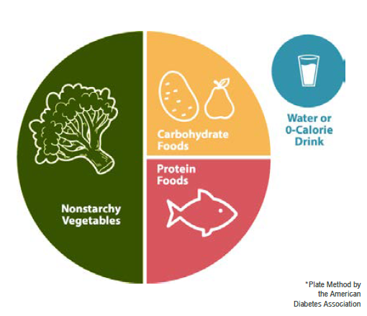
Topic 5: Understanding Proper Portion Sizes
Lesson 2: Making Healthy Food Choices
“We’re learning to measure how much food is on our plates.”
Learning portion sizes is easy.
“To learn the right size of portions, we use the Plate Method.”
Notes:
Ray and Angela found new ways to look at their food and think about what they eat. They also learned that they might not have to give up foods they eat every day if they control their portion sizes. Proper portion size is a key to losing weight. A portion is not the same as a serving. A serving is a recommended amount of food. It can be found on a food label, along with the calories, fat, and sugar for that serving. A portion is the amount of food you choose to eat and can, of course, be larger or smaller than a serving.
The Diabetes Plate Method is a visual way to create a healthy meal. Using this method, you can serve up meals with a healthy balance of vegetables, protein, and carbohydrates—without any counting, calculating, weighing, or measuring. The 2020-2025 Dietary Guidelines for Americans recommends making half of your grains whole grains. Whole grains include all whole-grain products and whole grains used as ingredients such as brown rice, quinoa, millet, oats, and whole-grain cereals and crackers. Refined grains include all refined-grain products and refined grains used as ingredients such as white breads, wheat, pasta, white rice, and refined-grain cereals and crackers. Many whole grains are good sources of dietary fiber. Most refined grains contain little to no fiber. Fiber can help you feel full, so you’ll be satisfied with fewer calories.
Refer to What is the Diabetes Plate Method? from the American Diabetes Association for more information on creating healthy meals that can help manage blood sugar.
Key Points
The following are some suggestions for controlling portion sizes. You can also ask participants to come up with their own tips.
Use the Diabetes Plate Method as a guide to create well-portioned meals with a healthy balance of vegetables, protein, and carbohydrates. Aim to make half of your plate non-starchy veggies (such as broccoli, lettuce, and peppers). Non-starchy veggies typically have fewer carbohydrates and calories than starchy veggies (such as corn, potatoes, sweet potatoes, and peas). Keep your grains and starchy foods (such as potatoes and oatmeal) in one quarter of the plate. Protein foods (such as chicken, lean meat, and fish) can go in the other quarter. The plate method can be a good guide toward healthier eating. It’s not necessarily something we can achieve all the time. Use it as a model.
Think about how other foods fit into your day:
A small amount of dairy (1 cup of skim milk). Dairy provides protein and calcium, as well as carbohydrates.
A small amount of fruit (1 apple, half a banana, or half cup of berries). Remember, fruit provides carbohydrates.
A drink that has low or no calories (water, sparkling water, or coffee without sugar).
Look at serving sizes on labels and start trying to bring your portion size closer to the serving size.
Split meals with friends at a restaurant or box up half the food right away to take home.
Food tracking increases awareness of portion sizing, especially when you measure food.
Tip
A food tracker can help your participants see what and how much food they are eating. Participants can use the Weekly Food Log or the Food Tracking Activity Log to record their food and drink intake.
Ask and Discuss
Show me what your portions look like on a typical plate of food for dinner. How does that compare to what we’ve talked about today?
How can you make healthier choices and still feel satisfied?
What else can you do to control the portion sizes you eat?

Slide 14
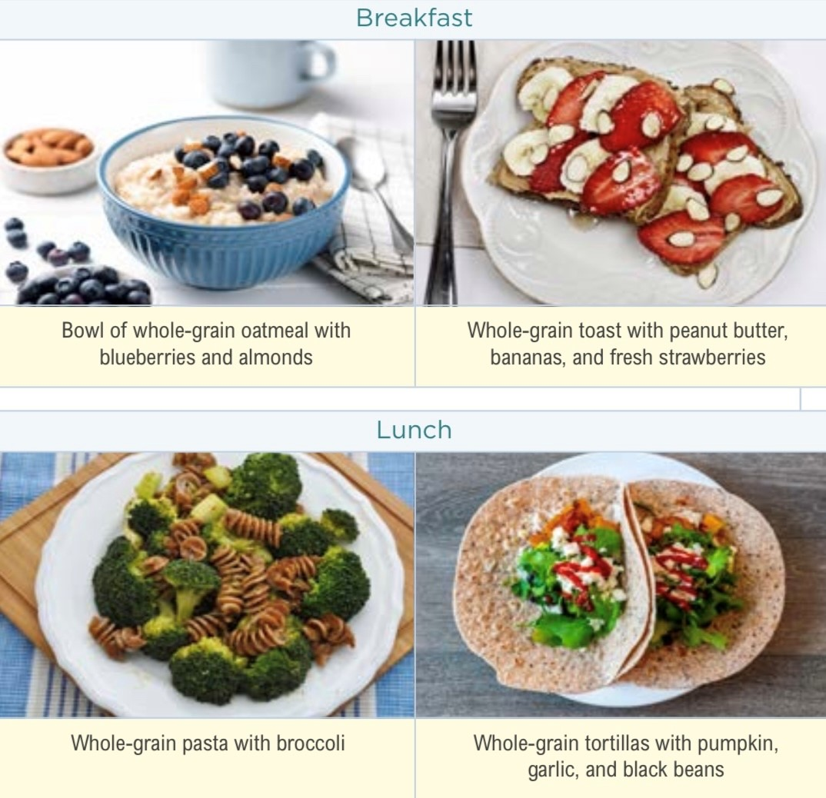
Topic 6: A Healthy Approach to Carbs
Lesson 2: Making Healthy Food Choices
“I choose healthier carbohydrates (starches), and make sure to balance them out with protein, fruits, and vegetables.”
Notes:
Angela learned that she doesn’t have to give up carbs. She learned to make small changes toward taking a healthy approach to carbs by choosing less processed carb foods and balancing out carbs with protein, fruits, and vegetables.
Our bodies break down or convert most carbs into glucose. Glucose is a type of sugar in your blood that is the main energy source for the body. The carbs we eat, including other sugars, like fructose (fruit sugar), sucrose (cane sugar), and lactose (milk sugar), are broken down into glucose to fuel your body. When you eat more carbs, your body makes more glucose, which increases your blood sugar. A hormone in your body called insulin helps sugar leave your blood and enter your cells. This sugar gives cells energy. In people with type 2 diabetes, the body doesn’t use insulin well. So, sugar builds up in their blood instead of going into their cells. That means the cells don’t get enough energy. And high blood sugar can cause many health problems over time. The types of carbs you consume impact your blood sugar. More processed carbohydrate foods convert to sugar more quickly in the body.
Key Points
Carbs provide your body with energy.
All carbs are NOT created equal. The difference is the fiber and nutrient content.
When you do have carbs, choose foods that are:
Low in calories, fat, and sugar
A good source of fiber
Rich in vitamins and minerals
Less processed or not processed at all. Remember, processed foods are often stripped of their nutrients (that is, their vitamins, minerals, and fiber).
Carbs come from a variety of foods. There are three main types of carbs: starches, sugars, and fiber.
Starches include three types of food: starchy veggies; beans, peas, and lentils; and grain foods.
Starchy veggies include corn, potatoes, green peas, winter squash, parsnips, yams, and plantains.
Beans, peas, and lentils include black, pinto, and kidney beans; red, brown, and black lentils; black-eyed peas, split peas, and garbanzo beans.
Grain foods consist of whole grains and refined grains. Choose whole grains. Whole grains contain fiber, vitamins, and minerals. Refined grains contain just starch and are stripped of valuable nutrients in the refining process.
Some foods containing sugars also contain other nutrients, in the case of fruit, milk, and yogurt. Other sugars, such as table sugar, maple syrup, and honey, contain few nutrients and add flavor, but also have additional calories. It is important to limit foods high in added sugars. Added sugar is sugar added during food preparation. Cake, candy, cookies, sugar-sweetened beverages, such as soda, flavored coffees, and smoothies, and ice cream all have added sugar.
Fiber can lower your blood sugar and cholesterol. It passes through your body without being digested. So, it fills you up without adding calories. Try to get 25 to 30 grams of fiber each day. Check the nutrition facts label to see how much fiber an item contains.
High-fiber foods include beans, peas, and lentils; veggies and fruits (especially ones that have skin or seeds that you eat); nuts (such as walnuts and almonds), and whole-grain foods.
Focus on a balance between carbohydrates, proteins, and fats in the foods you choose.
Remember, you can make healthier carb choices in small steps. Start small with one change. In time, this change will become a habit, and then you can make additional changes from there.
Tip
To help participants understand processed versus less processed carbohydrates, bring in an apple and some jellybeans or show an image of each. Explain that an apple contains carbs, but it also contains vitamins, minerals, and fiber. Jellybeans are another source of carbs, but contain no vitamins, minerals, or fiber. They contain a lot of added sugar. Foods in this category, like jellybeans, are often termed “empty calories” because they contain high sugar and high calories without additional nutritional value such as vitamins, minerals, and fiber.
Ask and Discuss
What types of carbs are you eating? Is it a healthy balance?
What is one small healthy change related to carbs that you can make?
What are some ways you can choose carbs wisely and make some healthy swaps?

Slide 15
Lesson 3
Increase Physical Activity

Slide 16
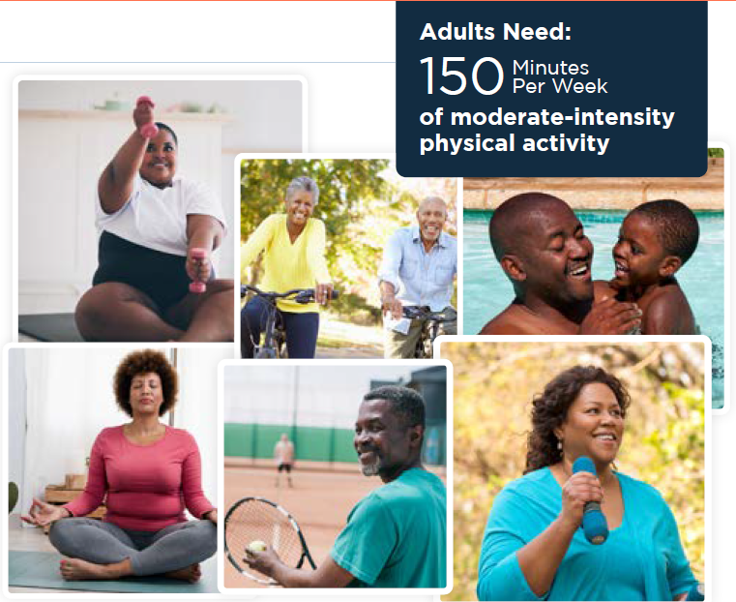
Topic 1: Getting Active
Lesson 3: Increase Physical Activity
“Preventing type 2 diabetes is not just about healthy food choices. I also had to get active. I do physical activity that adds up to at least 30 minutes a day.”
Notes:
In addition to lowering your risk of type 2 diabetes, getting active has many health benefits. Benefits of getting active include better sleep and mood, improved balance and flexibility, lower blood pressure and cholesterol, lower risk of heart attack and stroke, lower stress level, more energy, and stronger muscles.
According to the US Department of Health and Human Services’ Physical Activity Guidelines for Americans, adults should do at least 150 minutes a week of moderate-intensity activity for substantial health benefits. That could be 30 minutes a day, 5 days a week. You can spread your activity out during the week, so you don’t have to do it all at once. You can even break it up into smaller chunks of time during the day.
Key Points
Ask participants what they hear when you say, “30 minutes a day.” Tell participants to make getting active a part of their normal routine. Explain that when you form a habit and stick to it, it will become a part of your natural routine. Ask them what steps they can start with to work up to 150 minutes a week.
The key is to move more each day. There are lots of ways to get your 30 minutes of physical activity:
Walk, walk, and keep walking—with a friend or by yourself, but walk briskly. (If you can sing as you walk, you’re too slow. If you can talk, that’s a moderate pace.)
Take a family walk before or after dinner each evening.
Play basketball with the kids.
Show the kids how to dance to your kind of music. (Try to learn to dance to their music. Have a good laugh together.)
Download free exercise apps or try exercise videos online.
If you have a lawn, mow it, trim the shrubs, and take care of your garden. If you don’t have a garden, start one. It will give you many health benefits and put fresh vegetables on your table.
Clean your house to upbeat music.
Walk your dog or a friend’s dog.
Listen to the music CD/DVD or watch the music video in this Toolkit and dance along.
Go bowling.
Take the stairs instead of the elevator.
Play actively (run, walk, bike) with your kids or grandkids.
Get off the bus one stop early.
Ask and Discuss
Do you have a lot of time in your day when you are not physically active? For example, sitting at work, driving to appointments, preparing meals.
Can you think of ways to be physically active for 10 minutes at a time? (Listen for activities that really take 10 minutes and brainstorm ways to make shorter activities longer.)
What kinds of physical activities do you like? Why do you like them?
What are some of the benefits of being more physically active for you?

Slide 17
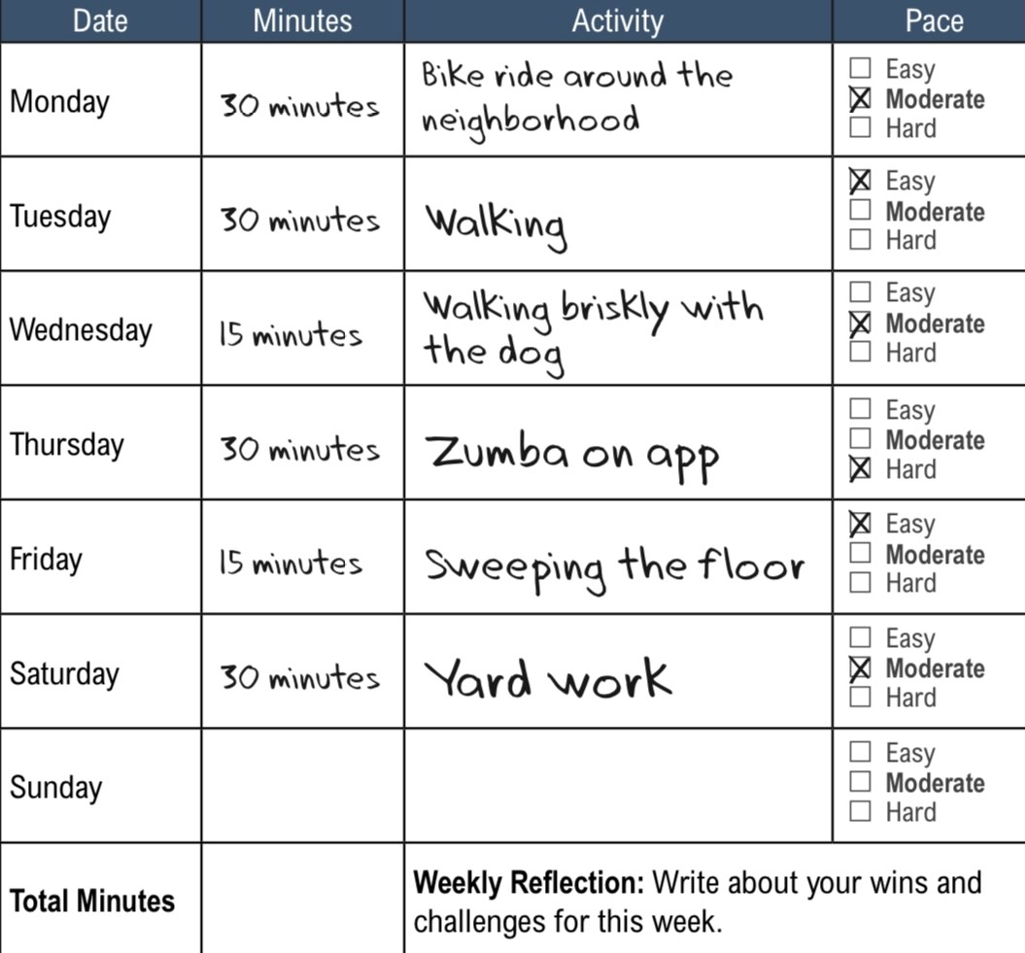
Topic 2: Track Your Activity
Lesson 3: Increase Physical Activity
“Tracking my activity helps
me stick to my goals, and
I have made it a part of my
daily routine.”
Notes:
Angela tracks her activity daily using a free app on her cell phone. She has learned that tracking, or self-monitoring, can help her keep up with her physical activity goals. She also identifies daily activities that count toward her 150 minutes of activity each week. She includes everyday activities like sweeping the floor briskly or raking leaves.
Key Points
Discuss the purpose of tracking physical activity. Tracking your activity each day can help you stay focused on your activity goals. It also allows you to see yourself progress toward your goals.
Tracking your activity has two steps.
Time your activity using a watch, clock, timer, fitness tracker, smartphone app, or computer app.
Record your minutes of activity using an activity log, notebook, spreadsheet, fitness tracker, smartphone app, computer app, or voice recording.
Track activity of at least a medium, or moderate, pace. To make sure you’re working out at a moderate, or medium, pace, use the Talk Test (you can talk, but not sing, during your activity).
Introduce participants to the Activity Log to track their minutes of activity each day. Refer to the Activity Log on page 54 in the Activities Guide.
Practice tracking with participants by marching in place and having them record the minutes in their logs.
March in place with participants. Keep track of how long they march.
Participants can hold on to a chair for support if they wish. If marching while standing is too
hard for them, they can march while seated.
Participants should use the Talk Test to make sure they’re marching at a moderate pace or more.
When you have finished marching, tell participants how long they marched for.
Have participants write down the time and activity in their Activity Log.
Ask and Discuss
What are some ways you can time your activity?
Besides using the Activity Log, what are some other ways to record your minutes of activity?
How will you practice tracking your activity?
What might you find challenging about tracking your activity? How will you work around these challenges?

Slide 18
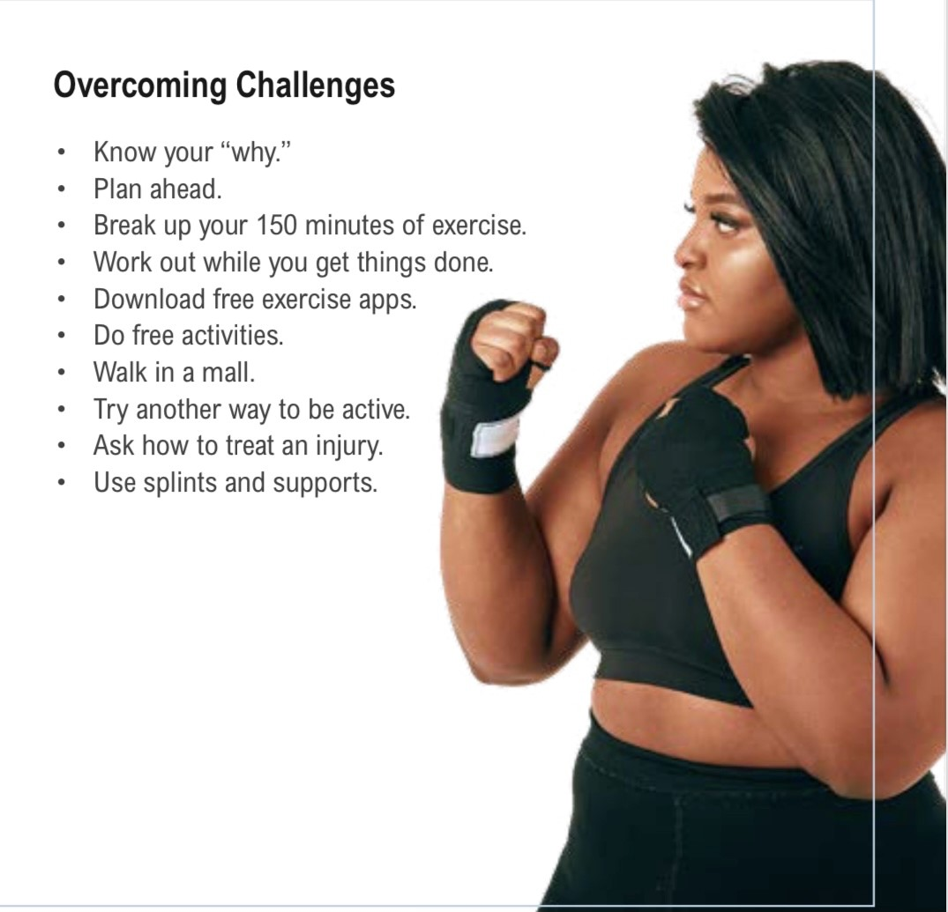
Topic 3: Challenges and Excuses
Lesson 3: Increase Physical Activity
“Making excuses is way too easy. I
added one healthy change a month
and broke up my physical activity into
smaller parts during the day.”
Notes:
Ray talks about excuses to avoid physical activity—he didn’t have time, he was too tired, and lots of others. So, he tackled them one at a time. He broke up 30 minutes into three 10-minute segments.
Key Points
Talk about challenges to physical activity. Have participants brainstorm all the challenges they can think of and write them down.
Talk about each challenge. Can participants find solutions or think of small things they can do to be more active? They don’t have to overcome every challenge on the spot. The key is to remind them that small steps are important to long-term change.
Challenges
I feel less motivated.
I have less time due to life changes.
I have less money due to life changes.
The weather is making it hard to walk outdoors.
I’m injured.
Ways to Succeed
Know your “why.” Remind yourself every day why you want to get active. Ask family and friends to remind you too.
Plan ahead. Make physical activity a regular part of your schedule. Put it on your calendar.
Break your 150 minutes into 10-minute chunks.
Work out while you get things done. Move briskly while you sweep the floor, mow the lawn, or walk your dog.
Download free exercise apps.
Do free activities like walking, dancing, and marching in place.
Walk in a mall.
Try another way to be active.
Ask your health care provider how to treat the injury. For instance, you may need to rest and ice the area.
Use splints and supports as needed.

Slide 19
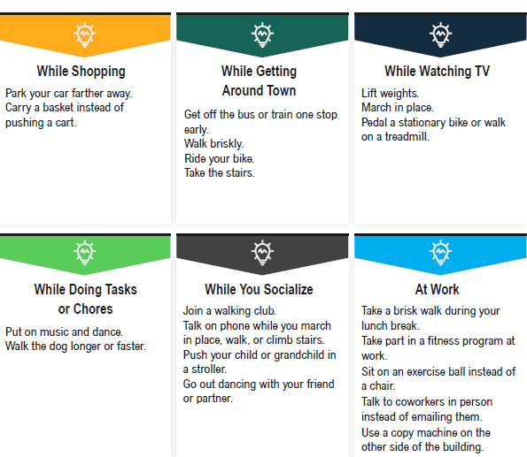
Topic 4: Finding Time for Physical Activity
Lesson 3: Increase Physical Activity
“I have learned to sneak in
physical activity into my daily
routine. I find that it also helps
me deal with stress.”
Notes:
Even when Angela is busy, she finds time to sneak fitness into her daily routine. She finds that the physical activity helps lower her stress level. There are many benefits of being active, including:
Better sleep and mood
Improved balance and flexibility
Lower blood pressure and cholesterol
Lower risk of heart attack and stroke
Lower stress level
More energy
Improved sexual health
Stronger muscles
Even though physical activity offers many benefits, it can be challenging to fit in physical activity when you have a busy lifestyle. Angela’s days are busy, but there are ways for her to fit in some physical activity and keep her other commitments.
Key Points
Ways you can fit in physical activity anytime during the day may include:
Schedule it.
Change your schedule.
Use a fitness app or tracker.
Find ways to fit it into the activities you already have planned.
Ways to be more active during our regular routines may include:
Shopping
Getting around town
Watching TV
Doing tasks or chores
Socializing
Working
Ways you can be physically active if going outside isn’t possible or the area is unsafe may include:
Keep workouts simple and use items around your home to work out.
Check with local community centers for physical activity offerings.
Look for free workout classes in gyms, parks, and other community locations.
Look online for free beginner workout videos.
Ask and Discuss
What are some ways that you can fit physical activity into your daily schedule? What specific times during the day can you add physical activity into your routine?
What makes it challenging to fit in physical activity in your routine?
What are some activities that you would like to try?

Slide 20
Lesson 4
Rewards and Setting Goals

Slide 21
Topic 1: Rewards for a Healthier Lifestyle
Lesson 4: Rewards and Setting Goals
“Change takes time. I can handle that. The best part is that I can see the rewards!”
“For me, I stopped feeling tired, weak and out of shape.”
My rewards come from the small changes. One at a time.
Notes:
Building healthier habits is intrinsically rewarding. The rewards come from the ways you think and feel about yourself and the things you can accomplish. At first you might not see or realize the benefits of making healthy food choices and increasing your physical activity. These benefits take time. Some examples of intrinsic rewards may include:
I feel strong and capable when I lift more weight than I thought I could.
I get to connect with friends when I exercise.
I leave the gym energized and ready to take on the day.
I feel less stressed.
I am better able to keep up with my kids.
I feel good about doing something healthy for my heart and my muscles.
I now exercise every day without even thinking much about it, when I once spent hours per day trying to motivate.
Key Points
Angela and Ray talk about their rewards.
For Angela:
She sings with more strength—and the choir noticed.
She played in the softball game at her family reunion.
She lost 10 pounds over the last year and a half—slow but steady progress.
Her friends are now in a walking group with her.
She no longer craves sugar and salt.
For Ray:
He lost about 8 pounds in 12 months—slow but steady loss.
He no longer keeps junk food in the house. He avoids temptation and saves money.
He still treats himself to Mom’s home cooking, but once a week instead of every day.
His knees no longer hurt all the time.
He can walk up steps and not be out of breath.
Ask and Discuss
What are some intrinsic rewards that keep you motivated to reach your goals?
What intrinsic rewards help make exercise a habit for you?

Slide 22
Topic 2: Summary of Key Points —Setting Goals
Lesson 4: Rewards and Setting Goals
“My road will not include diabetes. It does not have to be my destiny.”
“I take it one choice one day at a time. I’m making my own road to health.”
“Today I will …,”
“This week I will ….,”
“This month I will …”
Notes:
Remind participants about the three ways they can prevent or delay type 2 diabetes:
Lose at least 5% of their starting weight, or lose at least 4% of their starting weight and log an average of 150 minutes of activity each week, or lower their A1C by 0.2%.
Lose weight and maintain a healthy weight by making small changes in food choices to establish a healthier eating pattern.
Get at least 150 minutes of moderate-intensity physical activity a week. That’s only 30 minutes 5 days a week. Moderate activities may include brisk walking, yard work, actively playing with children, biking, dancing, or playing soccer.
Key Points
Start setting some activity and healthy eating goals with your participants.
Ask each person to commit to one thing to improve his or her health. Use the Physical Activity Commitment on page 55 in the Activities Guide to help participants stay on track with their goals.
Ask participants to finish these three sentences: “Today I will …,” “This week I will ….,” and “This month I will …”
Remind them that small changes lead to big rewards, and help them set themselves up for success
by choosing a change they CAN do!
Remind them that all lifestyle changes can be done with little cost by making a few adjustments in their daily routine.
Encourage participants to try out new routines so that they can become habits over time. When new routines become habits, they will be much easier to follow.
Ask and Discuss
What are your next steps (for example, take a walk after dinner, split lunch with friends, make a healthy menu)? What is one thing you will work on today? This week? This month?
Make a list of your goals to start on your road to health. Where will you put this list (for example, fridge, front door, bedroom mirror)?
How can I support you in your efforts?

Slide 23
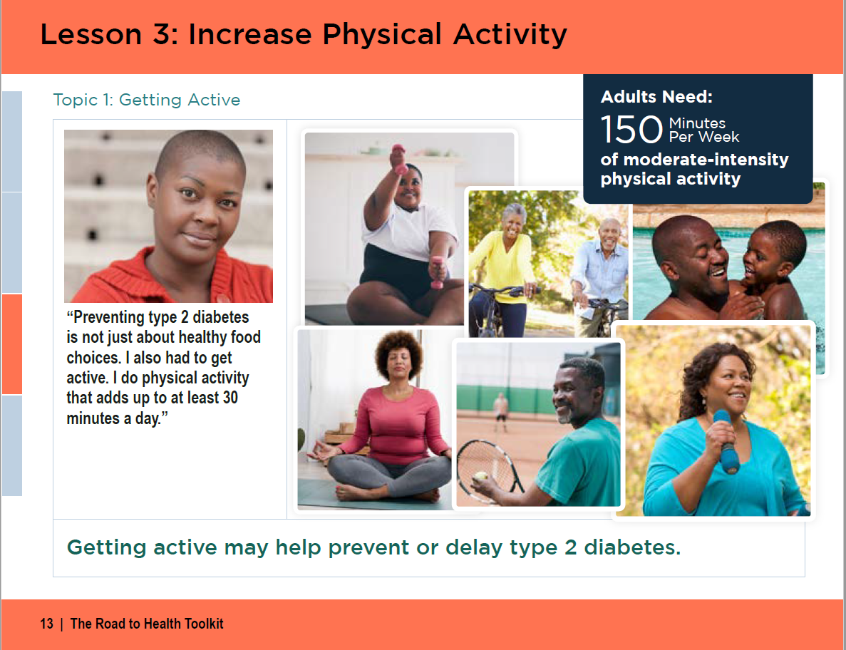
Lesson 3 screenshot

