Slide 1

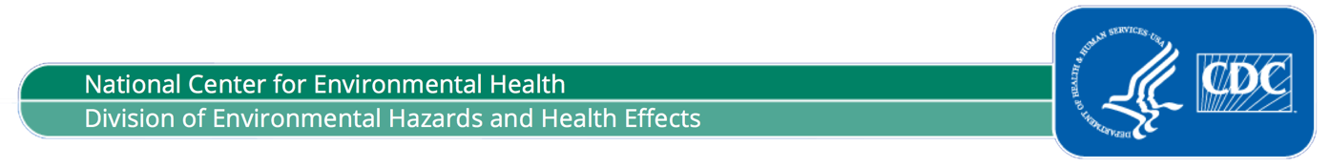
A TOOLKIT FOR PUBLIC HEALTH OUTREACH
Communicating the Health
Effects of Climate Change

Slide 2
Table of Contents
How to Use This Presentation 3
Title 4
What is Climate Change 5
How the Changing Climate is Affecting Human Health 6
Eight Climate-Related Health Effects 7 – 14
What Communities Can Do 15 – 26
BRACE Model 16
What Individuals Can Do 27 – 43
What CDC is Doing 44 – 45
What Our Program is Doing (CRSCI Grantee’s Perspective) 46 - 50
There’s Much We Can Do 51

Slide 3
How to Use this Presentation
The CDC Climate and Health Program developed the following slides in collaboration with climate communication experts to help you talk about the health harms of climate change. Our hope is that this presentation makes it easier to incorporate consistent, evidence-based public health messaging into your existing communications.
Tips for developing your presentation:
Mix & Match: Choose the slides that best fit your location and your audience.
Customize: Most of the slides are editable. Insert content specific to your program and locale. Use the licensed photos provided here, or even better, use photos that add a local flavor.
Use Plain Language: Follow Federal Plain Language guidelines using CDC’s resources (https://www.cdc.gov/other/plainwriting.html).
Please contact Eric Lahr (ekl8@cdc.gov) for questions or technical support.

Slide 4
HOW CLIMATE CHANGE IS HARMING HEALTH
AND WHAT WE CAN DO TO PROTECT THE PUBLIC
The Public Health Effects
of a Changing Climate

Slide 5
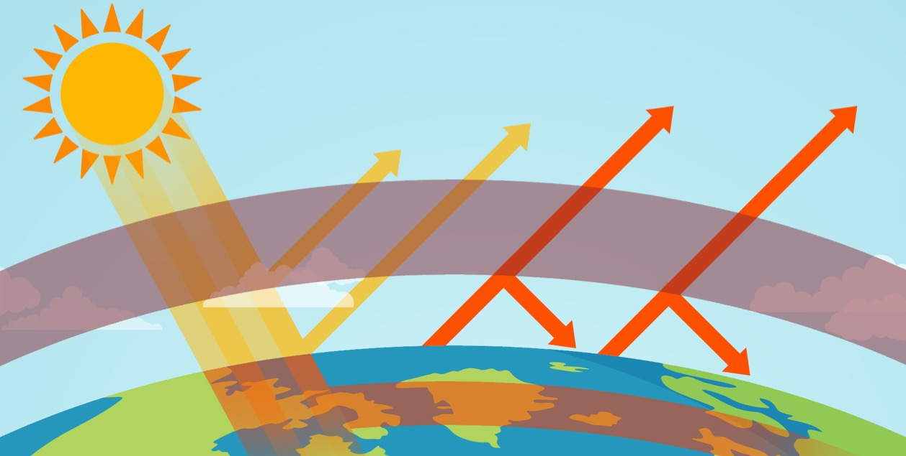
What is Climate Change?
Some solar radiation is reflected back into space
Greenhouse gases act like a blanket
Solar radiation is
trapped in Earth’s
atmosphere
Solar radiation enters Earth’s atmosphere
Notes:
When sunlight reaches the earth’s surface, it can be absorbed into the atmosphere or reflected back into space. Certain gases in the atmosphere prevent the sun’s heat from escaping. These “greenhouse gases,” including water vapor, carbon dioxide, methane, and nitrous oxide, have been increasing. More greenhouse gases in the atmosphere lead to an increase in both average and extreme temperatures, which impact human health.

Slide 6
How is Climate Change Affecting Health?
Extreme Heat
Air Pollution
Extreme Weather
Affecting Health Directly
Diseases Spread by Insects, Ticks, and Rodents
Contaminated Water
Contaminated Food
Spreading Disease
Destroying & Disrupting Food Supplies
Hunger and Malnutrition
Disrupting Well-Being
Mental Health Problems

Slide 7

AFFECTING HEALTH DIRECTLY
EXTREME HEAT
Higher heat, increased humidity, longer and more frequent heat waves can lead to:
dehydration and heatstroke
More Vulnerable: Outdoor workers, student athletes, people in cities, people without air conditioning, people with chronic diseases, pregnant women, older adults, and young children

Slide 8

AFFECTING HEALTH DIRECTLY
AIR POLLUTION
Increased wildfires, smog, pollen, and mold can lead to:
asthma and allergy attacks
More Vulnerable: People with heart and respiratory conditions such as heart disease, asthma, or chronic lung disease

Slide 9
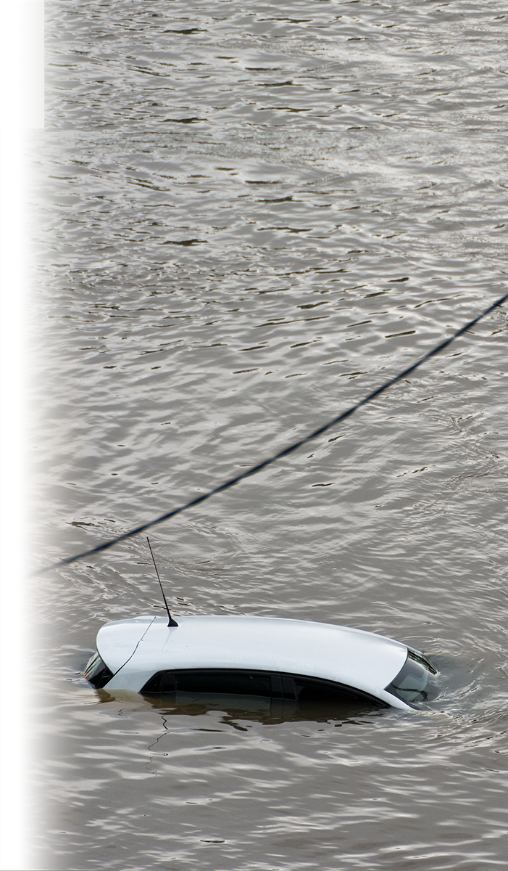
AFFECTING HEALTH DIRECTLY
EXTREME WEATHER
Increased frequency and severity of heavy downpours, floods, droughts, and major storms can lead to:
injury, illness, displacement, and death
[]
More Vulnerable: People who lack access to evacuation routes and people who can’t use stairs when elevators are out of service, people in wheelchairs, older adults, the poor, and people with disabilities, particularly if they are unable to access elevators and evacuation routes

Slide 10
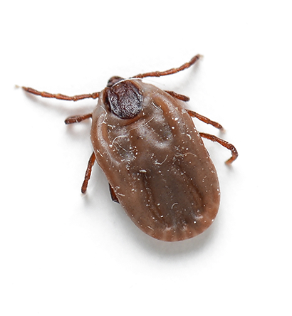
SPREADING DISEASE
INSECTS, TICKS, AND RODENTS
[]
Higher temperatures, changes in rain patterns, and disrupted ecosystems
help spread:
diseases carried by
insects, ticks, and rodents
More Vulnerable: People who spend more time outdoors in places where these insects and other disease-carriers live

Slide 11

SPREADING DISEASE
CONTAMINATED WATER
Higher water temperatures, heavier downpours, rising sea levels, and more flooding help spread:
gastrointestinal illness, diseases from toxins in swimming areas and drinking water
More Vulnerable: Children, the elderly, people with weakened immune systems, people in remote or low-income communities with inadequate water systems, and people in communities that are dependent on fish and shellfish

Slide 12
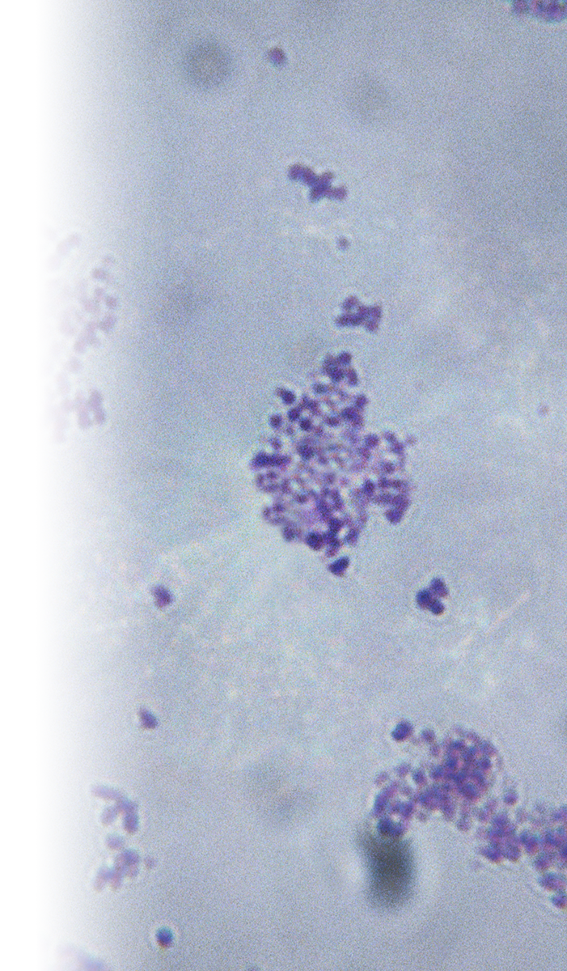
SPREADING DISEASE
CONTAMINATED FOOD
Increasing temperatures, humidity, and extreme weather
events help spread:
illnesses from bacteria and toxins in food
More Vulnerable: Infants, young children, the elderly, the poor, agricultural workers, and people with weakened immune systems

Slide 13
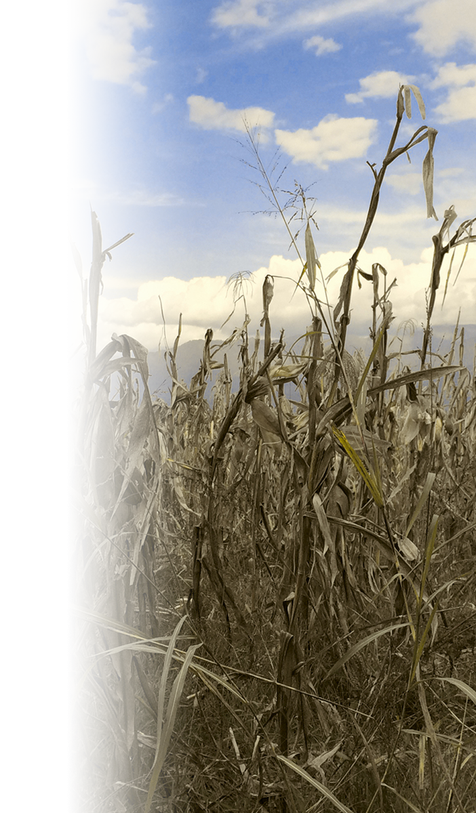
DESTROYING AND DISRUPTING FOOD SUPPLIES
HUNGER AND UNDERNUTRITION
Increasing temperatures, humidity, and extreme weather events can lead to:
undernutrition, vitamin deficiencies
More Vulnerable: Infants, young children, pregnant women, older adults, and poor communities

Slide 14
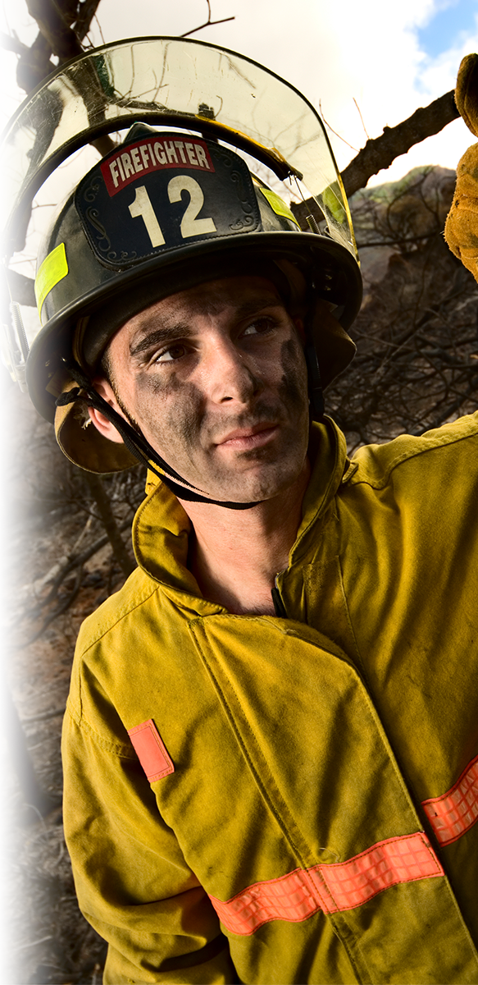
DISRUPTING WELL-BEING
MENTAL HEALTH PROBLEMS
Increased frequency and severity of extreme weather events can lead to:
stress, depression, anxiety, PTSD,
and suicidal thoughts
More Vulnerable: Children, older adults, pregnant and postpartum women, people with mental illnesses, the poor, homeless people, first responders, and people who rely on the environment for their livelihood

Slide 15
PUBLIC HEALTH HARMS OF CLIMATE CHANGE
What Communities Can Do

Slide 16
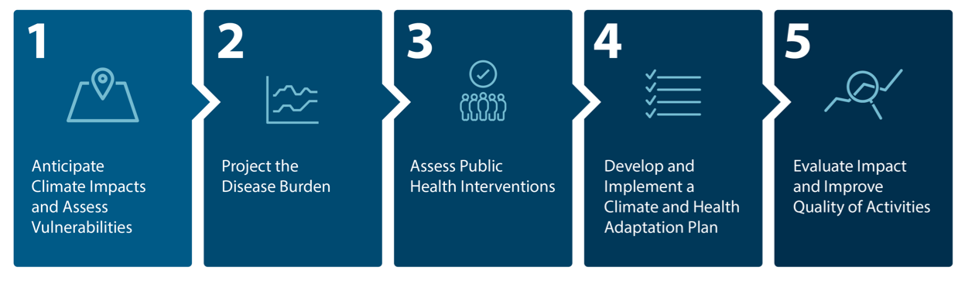
BRACE
CDC’s framework for climate and health adaptation
BUILDING RESILIENCE AGAINST CLIMATE EFFECTS

Slide 17

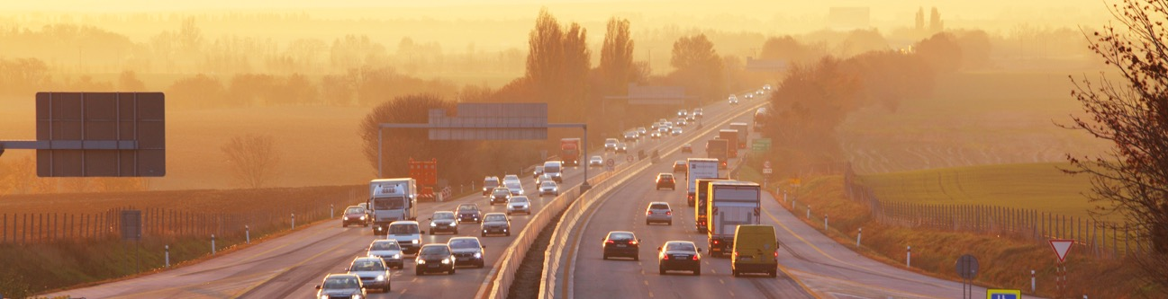
EXTREME HEAT
What Communities Can Do
Develop a Heat Response Plan
Develop or expand the extreme heat alert system
Ensure vulnerable populations can be reached
Plan cooling centers ahead of time

Slide 18

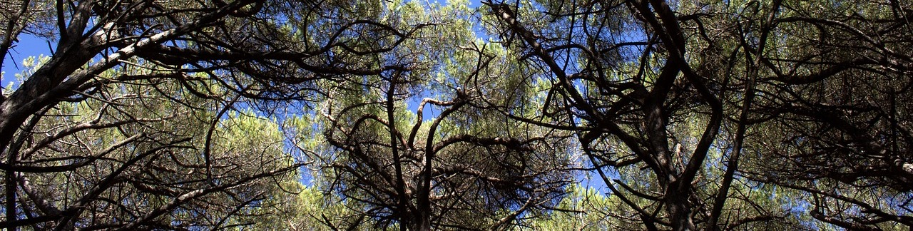
EXTREME HEAT
What Communities Can Do
Cool Your Community
Increase the tree canopy to help keep buildings and the surrounding air cooler

Slide 19


EXTREME HEAT
What Communities Can Do
Cool Your Community
Use cool paving and reflective and porous materials to help lower the surrounding temperature

Slide 20


AIR POLLUTION
What Communities Can Do
Encourage Active and Mass Transportation
Walking, biking, and shared transportation can lower traffic-related pollution

Slide 21


AIR POLLUTION
What Communities Can Do
Reduce Energy Waste
Energy efficient buildings and vehicles can reduce air pollution
Weatherize homes, offices, schools, and other buildings
Encourage the purchase of fuel efficient vehicles

Slide 22


STORMS & FLOODING
What Communities Can Do
Prepare Infrastructure
Identify buildings, roads, and other infrastructure that are most vulnerable to damage
Ensure existing and new infrastructure can withstand increasingly intense storms and flooding

Slide 23

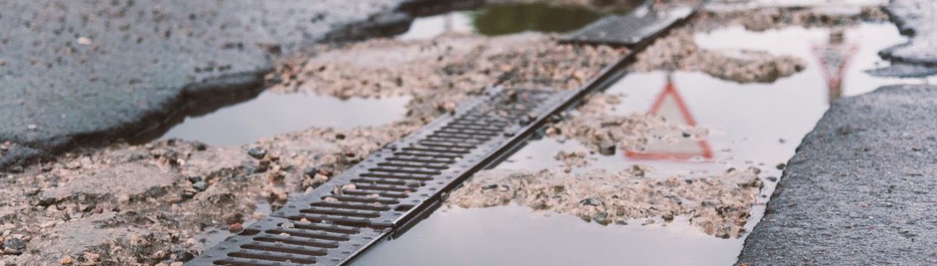
CONTAMINATED WATER
What Communities Can Do
Improve Sanitation and Water Management
Protect drinking water sources and delivery systems
Prevent sanitary sewer overflows

Slide 24

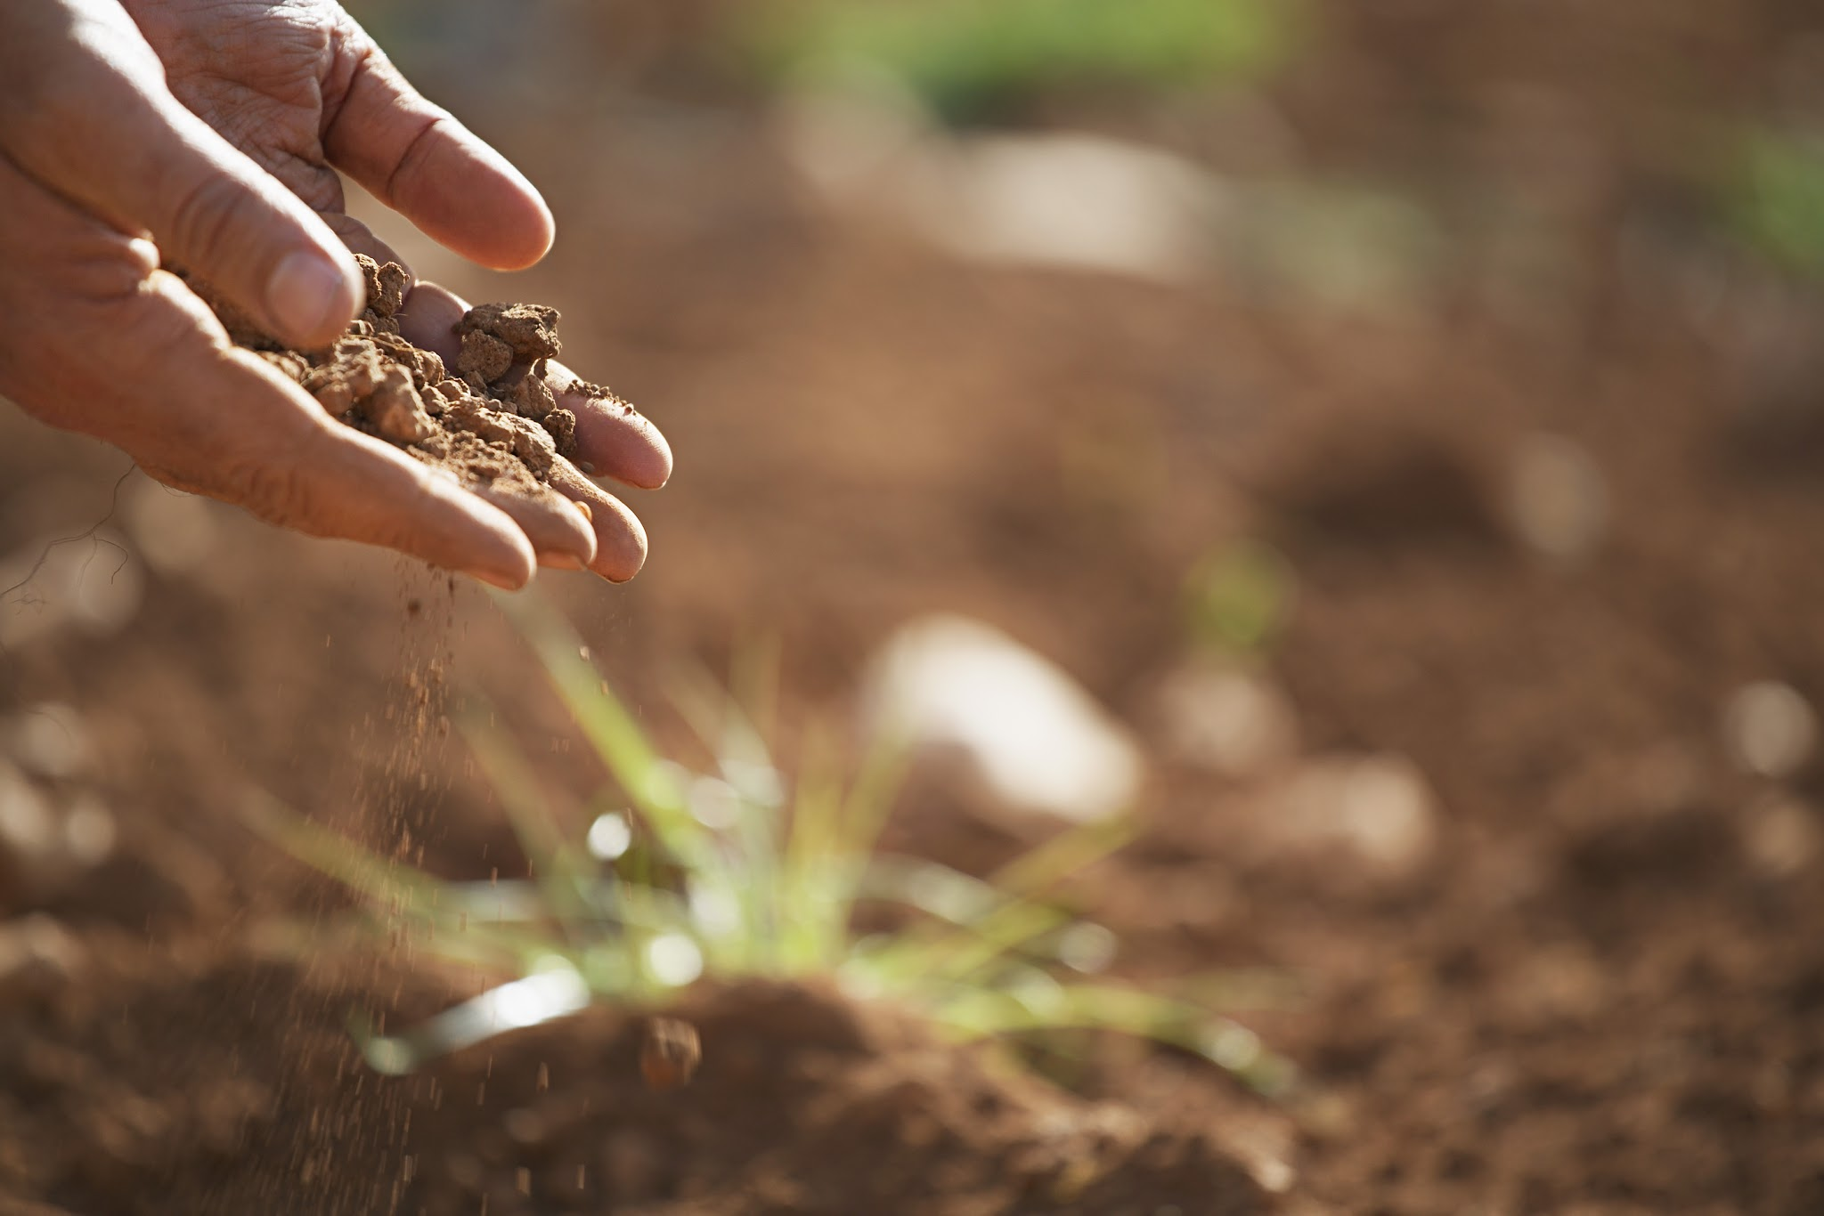
CONTAMINATED FOOD
What Communities Can Do
Disseminate Food Safety Messages
Monitor the effect of water contamination on agricultural products that may lead to foodborne illness
Bolster food safety messaging to public during extreme weather events
Notes:
https://www.cdc.gov/foodsafety/groups/consumers

Slide 25

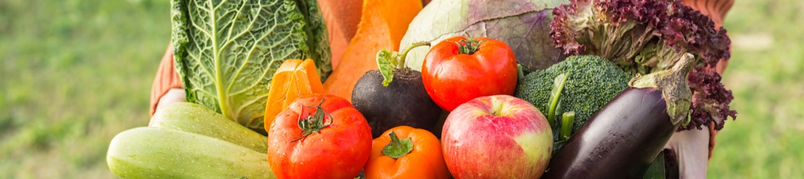
HUNGER AND MALNUTRITION
What Communities Can Do
Inform Public of Community Assistance
Resources
Disseminate information about food assistance programs to highest risk populations
Include information about who qualifies and how to access support

Slide 26


MENTAL HEALTH PROBLEMS
What Communities Can Do
Prepare an Emergency Plan
Develop behavioral health plans for disasters
Include clear messaging about access to mental health services and crisis counseling

Slide 27
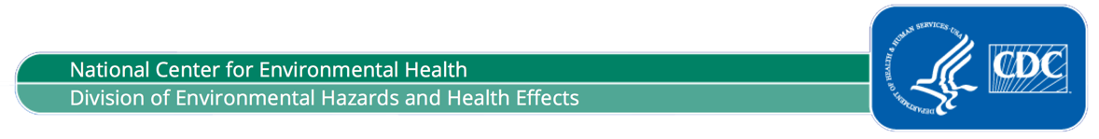
PUBLIC HEALTH HARMS OF CLIMATE CHANGE
What Individuals Can Do

Slide 28


EXTREME HEAT
What Individuals Can Do
Stay Hydrated
Drink plenty of liquids

Slide 29

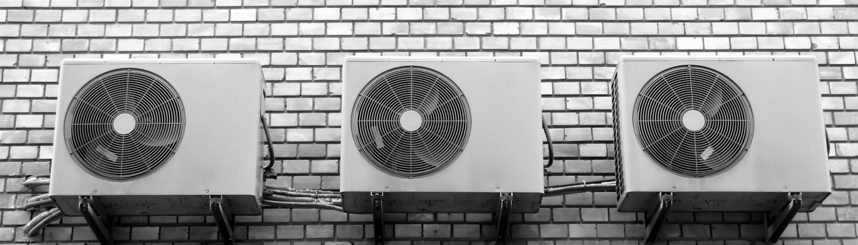
EXTREME HEAT
What Individuals Can Do
Stay Cool
Find places to cool off, such as a local mall, a library, or a cooling center

Slide 30


EXTREME HEAT
What Individuals Can Do
Check on Family and Friends
Keep a list of family, friends, and neighbors to check on during an extreme heat event

Slide 31

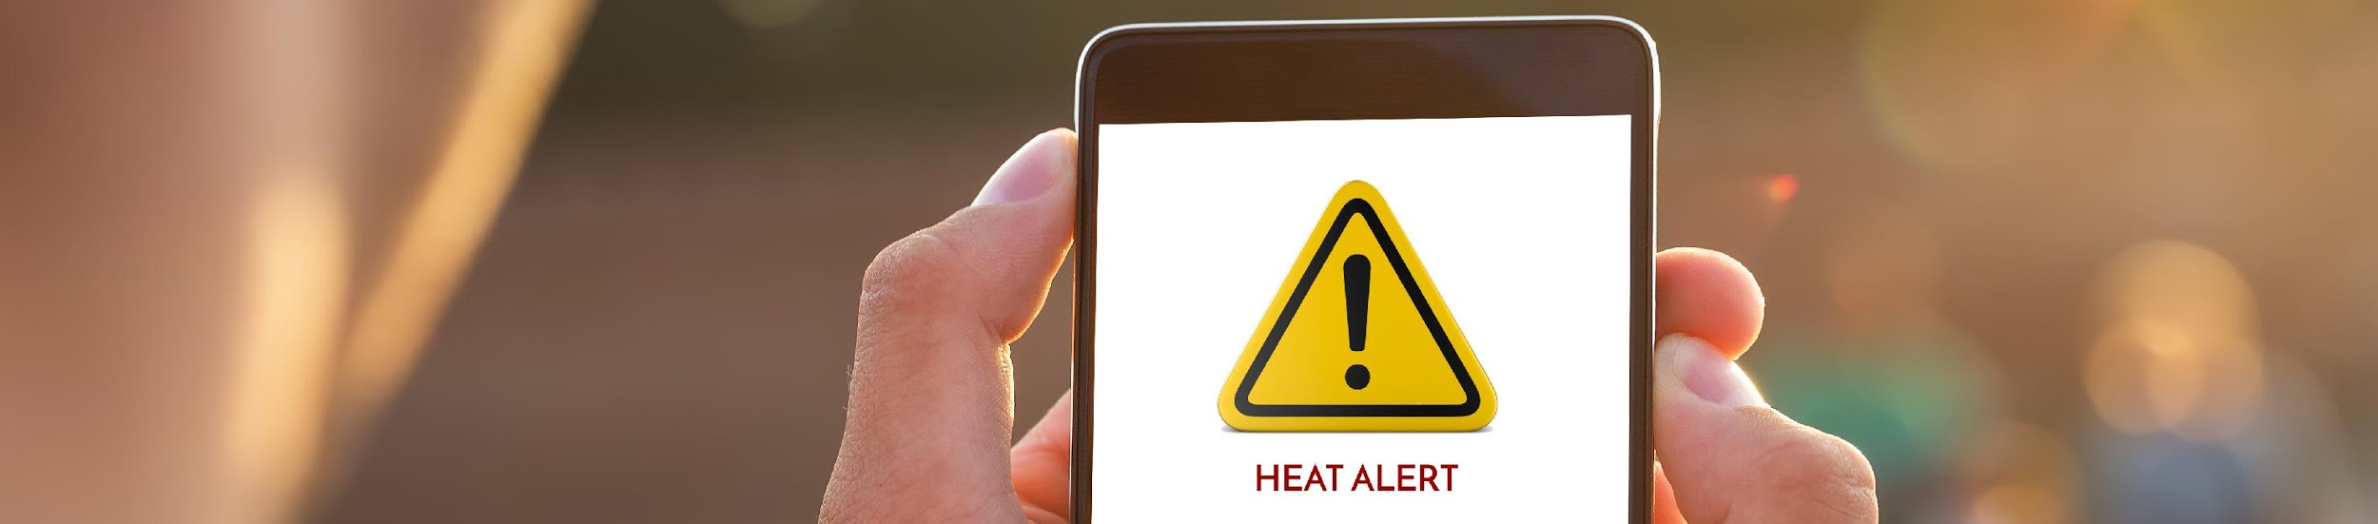
EXTREME HEAT
What Individuals Can Do
Plan Ahead
Subscribe to local health alert systems
Keep air conditioners and fans up-to-date
Check for local programs that:
                Provide free or reduced-cost air conditioners
            Help pay utility bills
            Provide transportation to cooling centers during extreme heat events

Slide 32


EXTREME HEAT
What Individuals Can Do
Plant Rooftop Gardens
Planting trees and plants helps provide shade to buildings and keeps surrounding air cooler

Slide 33



AIR POLLUTION
What Individuals Can Do
Monitor Air Quality Index and Stay Indoors
When pollen counts or ozone levels are high:
Stay indoors if you have asthma, heart problems, or are otherwise at risk
Cancel outdoor activities or move to air-conditioned location

Slide 34

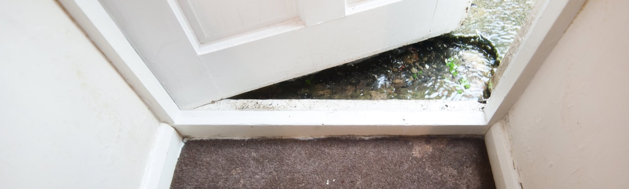
STORMS & FLOODING
What Individuals Can Do
Be Careful of Moisture Indoors
Carefully clean and dry flooded areas
Watch for mold growing indoors

Slide 35

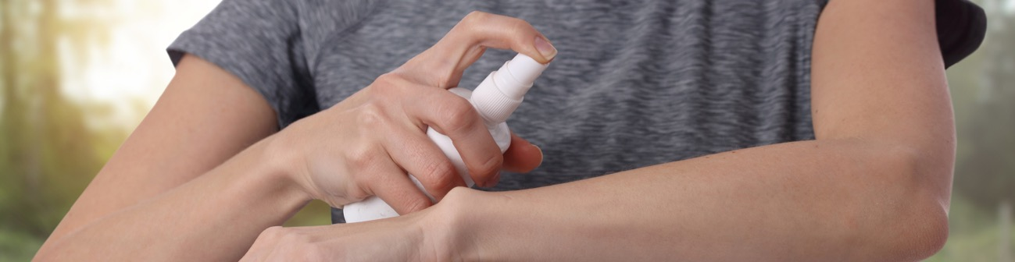
INSECTS, TICKS, & RODENTS
What Individuals Can Do
Prevent Insect Bites
Use insect repellant
Wear long sleeves and pants
Check carefully for ticks after being outdoors in wooded or grassy areas, especially in the summer

Slide 36

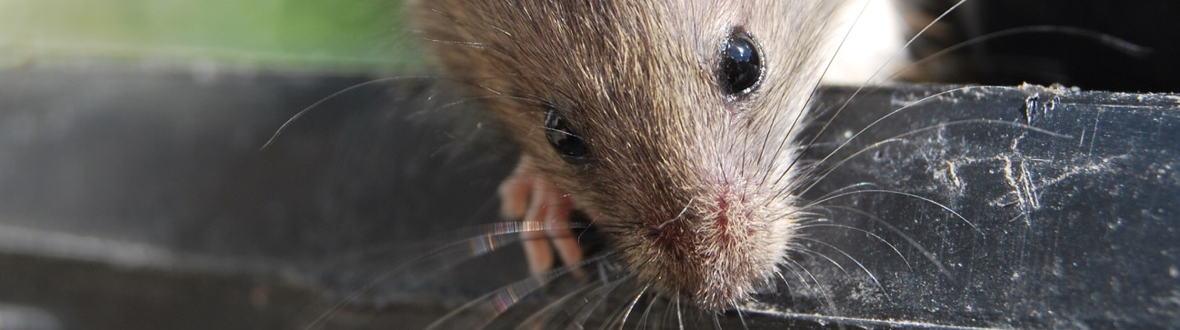
INSECTS, TICKS & RODENTS
What Individuals Can Do
Avoid Contact with Rodents and Droppings
Keep your home, cabin, or outbuildings free of mice and rats
Check with your local health department to learn how to safely clean up dead rodents and droppings

Slide 37

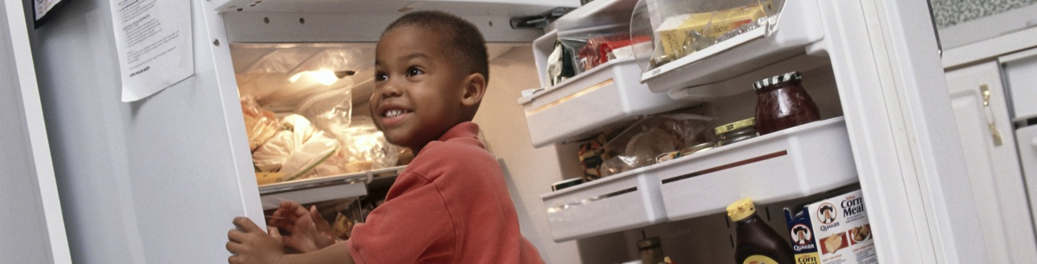
CONTAMINATED FOOD
What Individuals Can Do
Know Home Food Safety Basics
Cook: To the right temperature
Clean: Wash hands and surfaces often
Chill: Refrigerate promptly
Separate: Raw meats from other foods, don’t cross-contaminate

Slide 38


CONTAMINATED FOOD
What Individuals Can Do
See Your Doctor if You Have:
High fever (over 101.5 degrees F)
Blood in the stools
Frequent vomiting that prevents you from keeping liquids down
Signs of dehydration, including a decrease in urination, a dry mouth and throat, or feeling dizzy when standing up
Diarrheal illness that lasts more than 3 days

Slide 39

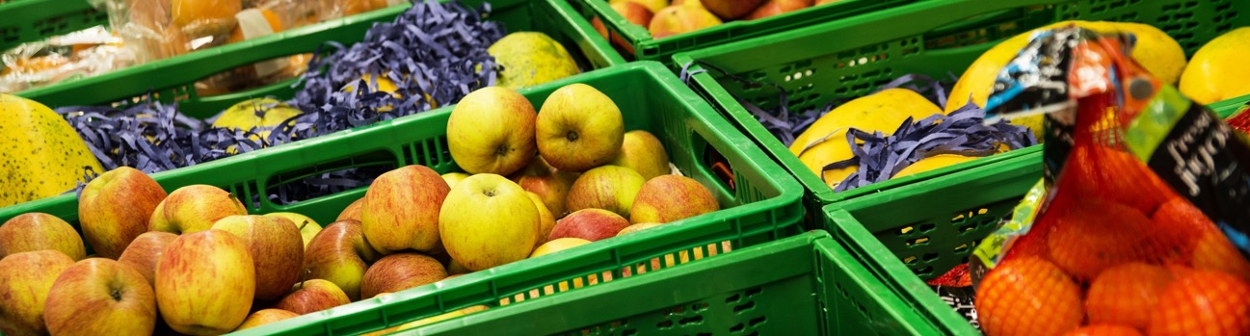
HUNGER AND MALNUTRITION
What Individuals Can Do
Find Out if Your Family Qualifies for Assistance
SNAP [insert state-specific link]
WIC [insert state-specific link]
School breakfast and lunch programs [insert state-specific link]

Slide 40


MENTAL HEALTH PROBLEMS
What Individuals Can Do
Know Your Signs of Stress
Difficulty concentrating and making decisions
Reduced interest in usual activities
Disbelief, shock, and numbness
Anger, tension, and irritability
Fear and anxiety about the future

Slide 41


MENTAL HEALTH PROBLEMS
What Individuals Can Do
Socialize with Friends and Family
Connect and talk with your friends, family members, and your community

Slide 42


MENTAL HEALTH PROBLEMS
What Individuals Can Do
Take Mental Breaks
Engage in activities to decompress such as exercise, listening to music, or spending time with a friend

Slide 43


MENTAL HEALTH PROBLEMS
What Individuals Can Do
Ask for Help
Seek professional help when symptoms are disrupting your day-to-day activities

Slide 44

PUBLIC HEALTH HARMS OF CLIMATE CHANGE
What CDC Is Doing

Slide 45

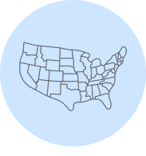
Climate Health Program (CHP)
What the CDC Is Doing
Established in 2009, the Climate and Health Program provides leadership to help communities anticipate, prepare for, and respond to the public health impacts of climate change.
The Climate and Health Program developed the five-step Building Resilience Against Climate Effects (BRACE) framework to help communities with adaptation planning.
CDC’s Climate-Ready States and Cities Initiative (CRSCI) is helping 16 states and two cities implement the BRACE framework.

Slide 46

ADAPTATION IN ACTION
What We Are Doing in [name of community]

Slide 47
OUR APPROACH
What We Are Doing in [name of community]
SOLUTION
CHALLENGE
RESULTS
What solutions did you implement?
What were your successes? How should they be replicated or scaled up? Why do these preventative and precautionary steps matter?
What climate and health challenge(s) did your community address?

Slide 48



[headline]
What We Are Doing in [our community]
OUR SOLUTION
UNIQUE OFFERING
LASTING IMPACT
[brief description about program, detailing which health harm it is addressing]
[information about key aspect of the program and how it is unique]
[information on results and consequences of program]
[add photos here]

Slide 49
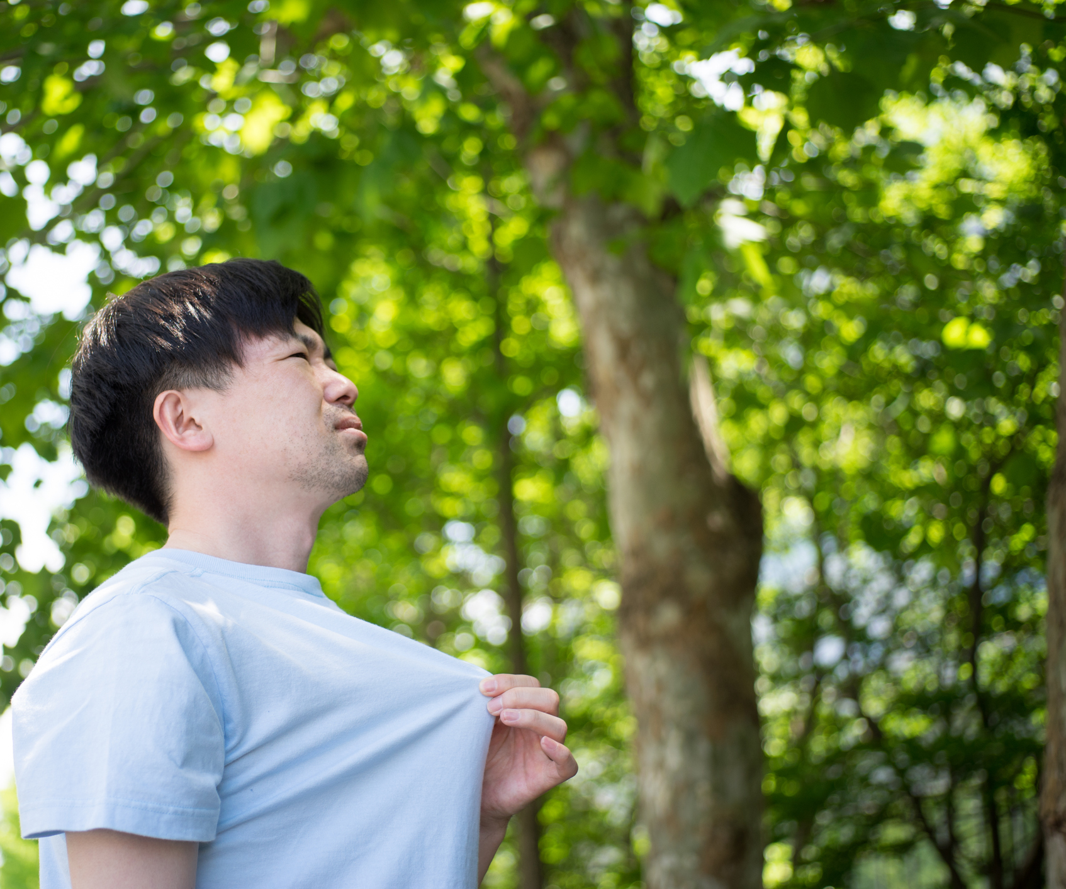

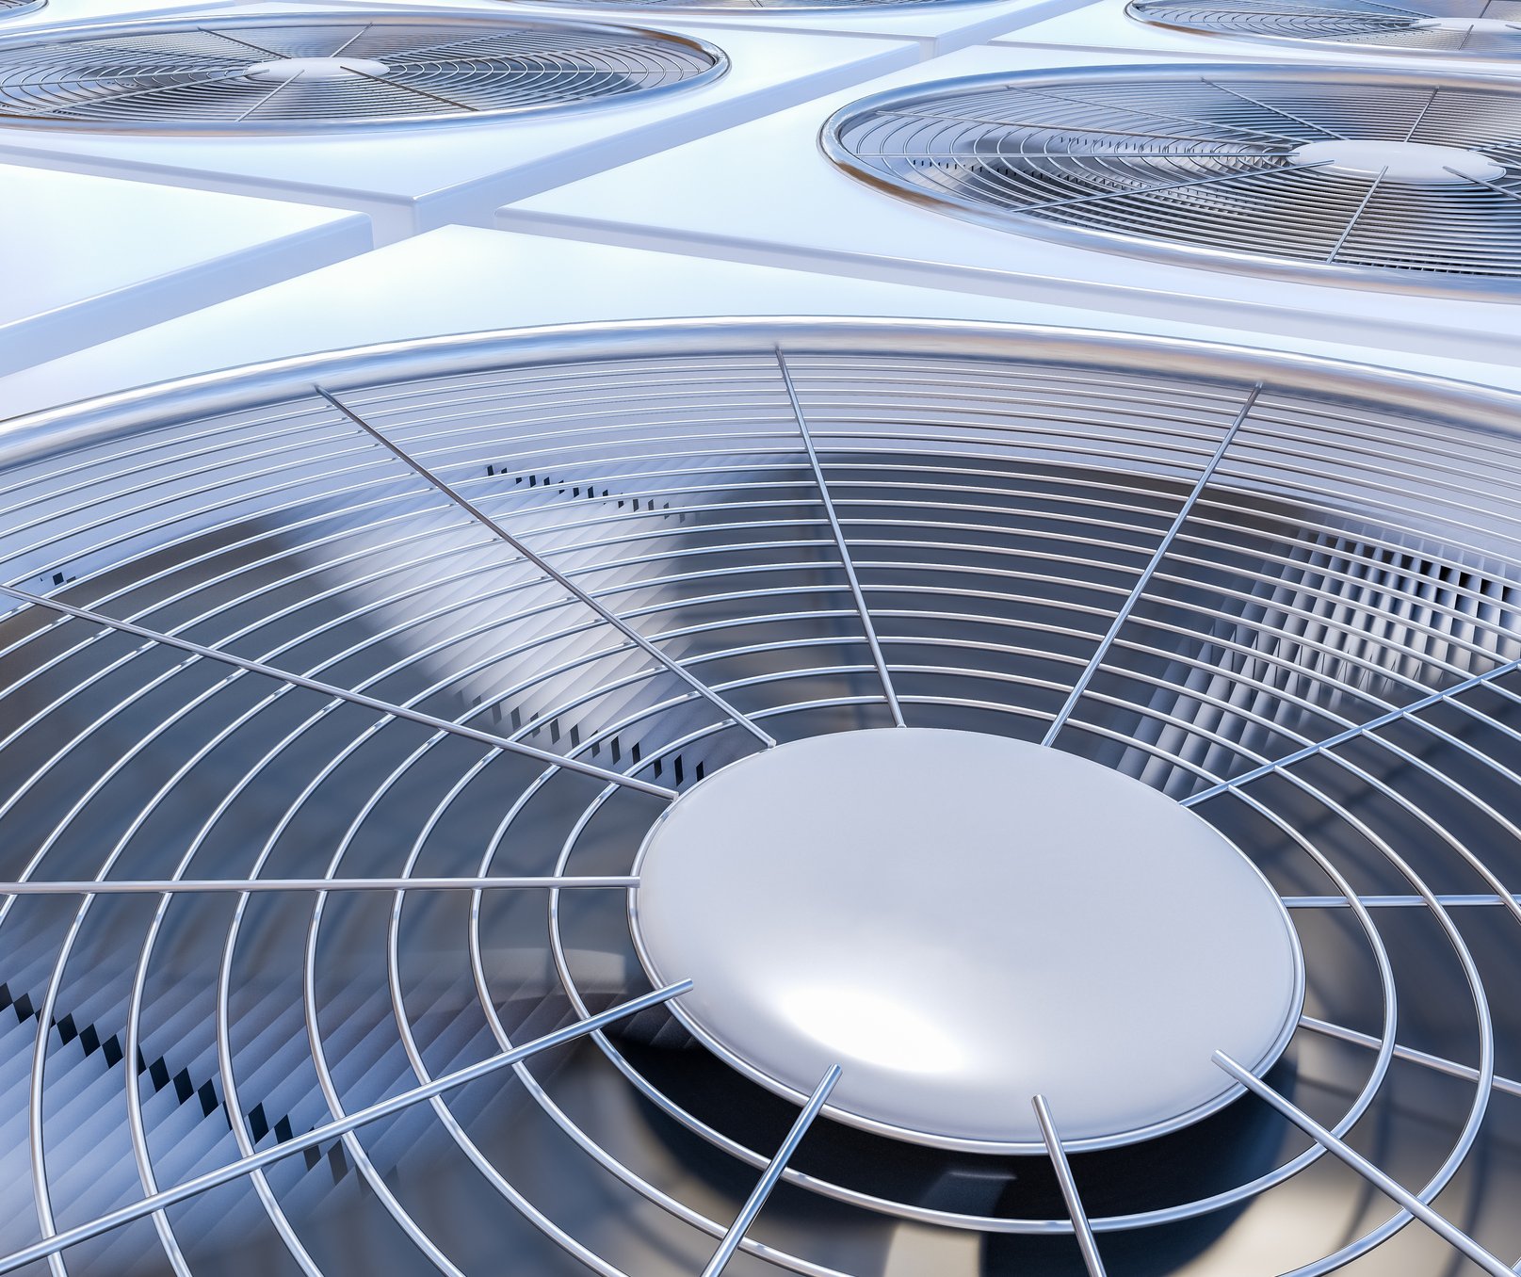
Adapting to the New Normal
What We Are Doing in Minnesota
OUR SOLUTION
UNIQUE OFFERING
LASTING IMPACT
Extreme Heat Toolkit to guide local health officials in responding to heat events
Use GIS mapping to identify vulnerable communities and neighborhoods
Resources allocated to most vulnerable areas and participating communities grew from two to six in just one year

Slide 50
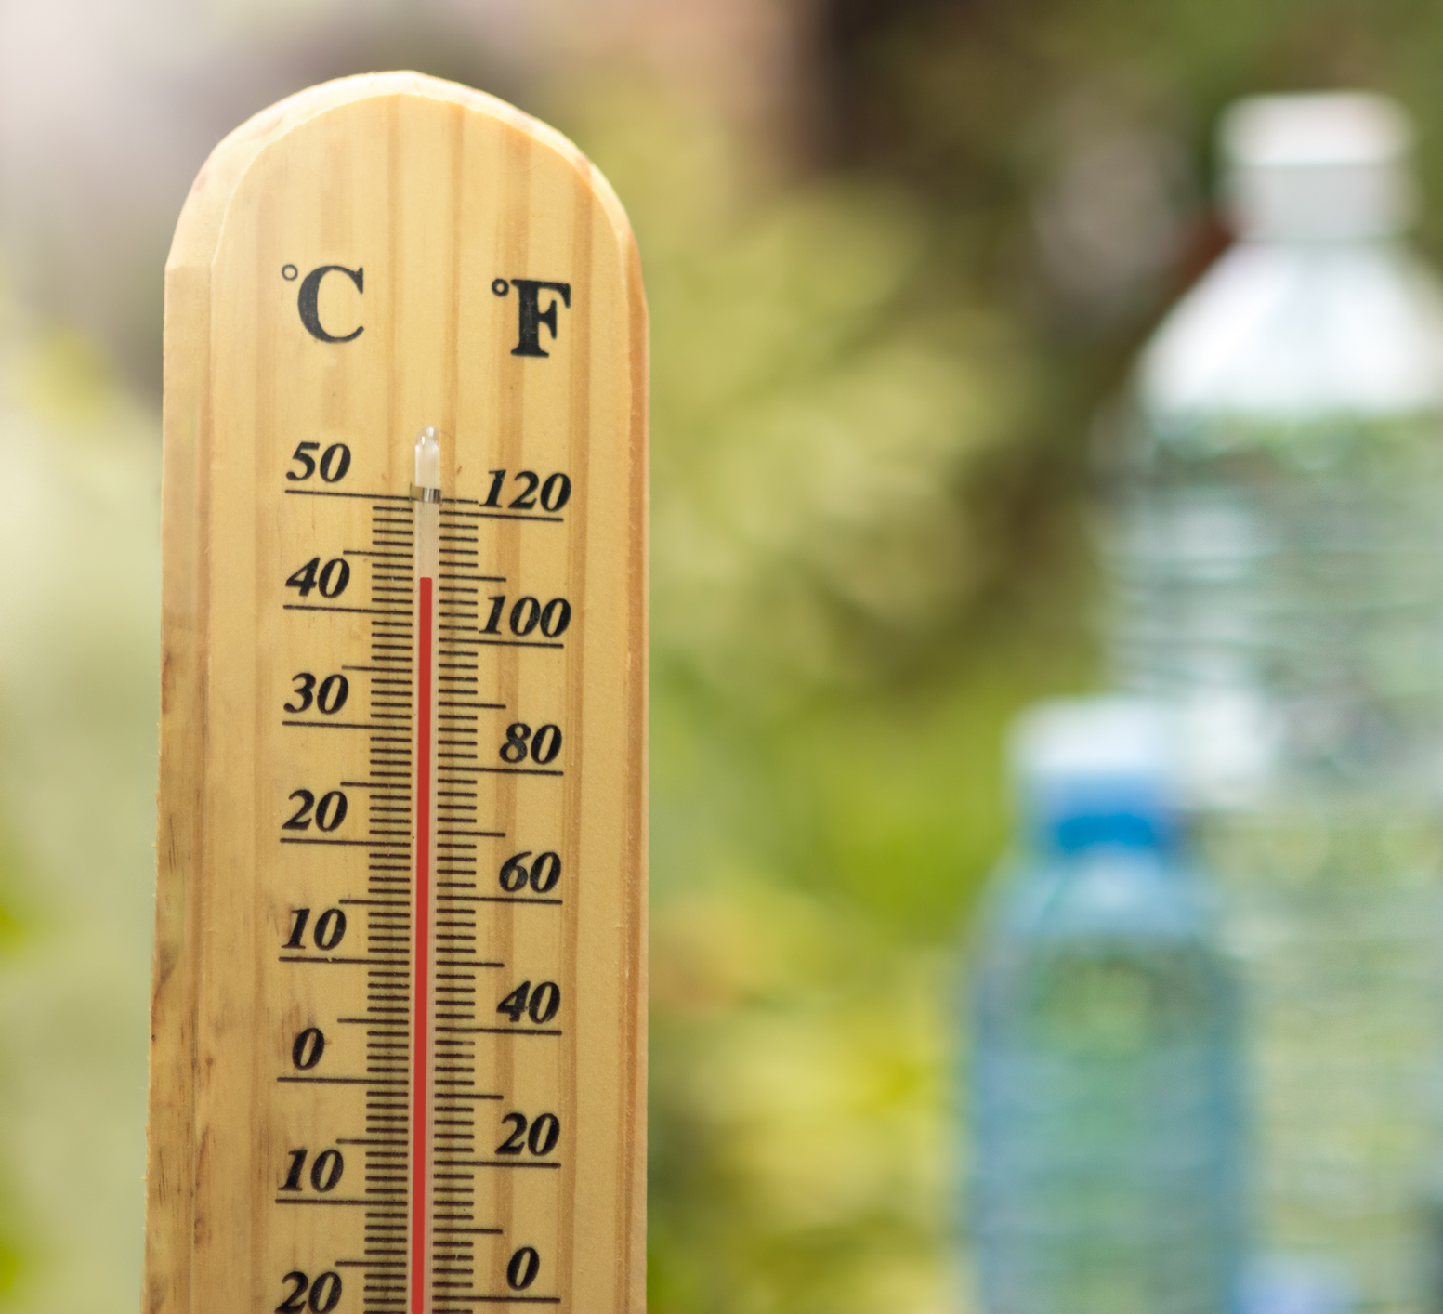
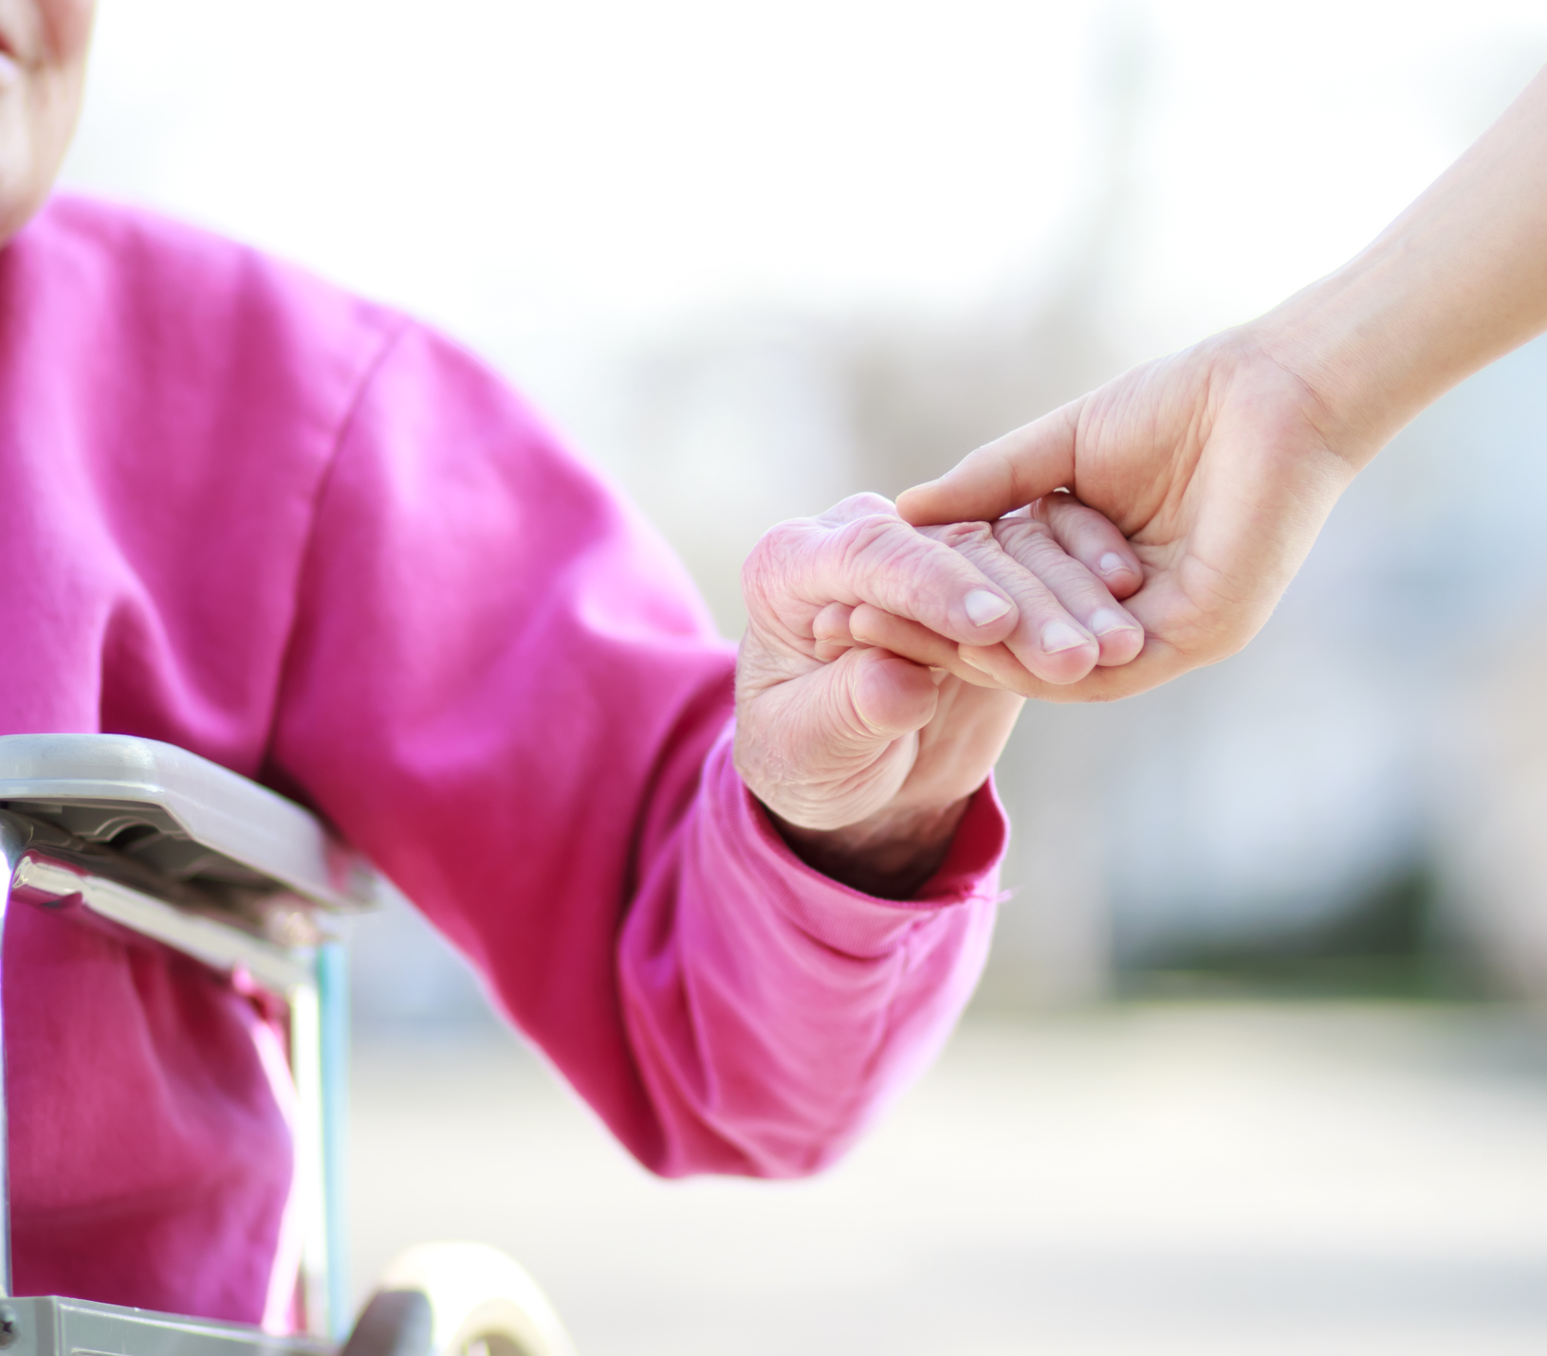
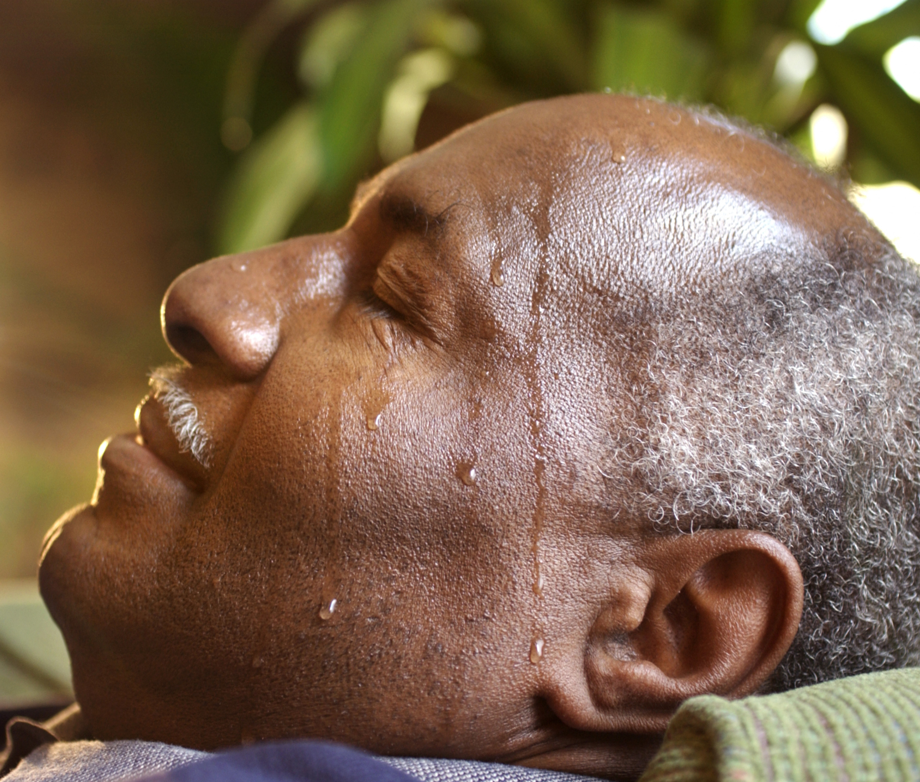
Bringing Health to the Forefront
What We Are Doing in San Francisco
OUR SOLUTION
UNIQUE OFFERING
LASTING IMPACT
The city’s first heat vulnerability index to pinpoint most susceptible neighborhoods
Index analyzed surface temperature data alongside 21 social and environmental vulnerabilities
Index now informs city planning decisions, education efforts, and designated cooling centers
Notes:
Today, the index is being used in a variety of adaptation efforts such as guiding where to designate cooling centers and where to conduct education and outreach efforts. Other local agencies are using the index, too. For example, city planners use the index to determine where more trees should be planted to offer shade and boost cooling effects.

Slide 51
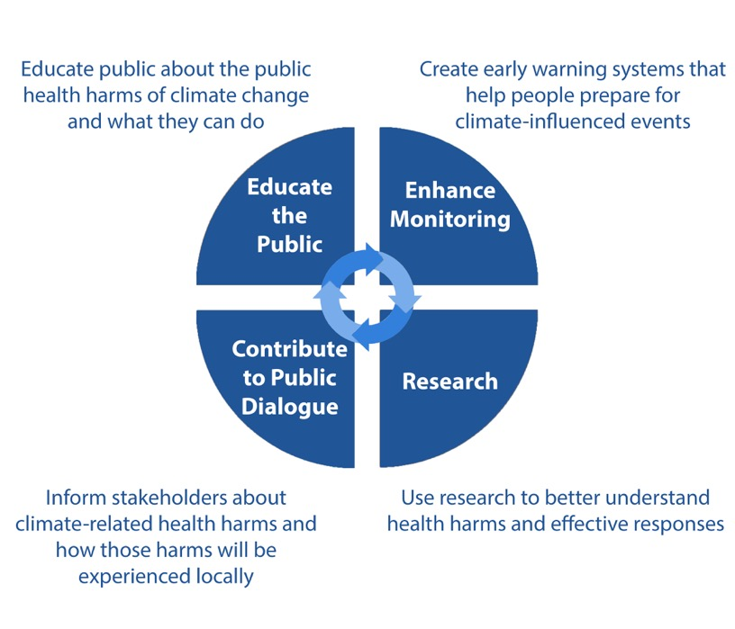
There’s Much We Can Do
There’s Much We Can Do

