Slide 1

Autism and Developmental Disabilities Monitoring (ADDM) Network
Surveillance Summary Supplemental Slides 2022
National Center on Birth Defects and Developmental Disabilities
Published April 15, 2025

Slide 2
2022 ADDM Surveillance Summary Citation and Link
Shaw KA, Williams S, Patrick ME, et al. Prevalence and Early Identification of Autism Spectrum Disorder Among Children Aged 4 and 8 Years — Autism and Developmental Disabilities Monitoring Network, 16 Sites, United States, 2022.
MMWR Surveill Summ 2025, 74 (No. SS-2): 1-22.
https://www.cdc.gov/mmwr/volumes/74/ss/ss7402a1.htm

Slide 3
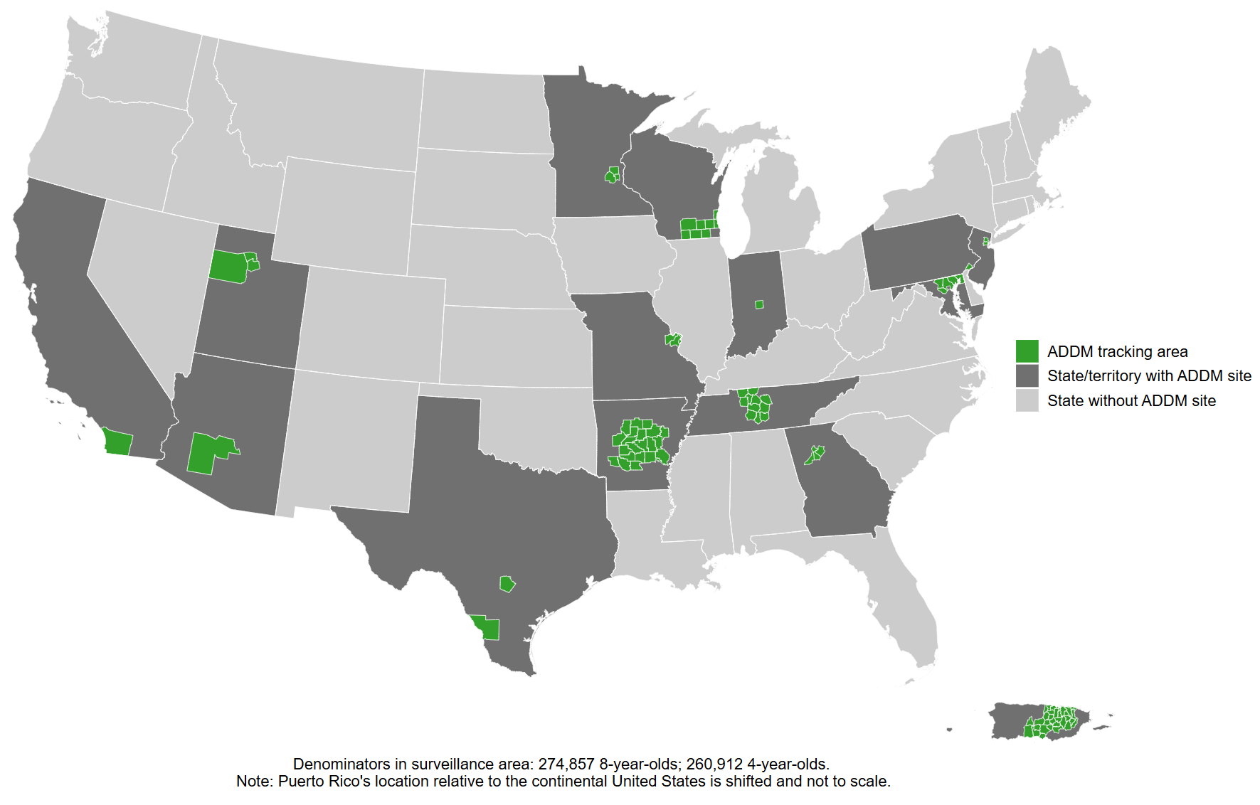
Autism and Developmental Disabilities Monitoring Network, 16 sites, United States, 2022

Slide 4
ADDM Ascertainment and Autism Spectrum Disorder (ASD) Case Definition
Records that included various billing codes from the International Classification of Disease, Ninth Revision (ICD-9) or International Classification of Diseases, Tenth Revision (ICD-10) or special education eligibility codes were requested from health and education sources. Children ages 4 or 8 who had a parent or guardian who lived in one of the surveillance areas during 2022 were classified as having ASD or suspected ASD if they met the criteria below.
ASD case definition | Suspected ASD case definition
Child has documentation of ever receiving: a written ASD diagnosis by a qualified professional, a special education classification of autism, OR an ASD ICD code obtained from administrative or billing information. | (4-year-old only) Child does not meet criteria of full case definition but there is a qualified examiner’s diagnostic statement that the child is suspected of having ASD.

Slide 5
ADDM Intellectual Disability Case Definition
Co-occurring intellectual disability was classified as:
  Intelligence quotient (IQ) score ≤70 on child’s most recent IQ test
  Examiner’s statement of intellectual disability on child’s most recent IQ test

Slide 6
ADDM Additional Data Sources and Variable Definitions
The number of children aged 4 and 8 years living in each surveillance area was obtained from the U.S. Census Bureau Vintage 2022 county-level single-year-of-age postcensal population estimates for 2022. Surveillance areas at four sites (Arizona, California, Minnesota, and Texas [Austin]) were partial counties and were defined using census tracts. For these sites, postcensal population estimates were adjusted using American Community Survey (ACS) estimates of included census tracts.
Sites linked American Community Survey 2022 5-year estimates for median household income (MHI) to records of children using their 2022 address. Census tracts for all sites combined were grouped into low, middle, and high MHI tertiles that included roughly equal populations of children.

Slide 7
ADDM Analytic Methods
Prevalence was calculated as the number of children with ASD per 1,000 children in the defined population or subgroup.
Cumulative incidence for children aged 4 years was compared with children aged 8 years in the ADDM Network. Cumulative incidence of ASD diagnosis was calculated per 1,000 children by dividing the total number of children with an ASD diagnosis or special education eligibility at each month of age by the 2022 age 4 or age 8 population denominator.

Slide 8
ADDM Analytic Methods – COVID-19 analysis
Numbers of evaluations and ages of earliest identification were aggregated by calendar month for children aged 4 and 8 years in 2022.
To compare the same age windows by calendar month, the numbers of evaluations and incidence of identification from 2014 (year 0) through 2018 (year 4) for children aged 8 years were subtracted from the same months during 2018 (year 0) through 2022 (year 4) for children aged 4 years.

Slide 9
Visualizations –
Key prevalence findings from children aged 8 years

Slide 10
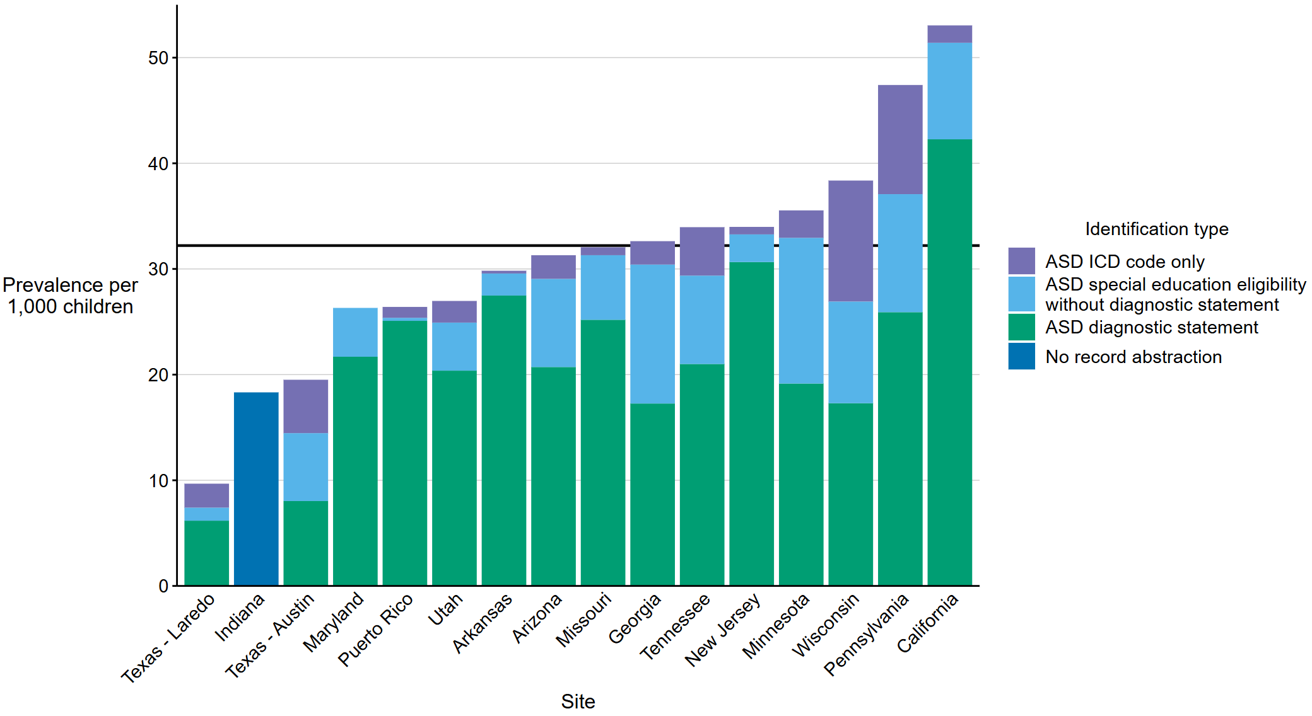
Prevalence of autism spectrum disorder per 1,000 children aged 8 years, by identification type and site*†
Autism and Developmental Disabilities Monitoring Network, 16 sites, United States, 2022
Abbreviations: ASD = autism spectrum disorder; ICD = International Classification of Diseases.
* Data from record abstraction were not available for Indiana.
† Horizontal line is the overall Autism and Developmental Disabilities Monitoring Network prevalence of 32.2 per 1,000 children aged 8 years. Children with documented ASD statements could also have ASD eligibility in special education or ASD ICD codes.

Slide 11
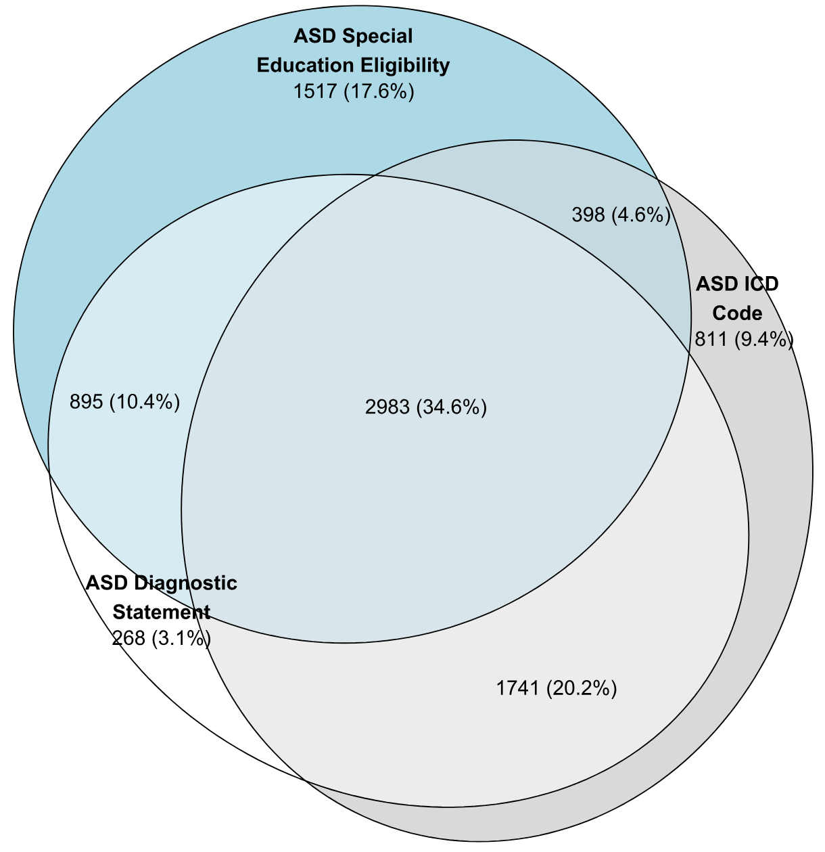
Euler diagram of different types of autism spectrum disorder identification among children aged 8 years with autism spectrum disorder*
Autism and Developmental Disabilities Monitoring Network, 15 sites, United States, 2022
Abbreviations: ASD = autism spectrum disorder; ICD = International Classification of Diseases.
* N = 8,613 (The ADDM Network has 16 sites; Indiana is not included in the figure because the site did not have ASD diagnostic statement data from record abstraction available).

Slide 12
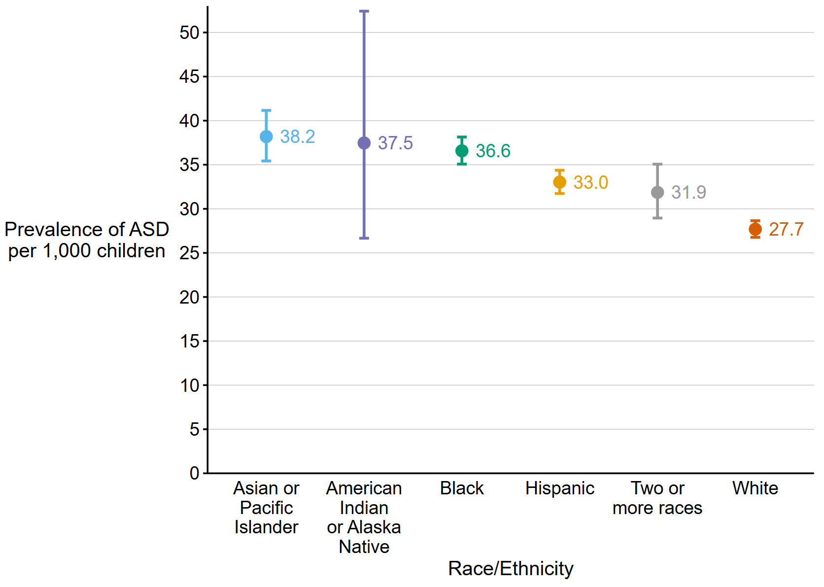
Prevalence of autism spectrum disorder per 1,000 children aged 8 years, by race/ethnicity*
Autism and Developmental Disabilities Monitoring Network, 16 sites, United States, 2022
Abbreviations: ASD = autism spectrum disorder.
*Dots are point estimates and horizontal lines are 95% CIs.

Slide 13
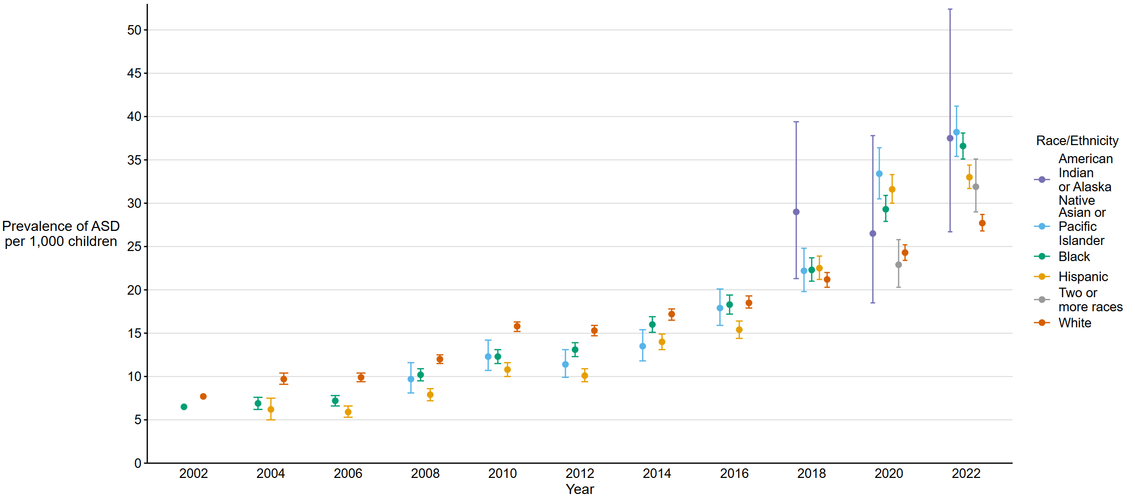
Prevalence of autism spectrum disorder per 1,000 children aged 8 years over time, by race/ethnicity
Autism and Developmental Disabilities Monitoring Network, 16 sites, United States, 2002–2022
Abbreviations: ASD = autism spectrum disorder.
* Dots are point estimates and horizontal lines are 95% CIs.

Slide 14
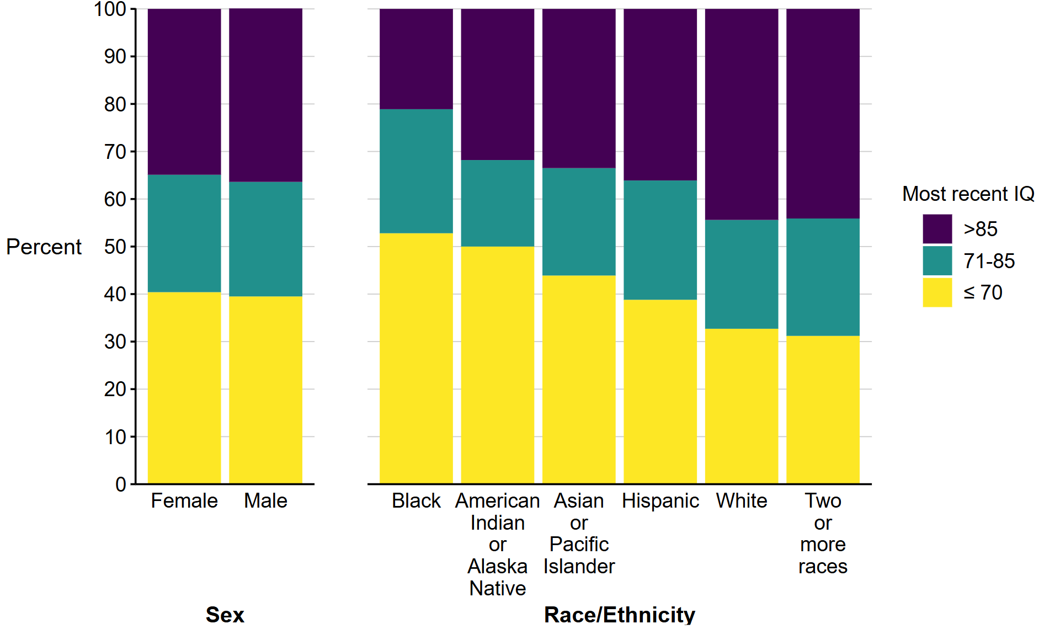
Distribution of intelligence quotient scores among children aged 8 years with autism spectrum disorder*†, by sex§ and race/ethnicity¶
Autism and Developmental Disabilities Monitoring Network, 15 sites, United States, 2022
Abbreviations: IQ = intelligence quotient.
* N = 8,613 (The ADDM Network has 16 sites; Indiana is not included in the figure because the site did not have data from record abstraction available).
† IQ >85 includes 25 children stated to have an IQ score above 70 but specific score was not given.
§ Excludes children with unknown sex (n = 13).
¶ Excludes children of other or unknown race (n = 115).

Slide 15
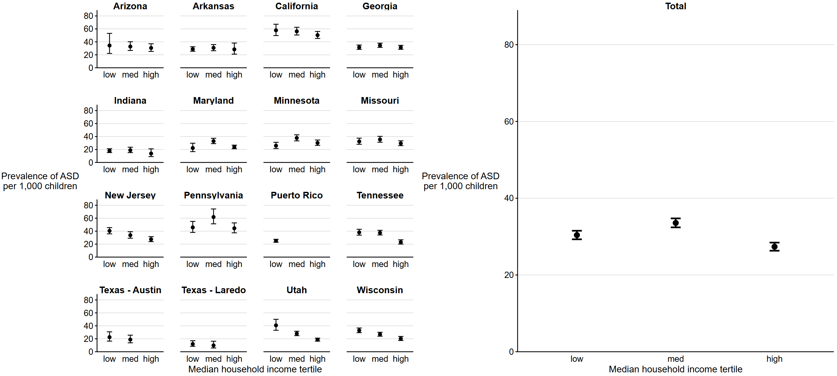
Prevalence of autism spectrum disorder per 1,000 children aged 8 years, by median household income tertile and site*†
Autism and Developmental Disabilities Monitoring Network, 16 sites, United States, 2022
Abbreviations: ASD = autism spectrum disorder.
* Dots are the point estimates and horizontal lines are the 95% confidence intervals.
† Cochran-Armitage test of trend for association between median household income tertile and ASD prevalence, by site and overall: Arizona p = 0.6; Arkansas p = 0.8; California p = 0.1; Georgia p = 0.9; Indiana p = 0.5; Maryland p = 0.1; Minnesota p = 0.4; Missouri p = 0.3; New Jersey p<0.01; Pennsylvania p = 0.7; Puerto Rico p = 0.5; Tennessee p<0.01; Texas-Austin p = 0.2; Texas-Laredo p = 0.04; Utah p<0.01; Wisconsin p<0.01; Total p<0.01 (not monotonic).

Slide 16
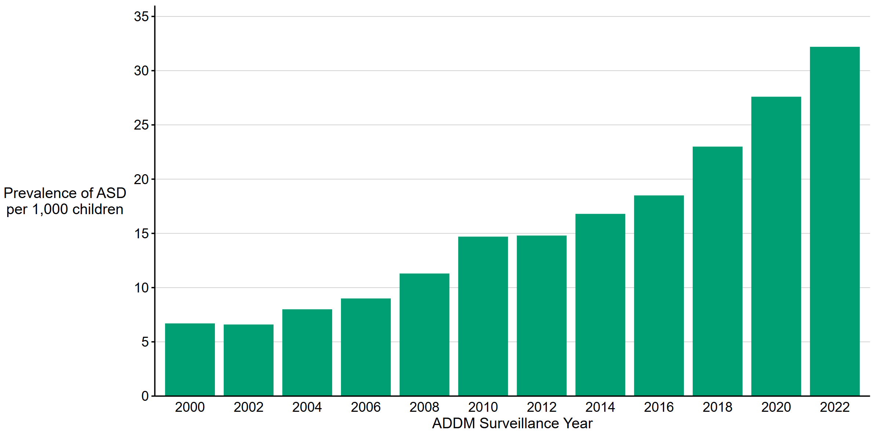
Prevalence of autism spectrum disorder per 1,000 children aged 8 years, by surveillance year
Autism and Developmental Disabilities Monitoring Network, 2000–2022
Abbreviations: ASD = autism spectrum disorder.

Slide 17
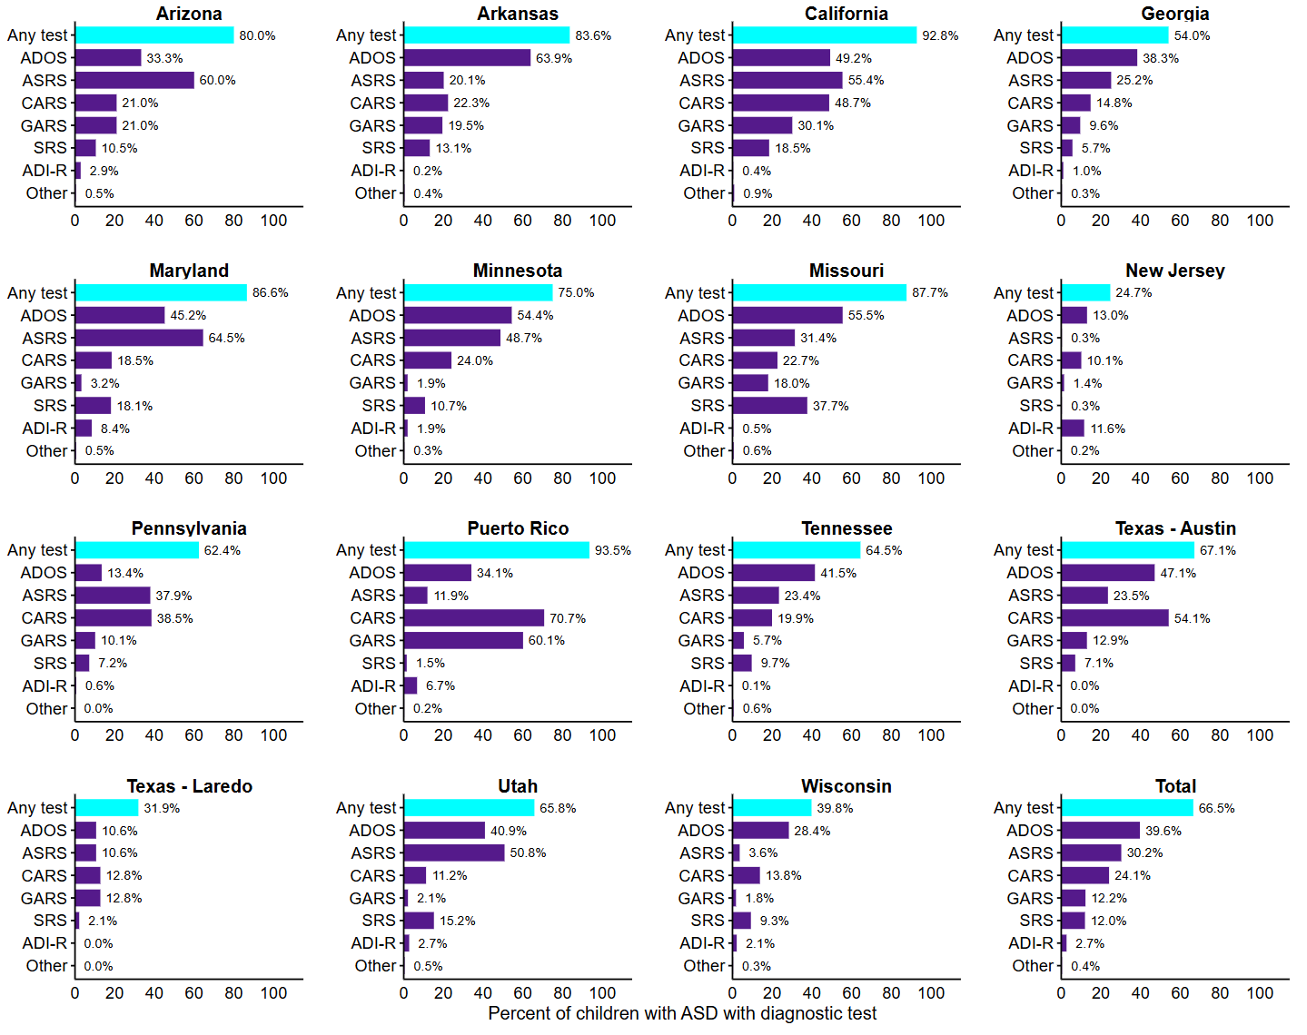
Percentage of children aged 8 years with autism spectrum disorder who have a recorded autism spectrum disorder diagnostic test, by site*
Autism and Developmental Disabilities Monitoring Network, 15 sites, United States, 2022
Abbreviations: ADI-R = Autism Diagnostic Interview-Revised; ADOS = Autism Diagnostic Observation Schedule; ASD = autism spectrum disorder; ASRS = Autism Spectrum Rating Scales; CARS = Childhood Autism Rating Scale; GARS = Gilliam Autism Rating Scale; SRS = Social Responsiveness Scale; other test category includes Asperger Syndrome Diagnostic Scale, Gilliam Asperger’s Disorder Scale, and Telemedicine-based Autism Spectrum Disorder Evaluation Tool for Toddlers and TELE-ASD-PEDS .
* N = 8,613 (The ADDM Network has 16 sites; Indiana is not included in the figure because the site did not have data from record abstraction available).

Slide 18
Visualizations –
Key early identification findings from children aged 4 years

Slide 19
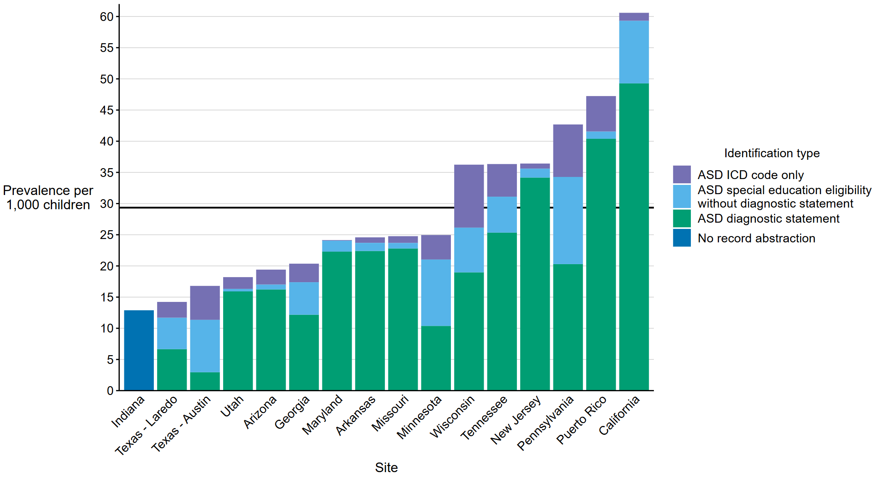
Prevalence of autism spectrum disorder per 1,000 children aged 4 years, by identification type and site*†
Autism and Developmental Disabilities Monitoring Network, 16 sites, United States, 2022
Abbreviations: ASD = autism spectrum disorder; ICD = International Classification of Diseases.
* Data from record abstraction were not available for Indiana.
† Horizontal line is the overall Autism and Developmental Disabilities Monitoring Network prevalence of 29.4 per 1,000 children aged 4 years. Children with documented ASD statements could also have ASD eligibility in special education or ASD ICD codes.

Slide 20
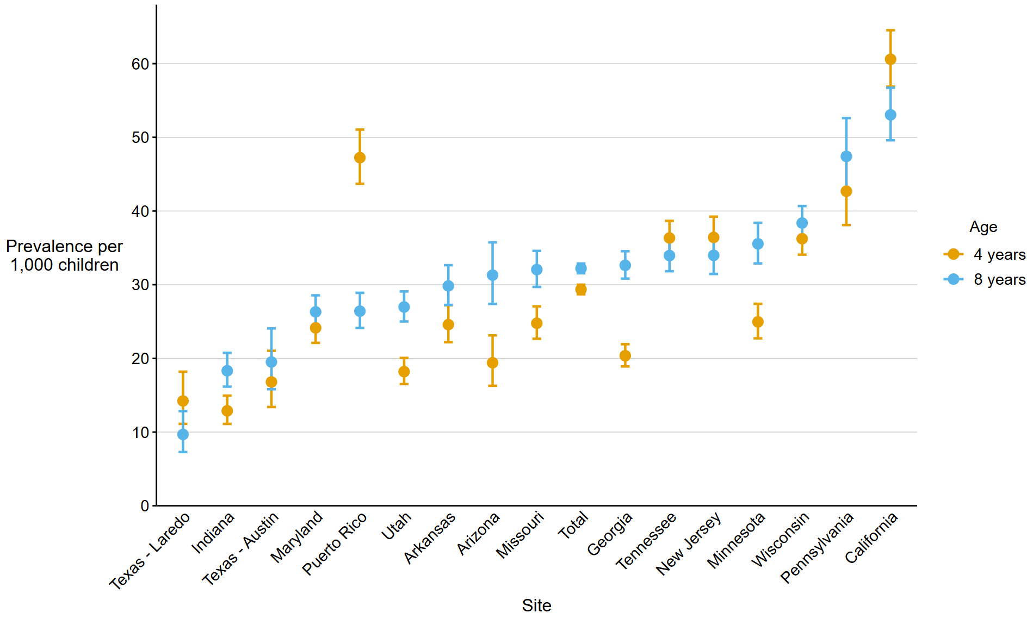
Comparison of autism spectrum disorder prevalence per 1,000 children aged 4 years and aged 8 years, by site
Autism and Developmental Disabilities Monitoring Network, 16 sites, United States, 2022

Slide 21
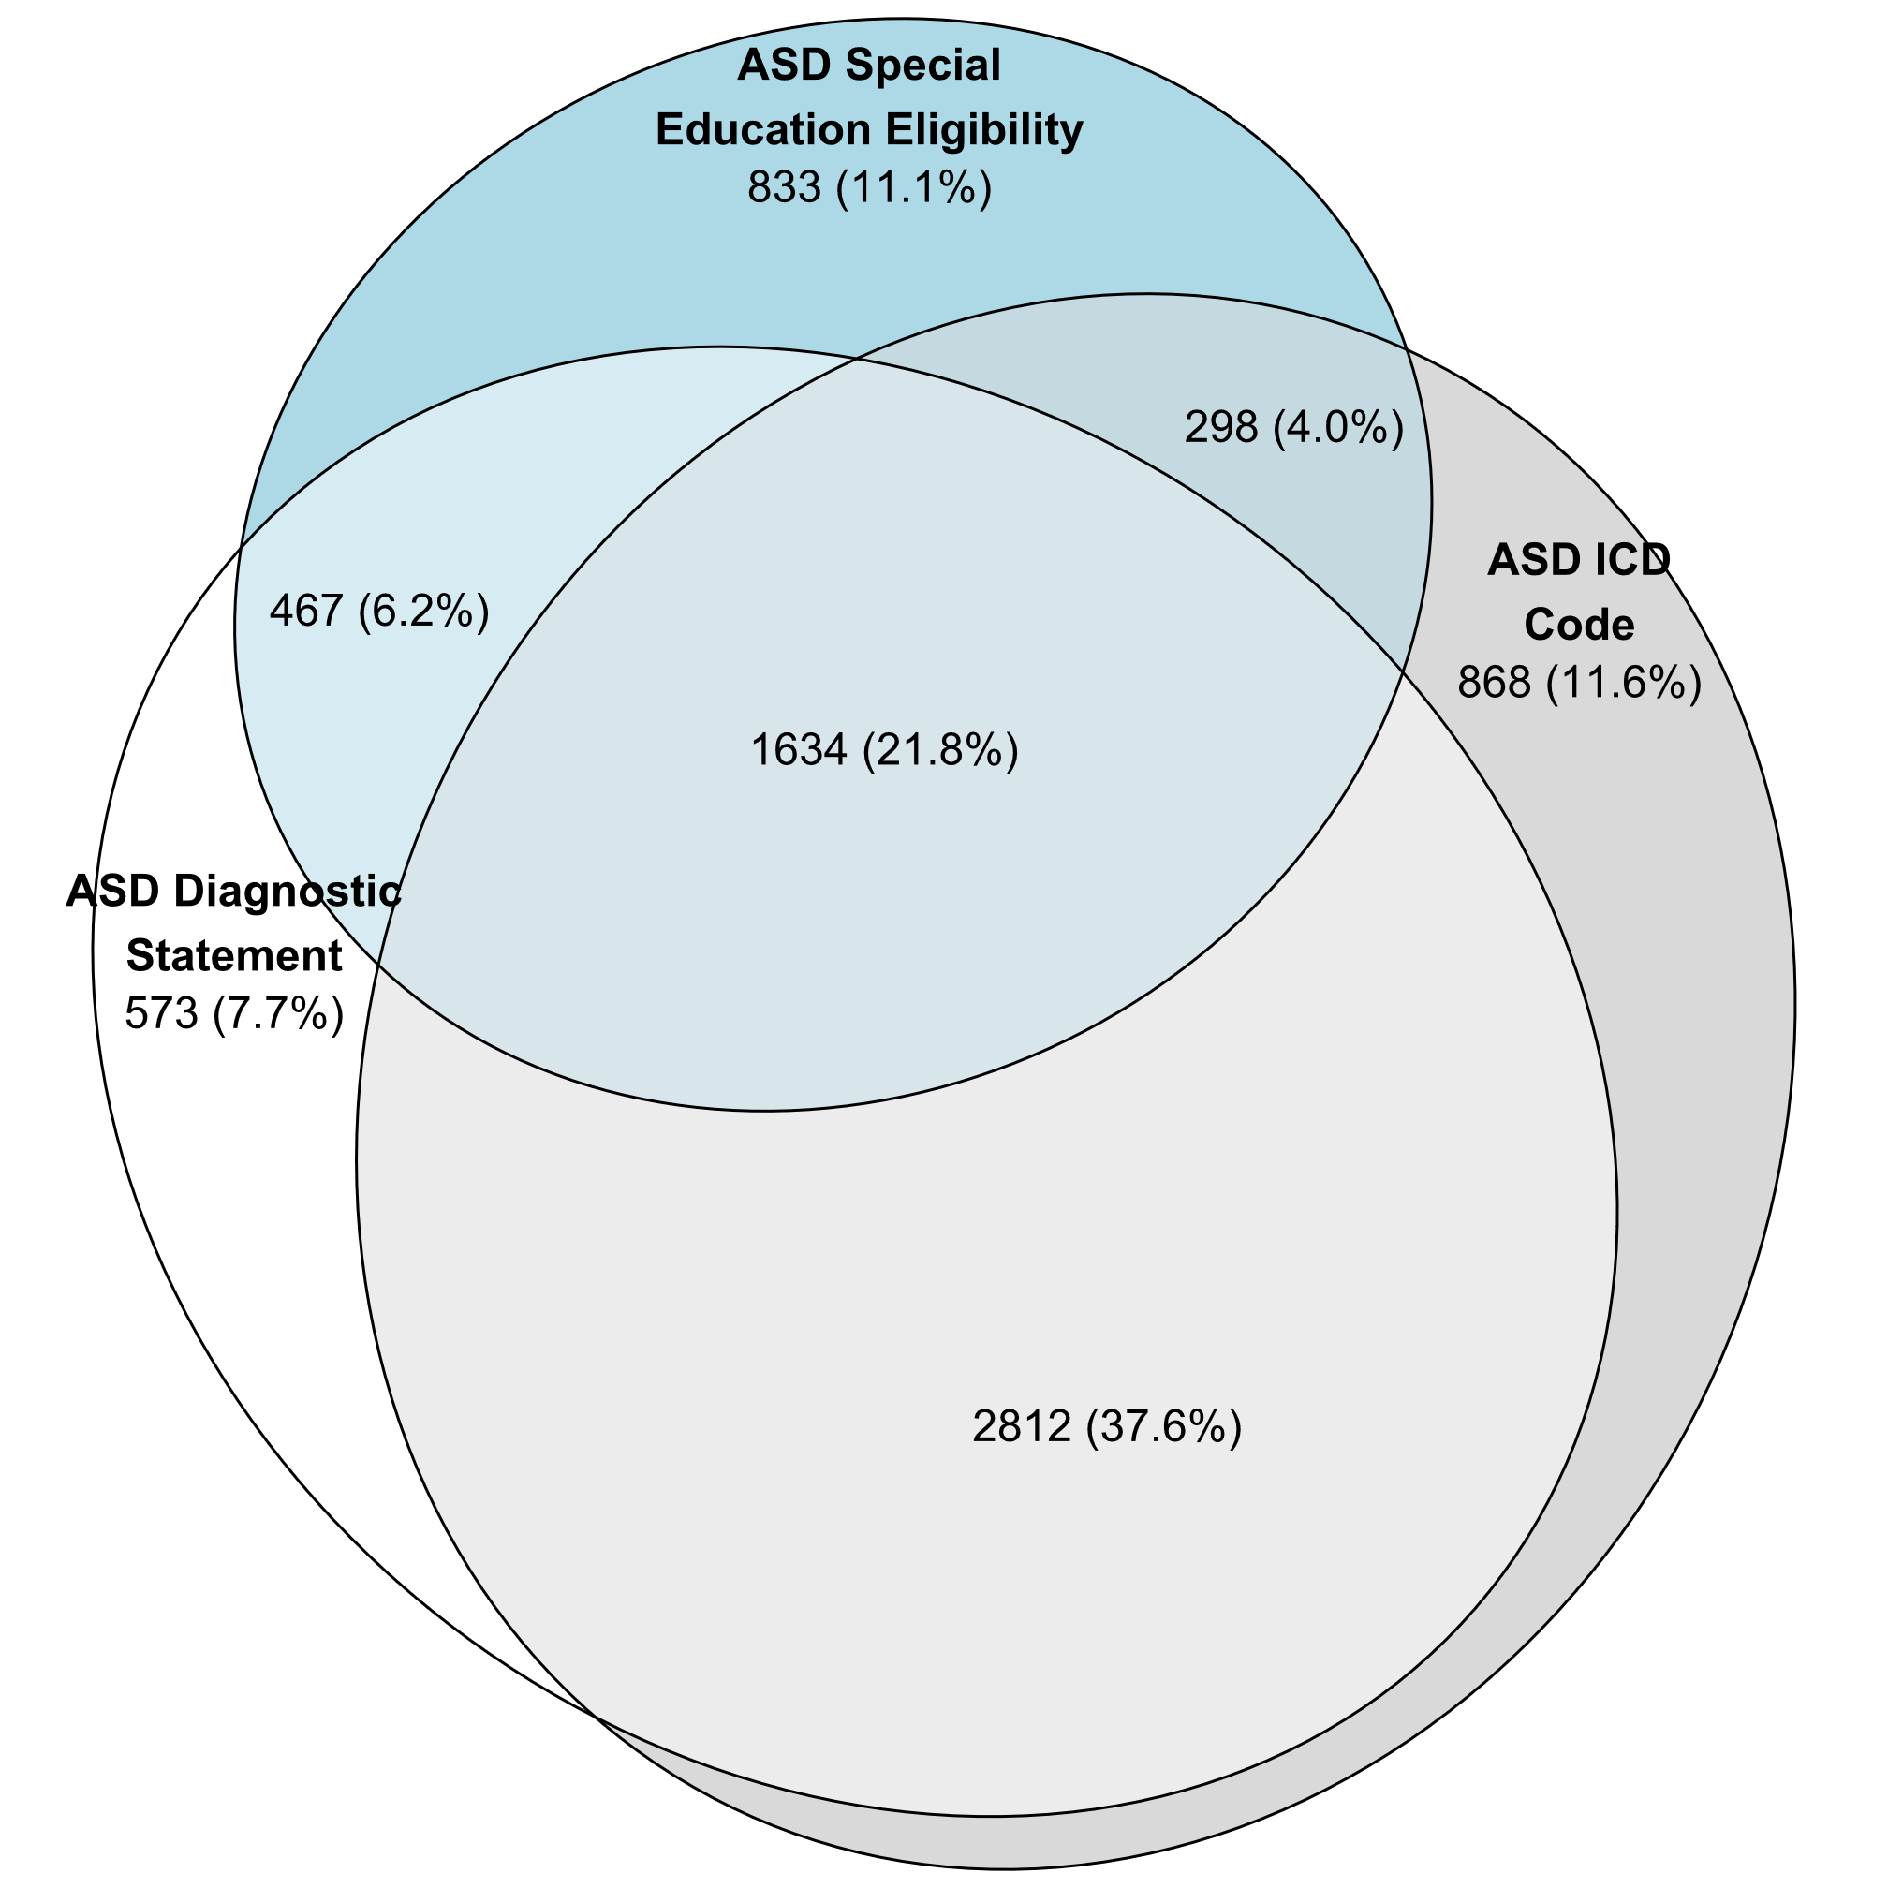
Euler diagram of different types of autism spectrum disorder identification among children aged 4 years with autism spectrum disorder*
Autism and Developmental Disabilities Monitoring Network, 15 sites, United States, 2022
Abbreviations: ASD = autism spectrum disorder; ICD = International Classification of Diseases.
* N = 7,485 (The ADDM Network has 16 sites; Indiana is not included in the figure because the site did not have ASD diagnostic statement data from record abstraction available).

Slide 22
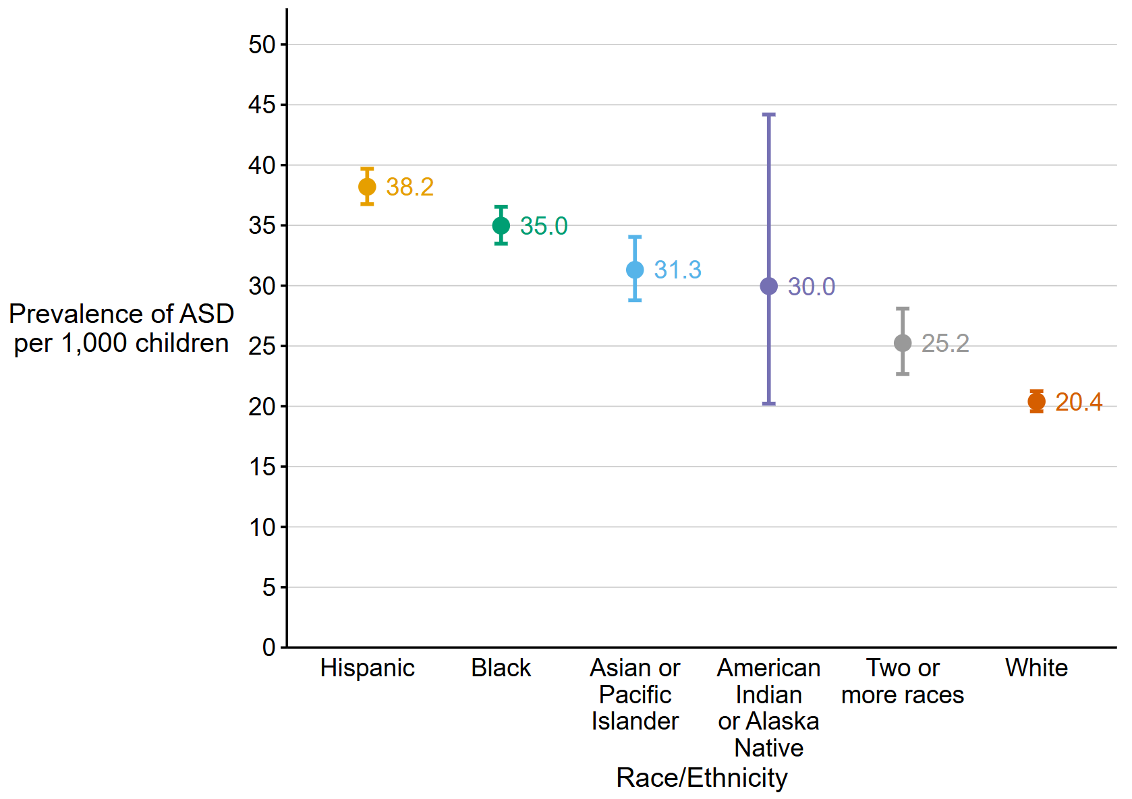
Prevalence of autism spectrum disorder per 1,000 children aged 4 years, by race/ethnicity
Autism and Developmental Disabilities Monitoring Network, 16 sites, United States, 2022
Abbreviations: ASD = autism spectrum disorder.
*Dots are point estimates and horizontal lines are 95% CIs.

Slide 23
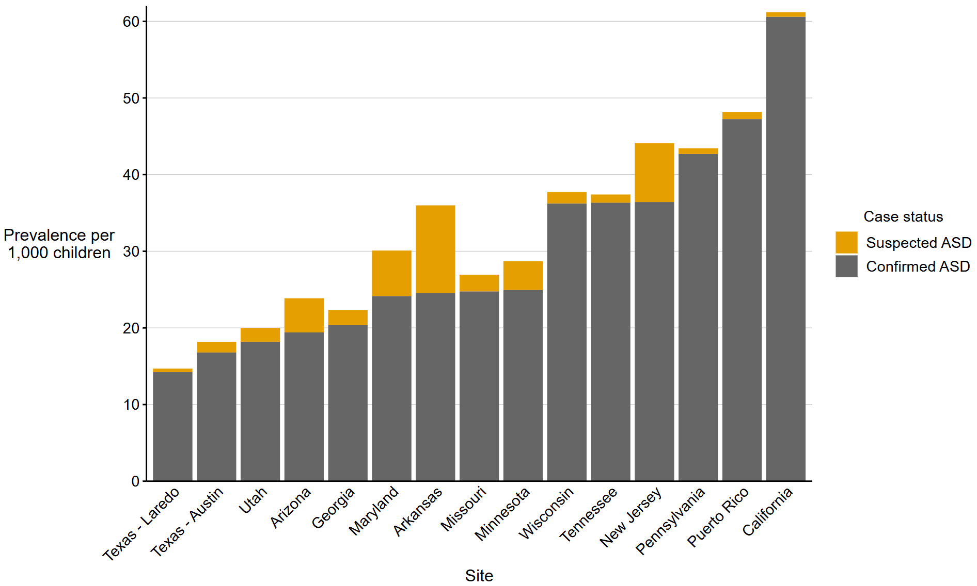
Prevalence of autism spectrum disorder and suspected autism spectrum disorder per 1,000 children aged 4 years, by site*
Autism and Developmental Disabilities Monitoring Network, 15 sites, United States, 2022
Abbreviations: ASD = autism spectrum disorder.
* The ADDM Network has 16 sites; Indiana is not included in the figure because the site did not have data from record abstraction available.

Slide 24
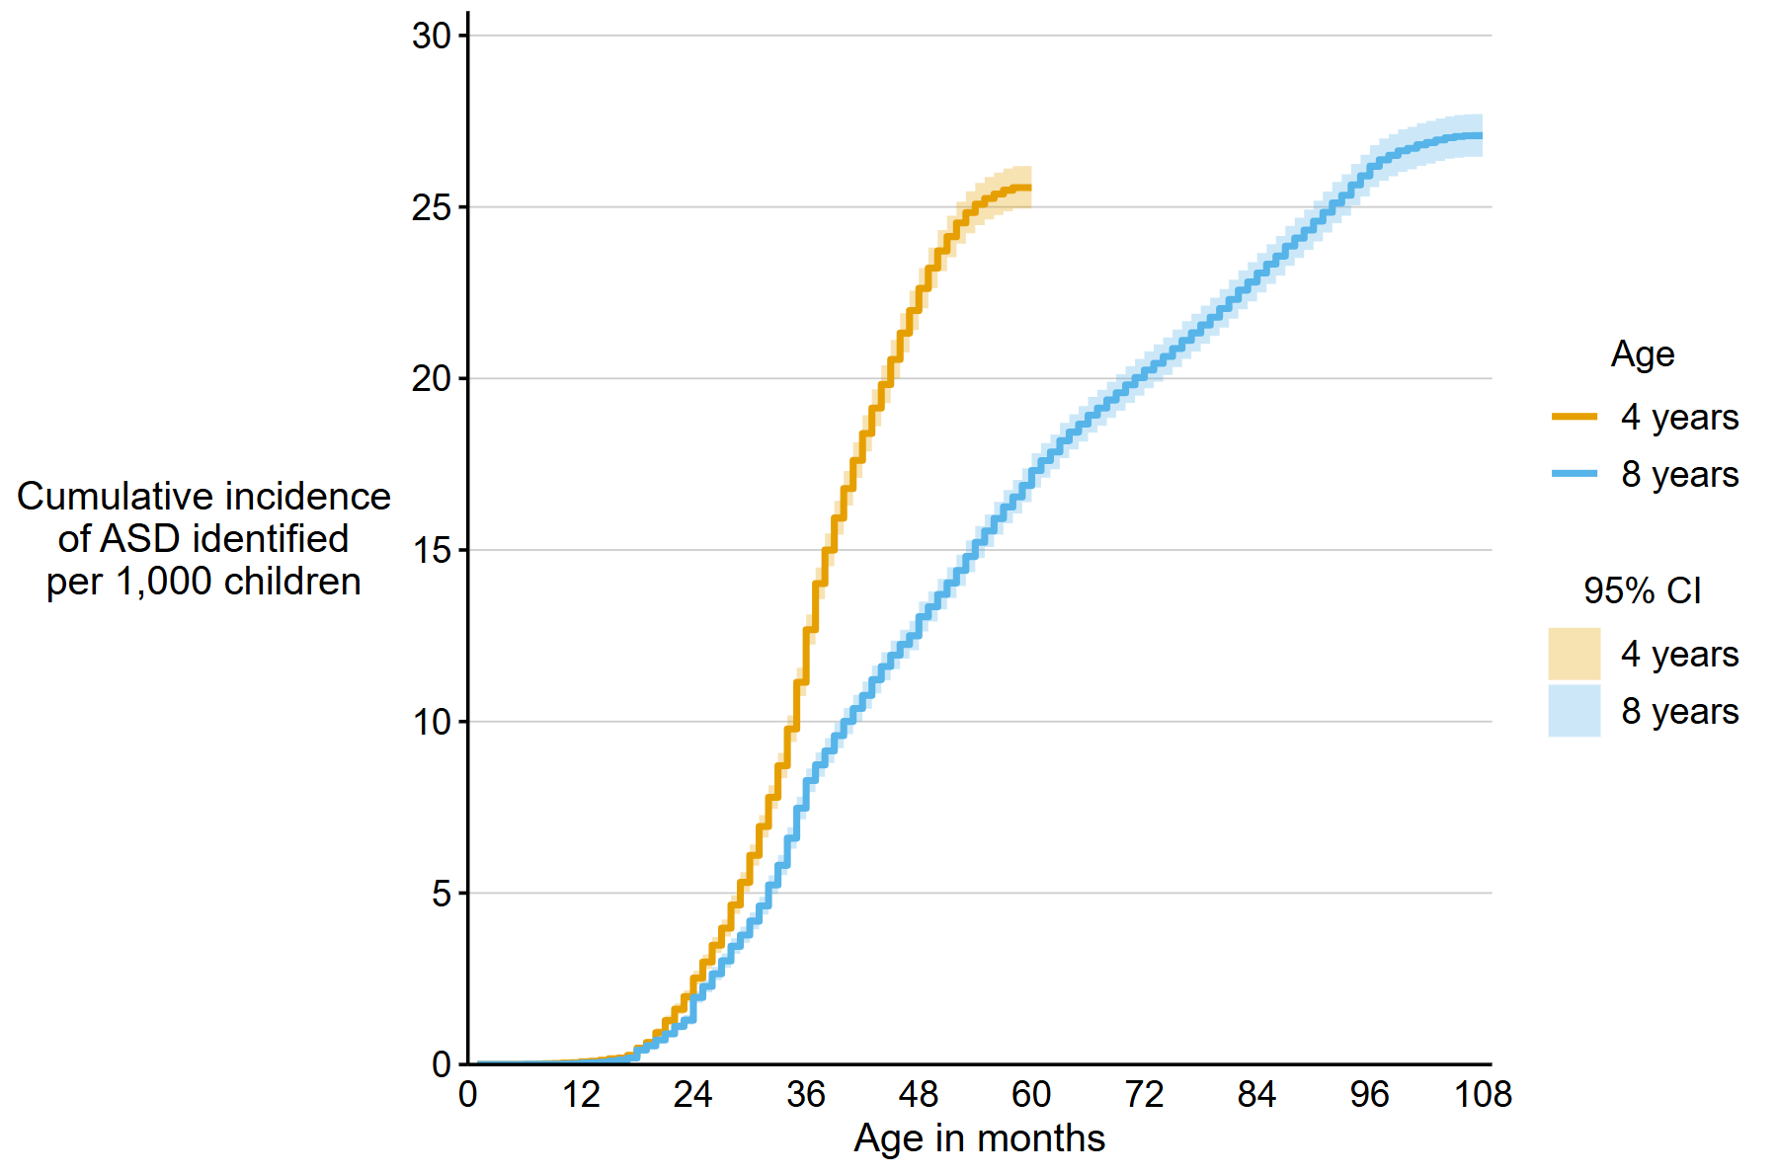
Cumulative incidence of autism spectrum disorder diagnosis or eligibility per 1,000 children aged 4 or 8 years*
Autism and Developmental Disabilities Monitoring Network, 15 sites, United States, 2022
Abbreviations: ASD = autism spectrum disorder.
* The ADDM Network has 16 sites; Indiana is not included in the figure because the site did not have data from record abstraction available.

Slide 25
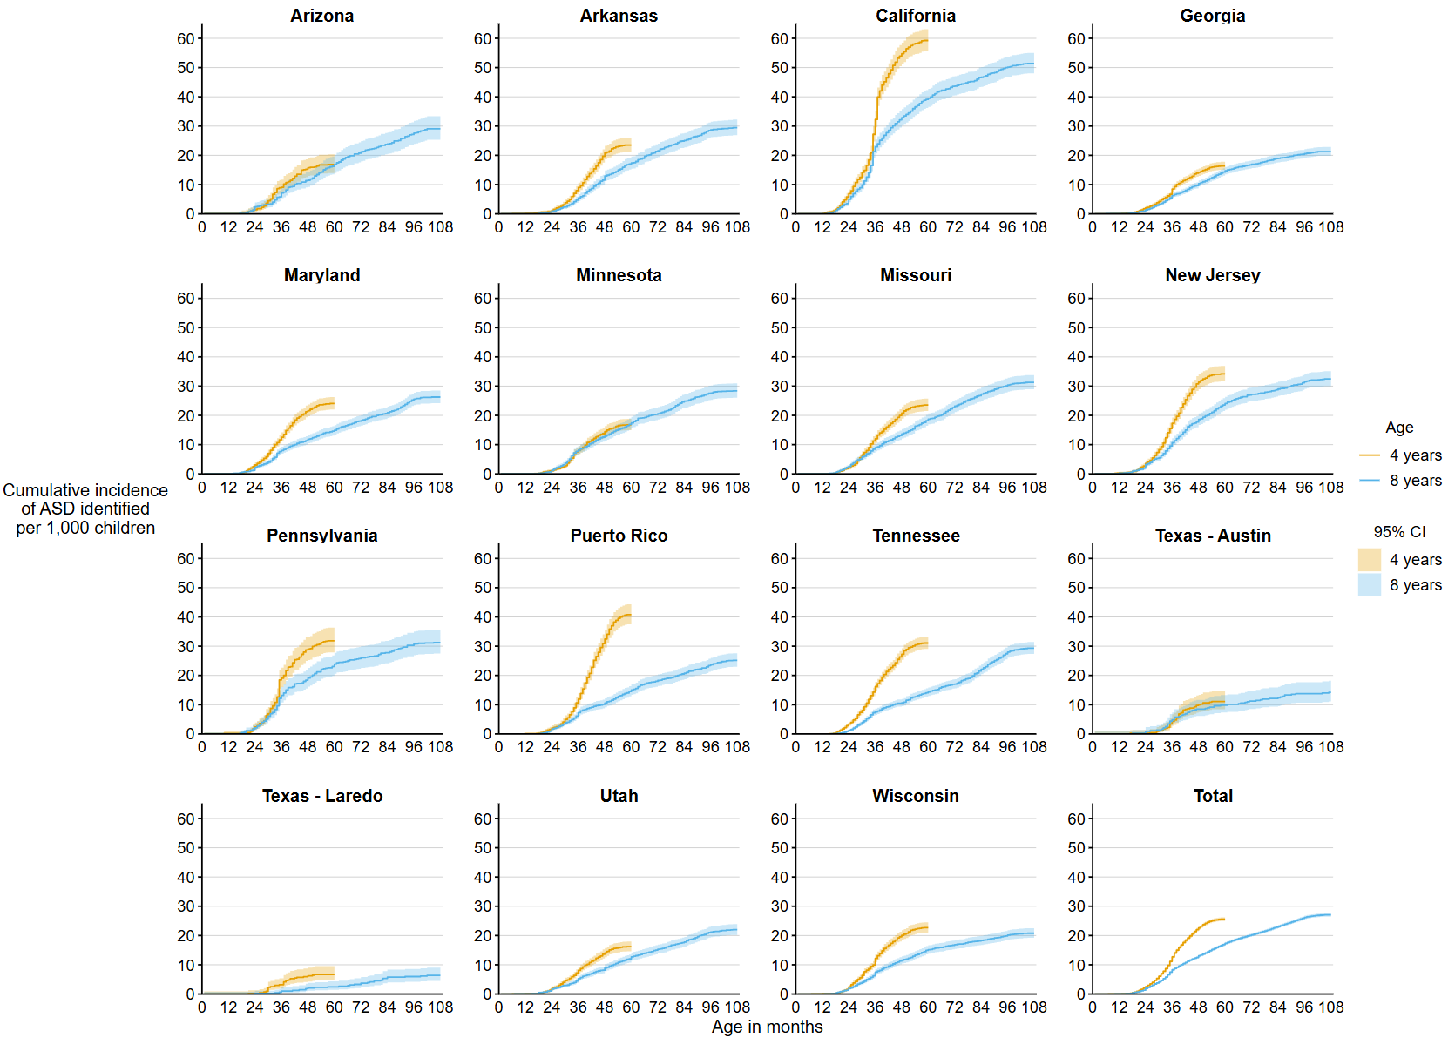
Cumulative incidence of autism spectrum disorder diagnosis or eligibility per 1,000 children aged 4 or 8 years, by site*
Autism and Developmental Disabilities Monitoring Network, 15 sites, United States, 2022
Abbreviations: ASD = autism spectrum disorder.
* The ADDM Network has 16 sites; Indiana is not included in the figure because the site did not have data from record abstraction available.

Slide 26
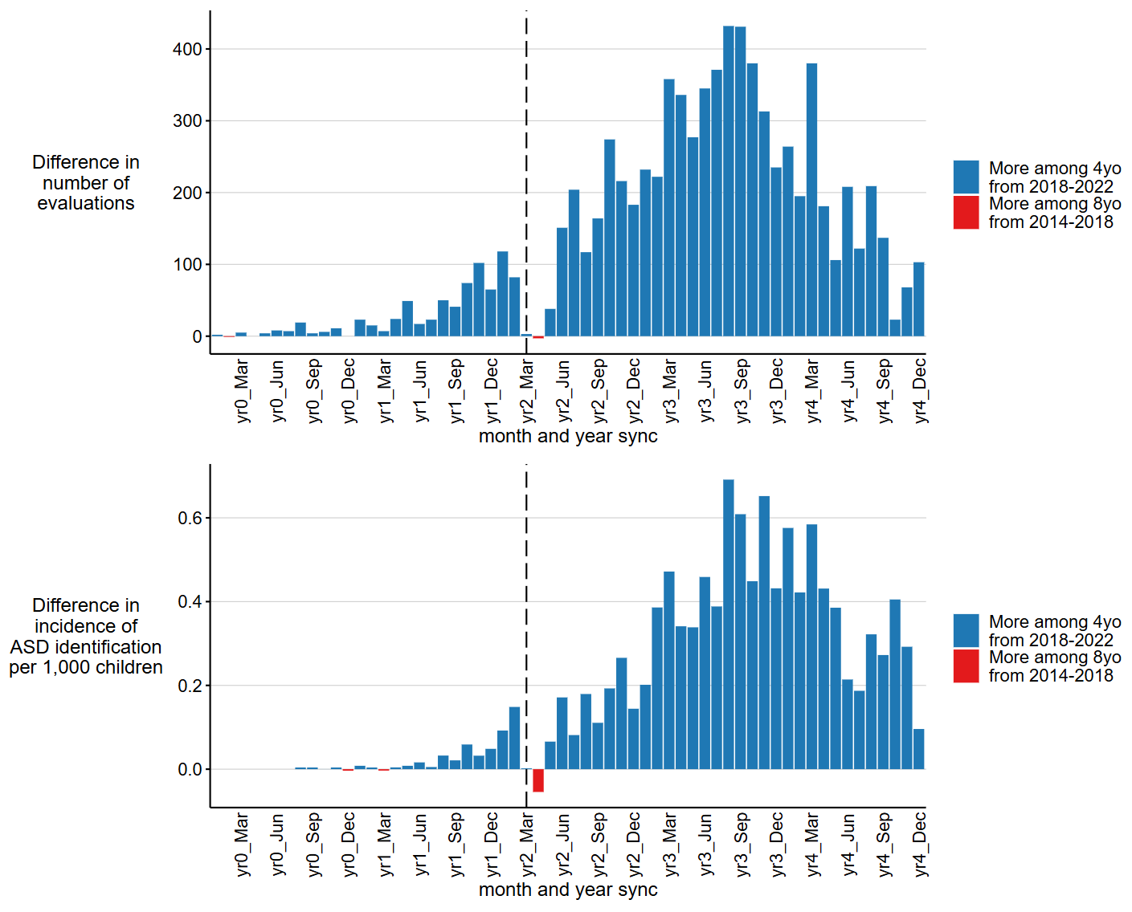
Difference in number of developmental evaluations and incidence of autism spectrum disorder identification per 1,000 children among children aged 4 years in 2022 during calendar years 2018–2022 and children aged 8 years in 2022 during calendar years 2014–2018, by month*†
Autism and Developmental Disabilities Monitoring Network, 15 sites, United States, 2022
Abbreviations: ASD = autism spectrum disorder.
* The ADDM Network has 16 sites; Indiana is not included in the figure because the site did not have data from record abstraction available.
† For children aged 4 years, year 0 to year 4 represents 2018–2022; for children aged 8 years, year 0 to year 4 represents 2014–2018. The dashed line represents the COVID-19 pandemic onset for children aged 4 years in 2022 compared to the analogous time window for children aged 8 years in 2022.

Slide 27
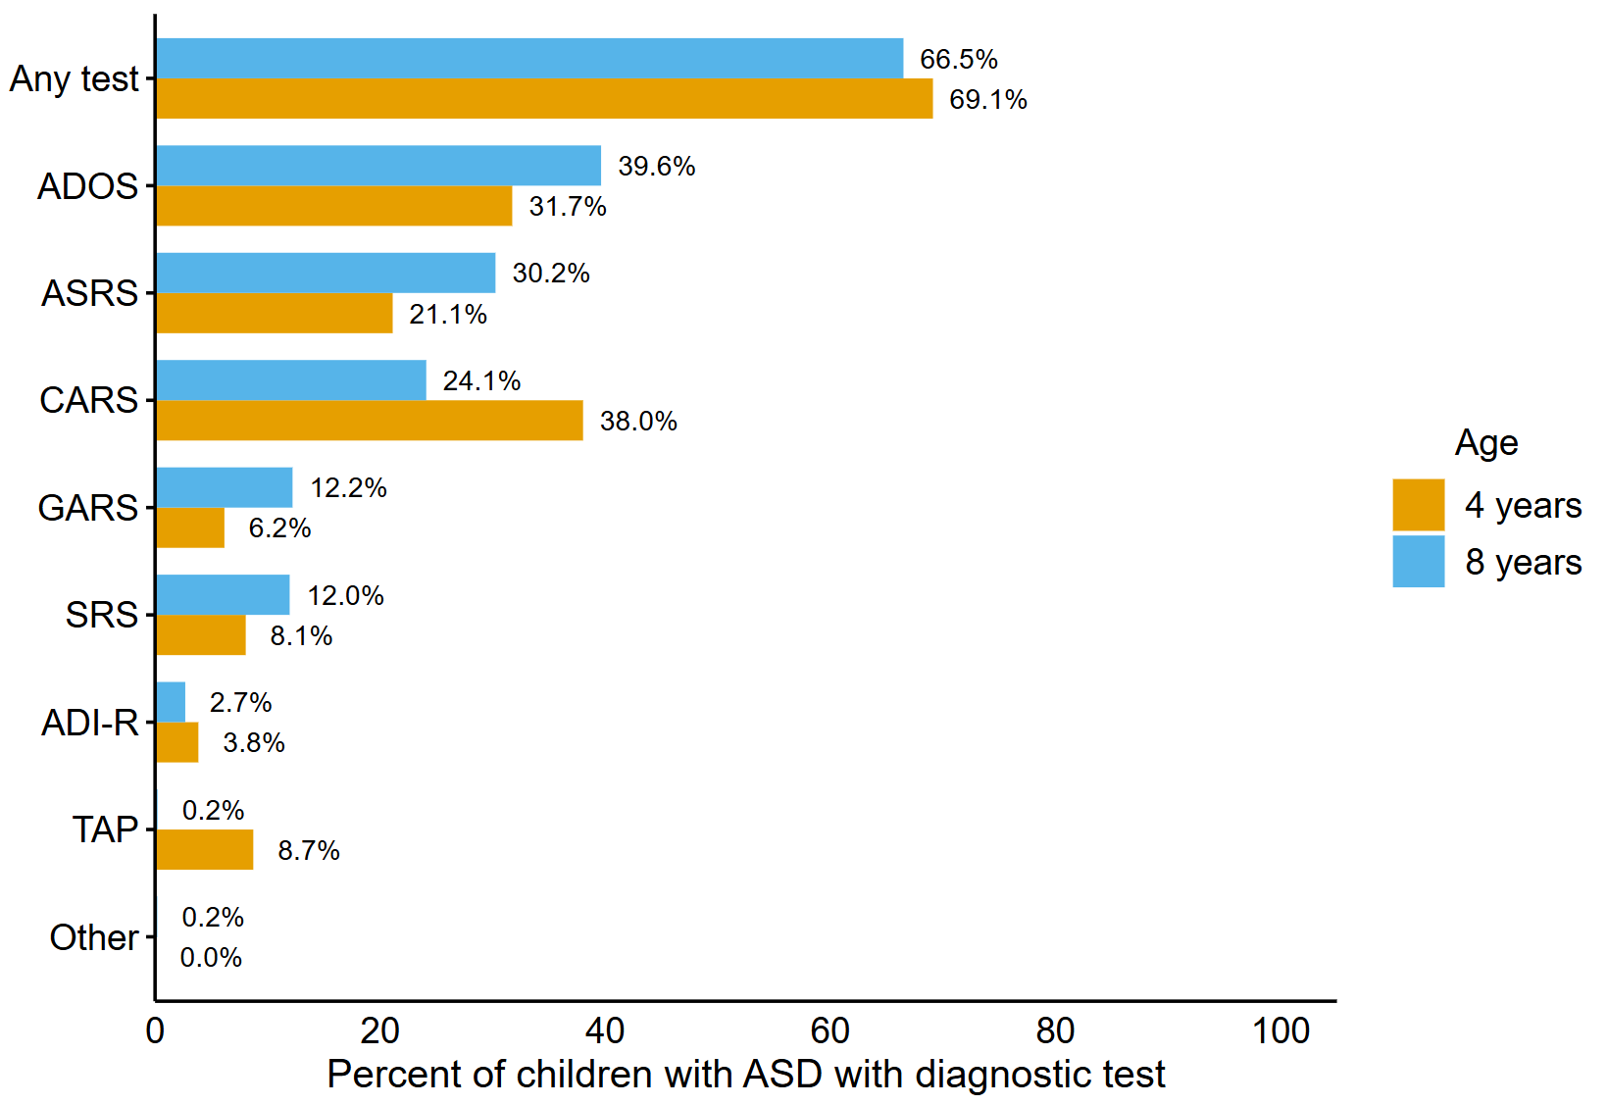
Percentage of children with autism spectrum disorder who have a recorded autism spectrum disorder diagnostic test by age*
Autism and Developmental Disabilities Monitoring Network, 15 sites, United States, 2022
Abbreviations: ADI-R = Autism Diagnostic Interview-Revised; ADOS = Autism Diagnostic Observation Schedule; ASD = autism spectrum disorder; ASRS = Autism Spectrum Rating Scales; CARS = Childhood Autism Rating Scale; GARS = Gilliam Autism Rating Scale; SRS = Social Responsiveness Scale; TAP = TELE-ASD-PEDS; other test category includes Asperger Syndrome Diagnostic Scale and Gilliam Asperger’s Disorder Scale.
* The ADDM Network has 16 sites; Indiana is not included in the figure because the site did not have data from record abstraction available

Slide 28
For more information, contact CDC
1-800-CDC-INFO (232-4636)
TTY: 1-888-232-6348 cdc.gov
Follow us on X (Twitter) @CDCgov & @CDCEnvironment
The findings and conclusions in this report are those of the authors and do not necessarily represent the official position of the U. S. Centers for Disease Control and Prevention.

