Slide 1
Advisory Committee to the Director (CDC)
February 21, 2024
9:00 AM – 3:00 PM
Closed Captioning: http://tinyurl.com/febacd
Event ID is: 16869

Slide 2
Welcome
David Fleming, MD
ACD Chair

Slide 3
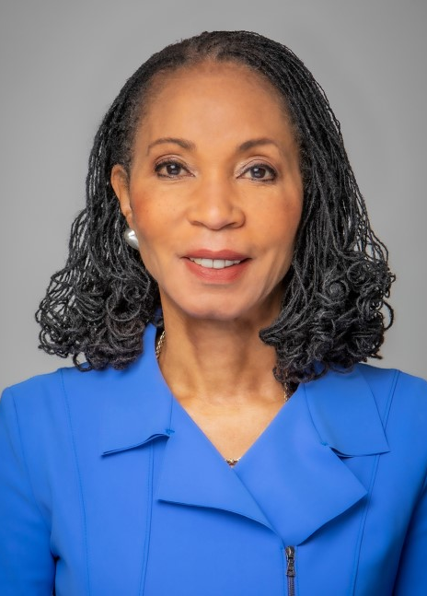
Committee Updates – New Member
Helene Gayle, MD, MPH
President, Spelman College, Atlanta GA
Term: 12/11/2023 – 06/30/2027

Slide 4

In Memoriam
Adaora Adimora,
MD, MPH

Slide 5
Director’s Update
Mandy K. Cohen, MD, MPH
Director, Centers for Disease Control and Prevention
Administrator, Agency for Toxic Substances and Disease Registry

Slide 6
Discussion

Slide 7
Public Health Accreditation
Leslie Ann Dauphin, PhD
Director, National Center for State, Tribal, Local, and Territorial Public
Health Infrastructure and Workforce

Slide 8
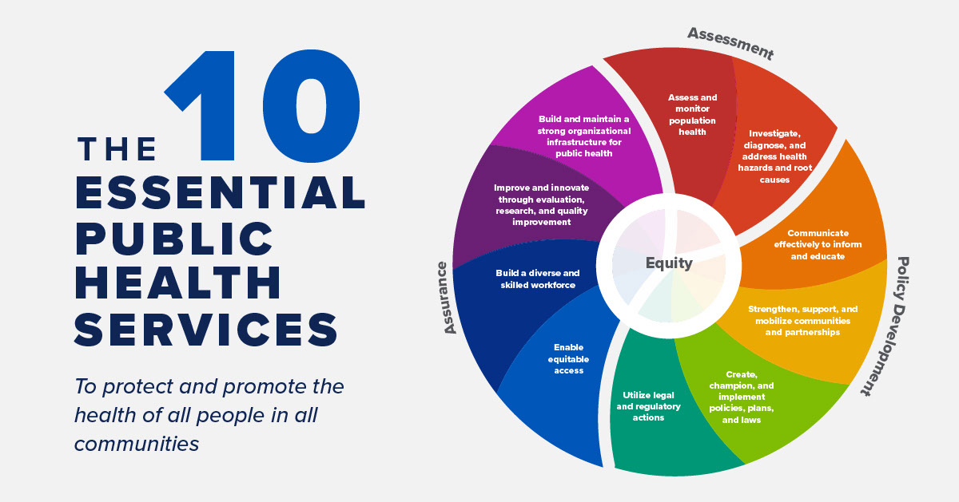
The Accreditation Process
Standards and Measures aligned to Essential Services and Foundational Capabilities
Accreditation assessment process
  Site visits
  Documentation
Reaccreditation
Learn more at https://phaboard.org/

Slide 9
National Voluntary Accreditation Program
The Public Health Accreditation Board (PHAB) is the national accrediting body for public health departments.
Through field-driven processes and with CDC support, PHAB establishes national consensus standards.
Explored concepts
Board established
Program launched
First HDs accredited
First HDs reaccredited
2004
2007
2011
2013
2018

Slide 10
CDC’s PHAB Cooperative Agreement Funding
(Does not illustrate co-funding with RWJF)
HM08-805
OT13-1301
OT18-1801
TO23-0002
*Other (i.e., NCHS, NCHHSTP, and Staffing Up investments)

Slide 11


Accreditation Today
More than 90% of the U.S. population is served by an accredited state or local HD (or both).
41
389
6
11
State:
40 health departments + D.C.
  80.4% (Denominator: 51)
3 more in process
Local:
322 health departments
  plus all 67 FL local health departments as part of Florida system
  16.8%
  (Denominator: 2,309
80+ more in process
Tribal:
6 health departments
9 more in process
Other sectors:
5 Vital Records/Health Statistics Units
  8.8%
  (Denominator: 57)
5 Army Installations
1 International

Slide 12
Evaluation Findings
95
88
Improved quality and performance
Helped use health equity to identify, address health priorities
Stimulated greater accountability and transparency
%
73
%
%
Health departments reported a decrease in the value or benefit of getting reaccreditation
31
53
%
%
Built relationships with new partners across sectors
Top 3 Challenges for Reaccreditation:
Staff time
Turnover
Leadership changes
Source: NORC at the University of Chicago. 2023. “Assessing the Effects of the Public Health Accreditation Board (PHAB) Accreditation Program: Final Evaluation Findings”

Slide 13




Discussion for Ongoing Opportunities
How can CDC assess if and how accreditation has helped public health agencies improve their quality of services?
What should CDC consider as we think about developing the Version 2027 Standards and Measures?
What role(s) should CDC offer to public health agencies to help strengthen their foundational capabilities?
  How can CDC help public health agencies address barriers, such as costs and burden?

Slide 14
Discussion

Slide 15
Break

Slide 16
Mental Health and Overdose
Deb Houry, MD, MPH
Chief Medical Officer and Deputy Director for Program and Science
Allison Arwady, MD, MPH
Director, National Center for Injury Prevention and Control

Slide 17

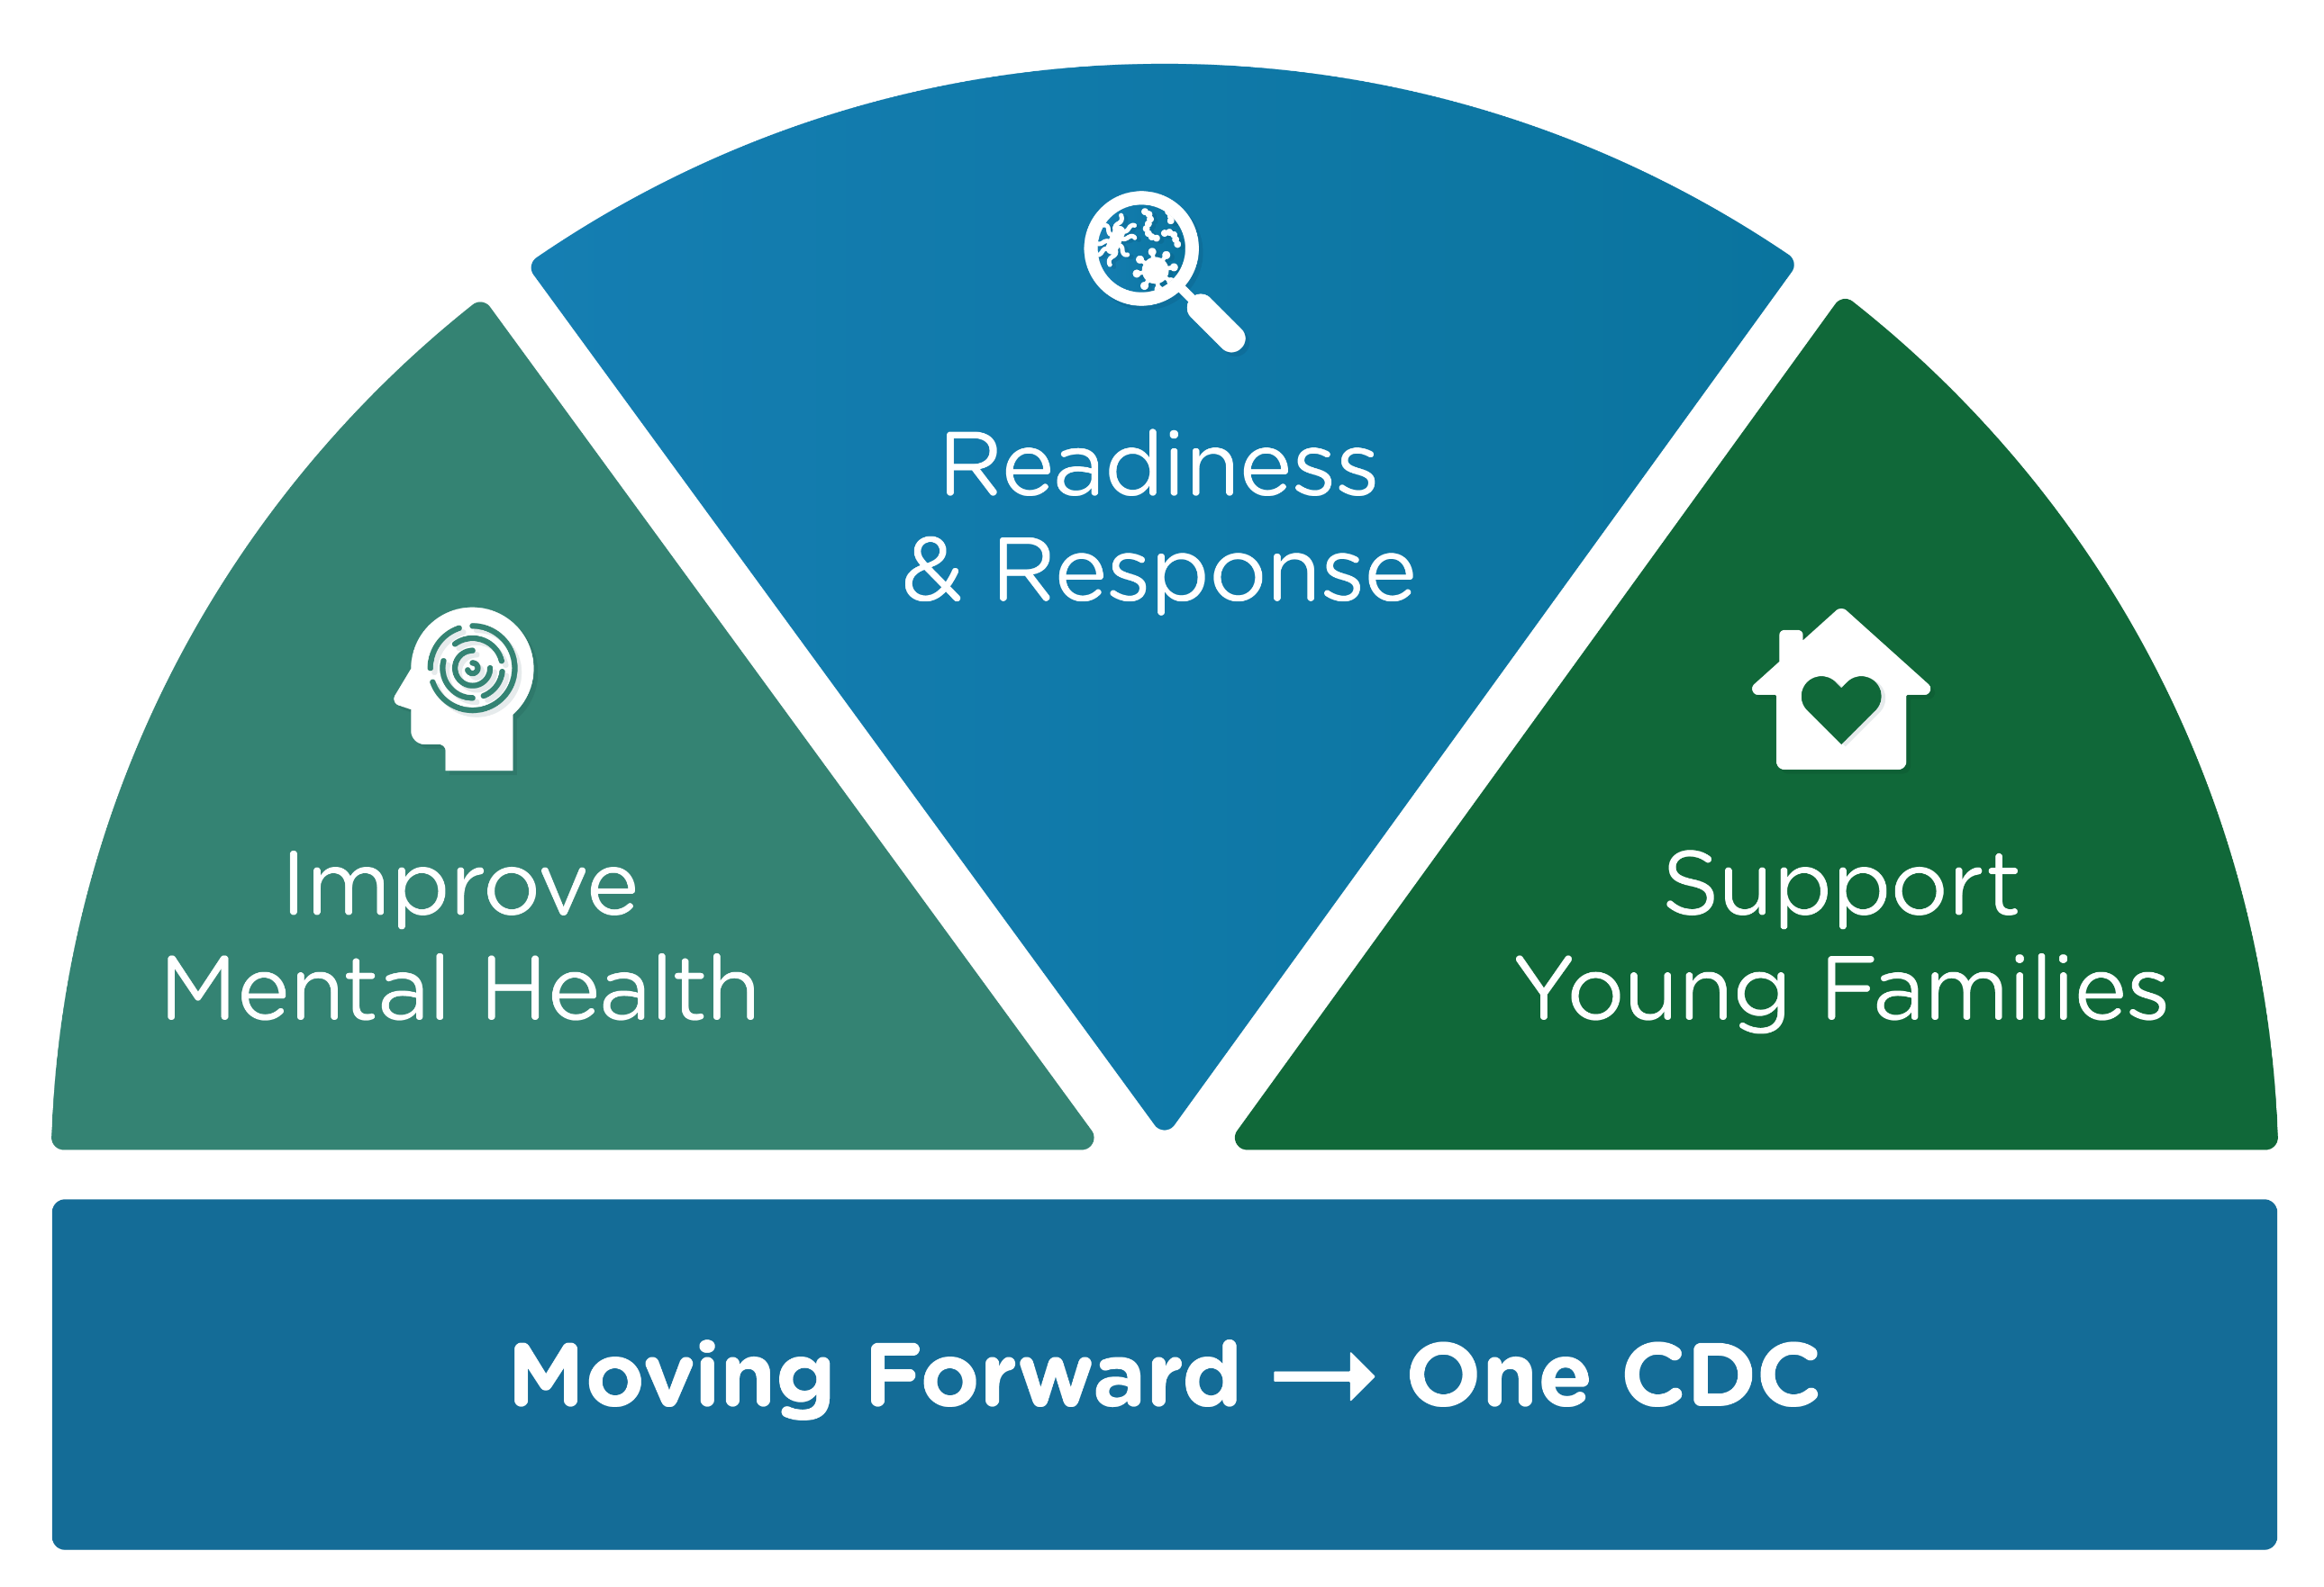
2024 CDC Priorities – Mental Health and Overdose
Focusing on upstream prevention to prevent morbidity and mortality from mental health and overdose:
  Collaborative initiatives
  HHS priorities
  Cross-agency support
  Strategic focus on research, NOFOs, and data

Slide 18

Mental health challenges are both a risk factor for and a side effect of the three Injury Center priority areas.
The Injury Center is invested in leveraging partnerships to reach key milestones in preventing overdose and improving mental health.

Slide 19
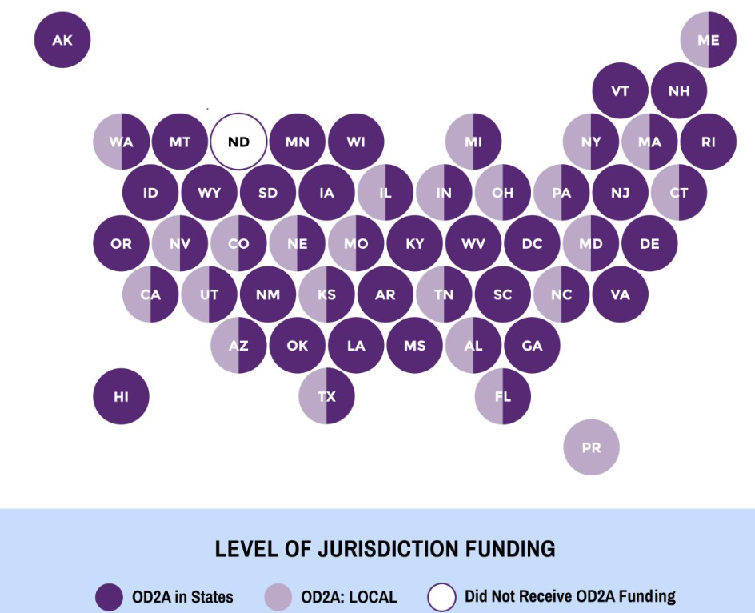
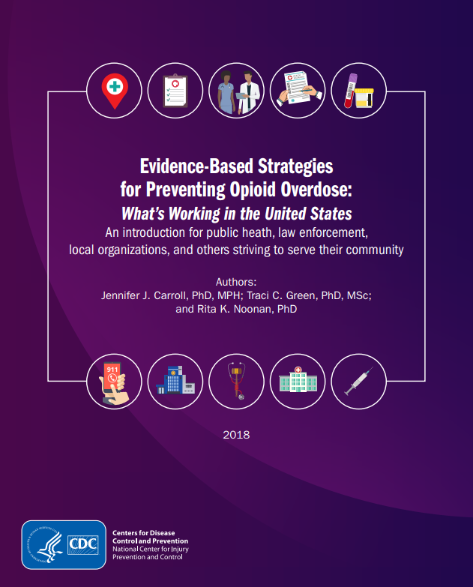
Overdose
112,000+ drug overdose deaths annually*
  The leading cause of death for Americans aged 18-45
90 Overdose Data to Action (OD2A) Recipients – $279M (FY23)
Evidence-Based Strategies
*12-months ending August 2023; provisional data
Notes:
Suggestion from David:
- Include a sentence about who is funded (e.g., health departments, cities/counties/territories health departments)
- What is funding used for? (e.g., linkages to care)

Slide 20
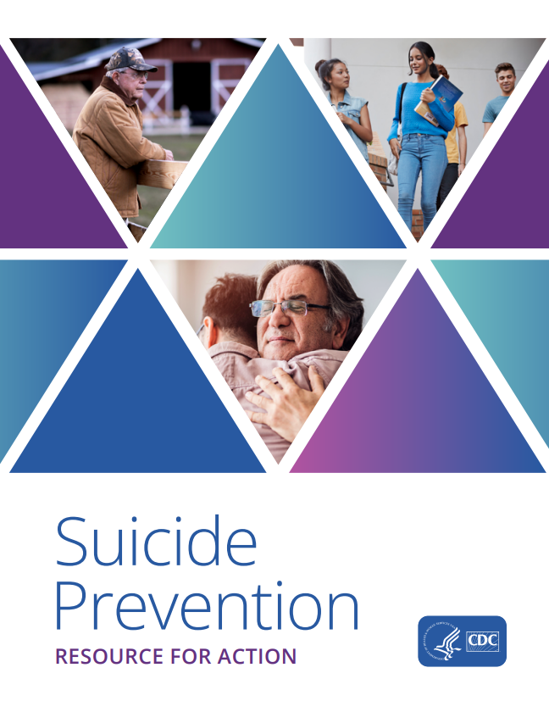
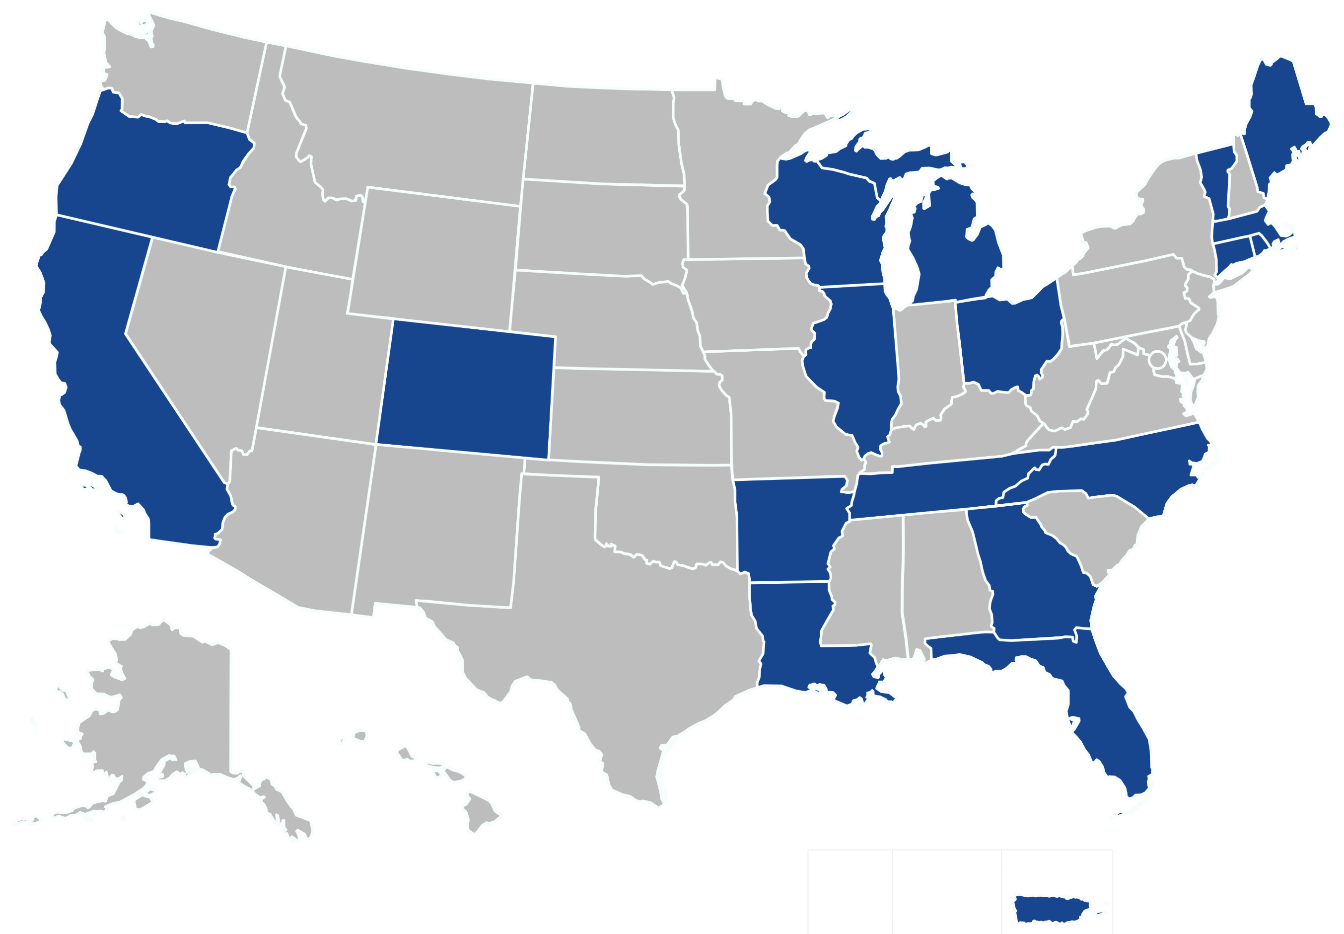
Suicide
49,000+ suicide deaths annually (increased 2.6% from 2021 to 2022)*
  1 in 10 high school students attempted suicide in 2021 (YRBS)
24 Comprehensive Suicide Prevention Recipients – $21.4M (FY23)
Resource for Action
*2022 data is provisional. YRBS: Youth Risk Behavior Survey.

Slide 21
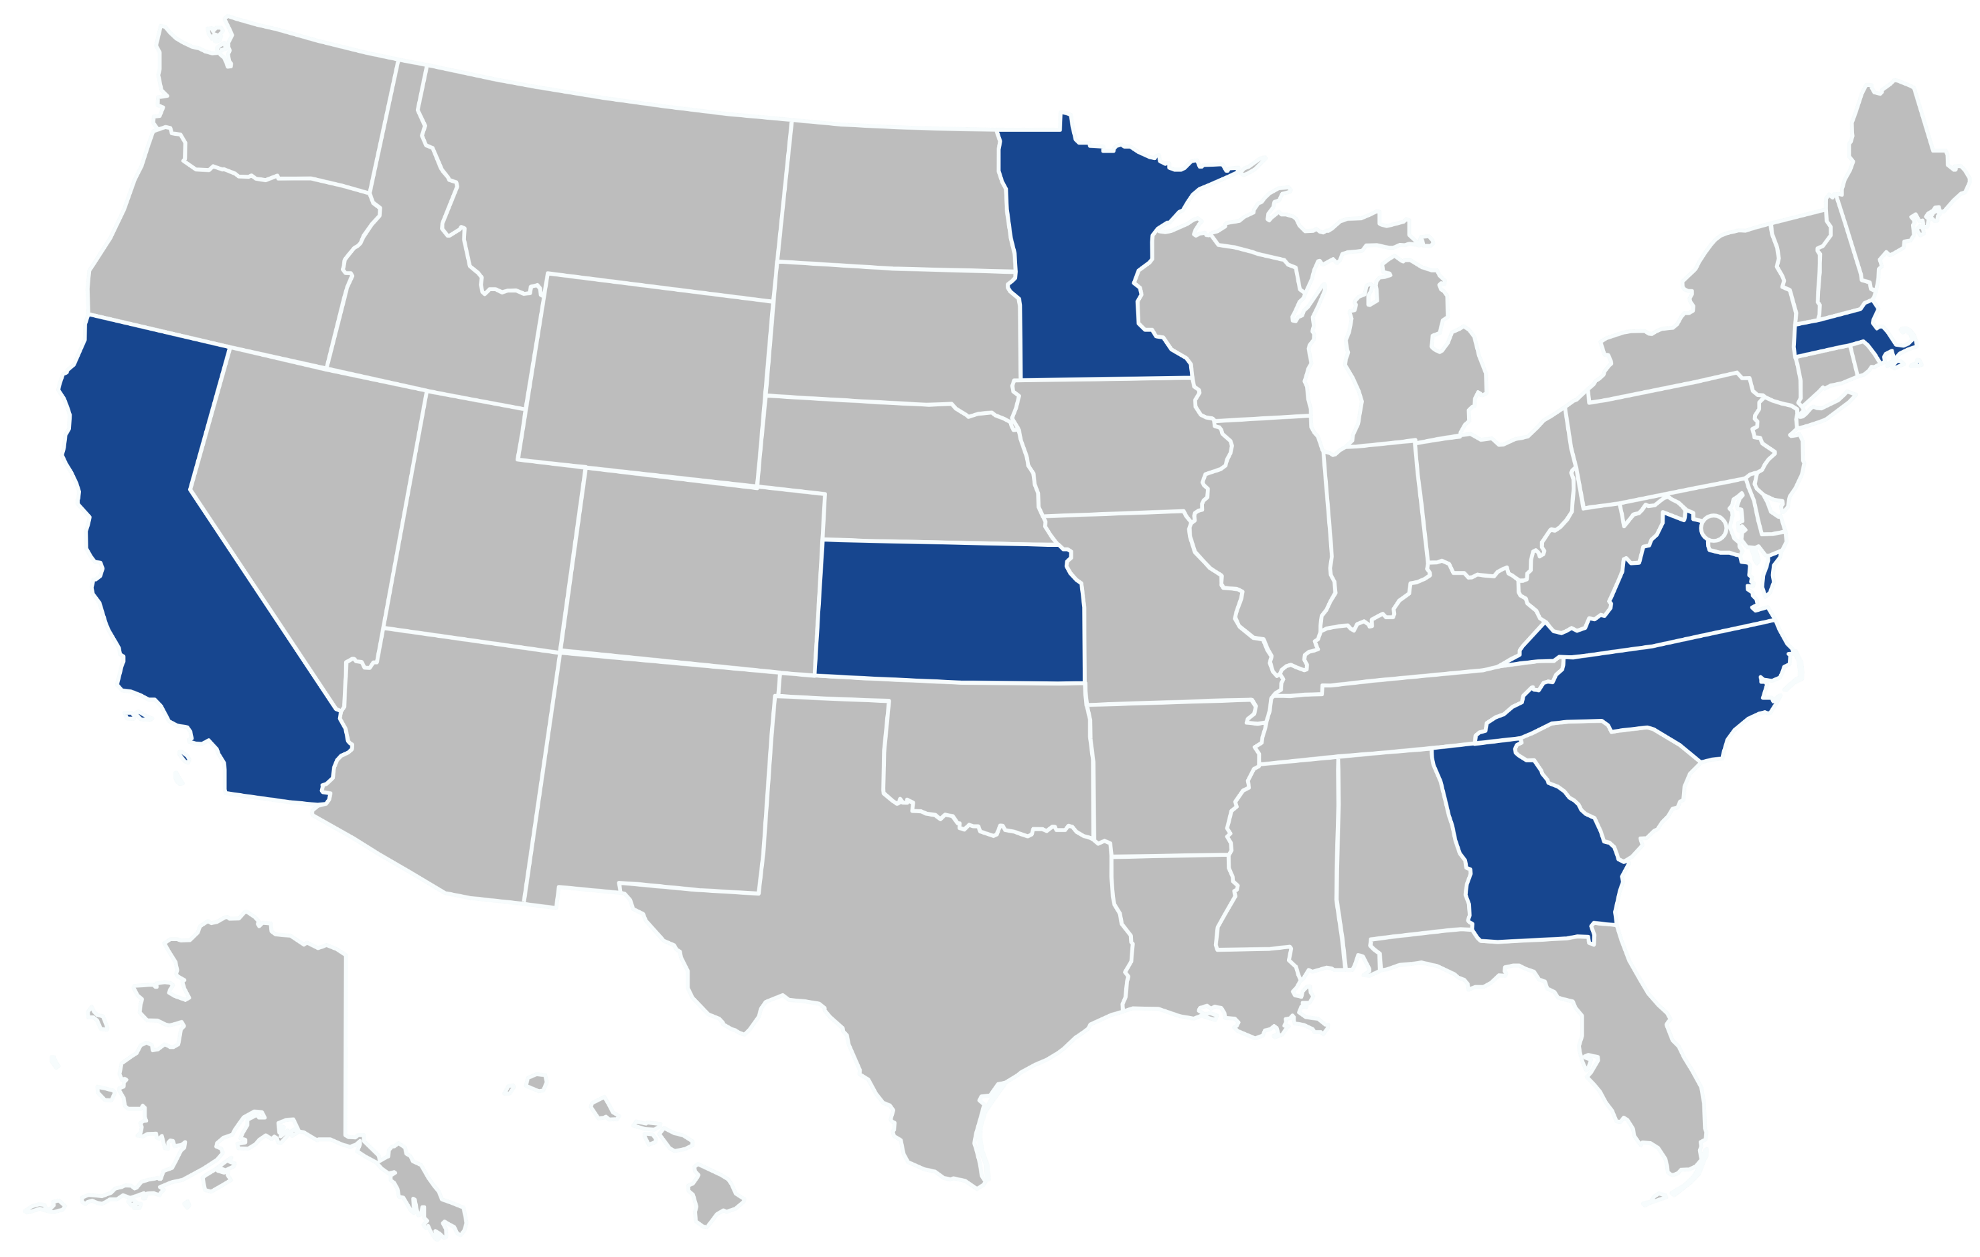
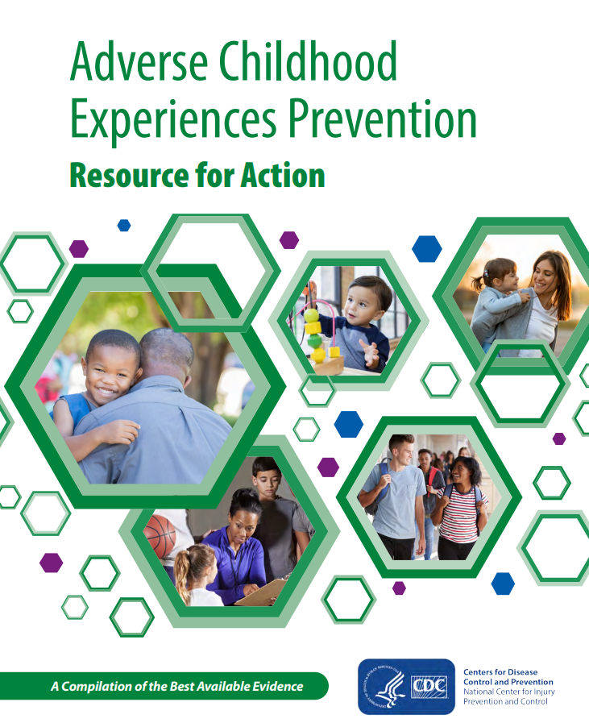
Adverse Childhood Experiences (ACEs)
Nearly 2 in 3 adults have experienced at least once ACE
12 EfC:PACE D2A* Recipients – $5.7M (FY23)
Resource for Action
*Essentials for Childhood: Preventing Adverse Childhood Experiences through Data to Action
Notes:
Consider including parameters for what NCIPC wants input on from the ACD

Slide 22
Discussion

Slide 23
Center for Forecasting and Outbreak Analytics: Progress to Date and Future Initiatives
Dylan George, PhD
Director, Center for Forecasting and Outbreak Analytics (CFA)

Slide 24
Center for Forecasting & Outbreak Analytics (CFA)
VISION
To empower people to save lives and protect communities from health threats.
MISSION
To harness cutting-edge analytics to improve response to public health emergencies.
GOALS
Predict
Deliver actionable analysis and response-ready modeling tools.
Inform
Generate practical decision support communications products.
Innovate
Drive technological and analytic innovation.
Advance
Build a world-class forecasting and outbreak analytics organization.
Notes:
In the midst of the COVID-19 pandemic, the Biden administration realized the need for an early warning disease forecasting capability to improve the nation's response to outbreaks. In early 2021, CFA was established and charged to use data and analytics to support decision-makers during public health emergencies.
To that end, CFA is working to harness cutting-edge analytics to improve response by prioritizing four goals across our center:
Predict
Inform
Innovate
Advance

Slide 25

Implementing CFA
President requests $100M in annual appropriations for FY 2024
November 2021
December 2022
March 2023
5 staff
American Rescue Plan Act provided multi-year, one-time supplemental funding of $200M
CFA's first base appropriation of $50M for FY 2023
8 staff
25 staff
68 staff
49% positions filled
May 2022
January 2023
February 2024
CFA needs good people and sustained support to build a world-class forecasting and outbreak analytics organization.

Slide 26



CFA's 2023 Accomplishments
Better Data
Quality Tools
Increased collaboration
Wastewater monitoring
Refactored COVID-19 pipeline
Virtual Analyst Platform
Respiratory Virus Response Modeling Task Force
Insight Net: Nat'l Outbreak Analytics & Disease Modeling Network
International collaboration
Respiratory Disease Season Outlook
FluSight influenza modeling
COVID & flu growth estimates
Ongoing disease monitoring
Impact: Spurring innovation and development of more accurate and actionable disease outbreak analytics to rapidly share with public health decision-makers.
Notes:
For the first time, CDC released jurisdiction-specific estimates of R_{t} for COVID-19 and influenza (flu) to help jurisdictions better prepare and respond to these seasonal diseases.
The effort is a collaboration between CDC’s Center for Forecasting and Outbreak Analytics (CFA) and the National Center for Immunization and Respiratory Diseases (NCIRD).
R_{t} is a measure of how efficiently a disease is spreading, based on reported hospitalization data. It tells us if COVID-19 or influenza virus infections are currently increasing or decreasing, but it does not reflect the overall burden of COVID-19 or influenza.
R_{t} cannot tell us about the burden of disease, only the trend of transmission. A decreasing R_{t} does not mean that transmission is low, just that we may have passed the peak of infections. It is useful to look at measures of respiratory disease activity in conjunction with R_{t}.
Assessments of epidemic growth status based on R_{t} are an important tool to help public health practitioners plan, including thinking about surge staffing and allocating resources.

Slide 27
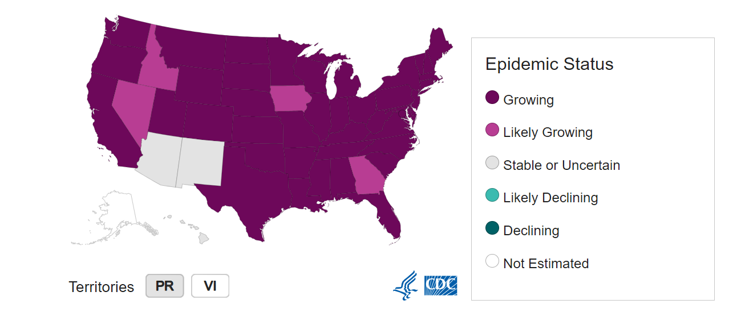
Example: COVID-19 and Influenza Growth Estimates
CDC’s first public state-level estimates of disease transmission rates R_{t} (COVID-19 & flu)
R_{t} = effective reproductive number
R_{t} estimates = a measure of how efficiently a disease is spreading
State-level specificity for COVID-19 and influenza
Publicly available and updated weekly on CFA website
Based on CFA & NCIRD collaboration, using reported hospitalization data
Current Epidemic Growth Status (Based on R_{t}) for States and Territories, Influenza, as of December 30, 2023
Impact: Knowing if COVID-19 or flu infections are currently increasing or decreasing helps jurisdictions and health care systems better prepare, plan for, and respond to these seasonal diseases
Notes:
For the first time, CDC released jurisdiction-specific estimates of R_{t} for COVID-19 and influenza (flu) to help jurisdictions better prepare and respond to these seasonal diseases.
The effort is a collaboration between CDC’s Center for Forecasting and Outbreak Analytics (CFA) and the National Center for Immunization and Respiratory Diseases (NCIRD).
R_{t} is a measure of how efficiently a disease is spreading, based on reported hospitalization data. It tells us if COVID-19 or influenza virus infections are currently increasing or decreasing, but it does not reflect the overall burden of COVID-19 or influenza.
R_{t} cannot tell us about the burden of disease, only the trend of transmission. A decreasing R_{t} does not mean that transmission is low, just that we may have passed the peak of infections. It is useful to look at measures of respiratory disease activity in conjunction with R_{t}.
Assessments of epidemic growth status based on R_{t} are an important tool to help public health practitioners plan, including thinking about surge staffing and allocating resources.

Slide 28
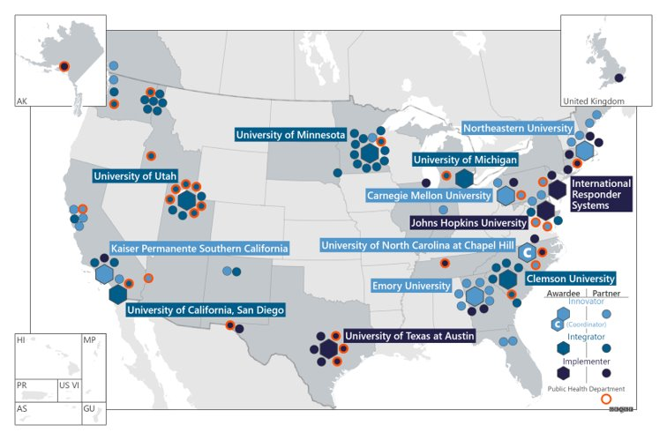
Insight Net
$262.5M investment over five years
The first national network for outbreak analytics & disease modeling
Established in 2023 to improve outbreak response and enhance the federal, state, and local ability to control epidemics and pandemics
Network of performers from public and private sectors designing, testing, and implementing forecasting tools & techniques
13
Primary awardees
>100
Secondary & Tertiary Partners
35
States
Map of US states and territories, showing 13 primary Insight Net awardees and partners. *Colors indicate awardee type.
Notes:
“Insight Net” is a network of collaborators from the public, private and academic sectors who will work to develop and implement tools to improve speed, accuracy, and use of data and analytics during health emergencies.
While we have 13 primary awardees, Insight Net is really a network of networks, including a diverse mix of more than 100 organizations across 22 states, by leveraging connections with state, local, private, public, and academic partners to create a consortium of collaborators.
The modeling, forecasting and analytic outputs from Insight Net will empower public health leaders, especially at the state and local level, to better understand the trajectory of the next outbreak and make informed decisions to protect their communities, families, and themselves during communicable disease outbreaks.
At $252.5 million over 5 years, it represents the largest U.S. government investment in scaling up disease outbreak modeling and forecasting to date.
At the core of this cooperative agreement is the partnership and collaboration between academia, public health agencies, and the private sector.

Slide 29

CFA's 2024 Goals
Even Better Data
Better Tools
More access & support
Wastewater monitoring for more diseases
Incorporating more new data sources
Insight net & CFA data scientists work to innovate, implement and integrate new forecasting & decision-support tools
Influenza modeling tool kit
Expanding Virtual Analyst Platform (VAP)
Expanding & implementing new Insight Net tools
STLT Support
Impact: Empower decision-makers with the best available models, forecasts and analytics, so they can be prepared for and respond at the earliest signs of a public health threat.
Notes:
For the first time, CDC released jurisdiction-specific estimates of R_{t} for COVID-19 and influenza (flu) to help jurisdictions better prepare and respond to these seasonal diseases.
The effort is a collaboration between CDC’s Center for Forecasting and Outbreak Analytics (CFA) and the National Center for Immunization and Respiratory Diseases (NCIRD).
R_{t} is a measure of how efficiently a disease is spreading, based on reported hospitalization data. It tells us if COVID-19 or influenza virus infections are currently increasing or decreasing, but it does not reflect the overall burden of COVID-19 or influenza.
R_{t} cannot tell us about the burden of disease, only the trend of transmission. A decreasing R_{t} does not mean that transmission is low, just that we may have passed the peak of infections. It is useful to look at measures of respiratory disease activity in conjunction with R_{t}.
Assessments of epidemic growth status based on R_{t} are an important tool to help public health practitioners plan, including thinking about surge staffing and allocating resources.

Slide 30
Discussion

Slide 31
Lunch

Slide 32
Update on CDC Moving Forward
Kate Wolff, MPA
Chief of Staff

Slide 33
Core Areas for Improvement
Background
CDC Moving Forward is an effort to promote a public health action-oriented CDC committed to accountability, collaboration, communication, timeliness, and equity through refining and modernizing CDC structures, systems, and processes.
Share Scientific Findings and Data Faster
Increase Laboratory Capacity, Quality, and Safety
Translate Science into Practical, Easy to Understand Policy
Prioritize Public Health Communication
Develop a Workforce Prepared for Future Emergencies
Promote Results-Based Partnerships
Modernize Data
Integrate Health Equity

Slide 34


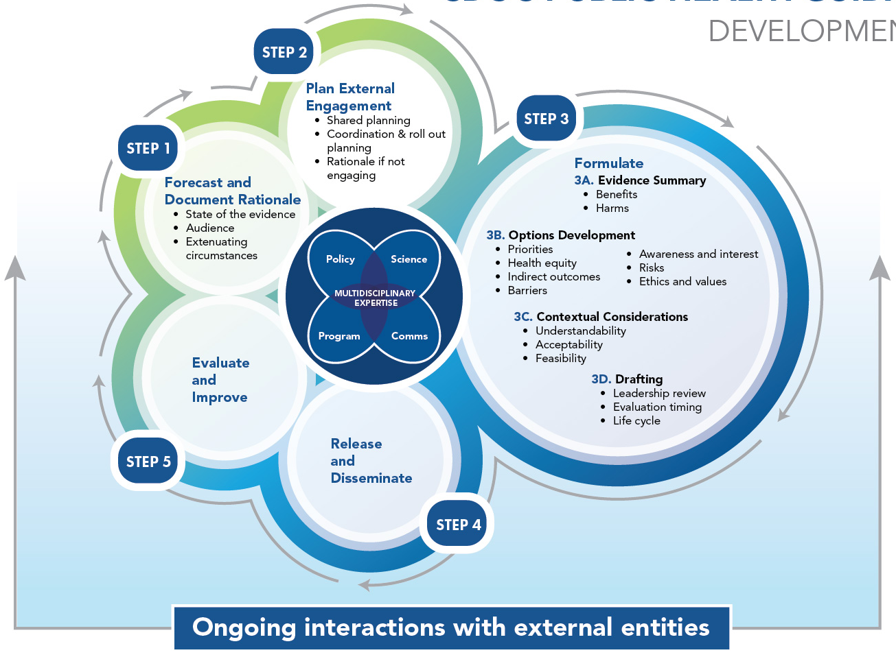

Examples of Impact & Progress
Share Scientific Findings
and Data Faster
Increase Laboratory Capacity, Quality, and Safety
Translate Science into Practical Policy
Clearance Process
Laboratory Quality Plan (LQP)
PH Guidance Framework
A refreshed process to improve efficiency and effectiveness of current clearance system. To date, changes have cut review times in half, resulting in 120% CDC-wide improvement in clearance rate.
A flexible, enterprise-wide system to facilitate effective, efficient lab quality activities. eQMS is one of six components of CDC’s LQP. CDC is piloting cloud-based software to manage eQMS in preparation for an agency-wide phased rollout.
A consistent approach to developing evidence-based options for public health actions, informed by internal collaboration across program, science, policy, and communication, as well as external engagement. PHGF rolled out internally in Q4 2023.

Slide 35
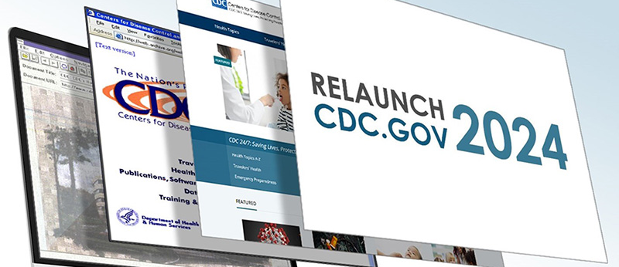


Examples of Impact & Progress
Prioritize Public Health Communication
A Workforce Prepared for Future Emergencies
Integrating
Health Equity
Clean Slate
CDCReady
PH Infrastructure Grant
An initiative to re-envision CDC.gov website with optimized, streamlined content by March 2024. CDC estimates a reduction of at least 64% of the current content.
A new, consolidated platform for emergency preparedness and response information sharing, operations, and data integration. In six months, the platform has saved 120 labor hours.
A 5-year, $5B+ investment in public health workforce and foundational capacities, which publicly committed to directing resources in ways that support diversity and health equity. 107 public health departments and 3 national partners received funding.

Slide 36





Examples of Impact & Progress
Modernizing
Data
Promote Results-Based Partnerships
Electronic Case Reporting
Collaborative Initiatives
Rapidly Identifying and Responding to Threats
Improving Mental Health and Combatting the Overdose Crisis
A process increasing data efficiency and providing real-time reports for disease tracking, case management, and contact tracing. 26,200+ US health care facilities are using eCR, allowing officials to share data to partners and the public.
A selection of existing programs, policies, or data activities that focus on improving and protecting health and showcase the joint leadership of federal agencies alongside other partners. Metrics and milestones will be tracked for the next 9-12 months.
Supporting Young Families

Slide 37
Timeline & Outlook
Implementation activities are ongoing and will continue across the agency.
CDC is dedicated to understanding the impact of changes made, associated metrics, and opportunities for continuous improvement.
End of 2023
75% of actions (e.g., process improvements, system enhancements) completed
Apr 2022 – Aug 2022 | Sept 2022 – Dec 2022 | Jan 2023 – Dec 2024 | 2025 & Beyond
Data collection | Reorg & Process improvement planning | Implementation, Tracking, & evaluation; Launch one cdc | ONE CDC Continuous Improvement
Ongoing feedback from CDC leaders and staff, as well as external partners, to refine and execute plans

Slide 38
Discussion

Slide 39
CDC Update: Health Equity
Leandris Liburd, PhD, MPH, MA
Acting Director, Office of Health Equity
Notes:
Good afternoon. First of all, I’d like to acknowledge the ACD for their leadership and contributions in laying out recommendations to enhance and accelerate CDC’s efforts to achieve health equity across its broad portfolio of public health science and programs. The now-sunset Health Equity Workgroup of the ACD put forth recommendations across three task areas, which were adopted as recommendations by the ACD and subsequently acknowledged by the Secretary of the Department of Health and Human Services. The Office of Health Equity has been tasked with leading the implementation of the recommendations in close collaboration with the national centers, institute, and offices of CDC.
During the last ACD meeting in November, I provided a brief overview of CORE, CDC’s Health Equity Science and Intervention Strategy, and described some actions that were underway to incorporate the ACD’s recommendations into CDC’s science, programs, and policies. Today, I will discuss our continued progress and accomplishments and reflect on the work that remains.

Slide 40





OHE Strategic Imperatives
Strategy: Institutionalize and align agency-wide initiatives to accelerate progress toward health equity.
Funding: Expand the integration of health equity in CDC funding.
Partnerships: Increase community engagement with populations that experience health disparities and health inequities.
Public Health Workforce: Build CDC’s internal capacity of subject matter expertise in health equity within a workforce and workplace of diversity, equity, inclusion, accessibility, and belonging.
Science & Interventions: Implement equitable, community informed practices for advancing health equity in research, surveillance, evaluation, preparedness and response, and laboratory science.
Notes:
The Office of Health Equity exists to ensure health equity is embedded in an all-of-public health approach to overcoming persistent health disparities and health inequities across a range of population groups that disproportionately experience poor health outcomes. This work is done in collaboration with Centers, Institute, and Offices across the agency.
In 2023, OHE identified five strategic imperatives as part of our Strategic Plan, highlighting priority goals and major activities through the 2024 calendar year. OHE is using this plan to pursue our mission and guide our day-to-day work to advance health equity.
The first imperative is “Strategy.” We are working to institutionalize and align agency-wide initiatives to accelerate progress toward health equity. To this end, we have developed an office-wide strategic plan, including a multi-year roadmap and metrics, that integrates health equity, social and structural determinants of health (SSDOH), and diversity, equity, inclusion, accessibility, and belonging (DEIAB). This is the foundation for creating long-term change within CDC to advance health equity.
Across the additional four strategic imperatives – focused on Funding, Partnerships, Public Health Workforce, and Science and Interventions – we are operationalizing the recommendations that were approved by the ACD. We have intentionally aligned the activities within these imperatives with the ACD’s health equity recommendations, and I will highlight some of our progress in the next few slides.

Slide 41
Recommendations: Task Area 1: Enable and assure the meaningful involvement of communities in agency decision-making, the development of health equity policies, program implementation, and evaluation.
CDC should take specific steps to build and strengthen its relationship with underserved communities and community-based organizations (CBOs) that support them.
CDC should engage with state, tribal, local, and territorial (STLT) public health agencies to identify and implement best practices to build and strengthen relationships between STLT public health agencies and underserved communities and the CBOs that support them.
Notes:
Consistent with Task Area 1, CDC recognizes community engagement is the cornerstone of good public health practice. Our “Partnerships” imperative is focused on increasing community engagement with populations that experience health disparities and health inequities.
For more than a decade, OHE has collaborated with public health organizations such as ASTHO, NACCHO, and, more recently, the National Association of State Offices of Minority Health to promote health equity. Last year, we established and convened a collective of public health leaders representing state, local, and territorial health departments and community-based organizations known as the Power of Partnerships Health Equity Alliance. This Alliance is a forum for problem-solving and information exchange as we work to integrate and institutionalize health equity into the day-to-day practice of public health. OHE is continuing to expand our partnerships with STLT organizations through our continued collaboration with CDC’s Public Health Infrastructure Center, which is now a collaborator in the Power of Partnerships Alliance. By aligning ourselves more closely with PHIC, we seek to improve and increase community engagement among state, tribal, local, and territorial departments of public health.
OHE has developed an overarching health equity partnership plan to facilitate the strategic engagement of partners. Since the last ACD meeting in November, OHE has convened meetings with multiple organizations that prioritize racial and ethnic minority groups, including the National Medical Association, the Natl Hispanic Medical Association, the American College of Preventive Medicine, Choose Healthy Life, and PROCEED, among others. In these meetings we sought to determine how we can collaborate in the future.
In 2023, OHE launched a series of health equity partnership webinars to bring together an intersectional collective of health equity organizations that focus on a range of populations including racial and ethnic minorities, people with disabilities, LGBTQ+ individuals, and more. Public health, healthcare, and other partners join the partnership webinars to learn about and apply promising health equity strategies in their communities – hearing from both CDC and external partner programs. We’ve hosted two partner webinars to date. Over 2500 partners (registered) and over 1300 joined us live for sessions on the respiratory virus response season and health equity communications – this health equity partner series will continue throughout 2024 with webinars occurring approximately every other month.
We’re also proud of our support of the CDC Respiratory Virus Season Response virus as we leveraged our partner network to coordinate a dozen listening sessions with over 70 community-based organizations and national minority-serving organizations to put respiratory prevention messages in the hands of community leaders and to gather feedback on any gaps or needs in RVR communication to share with our Respiratory Virus Center colleagues. We shared a thematic analysis from the listening sessions with NCIRD and they are working to address the challenges and gaps raised to ensure that we have improved, culturally relevant, and informed messaging for priority populations who are disproportionately impacted.

Slide 42
Recommendations: Task Area 2: Align and restructure, as necessary, CDC policies, resource allocation, and program practices to maximize the ability for staff and partners to address health inequities in their day-to-day work.
CDC should immediately initiate a coordinated, agency-wide assessment of all grants, cooperative agreements, and contracts across all programs, projects, and activities.
All CDC PPAs should jointly create and put into practice a publicly accessible policy document for applicants and grantees responding to CDC Notice of Funding Opportunities (NOFOs).
CDC should develop more equitable systems throughout the lifecycle of NOFOs, from planning and development to selection and post-award support.
Notes:
Task Area 2 calls out the impact of CDC’s organizational structure and how it impacts staff’s ability to pursue health inequities. Because of the tremendous role and responsibility CDC has in instituting and supporting public health programs, projects, and activities through resource allocation and program guidance, we have a strategic imperative on “Funding” that is focused on ways to expand the integration of health equity in this area.
Through CORE, we previously convened health equity SMEs from across CDC programs to identify health equity guidance that could be incorporated into CDC’s non-research Notice Of Funding Opportunity or NOFO template. These changes to the NOFO template will cue NOFO writers to address health equity in the design of their NOFOs and, after being published for competition, will cue applicants to address health equity in the framing of their programmatic response.
The Office of Health Equity, along with the Office of Grant Services, is launching a training series in the Spring (April) 2024 to provide guidance and education to CDC NOFO writers that helps strengthen capacity, and consistency to effectively integrate health equity considerations.
In addition, at the being of February, CDC posted the full notice of funding opportunity (NOFO) for the Strengthening Public Health Systems and Services through National Partnerships to Improve and Protect the Nation's Health cooperative agreement, also called the National Partners CoAg. This cooperative agreement takes the place of CDC’s National Partners Umbrella CoAg (also called 1802), which will sunset on July 31, 2024. Mention of national minority orgs that were funded through 1802.
We welcome your assistance to help us spread the word about this tremendous new opportunity to support the nation’s public health system partners. Applications are due April 1, 2024.
The National Partners CoAg will support organizations that work with governmental public health and other sectors, over five years, to provide capacity-building assistance within the public health system to:
Increase the knowledge, skill, and ability to deliver essential public health services,
Improve organizational and systems capacity and capability to address prioritized, equity-based public health priorities, and
Strengthen the nation's public health infrastructure and performance.
Mention how community based organizations would be able to apply or have a national partner for new co-ag

Slide 43
Recommendations: Task Area 3: CDC should immediately initiate a coordinated, agency-wide approach to develop and integrate strategies to influence the effects of drivers of health equity across the entire range of its public health programming.
CDC should immediately initiate a coordinated, agency-wide approach to identify and implement measures of underlying drivers of equity and health equity in ways that make them accessible and useful to communities and public health programs.
CDC should immediately initiate a coordinated, agency-wide approach to develop and integrate strategies to influence the effects of drivers of health equity across the entire range of its public health programming.
Notes:
For Task Area 3, OHE is collaborating with other CIOs to develop approaches and resources to facilitate the systematic and consistent integration of recommended practices for health equity science across the agency. Our Science and Interventions imperative underscores the need for equitable, community-informed approached to advance health equity in research, surveillance, evaluation, preparedness and response, and laboratory science.
The Office of Health Equity continues to work closely with the Office of Science to increase awareness and application of the Health Equity Science Principles. CDC’s Health Equity Science Principles are six high-level principles to guide the development, implementation, dissemination, and use of effective health equity science. OHE recently co-authored an article in Public Health Reports, highlighting these principles and examples of how these principles may be integrated into scientific practice.
In collaboration with the Office of Science, OHE played a key leadership role in developing and is now assisting in disseminating CDC data standards for race and ethnicity, sexual identity and gender orientation, and occupation and industry. This will help ensure a uniform approach to data collection and use of these data.
The Office of Public Health Data, Surveillance and Technology through the Data Modernization Initiative is working on data platforms to put data on drivers of health inequities at the fingertips of CDC scientists which will be followed by the development of tools to assist CDC scientists and evaluators, communities, and public health programs in optimizing their use.
OHE is also leading the development of guidance principles to help CDC scientists and evaluators engage and catalyze meaningful participation from communities that have experienced marginalization. In tandem with this process, CDC is identifying best practices and examples of initiatives and approaches for the inclusive engagement of communities in data collection, analysis, and interpretation.
Much of this work is still in progress, but the necessity of understanding and addressing drivers of health disparities and health inequities using data and other public health strategies is a priority for CDC.

Slide 44



Looking Ahead
Agency-wide leadership in health equity
Engage and invest in communities
Strategic foresight and innovation
Notes:
As the agency’s health equity champions, we are working collaboratively across the agency to achieve key milestones toward the advancement of health equity. The ACD’s health equity recommendations provide a framework for how we may chart additional efforts that will accelerate movement toward achieving health equity.
We recognize that health equity must be at the core of developing any intervention, innovative solution, policy, or programming for populations affected by health disparities, including the authentic representation and inclusion of community members and community-based organizations. The recommendations reiterate that we must be intentional about pursuing and securing community engagement. As we strive to expand the body of evidence about interventions that will reduce health inequities, we continue to invite partners from multiple sectors who can collaborate to identify, develop, and implement solutions.
As we look ahead, CDC is committed to transforming its public health research, surveillance, and implementation science through innovation and collaboration. In addition, we must integrate health equity considerations in funding to address drivers of health inequities; and we must recruit and retain a workforce that represents diversity in academic disciplines, lived experience, and is prepared to do the work that will reduce and ultimately eliminate health disparities while ensuring all people have the opportunity to attain their best health possible.
Thank you. Questions?

Slide 45
Discussion

Slide 46
Communications and Public Engagement Workgroup (Proposed)
Andi Lipstein Fristedt, MPA
Deputy Director for Policy, Communications, and Legislative Affairs
Kate Galatas, MPH
Senior Communications Officer, Workgroup DFO

Slide 47
Purpose
Provide recommendations on communicating with the public directly and more effectively
1
Focus on reaching local communities with messages
2
Bring together experts in:
3
Communications
Public Health
Community Engagement
Behavioral Science/Change

Slide 48
Effective Communication Goals
Build Relationships and Communicate with Trusted Messengers
Increase Transparency
Deliver Action-Oriented Messaging
Tailor Messages to Audiences
Improve Risk Communication Practices

Slide 49
Proposed ACD Work Group (as outlined in the TOR)
Work Group Draft Name:
Communications & Public Engagement Work Group (CPEW)
CPEW Co-Chairs:
Drs. Octavio Martinez and Rhonda Medows
CPEW Composition (NTE 15 members) with expertise in:
Communications, including public relations, health communication, risk communication, communication research, and marketing
Community and partner engagement
Public health science and practice, including implementation
Behavioral science/behavior change campaigns

Slide 50
CDC Charge to CPEW: Potential Areas of Exploration
How can CDC build more robust relationships and mechanisms to communicate via trusted messengers (e.g. clinicians, faith leaders, etc.)?
How can CDC improve and tailor its risk communication efforts to better align with audience perceptions and match risk levels?
What are the ways CDC can deliver more actionable, understandable and focused communications to help people protect their health?
How should CDC tailor messages and communications methods to different audiences, particularly for historically marginalized communities?
Are there considerations to achieving greater transparency in addition to increasing the pace, content and reach of CDC's communications?
What mechanisms should CDC use to evaluate/measure progress in its public-facing communication efforts?
How might CDC ensure greater consistency and minimize perceived contradictions in its communications at all levels?

Slide 51
Next Steps (based on results of today’s vote)
Recruit CPEW Members
    Solicit interest from ACD members
    Submit Federal Register Notice
Set up member review panel (to establish criteria/select CPEW members)
Schedule first CPEW meeting (before 3rd quarter 2024)
Submit Summary Report to ACD (NLT June 2025)

Slide 52
Discussion and Vote

Slide 53
Closing Remarks
David Fleming, MD
ACD Chair

Slide 54
Adjourn

