Slide 1
Advisory Committee to the Director (CDC)
November 14, 2023
9:00 AM – 3:30 PM
Closed Captioning: : https://www.streamtext.net/player?event=14257AdvisoryCommitteeDirectorMeeting
Event ID is: 14257
Notes:
Deb Houry (DFO) – “Good morning and welcome to the meeting of the Advisory Committee to the Director – please note the closed captioning link has been provided in the chat box for your convenience.”

Slide 2
Welcome, Roll Call
David Fleming, MD
ACD Chair
Notes:
David Fleming (MODERATOR) – Welcome ACD members. “We would also like to take this time to acknowledge and thank Lynn Goldman and Michelle Albert for their invaluable service to the Committee.”
Deb Houry (DFO) – “And on that note, two new members have been approved by HHS to join the ACD in early 2024. Once they have been fully onboarded, we will announce them.”

Slide 3
CDC Update – ACD Laboratory Workgroup Recommendations
Victoria Olson, PhD
Deputy Director, Office of Laboratory Science and Safety, CDC
Reynolds (Ren) Salerno, PhD
Acting Director, Center for Laboratory Systems and Response, CDC

Slide 4
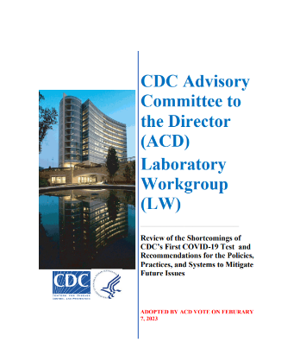
ACD Laboratory Workgroup Report, February 2023
Senior leader for laboratories, reporting to the CDC Director, with major responsibility and authority for laboratories at the agency
Cultivate and foster a culture of laboratory quality through the adoption of a comprehensive clinical laboratory quality management system across the agency
Involve external experts in its review and deployment process for clinical tests for pathogens with pandemic potential
Consolidate key laboratory support functions into a new Center, focus on clinical laboratory quality, laboratory safety, workforce training, readiness and response, and manufacturing
Create and exercise plans for developing tests for novel public health challenges
The CDC should incorporate redundancy into the national responsibility for test development.
Recommendations for Enhancing CDC Laboratory Policies, Practices and Systems

Slide 5
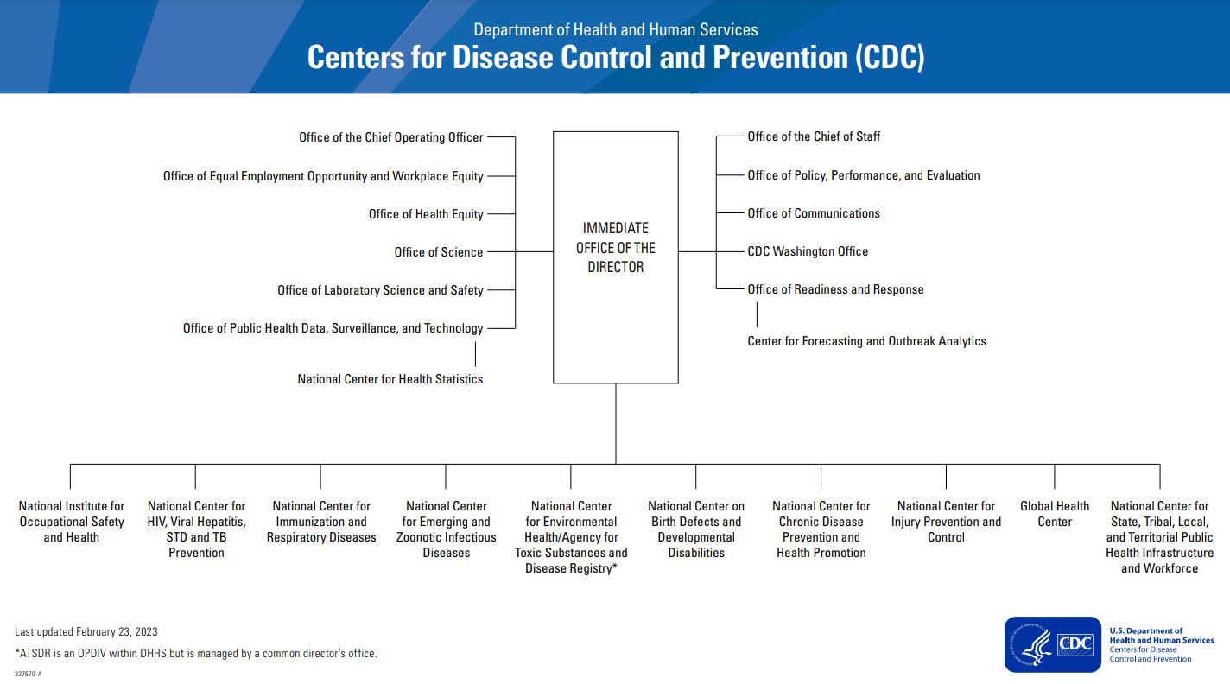
Center for Laboratory Systems and Response
Notes:
CDC moving forward reorg [which has been presented to ACD before] noting:
OLSS moved into IOD – recognizing senior laboratory leader

Slide 6
Quality Management System for Laboratories
Quality Manual for Microbiological Laboratories (QMML)
  Describes quality standards for CDC infectious disease laboratories
    Clinical diagnostics
    Surveillance
    Research
  Improvements based on feedback
    Center laboratory leadership
    CDC laboratory community
    APHL laboratory directors
  Implementation ongoing
Electronic Quality Management System (eQMS)
  Designed to be flexible, easy to use, and facilitate CDC laboratory quality activities
  Track quality indicators:
    Document management
    Personnel training/qualifications
    Equipment/instrument maintenance
    Non-conforming events, root cause analyses, risk analysis
    Corrective and preventive actions
    Personnel competency assessments
    Proficiency testing
Notes:
Dedicated efforts ongoing for comprehensive quality management system (QMS) for laboratories
Quality Manual for Microbiological Laboratories (QMML) completed and implementation begun
Electronic QMS project accelerated and launch of first 2 modules to pilot laboratories

Slide 7
Infectious Disease Test Review Board (IDTRB)
Mission:
  Review and approve all modified and new tests that will be shared outside of CDC
  Ensures external review of test validation by subject matter experts
Process:
  Documented test method validation, review, and approval within Center prior to submission
Concept &
Pre-Development
Test Method Design
Test Method Validation
Submission to the IDTRB for Formal Review
Review and approval by CIO program leadership
Review and approval by CIO Branch and Division
Review by two Subject Matter Experts (SMEs) external to program & CIO Associate Director for Laboratory Science (ADLS)
Test Method Development Process that occurs in CIOs
Notes:
Support of Infectious Disease Test Review Board – which provides external to program expert review prior to deployment of new tests

Slide 8
Infectious Disease Test Review Board (IDTRB)
Submission to IDTRB
Review by two SMEs of appropriate test method
IDTRB review of SME recommendations
Board approval provided with clear language on how each test should be used and deployed
Submission form includes necessary test validation documentation and CIO approvals
Administrator facilitates board selection of SME reviewers
SME reviewers submit justified recommendations to IDTRB
Administrator communicates decision to PI
If test not approved, administrator aids in requested remediation prior to resubmission
Impact:
  Verification and review to ensure tests are high-quality and suitable for intended purpose prior to externalization by Board SMEs and members
  Encourage continuous quality improvement while providing quality assurance to ensure reliable test results
Notes:
Support of Infectious Disease Test Review Board – which provides external to program expert review prior to deployment of new tests

Slide 9
Center for Laboratory Systems and Response
Associate Director for Laboratory Science and Safety (ADLSS)
James Pirkle, MD, PhD
Management and
Operations Office
Center for Laboratory Systems and Response (CLSR)
Office of the Director
Reynolds M Salerno, PhD, Acting Director
Deputy Director (TBN)
CDC Laboratory IT Governance
Office of Science, Strategy, and Program Evaluation
Communication and
Partnerships Office
Office of Policy and
Regulatory Affairs
FY2024
Division of Laboratory Systems
Division of Core Laboratory Services and Response

Slide 10
Division of Laboratory Systems
Office of Communication
Dr. Alexandra Mercante
OFFICE OF THE DIRECTOR
Acting Director
Dr. Victor D Jesus
Deputy Director Management Program and Operations
David Petway
Deputy Director for Science
Dr. Collette Fitzgerald
Office of Science
Dr. Bin Chen
Office of Policy
Dr. Jodi Jackson
Management and Operations Office
Joe Lisko
National Laboratory Response Systems Branch
Jasmine Chaitram
Quality and Safety Systems Branch
Dr. Victor De Jesus
Training and Workforce Development Branch
Dr. Kelly Winter
Laboratory Data Exchange & Standards Team
Clinical Laboratory Engagement Team
Quality Core Team
CLIA Core Team
Training and Strategy Operations Team
Just-in-Time Training Team
Laboratory Response Network-B
ELIMS Team
Safety Core Team
Data Science Team
Virtual Reality and Learning Tech Trends Team
Outreach and Engagement Team
Dissemination Team
CoAgs and Workforce Development Team
eLearning and Training of Trainers Team
Partnerships and Promotions Team
As of October 1, 2023

Slide 11
NCEZID Division of Core Laboratory Services and Response
Drug Services
Dr. Julian Jolly
OFFICE OF THE DIRECTOR
Director
Dr. Darin Carroll
Deputy Director
Gary Cobb
Division Management Official
Donnell Warren
Associate Director for Laboratory Science
Dr. Jonathan Moon (Acting)
Senior Advisor for Policy and Senior Communications Specialist
Suzette Bartley
Quality Management Program
Heather Hughes
DSR IT
Ferlando Barnes
Cost Recovery
Robin Scarborough and Jon Worley
Comparative Medicine Branch
Dr. Nathaniel Powell
Preparedness, Response, and Outbreak Support Branch
Dr. Dennis Bagarozzi
Laboratory Products and Services Branch
Owen Herzegh
Advanced Diagnostics and Biotechnologies Branch
Dr. Jon Pohl
Roybal Facility
HCL Facility
Specimen Triage and Tracking Team (+CDC Biorepository)
Immuno-diagnostic Development Team
Media and Buffer Production
Stockroom
Peptide Synthesis
Bio-informatics
Lawrenceville Facility
Animal Behavior
Cell Culture Production
Water Quality Laboratory
Genomic Sequencing
DNA Synthesis
Core Operations, Outbreak Response, and Support Lab (+BRRAT Lab and Molecular Diagnostics Development)
Diagnostic Manufacturing Lab
Ft. Collin Facility
Lab Animal Medicine Residency Program
Shipping and Export Activity
Laboratory Waste Management Program
Protein Chemistry and Proteomics
Technologies Assessment
As of October 1, 2023

Slide 12

Request for Information (RFI): Public-Private Partnerships to Support Test Development and Production
Background: To improve efficiency of rapid test development, technology transfer, and validation prior to a public health emergency, and to enable rapid test manufacture during a response
Purpose: To ascertain the level of interest of private sector test developers to inform and establish pre-event collaborations
Objective: To understand the type of support, cost, and resources needed to enhance diagnostic test production capacity prior to and during a PHE
RFI QR Code for more detailed information and requirements
Open Dates: Oct 31 – Nov 15, 2023

Slide 13
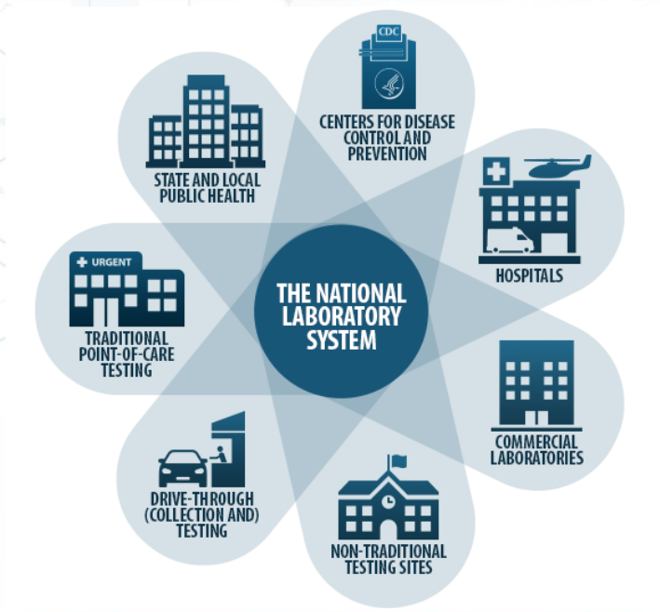
Roadmap for Public and Private Laboratory Engagement for Emergency Response
Contract awarded to Gryphon Scientific
  Sept 18, 2023, through Sept 17, 2024
  1 Optional Year
Goals
  Gather and review information from the clinical laboratory survey, after action reports, and internal and external SMEs
  Create a roadmap for partnering with private sector laboratories and other partners to meet needs during a Public Health Event
  Explore mechanisms for formal agreements with partners through Memorandum Of Understandings or contracts

Slide 14
Summary – Goals of CLSR
Provide cross-cutting laboratory operation and systems support for CDC’s infectious disease laboratories, including standardization of test development and deployment as well as support for laboratory animal studies
Work across CDC, federal partners, and the national laboratory system to ensure scientifically advanced, timely, and efficient laboratory response and diagnostic testing for infectious disease outbreaks, epidemics, and pandemics
Strengthen the agency’s public health responses by:
  Placing the Laboratory Response Network under new leadership
  Coordinating diagnostic and testing capabilities of the public and commercial sectors
  Consolidating CDC’s laboratory data exchange and laboratory response programs
  Providing additional support to internal CDC laboratories during PHEs

Slide 15
Joshua Sharfstein, MD and Jill Taylor, PhD
Co-Chairs
Laboratory Workgroup

Slide 16
Term of Reference
Issue: CDC laboratories need to use best laboratory science advances to protect public health – advances that often originate in academia, small companies, or major instrument manufacturers. These advances include new instrument platforms, new diagnostic tests, and new laboratory diagnostic technologies. At the same time, CDC should be promoting testing that can be readily performed on commonly available instrument platforms and using diagnostic technologies that are readily available to private and public health partner laboratories.
Questions: How can CDC ensure that it stays at the forefront of laboratory technology and laboratory science advances that benefit public health? At the same time, what could CDC do better to promote testing on commonly available instrument platforms and to better use diagnostic technologies that are readily available to private and public health partner laboratories?

Slide 17
Process
The Laboratory Workgroup (LW) met virtually on Friday September 15, 2023.
The LW members heard from two external guests:
Dr. Bruce Tromberg, National Institute of Biomedical Imaging and Bioengineering, NIH, and leader of the Rapid Acceleration of Diagnostics (RADx®) Program,
Mr. Rodney Wallace, Director of the Biomedical Advanced Research and Development Authority (BARDA)'s Detection, Diagnostics and Devices Infrastructure Division.
The LW also heard from two subject matter experts from CDC
Dr. Ren Salerno, Acting Director, CDC Center for Laboratory Systems and Response
Dr. Duncan MacCannell, Director, CDC Office of Advanced Molecular Detection.

Slide 18
What are the challenges to enhancing public-private partnerships at CDC?
CDC’s formal engagement practices: complex, lengthy, and time-consuming processes
Inadequate resources to support continuing scientific advancement at CDC
Cultural norms: Balancing investing in scientific advances with avoiding the perception that the government is favoring one company or technology over another
The CDC does not take full advantage of the scientific expertise and technological advances available outside government.

Slide 19
Pre-existing models of public-private partnerships
National Institutes of Health: RADx® Rapid Acceleration of Diagnostics Program
Biomedical Advanced Research Authority: BARDA
Department of Energy: Strategic Partnerships Program

Slide 20
Public-private partnerships have already advanced CDC’s mission
MOU with clinical partners for surge testing
SPHERES collaboration includes scientists from clinical and public health laboratories, academic institutions, and the private sector.
Commercial labs action during mpox outbreak
Pathogen Genomic Centers of Excellence which are collaborations between U.S. public health agencies and academic institutions
CDC with RADx and an industry partner currently collaborating on HCV elimination

Slide 21
Laboratory preparedness in public health emergencies
The COVID-19 pandemic clearly indicated that all laboratory sectors played an essential role in providing diagnostic or surveillance testing, and no one sector, acting alone, could support the unprecedented needs.
There is a critical need to develop, formalize and exercise the concept of a national laboratory system in which all partners understand their roles and responsibilities, and act in a coordinated fashion during biological emergencies.
CDC should take the lead in organizing the health-related federal agencies and all sectors of the laboratory and diagnostics manufacturing industries to develop a role-based plan for managing the next biological emergency.
The first step in developing that plan must be to make building and maintaining external relationships of prime importance to CDC.

Slide 22
Proposed Action Steps
CDC should explore the feasibility of developing formal partnerships with other federal scientific agencies to take advantage of their pre-existing relationships with private industry.
CDC should make working with the private sector an accepted approach to ensuring that CDC stays at the forefront of laboratory technology.
CDC should consider making testing for rare or esoteric diseases available in non-CDC public health laboratories and large academic reference laboratories.
CDC should take the leadership role in convening representatives of all laboratory sectors in the US, as well as leadership from federal agencies with a health and preparedness role. The task of this group would be to develop and exercise a living plan for coordinating the functions of the agencies and laboratory sectors during biological emergencies.
CDC should consider always including external subject matter experts (SMEs) in the laboratory sciences as members on relevant CDC Advisory Committees and Boards of Scientific Counselors.

Slide 23
ACD Vote to Adopt Laboratory Workgroup Report and Action Steps

Slide 24
Term of Reference
Issue: Excellent laboratory scientists are essential for high-quality, advanced laboratory testing, laboratory research and clinical laboratory testing. The market for such scientists is highly competitive with the private sector offering compensation that is extremely difficult for CDC to match.
Question: How can CDC better recruit and retain outstanding laboratory scientists to ensure high-quality, advanced laboratory testing at CDC?

Slide 25
Process
The Laboratory Workgroup (LW) of the Advisory Committee to the Director (ACD) met virtually on Monday October 24, 2023.
Dr. Tara Henning, PhD, who leads the Laboratory Leadership Service (LLS) Fellowship Program
Kelly Mathis, Supervisory Strategic Business Partner, OHR;
Jason Washington, Strategic Business Partner, OHR;
Victoria Olson, PhD, Deputy Director, Office of Laboratory Science and Safety (OLSS); and
Wendi Kuhnert, PhD, Deputy Director for Laboratory Readiness and Response , National Center for Emerging Zoonotic and Emerging Infectious Diseases

Slide 26
Laboratory Workgroup Findings
Administrative processes in place at CDC to recruit scientific staff are complex, rendering it challenging, and at times impossible, to find and attract technically qualified personnel
Even when technically qualified personnel are identified, the ability to recruit the most capable personnel is often not administratively supported
The result is a shortage of talented and qualified scientists to direct and staff laboratories performing diagnostic testing, as well as those responsible for national preparedness and response functions during biological and environmental emergencies. Similar limitations were identified with respect to scientists working in and leading CDC’s research laboratories.
The CDC’s administrative challenges in recruiting and retaining highly qualified scientific staff result in a national vulnerability that puts public health and safety at risk.

Slide 27
Proposed Action Steps
CDC Executive Leadership should urgently request a review of federal recruitment policies and procedures and a report on policy changes that can be made to address this issue. The LW understands that some changes may require Congressional action but believes progress can be made short of such reforms as well
CDC should strongly consider capitalizing on the success of the Laboratory Leadership Service (LLS) program to design an additional year that could prepare LLS Fellows to sit for the Board Exams to qualify them as Clinical Laboratory Directors.
CDC should enhance retention of scientists by developing a career path that will support laboratory scientists advancing in their careers while remaining in the laboratory doing critical work for the American people.
The Office of Human Resources at CDC should contact Human Resources offices at other federal agencies that require scientific and technical staff to become informed about their scientific hiring practices and policies.

Slide 28
ACD Vote to Adopt Laboratory Workgroup Report and Action Steps

Slide 29
Thank you to the Laboratory Workgroup Members and CDC Staff

Slide 30
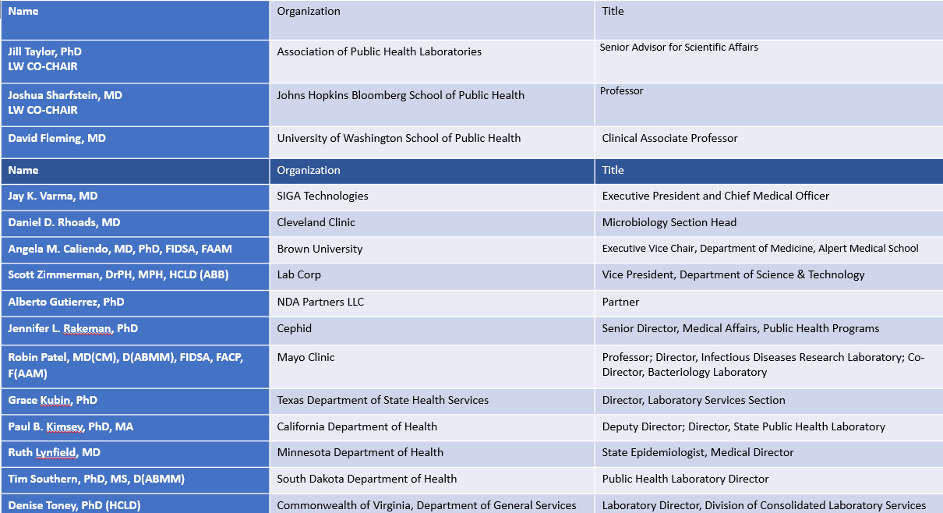
Thank you to the Laboratory Workgroup

Slide 31
Thank you to CDC team
The LW Chairs would like to express our gratitude and appreciation to:
  The members of the Laboratory Workgroup
  Our ACD Designated Federal Officials, Dr. Auerbach and Dr. Houry, and our Lab Workgroup DFO Lauren Hoffmann.
  The external subject matter experts as well as CDC experts and all those we met with for their openness and willingness to discuss challenges and find solutions.
Notes:
CDC has already instituted many of the LW recommendations and we congratulate CDC’s executive leadership for their forward thinking.
We feel confident that we have provided CDC with insightful ways to move laboratory improvement efforts forward.
With our work to address all of the Terms of Reference now complete, it’s time to sunset the workgroup and allow the CDC and its new director to determine the next steps.

Slide 32
Discussion and Vote
32
Notes:
David – Thank Dr. Sharfstein and Dr. Taylor and begin discussion. “For all members wishing to speak, please raise your hand virtually. We’ll recognize you and then you can unmute yourself to speak.”

Slide 33
Vote to Sunset the Laboratory Workgroup
The Advisory Committee to the Director acknowledges and appreciates the significant contributions of the Laboratory Workgroup in advancing CDC’s public health laboratories. After careful evaluation of the workgroup's achievements, the successful completion of its goals, and the valuable insights gained during its tenure, the ACD hereby makes a motion to sunset the Laboratory Workgroup.
Notes:
David (VOTE) - (SLIDE 33) “We express our deepest gratitude to the members of the Laboratory Workgroup for their dedication and hard work. We are confident that our future endeavors will continue to enhance the role of CDC’s laboratories, and we look forward to exploring new opportunities for collaboration in this important area. The knowledge and experiences from the workgroup will be used to integrate laboratory improvement efforts into our ongoing committee work. The ACD hereby makes a motion to sunset the Laboratory Workgroup.”

Slide 34
Charlene Wong, MD, MSHP
Senior Advisor for Health Strategy, CDC
Protecting Health as a Team Sport: Supporting Young Families

Slide 35



Protecting Health as a Team Sport
Identifying and Responding to
Health Threats
Accelerating impact by bringing public health alongside health care, social supports, public and private sectors and other teammates
Shared prioritization and accountability with federal as well as state and local partners
Model the approach with tactical, collaborative initiatives
Telling the story of successes built together
Improving Mental Health and Combatting Overdose
Supporting Young Families

Slide 36











Collaborative Initiatives
Can accelerate impact on major public health issues by leaning into results-based partnerships and increased partner engagement
Showcase the joint leadership of federal government agencies through aligned priorities
Can demonstrate measurable impact within the next 9-12 months
Were proposed, narrowed and refined by CIOs with cross-agency input
Build upon established partnered public health activities across CDC
Collaborative Initiatives are existing CDC programs, policies, or data activities that…

Slide 37

Collaborative Initiatives and Moving Forward
Results-Based Partnerships in Moving Forward: “To increase collaboration with partners to solve major health problems, CDC is promoting results-based partnerships agency-wide by increasing partner engagement through new management systems and communication and providing more avenues to receive partner feedback”
Collaborative initiatives are implementing several partnership best practices:
Aligning on strategic priorities
Building a collaborative tactical work plan
Stating measures of shared accountability

Slide 38



Supporting Young Families
CDC is breaking down siloes and prioritizing upstream prevention so that children and families have what they need to thrive.
Learn the Signs. Act Early. for Child Development
Improving Care for Postpartum Mothers
Expanding Implementation of Positive Childhood Experiences Strategies

Slide 39
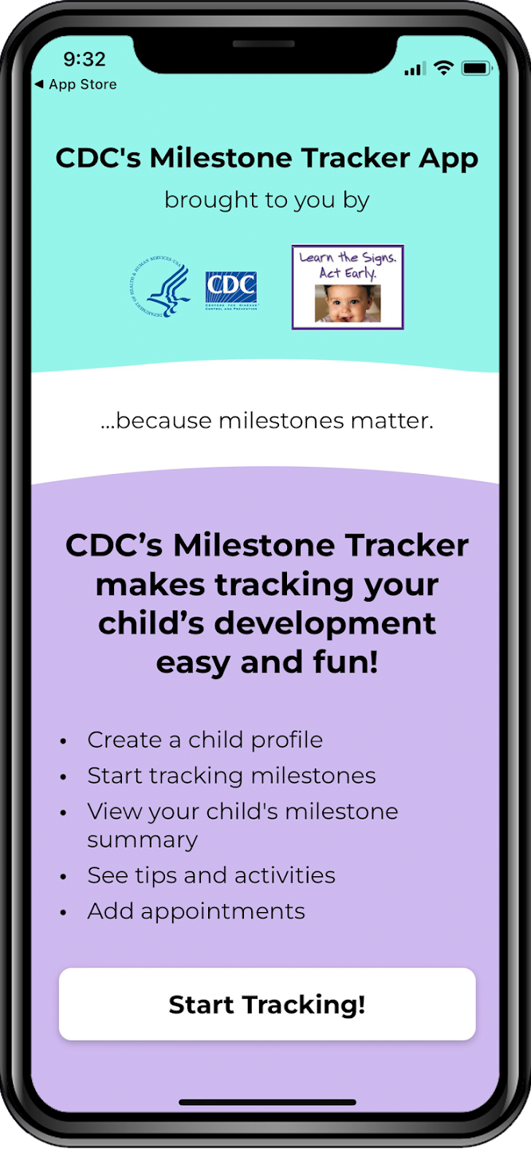



Learn the Signs. Act Early. for Child Development
Measuring Success and Sharing Accountability
Process Metric: Increase the number of Learn the Signs App users by 25% to at least 2.2M by Oct 2024 (baseline from 1.8M in Sept 2023).
Process Metric: At least 50% of the 151 Early Childhood Development-funded FQHCs report using Learn the Signs training and materials by August 2024.

Slide 40

Expanding Implementation of Positive Childhood Experiences Strategies
Measuring Success and Sharing Accountability
Process metric: Increase downloads of the CDC’s “ACES Prevention: Resource for Action” by 10% by October 2024.
Additional metrics to be developed with partners

Slide 41


Improving Care for Post-Partum Women
Measuring Success and Sharing Accountability
Milestone: Launch the Hypertension in Pregnancy QI Change Package by May 2024
Process Metric: 20% increase in the percentage of people with hypertension disorders in pregnancy receiving effective treatment (e.g., self-measured BP monitoring, medication, lifestyle changes) in 200+ participating practices by Dec 2024

Slide 42
Collaborative Initiatives: Moving Forward
CDC is committed to promoting results-based partnerships and being part of an integrated system that protects the public’s health.
Partnership as a Core Capability at CDC
Public health
Health care
Public and private sector
Social supports and others
Integrated system that protects the public’s health

Slide 43
Discussion
43

Slide 44
Break

Slide 45
Fiscal Responsibility Act (FRA) of 2023:
Impact on COVID-19 Supplemental Funding for CDC
Sherri A. Berger, MSPH
Senior Counselor, CDC

Slide 46
The Fiscal Responsibility Act (FRA) of 2023
This is the bill that resulted in a rescission (or “returning”) of COVID-19 Supplemental funding from CDC:
    These were not funds that had already been obligated
    These were funds that had approved spend plans, however, the funds were not yet obligated by the agency
The bill also set spending caps for the Federal Appropriations process for Fiscal Years 2024 and 2025.
    The bill capped discretionary funding levels for FY 2024 and FY 2025, which will impact CDC’s base budget through the annual appropriations process.

Slide 47
COVID-19 Supplemental Funding:
Of the $27 billion direct to CDC:
    $600 million was deposited into the Infectious Disease Rapid Response Reserve Fund (IDRRRF).
    CDC had obligated more than 91% (not including funds deposited into IDRRRF) at the time the bill was signed.
    Close to $1.3 billion was rescinded.
Of the $55 billion via HHS:
    CDC had obligated more than 96% at the time the bill was signed.
    Close to $1.7 billion was rescinded.
    This included all remaining Public Health Workforce dollars were rescinded.
    HHS retained some Testing & Mitigation funds.

Slide 48
Overview: COVID-19 Supplemental Funding
Over the multiple COVID supplementals since 2020, CDC was to receive $27 billion directly:
  Coronavirus Preparedness and Response Supplemental Appropriations Act = $2.2 billion
  Coronavirus, Aid, Relief and Economic Security Act = $4.312 billion
  Paycheck Protection Program and Health Care Enhancement Act = $1 billion
  Coronavirus Response and Relief Supplemental Appropriations Act = $8.54 billion
  American Rescue Plan Act of 2021 = $11.52 billion
Over the multiple COVID supplementals since 2020, CDC was to receive $55 billion via HHS:
  American Rescue Plan Act of 2021, Workforce = $6.06 billion
  American Rescue Plan Act of 2021, Testing & Mitigation = $16.9 billion
  Paycheck Protection Program and Health Care Enhancement Act = $10.25 billion
  Coronavirus Response and Relief Supplemental Appropriations Act = $21.36 billion

Slide 49
Impacts to CDC’s Supplemental Funding
The largest impact to COVID-19 Supplemental Funding provided to CDC includes:
    Vaccine distribution and related activities (e.g., safety monitoring, effectiveness studies, collection and sharing of vaccine data, support to NGOs and CBOs to increase vaccination rates, etc.) = $850+ million
    Vaccine Confidence = $102 million
    Global health activities = approx. $300 million
Some key priorities (e.g., data modernization and genomic sequencing) were not impacted.

Slide 50
Implementing the Bill
Based on the recissions, CDC had to make difficult decisions and identified activities that will end or scale back substantially by the end of this fiscal year or sooner, including internal CDC support and funding to public health partners, jurisdictions, and community-based organizations.
Most remaining funds are intended for specific activities (e.g., data modernization, genomic sequencing, wastewater surveillance, etc.), CDC is working to obligate the remaining funds.
Where feasible, the agency is actively working to continue its commitment to the work.

Slide 51
Examples of Programs that Were Scaled Back or Ended Early
Immunization Information Systems ($163M)
Partnering for Vaccine Equity program ($150M)
Vaccine Confidence ($102M)
Global Vaccine Readiness and Technical Assistance ($62.5M)
Enhanced Pan-Respiratory Surveillance ($102.5M)
Global Public Health Data Innovation ($46.9M)
Disease Intervention Specialists ($473.3M)
Laboratory Data Exchange ($240.8M)
Public Health AmeriCorps ($118.3M)

Slide 52
Other FRA Impacts Beyond COVID-19: Data Subject to Change
The bill also capped discretionary funding levels for FY 2024 and FY 2025, which will likely impact CDC’s base budget through the annual appropriations process.
In June, the House & Senate released their allocations for Labor/H:
  Senate cap: Labor-HHS-Education: $195.2 billion
  House cap: Labor-HHS-Education: $147.1 billion
House $48.1 billion lower than Senate and the Senate is almost $12 billion below FY 2023 levels. The House LHHS Sub-committee subsequently revised the planned budget cap, it is now $23 billion lower.
The Senate mark was $9.142 billion, including $7.712 billion in budget authority, $1.186 billion in Prevention Fund, and $244.330 million in transfers from PHS Evaluation funds. In total, roughly $40 million below the FY 2023 Enacted.

Slide 53
Background

Slide 54
Programs that Were Reduced or Ended Early
Immunization Information Systems (IIS) ($163M): Planned to support critical operations, maintenance, and modernization of IIS over two years. This funding would have been provided to 64 jurisdictions to operate, maintain, and modernize systems, improvements to support reporting and data sharing, and ongoing operations and maintenance of infrastructure that enables data exchange between jurisdictions and providers.
Partnering for Vaccine Equity (P4VE) program ($150M): P4VE is one of CDC’s flagship health and racial equity programs. Launched at the beginning of the pandemic, P4VE has provided funding and support to a diverse array of partners, to provide an unprecedented level of support for work within communities using trusted messengers to increase vaccine equity in racial and ethnic minority communities across the country.
Vaccine Confidence ($102M): Funding supported continued development and dissemination of COVID-19 vaccine resources, for both the provider community and the general public. Communications resources are supported by CDC’s national vaccinate with confidence strategy and include evidence-based information about vaccine development, safety monitoring, approval processes, recommendation criteria, and technical aspects of the COVID-19 vaccine program, such as storage and handling, vaccine administration, and use of the new and expanded vaccine tracking and monitoring systems.
Notes:
Examples:
More than $200 million in planned awards to jurisdictions to support IIS modernization over two years will not be made. Note: COVID-19 supplemental funding is not the only source of funding for state immunizations systems, IIS is funded with yearly appropriations.
New Vaccine Surveillance Network (NVSN): Since 2020, NVSN has supported pediatric COVID-19 policy decisions with real-time surveillance among children seeking care in outpatient clinics, emergency departments, and pediatric hospitals. NVSN collects data on children in the outpatient, ED, and hospital settings through parent interview, medical chart review, and specimen testing. Vaccination status is verified in state IIS registries and with primary care providers. Data are used to evaluate vaccine effectiveness, determine the etiology and burden of acute viral respiratory disease and COVID-19 in children, and characterize the clinical severity and epidemiology of COVID-19 and associated conditions, such as MIS-C.
Vaccine Effectiveness Studies:
Virtual SARS-CoV-2, Influenza, and Other respiratory viruses Network (VISION): is an electronic-healthcare record (EHR) based network in 9 sites across 11 states. IVY provides robust, timely, and genomic-specific COVID-19 vaccine effectiveness (VE) data as well as collection of pre-and post vaccination sera and peripheral blood mononuclear cells. IVY VE data are used domestically and globally by many stakeholders to inform vaccine policy and to encourage vaccine uptake. Losing VISION will result in an inability to rapidly assess COVID-19 VE against hospitalization, critical illness, and death and a lack of data to inform key vaccine policy decisions that will be detrimental to public health.
Investigating Respiratory Viruses in the Acutely Ill (IVY): The IVY network currently consists of 25 medical centers in 20 U.S. states. IVY was created initially in 2019 to estimate how well influenza (flu) vaccines work to prevent severe flu illness among intensive care unit (ICU) patients. In 2021, IVY expanded to also assess how well flu vaccines work to prevent flu hospitalizations and how well COVID-19 vaccines work to prevent COVID-19 hospitalizations. A loss of IVY infrastructure and stable, long-term partnerships will be detrimental to CDC’s ability to understand and respond to emerging public health threats, such as highly pathogenic avian influenza, and would have substantial consequences for CDC’s pandemic readiness.
Vaccine Confidence
These funds support enhanced efforts to engage with and improve the reach to disproportionately affected communities at the local and regional levels. Major activities included:
In collaboration with ASPA and HRSA, developed a nationwide public education campaign including cooperative agreements to community-based organizations to build vaccine confidence.
In collaboration with OSG and OASH, developed Trusted Messenger with a critical focus on communicating scientific information and address COVID-19 vaccine misinformation and disinformation.
In collaboration with HRSA, targeted vaccine confidence in rural communities through the Rural Clinic Vaccine Confidence initiative.

Slide 55
Programs that Were Reduced or Ended Early (cont.)
Global Vaccine Readiness and Technical Assistance ($62.5M): Funding supported countries to vaccinate target populations rapidly to achieve high coverage, including among special populations such as displaced, refugee, and migrant populations. Funding also supported safety and effectiveness monitoring and evaluation and strengthening public health programs to minimize the negative effect of the COVID-19 pandemic on the prevention and control of other vaccine preventable diseases.
Enhanced Pan-Respiratory Surveillance ($102.5M): Funding supported sample/data collection, access, and strengthening laboratory and healthcare technical capacity to enhance detection of respiratory disease threats by CDC and country partners globally, focused on diseases of pandemic potential.
Global Public Health Data Innovation ($46.9M): Funding supported development of sustainable partnerships and innovative investments in public health data exchange and informatics to modernize approaches to prevention, detection and response to COVID-19, ongoing public health threats and future pandemic threats. This activity is closely coordinated with CDC’s Data Modernization Initiative and Forecasting Center.
Notes:
At country, regional, and headquarters levels, funding supported:
Infection, Prevention, and Control (IPC): planning and implementation of activities that prevent healthcare-associated transmission of SARS-CoV-2 and other infectious diseases among healthcare workers and patients. Activities include site supervision via IPC specialists, deployment of systems to monitor and report IPC conditions and healthcare infections to stakeholders (e.g., Ministries of Health, CDC, etc.), and expansion of IPC quality improvement processes.
Laboratory Quality, Surveillance, and Epidemiology: detect, diagnose, and assess disease in populations to inform and evaluate public health action; in addition to COVID-19, Ebola and other VHFs will be studied to understand the impact of various therapeutic or prophylactic interventions, as well as community interventions; conduct applied research to develop and evaluate vaccines, therapeutics and diagnostics; prepare countries to identify and respond to mosquito-borne disease importation, strengthening collaborations with bilateral and multilateral partners, and establishing the utility of novel mosquito control measures.
Targeted National Public Health Institute (NPHI) surge support: enhance capacity and capability of NPHI’s in information exchange and decision-making driven by on-the-ground facts that are essential to effective response to the COVID-19 pandemic and other emerging disease threats, including public health emergency management. NPHI’s are natural focal points for inter-ministerial and cross-border collaboration that enables an effective border health strategy and multi-country approach to COVID and other emergencies and threats.
Other technical assistance to International Organization and Ministry of Health partners on emergency management, regional and cross-border cooperation and in support of public health communications and special studies and field investigations.

Slide 56
Programs that Were Reduced or Ended Early (cont.)
Disease Intervention Specialists ($447.9M): by ending this program early, CDC will not provide the final two years of funding to jurisdictions to supplement an existing 5-year program designed to train staff on contact tracing and case investigations.
Laboratory Data Exchange ($237.8M): This data initiative supports the automated electronic transmission of laboratory data between public health and the nation’s clinical, commercial, and public health laboratories.
Public Health AmeriCorps ($118.3M): This program aims to build a new generation of public health leaders to help tackle COVID-19 and respond to other pressing public health needs.

Slide 57
Discussion
57

Slide 58
Agency Priorities and Updates
Mandy K. Cohen, MD, MPH
Director, CDC, and Administrator, Agency for Toxic Substances Disease Registry

Slide 59
Discussion

Slide 60
Lunch

Slide 61
Leandris Liburd, PhD, MPH, MA
Acting Director, Office of Health Equity
CDC Update: ACD Health Equity Workgroup Recommendations
Notes:
Good afternoon. First of all, I’d like to thank the Health Equity Workgroup for their leadership and contributions over this past year in laying out Action Items that when fully implemented can enhance and accelerate CDC’s efforts to achieve health equity across its broad portfolio of public health science and programs. You brought together diverse standpoints and lived experiences to strengthen and challenge our ways of knowing and how we engage with the public in promoting and protecting the nation’s health. Your time and insights are invaluable and we will work hard to move forward the wisdom of the Workgroup.
The Health Equity Workgroup through 3 Task Areas, submitted Action Items to the ACD which were adopted as recommendations by the ACD and subsequently acknowledged by the Secretary of the Department of Health and Human Services.
The Office of Health Equity has been tasked with leading the implementation of the recommendations in close collaboration with the national centers, institute and offices of CDC.
Building upon CORE, CDC’s Health Equity Science and Intervention Strategy, the recommendations center communities and population groups disproportionately impacted by public health threats. The recommendations also focus on drivers of largely preventable health disparities and inequities, and systems changes that ultimately transform how we do our work for more equitable protection of the health, safety and security of the U.S.
I will briefly review CORE and then share the recommendations. I will describe some of what we’re currently doing to incorporate these recommendations into CDC’s science, programs, and policies, and the work that remains.

Slide 62

CDC’s CORE Commitment to Equity
CDC launched an agency-wide strategy to integrate equity into the fabric of all we do
Cultivate comprehensive health equity science
CDC embeds health equity principles in the design, implementation, and evaluation of its research, data, surveillance, and intervention strategies
Optimize interventions
CDC uses scientific, innovative, and data-driven strategies that address environmental, place-based, occupational, policy and systemic factors that impact health outcomes and address drivers of health disparities
Reinforce and expand robust partnerships
CDC seeks out and strengthens sustainable multi-level, multi-sectoral and community partnerships to advance health equity
Enhance capacity and workplace diversity, inclusion, and engagement
CDC builds internal capacity to cultivate a multi-disciplinary workforce and more inclusive climates, policies, and practices for broader public health impact
https://www.cdc.gov/healthequity/core/
Notes:
Launched in 2021, CORE is the first AGENCY-WIDE health equity strategy, and the mobilization of the national centers, institute, and offices that make up CDC around this strategy has been impressive. CORE strives to move beyond naming differences through “markers,” such as race, to identifying and addressing changeable “drivers,” such as those contextual factors that impact population health outcomes.
CDC’s CORE framework weaves health equity into the fabric of all we do.
CDC’s CORE commitment to health equity stands on four key pillars:
“C” – Cultivate comprehensive health equity science
CDC embeds health equity principles in the design, implementation, and evaluation of its research, data, surveillance, and intervention strategies.
“O” – Optimize interventions
CDC uses scientific, innovative, and data-driven intervention strategies that address environmental, place-based, occupational, policy, and systemic factors that impact health outcomes and address drivers of health disparities.
“R” – Reinforce and expand robust partnerships
CDC seeks out and strengthens sustainable multi-level, multi-sectoral, and community partnerships to advance health equity.
“E” – Enhance capacity and workplace diversity, inclusion and engagement
CDC builds internal capacity to cultivate a multi-disciplinary workforce and more inclusive climates, policies, and practices for broader public health impact.
The national centers, institute and offices submit progress updates to a dashboard and agencywide reports are compiled by the CORE Leadership Team annually.

Slide 63
Recommendations: Task Area 1: Enable and assure the meaningful involvement of communities in agency decision-making, the development of health equity policies, program implementation, and evaluation.
CDC should take specific steps to build and strengthen its relationship with underserved communities and community-based organizations (CBOs) that support them.
CDC should engage with state, tribal, local, and territorial (STLT) public health agencies to identify and implement best practices to build and strengthen relationships between STLT public health agencies and underserved communities and the CBOs that support them.
Notes:
The ACD recommendations provide a blueprint that can inform how we do our work, illuminate gaps in our pursuit of health equity, and challenge us toward greater innovation.
Consistent with Task Area 1, CDC recognizes community engagement is the cornerstone of good public health practice. There are many CDC programs that have meaningful community leadership and engagement in their implementation such as the REACH program, the Partnering for Vaccine Equity Program, and Community-Based Approaches to Reducing Sexually Transmitted Diseases (CARS), to name a few.
Since 1999, CDC has supported the REACH program – an acronym for Racial and Ethnic Approaches to Community Health – which focuses on physical activity and other chronic disease prevention activities. 2024 will be the 25th anniversary of REACH and it’s the longest-running racial/ethnic disparities initiative at CDC. REACH has continued to be a strong community-focused program in over 40 areas across the country. Much of its success has been due to its commitment to community leadership, coalition building, and the engagement of a trusted network of community leaders.
The Office of Health Equity recently released Health Equity Intervention and Action Principles, which are a set of seven evidence- and practice-based principles designed to support the development, scaling, and implementation of interventions while also fostering systems and processes that promote health equity.
To insure racial and ethnic communities are prepared for the 202-24 respiratory virus season, the Office of Health Equity has reached out to community-based organizations and national minority-serving organizations to put Respiratory Virus Season prevention messages in the hands of community leaders.
We are also collaborating with the Public Health Infrastructure Center and state and local offices of minority health and health equity to improve and increase community engagement among state, tribal, local, and territorial departments of public health.

Slide 64
Recommendations: Task Area 2: Align and restructure, as necessary, CDC policies, resource allocation, and program practices to maximize the ability for staff and partners to address health inequities in their day-to-day work.
CDC should immediately initiate a coordinated, agency-wide assessment of all grants, cooperative agreements, and contracts across all programs, projects, and activities (PPAs).
All CDC PPAs should jointly create and put into practice a publicly accessible policy document for applicants and grantees responding to CDC Notice of Funding Opportunities (NOFOs).
CDC should develop more equitable systems throughout the lifecycle of NOFOs, from planning and development to selection and post-award support.
CDC should develop more equitable systems throughout the lifecycle of NOFOs, from planning and development to selection and post-award support.
Notes:
Task Area 2 calls out the impact of CDC’s organizational structure on the ability of staff and partners to pursue health inequities.
There are numerous statutes, regulations and other federal directives that inform CDC’s operational policies, resource allocations, and program practices.
Through CORE, we convened health equity SMEs from across CDC programs to identify health equity guidance that could be incorporated into CDC’s non-research Notice Of Funding Opportunity or NOFO template. These changes to the NOFO template will cue NOFO writers to address health equity in the design of the NOFO and after published for competition will cue applicants to address health equity in the framing of their programmatic response.
The Office of Health Equity is providing training to NOFO writers to build comfort, capacity, and consistency with effectively integrating the health equity considerations. Where there are opportunities for wider distribution of announcements of Notices of Funding Opportunities, we can work with the Office of Financial Resources identify those venues that will reach more eligible applicants.

Slide 65
Recommendations: Task Area 3: CDC should immediately initiate a coordinated, agency-wide approach to develop and integrate strategies to influence the effects of drivers of health equity across the entire range of its public health programming.
CDC should immediately initiate a coordinated, agency-wide approach to identify and implement measures of underlying drivers of equity and health equity in ways that make them accessible and useful to communities and public health programs.
CDC should immediately initiate a coordinated, agency-wide approach to develop and integrate strategies to influence the effects of drivers of health equity across the entire range of its public health programming.
Notes:
Task Area 3: CDC should immediately initiate a coordinated, agency-wide approach to develop and integrate strategies to influence the effects of drivers of health equity across the entire range of its public health programming.
The Office of Health Equity has worked closely with the Office of Science to develop Health Equity Science Principles. Among domains of excellence for science, the Office of Health Equity ensured the inclusion of a health equity domain that provides criteria for appropriately addressing health equity in the development of scientific manuscripts and other related products. We are still socializing these principles and the health equity domain across CDC.
The Office of Public Health Data, Surveillance and Technology through the Data Modernization Initiative is working on data platforms to put health equity drivers at the fingertips of CDC scientists which will be followed by the development of tools to assist CDC scientists and evaluators, communities and public health programs in optimizing their use.
Much of this work is still in progress, but the necessity of understanding and addressing drivers of health disparities and health inequities using data and other public health strategies is a priority for CDC.

Slide 66



Looking Ahead
Agency-wide leadership in health equity
Engage and invest in communities
Strategic foresight and innovation
Notes:
As a result of the health equity recommendations from the ACD, CDC has a blueprint from which to chart additional efforts that will accelerate movement toward achieving health equity.
We recognize that health equity must be at the core of developing any intervention, innovative solution, policy, or programming for populations affected by health disparities, including the authentic representation and inclusion of community members and community-based organizations. As we look ahead, CDC is committed to transforming its public health research, surveillance, and implementation science through innovation and collaboration.
CORE allows us to learn more about the drivers of disparities and impact of social determinants on health outcomes, expand the body of evidence of what interventions will reduce the inequities that affect health, and invite partners from multiple sectors who can collaborate to implement solutions.
The recommendations reiterate that we must be intentional about pursuing and securing community engagement. In addition, we must Integrate health equity considerations in funding to address drivers of health inequities; and we must recruit and retain a workforce that represents diversity in academic disciplines, lived experience, and is prepared to do the work that will reduce and ultimately eliminate health disparities while ensuring all people have the opportunity to attain their best health possible.
Thank you. Questions?

Slide 67
Daniel Dawes, JD and Monica Valdes Lupi, JD, MPH
Co-Chairs
Health Equity Workgroup
Notes:
High level overview:
- achievements to date
- next steps

Slide 68
HEW Purpose
Provide input to ACD on the scope and implementation of CDC’s CORE strategy, influencing internal work and that of STLT public health agencies, constituents, and partners
Prepare reports with findings, observations, and outcomes to enhance the CORE strategy
Suggest innovative and promising health equity practices
Suggest ways to embed anti-racist policies/practices in public health programs
Notes:
As a reminder, the purpose of the Health Equity Workgroup was to…. [read slide]

Slide 69
TASK AREA 1
TASK AREA 2
TASK AREA 3
Enable and assure the meaningful involvement of communities in agency decision-making, the development of health equity policies, program implementation, and evaluation.
Align, and restructure as necessary, CDC policies, resource allocation, and program practices so as maximize the ability for staff and partners to address health inequities in their day-to-day work.
In concert with communities, take immediate and decisive action to expand, embed, and integrate approaches to measure and influence drivers of health equity across all public health programs.
ACD Lead: Daniel Dawes
David Brown
Delmonte Jefferson
Maria Lemus
Bonnie Swenor
Bobby Watts
ACD Lead: Monica Valdes Lupi
Nafissa Cisse Egbuonye
Octavio Martinez
Rhonda Medows
Julie Morita
Mysheika Roberts
Paula Tran
ACD Lead: David Fleming
Ada Adimora
Michelle Albert
Philip Alberti
Cary Fremin
Rachel Hardeman
Notes:
The workgroup divided into three Task Areas to support its work.

Slide 70
Accomplishments
February 2023: adoption of Task Area 3
May 2023: adoption of Task Area 1 and 2
Full set of recommendations acknowledged by HHS
Notes:
Overall, the workgroup has established eight recommendations to support CDC in advancing health equity.
-- Task Area 3 – 2 recommendations – adopted by ACD in February 2023
-- Task Area 1 had 2 recommendations – adopted by ACD in May 2023
-- Task Area 2 had 4 recommendations – adopted by ACD in May 2023

Slide 71
Next Steps
CDC will consider the Health Equity Workgroup’s action steps and the resulting eight ACD recommendations for implementation
CDC will provide progress updates
Notes:
Having developed actionable steps that resulted in 8 ACD recommendations, we feel confident that we have provided CDC with insightful ways to move the health equity work forward. In her presentation, Dr. Liburd has discussed some of the groundwork in the incorporation of our recommendations into the work of the agency.
With that, the Health Equity Workgroup has successfully met its charge. It is now time to sunset the workgroup and allow CDC and its new director to determine next steps. The Office of Health Equity will continue to provide health equity updates to the ACD at future meetings.

Slide 72
Thank you to HEW Members
Co-Chairs:
Daniel Dawes, JD
Monica Valdes Lupi, JD, MPH
ACD Members:
Adaora Alise Adimora, MD, MPH
Michelle A. Albert, MD, MPH, FACC, FAHA
David Warren Fleming, MD
Cristal A. Gary, MPP
Lynn R. Goldman, MD, MS, MPH
Rachel R. Hardeman, PhD, MPH
Rhonda M. Medows, MD
Julie Morita, MD
Octavio Martinez Jr., MD, MPH, MBA, FAPA
Public Members:
Philip Alberti, PhD. Association of American Medical Colleges
David Brown, MBA. YMCA
Nafissa Cisse Egbuonye, PhD, MPH. Black Hawk County Public Health (Iowa)
Cary Fremin, BS. Dot Lake Village Council, Dot Lake Village
Delmonte Jefferson, BS. Center for Black Health & Equity
Maria Lemus, BA. Visión y Compromiso and Network of Promotoras & Community Health Workers
Mysheika Roberts, MD, MPH. Department of Public Health - Columbus, Ohio
Bonnielin K. Swenor, PhD, MPH. Johns Hopkins University Disability Health Research Center
Paula Tran, MPH. Wisconsin Department of Health Services
G. Robert Watts, MPH, MS. National Health Care for the Homeless Council
Notes:
We would like to express our gratitude and appreciation for the efforts of the members of the Health Equity Workgroup.

Slide 73
Thank you to CDC team
Euna M. August, PhD, MPH, MCHES®
Kerry Caudwell, DPA, MPA
Bridget Richards, MPH
Leandris Liburd, PhD, MPH, MA
Notes:
We would also like to acknowledge our Designated Federal Officer, Dr. Euna August, and the CDC staff who have supported us along the way –
Kerry Caudwell, Bridget Richards, and Dr. Leandris Liburd.
Together, we worked collaboratively with CDC experts to better understand the overarching health equity goals that are so imperative to improving public health for all.

Slide 74
Discussion
74

Slide 75
Vote to Sunset the Health Equity Workgroup
“ The Advisory Committee to the Director acknowledges and appreciates the significant contributions of the Health Equity Workgroup in advancing health equity initiatives. After careful evaluation of the workgroup's proposed action steps that were later approved by the ACD Committee in the form of eight recommendations and subsequently acknowledged by the Department of Health and Human Services, the ACD hereby makes a motion to sunset the Health Equity Workgroup. ”
Notes:
David (VOTE) – (SLIDE 75) “We recognize the successful completion of the health equity workgroup’s recommended task areas and the valuable insights gained during its tenure, in particular, the completion of the Health Equity Terms of Reference. The knowledge and experiences from the workgroup will be utilized to integrate health equity principles into our ongoing work. We express our deepest gratitude to the members of the Health Equity Workgroup for their dedication and hard work. We are confident our future endeavors will continue to promote health equity, and we look forward to exploring new opportunities for collaboration in this important area. The health equity workgroup’s contributions to public health will continue as CDC considers the important next steps to bring to life many of its recommended actions. The ACD hereby makes a motion to sunset the Health Equity Workgroup.”

Slide 76
Break

Slide 77
Jen Layden, MD, PhD
Director, Office of Public Health Data, Surveillance, and Technology, CDC
CDC Update – ACD Data and Surveillance Workgroup Recommendations

Slide 78



Recommendations on Data and System Certification
Goals
Data Use Agreements
Minimal Data
Certification

Slide 79
Focus on Core Data
Core Data are important data sources to ensure robust ability to detect and monitor new and evolving public health threats
Core Data
Syndromic Surveillance Data
Vital Statistics Data
Hospital Capacity Data
Case Data
Vaccine Admin. Data
Lab-Based Test Data

Slide 80
Data Use Agreements (DUAs)
Nov. 2022 DSW Report Summary
ACD recommended:
  A proactive approach to DUAs to prepare for future responses;
  A streamlined creation and negotiation process;
  consistent language across CDC DUAs on protecting individual privacy
  CDC’s DUA to address other concerns like the use and re-release of data, consistent with laws applicable to each party

Slide 81



DUA Goals
Goals
Create consistent, agency-wide terms
Expand and enhance program use of data in CDC custody
Improve data sharing relationships with STLT jurisdictions and partners
Notes:
TPs:
- We worked with programs across CDC and gathered information across national partners and STLTs to understand where we could create consistent terms, enhance efficient and effective data use, and redefine our agreements with STLTs to be based on an agency-to-agency relationship.
We believe this approach will serve us in future emergencies and provide a single point of contact for jurisdictions to address concerns around DUAs.

Slide 82
CDC’s New “Core DUA” Components
Common, non-variable terms that apply to core data sources
    Federal law requirements (e.g., security, privacy)
    Procedures (e.g., notification to jurisdictions ahead of release or publication)
Addenda to the common terms can be used for specific data sources
    Jurisdictional terms (e.g., requirements or limitations to data sharing in STLT law)
    Procedures (e.g., data standards)
Shared policy governance in OPHDST
    Accountability and engagement (e.g., where to direct questions)
Notes:
TPs
There are 3 components to our DUA solution, each with specific goals.
A shared set of “common terms” that apply across all data sources to address Federal law requirements, such as ensuring data will be securely stored and privacy maintained, as well as procedural requirements such as providing notice to jurisdictions ahead of release or publication.
These terms should really apply to most STLT data coming to the agency, and we can incorporate other data sources into this model in the future.
Each of the data sources you mentioned as being critical to include can determine whether they will need terms in addenda to best work with jurisdictional partners.
For example, jurisdictions may need to add terms where state vaccine law restricts the sharing of data in certain circumstances, and there may be specific data standards or governance required for sharing some of these datasets.
We also added a shared policy governance function in our office to ensure we are developing, updating, negotiating, answering questions, and making decisions around our DUA policy in a centralized way.
- Acknowledging that the agency has already agreed to certain terms in DUAs for some of these data sources that will need to expire in the next year or two before we can fully incorporate them, we look at this work as iterative and reflecting a relationship with jurisdictions that can maximize data exchange.

Slide 83
Timeline
November 2023
Communicate plans to partners and jurisdictions
December 2023
Transition all DUAs for Core Data to OPHDST management
Communicate internally for new DUA procedures
Solicit feedback
January 2024
Negotiate terms of Common Provisions and Addenda with STLTs
Strengthen internal policy governance
2024 on
Incorporate other data sources into the new structure
Evaluate success of the Core DUA
Notes:
TPs
In this slide, we have sketched out an aggressive timeline for implementation for the core DUA.
I will highlight two components:
CDC, through OPHDST, will be transitioning to maintaining and negotiating the core DUA with STLTs starting on December 1.
We expect the core DUA to be an iterative document, where we will negotiate common terms and those for individual data sources with STLTs in 2024, and will simultaneously work on strengthening internal governance around data sharing as well as evaluating the successes and lessons learned from this process into the future to adjust and improve as we go.

Slide 84
Key Benefits and Impacts
Strengthens data exchange relationships with STLTs
Increases trust and transparency
Supports future technological innovations
Maintains necessary jurisdictional flexibility
Reduces burden on STLTs and CDC to negotiate and monitor individual DUAs
Improves engagement and accountability
Notes:
TPs:
To that end, we listed some benefits here. I will call out 3 in particular:
Through this agreement, we are strengthening data exchange. Specifically, we will enable agency-wide use of data for routine public health purposes. The agreement is scalable to allow surge during responses – and sharing back to jurisdictions.
This will allow us to meet all 3 project goals of consistency, increased data use, and a stronger relationship with STLTs.
We believe establishing clear responsibilities for protecting all core data and simplified processes for CDC and STLTs to work together will increase CDC’s trust and transparency.
This is critically important to all of our data functions.
We also want to support future technological advances. As we are looking forward to interoperability changes that will make public health data increasingly usable and accessible, we want to build in flexibility and make sure the terms do not get in the way of innovation.
Using common requirements will enable simpler reporting for STLTs to CDC and enable reliable data pipelines.
If asked about other bullets:
Eliminating multiple custom DUAs and siloed implementation at CDC reduces burden for data stewards on both sides.
Jurisdictional laws and requirements change with ever legislative session, and CDC wants to make it easy for STLTs to maintain necessary jurisdictional flexibility while still maximizing the potential for data sharing practices.
Working collaboratively with STLTs, including providing training and support, will increase engagement around data sharing.
OPHDST will serve as the main point of contact for the core DUA and support the agency to establish strong data governance and increase accountability for the public.

Slide 85
Minimal Data
Nov. 2022 DSW Report Summary
ACD recommended:
  Establishment of minimal data necessary base standards for public health activities (6 core data sources)
  Leverage Health IT data standards when possible, to promote efficient data sharing and exchange
  Harmonize data standards to reduce duplication
  Ensure data availability for situational awareness

Slide 86
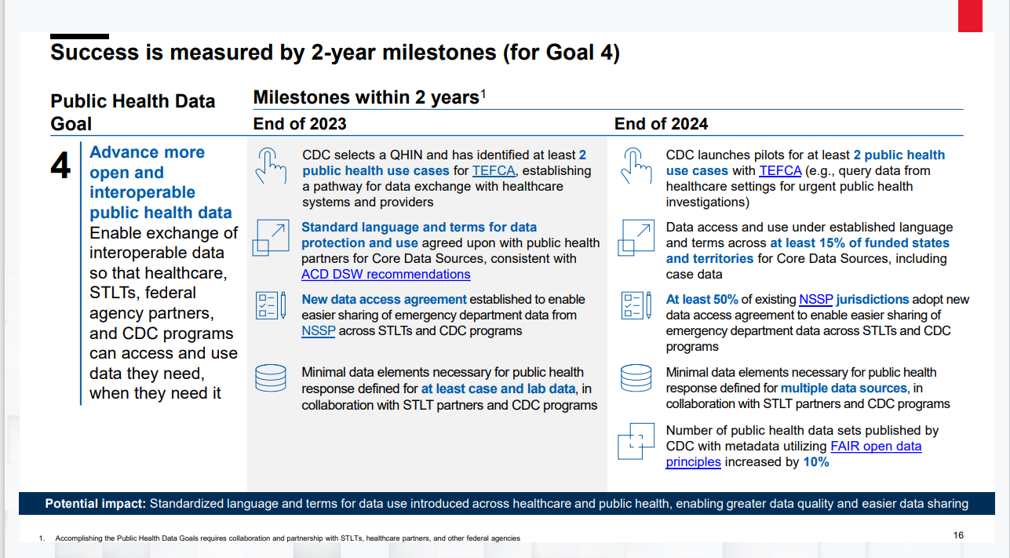
Initial Focus on Case and Laboratory Minimal Data Elements
Examined existing internal standards and data collections
Surveyed external standards, including healthcare standards, for synergies
Established processes for sharing and receiving feedback with national partners and STLTs
Milestone 4.4 in the Public Health Data Strategy
Completion Date: End of 2024
Notes:
Goal is to support situational awareness at CDC.

Slide 87
Example: Case Data Situational Awareness
INPUT
What do states routinely collect, and have in their systems at the start of an event?
OUTPUT
Minimum dataset for line-level case situational awareness at the start of an event
OMB-approved data elements for NNDSS (Generic V2, lab, vaccine)
Situational Awareness (SA) Reports from CDC EOC
What is already defined for routine, condition-agnostic, case notification?
What questions need to be answered at the start of an event?
Notes:
This schematic shows our process for defining what is a “minimum dataset” for situational awareness in case surveillance.
CDC:
Identified data elements that are aligned with USCDI (an established Health IT standard)
Identified data elements routinely exchanged between STLTs and CDC as part of existing data streams

Slide 88
Key Milestones for Case and Laboratory Minimal Data Elements
Case Data:
  March 2023: CDC established initial draft Minimal Data Elements for situational awareness at the federal level at the beginning of an event
    List is a subset of GenV2
    List includes some laboratory and immunization data that go beyond traditional case
  June 2024: CDC engages STLT and federal partners to align minimal data elements with health IT standards
Laboratory Data:
  December 2023: CDC finishes socializing initial draft minimal data elements for situational awareness agency-wide
  February 2024: CDC engages STLTs to align draft with existing practice and solicit feedback
Notes:
First the discussion is “what” do we expect CDC to have and what do we exepct CDC to get – this list is 67 data elements but is actually smaller when we recognize that things like “age” can be split into three data elements. This is a list that is based on what CDC will get, and how this will translate directly to monitoring a condition at a national level.
The list is already aligned to USCDI.
The next step is to align this list with public health system capability.
We cannot stop with defining what already exists – we must prioritize between the different element needs and timing. In 2024, we’ll look towards what health IT standards are for defining different elements in part of a data lifecycle.
This project for minimal data in situational awareness had many successes. CSTE is currently gathering feedback and we plan to continue forward as it provides a valuable artifact of a very specific problem. OPHDST, however, has a bigger mission and we need to align how minimum data, core data, and health IT standards all work together. How do these profusion of terms relate to the day to day problems experienced by healthcare and by STLT? How do they fit into the bigger picture? In order to do this, we need to be really explicit about how data needs differ at CDC than at STLT, and what data is needed at every phase of routine, and emergency.

Slide 89
Next Focus: Hospitalization and Healthcare Capacity Minimal Data
Implementing an agency-unified plan for hospitalization data and hospital bed capacity / utilization data.
  Focus and rationalize current ED and inpatient hospital encounters, admissions, hospitalizations, and hospital bed utilization and capacity data collection efforts for situational awareness and emergency response;
  Define and ensure access to minimum necessary emergency department (ED) and inpatient hospital encounter, admission, or hospitalization data and hospital bed capacity or utilization data for decision-making and public health action; and
  Guide future investments aimed at advancing and supporting automated, standards-based exchange of these data with hospitals.

Slide 90
Key Benefits
Provides transparency and clarity in defining the key data elements / sources needed for CDC’s key public health responsibilities
  Focus is on minimal data necessary for essential situational awareness
Streamlines reporting burden on data senders, and enables data senders to proactively prepare
  Aligns priority data elements to Health IT standards, enabling more robust interoperability with healthcare
  Allows CDC programs more time for data analysis and application, and less on the mechanics of collecting the data
  Allows alignment with STLT partners
Supports a more collaborative data atmosphere across the public health ecosystem, which will enable faster coordination in emergencies and all public health action—rather than siloed data approaches

Slide 91
Public Health Certification
Nov. 2022 DSW Report Summary
ACD recommended:
  Establishment of public health standards and certification
  Ensure public health data systems and technologies develop and maintain core capabilities
  Ensure public health data systems and technologies can integrate standardized data from healthcare organizations.

Slide 92
Public Health Certification
CDC and ONC are close partners on data modernization, for which clarifying system and technology capabilities is a crucial component.
Establish a North Star Architecture to guide development of public health systems and technologies
Identify systems and technologies used to integrate data from healthcare
Continued collaboration to utilize regulatory paths and move to Notice of Proposed Rulemaking to build public health certification.
Notes:
TPs:
Certification is an ongoing collaborative goal. We have close collaboration with ONC, to ensure that public health has clear expectations of what systems and products are capable of doing. This will ensure that when healthcare sends data, public health systems are ready to receive, process and utilize that data effectively.
ONC's 2023 regulatory agenda includes a NPRM that will cover public health certification. CDC is working with ONC at this time to ensure its future rulemaking addresses DSW recommendations and solicit feedback on the proposal for public health certification.
We have worked to understand where this effort can be most focused, and what systems STLT colleagues rely on to process data.

Slide 93
Action Steps to Public Health System Capabilities
CDC has funded the establishment of implementation centers:
implement public health data exchange/systems that correspond to potential certification requirements
implement scalable date exchange approaches
Provide technical assistance to STLTs
IT and Data Governance Board Executive Endorsements:
Align ITDG governance / system reviews with ONC HTI system standards
Policy / Incentive Levers:
With HTI 1 / 2, align funding / grant requirements and guidance to system standards

Slide 94
In May 2023, ACD recommended three priority areas to addressing workforce:
  Assess workforce needs to support the Data Modernization Initiative (DMI) including identifying the range of skills needed, the size of the workforce gap, and a prioritized roadmap to meet short and medium-term needs
  Assemble a cohesive workforce training strategy aligned with identified needs and work with the private sector and academia partners to build programs that enable upskilling, recruitment, and retention
  Issue guidance on the use of dedicated data infrastructure funds including how funds may be used to support the epidemiology, public health data science, and IT workforce
Three Priority Areas to Addressing Epidemiology, Public Health Data Science and Informatics, and Information Technology Workforce.

Slide 95
New Terms of Reference were
drafted because:
  The existing TOR document does not address CDC’s current challenges.
  The new TOR document will align the workgroup's objectives with the CDC's current priorities and needs of the office.
BACKGROUND

Slide 96
New Terms of Reference will address the following challenges
Fragmented Data Ecosystem: The CDC currently employs multiple data reporting systems, each designed for specific purposes and programs. This fragmentation leads to inefficiencies in data collection, processing, and analysis, as well as increased administrative overhead.
Data Silos and Redundancies: Different reporting systems often operate in isolation, creating data silos that inhibit seamless information sharing across departments and programs. Redundant data entry and storage occur due to overlapping functionalities, resulting in wasted resources.
Inconsistent Data Quality and Health IT Standards: With various reporting systems in place, maintaining consistent data quality and adhering to standardized data collection protocols becomes challenging. Inconsistencies in data quality can impede accurate trend analysis and hinder the CDC's ability to respond effectively to emerging health threats.
Resource Allocation and Sustainability: The operation and maintenance of multiple reporting systems require significant financial and human resources and is not a sustainable model.

Slide 97
continued
5. Delayed Response to Public Health Emergencies: The fragmented data reporting landscape may lead to delayed responses during public health emergencies, as critical information might not be readily available or easily accessible
6. Integration Challenges with External Partners: Collaborating with external stakeholders, such as state health departments or international organizations, becomes more complex when disparate reporting systems are involved. Integration difficulties may lead to delays in sharing crucial health information.
7. High burden: There are redundant reporting expectations, often for the same or similar data, on partners, including healthcare and jurisdictional partners. This places a high burden on critical partners, with sometimes limited return value.

Slide 98
Julie Morita, MD and Nirav Shah, MD, MPH
Co-Chairs
Data and Surveillance Workgroup

Slide 99
Focus Issues for First Meeting:
1. Data Authority
2. Public Health
Systems Certification
FOR ACD DECISION
DSW TOR re-alignment
Terms of Reference ​
​
  Authorities​ (Rec1)
  Data Exchange​ (Rec1)
  Workforce​ (Rec2)
  CDC Data Reporting Systems
  Forecasting & Analytics​
  Breaking Down Siloes​
  Assuring Sustainability​
Notes:
I want to use this time to walk together through some of the main issues and then the related questions that the ACD will be asked to consider.

Slide 100
Questions to Address Key Issues in TORs
How can the CDC implement a process to comprehensively assess data reporting systems, aiming to enhance sustainability, alleviate partner burdens, and minimize potential redundancies?
How can this process effectively streamline the evaluation of technical, system, and procedural aspects within CDC's data reporting systems, while establishing clear criteria for identifying and eliminating redundancies?

Slide 101
Discussion and Vote

Slide 102
Closing Remarks
David Fleming, MD
ACD Chair

Slide 103
Adjourn

